Slide 1


Name Generation with Autoregressive Character-level Language Modeling
Eljan Mahammadli
Prof. Steve Kaisler, Prof. Jamaladdin Hasanov
6917
03/08/2023

Slide 2
Project Objective
Character-based language model for word generation.
Comprehensive Study
Multiple models: Bigram, MLP, Wavenet, RNN, GRU, and Transformer (GPT-2).
Encapsulation with a command-line interface.
Experimenting models on a dataset of company names.
Versatile tool
Notes:
Comprehensive Study: Conducted a thorough investigation of various types of language models, spanning from traditional models like Bigrams to state-of-the-art architectures like Transformers.

Slide 3
Heilmeier Questions
What are you trying to do?
How is it done today, and what are the limits of current practice?
What is new in your approach and why do you think it is successful?
Who cares?
What are the risks and payoffs?
How much did it cost?
How long did it take?
What are the midterm and final exams to check for success?
Notes:
Developed a system for training and generating words using character-based language modelling.
Built multiple models including Bigram, MLP, Wavenet, RNN, GRU, and Transformer (GPT-2).
Encapsulated all the models in a Python script with a command-line interface.
Trained and tested these models on a dataset of company names.
Created a system that can be easily applied to any name collection for name generation.

Slide 4
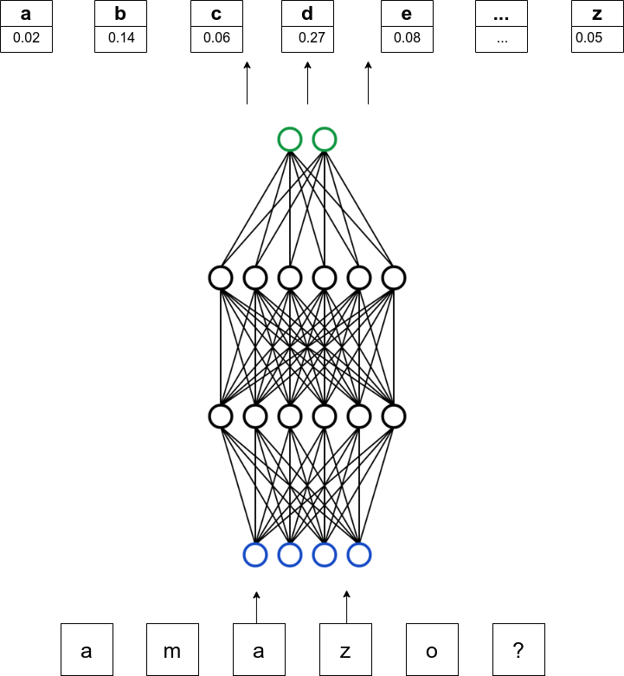
What is Character-level Language Model?
Language models can predict the next token in a sequence.
Probability is typically dependent on the preceding n tokens.
Generate novel and valid names.
Words often don't follow grammatical rules, so these models a flexible choice.
P(w₁,w₂, …,w_{T}) = ∏ P(w_{t} | w₁, ..., w_{t-1}) for t=1 to T

Slide 5
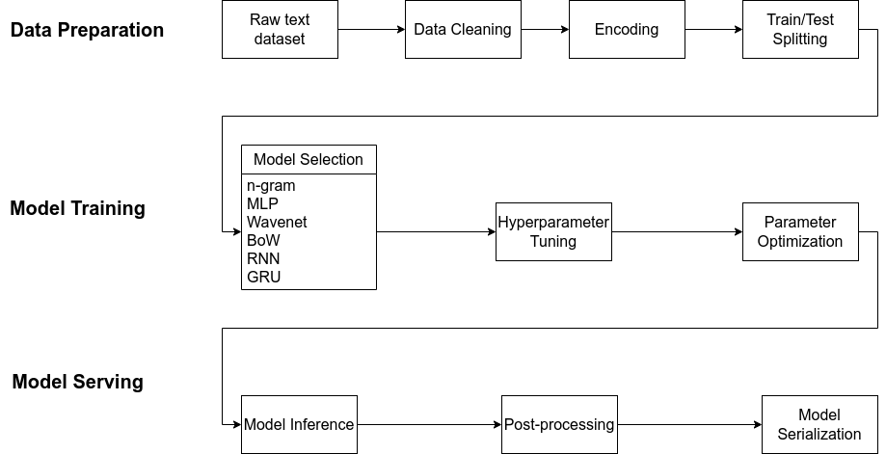
System Architecture

Slide 6
Key steps
Explored, developed, and conducted analyses of pivotal models and architectures that have significantly influenced the evolution of language modelling.
N-gram, 1970s for LM
MLP, Bengio et al. 2003
CNN, DeepMind WaveNet 2016
RNN, Mikolov et al. 2010
GRU, Kyunghyun Cho et al. 2014
Transformer, Vaswani et al. 2017

Slide 7
Model Specs
Bigram - probability distribution of pairs of consecutive characters
MLP - 10-d feature vector, 200 hidden neurons, 3 block size, 11 897 total parameters.
Wavenet - 24-d character embedding space, 128 neurons in each hidden layer, 76 579 total parameters
RNN - 4 layers, and 64 nodes per layer and hidden neurons, 11 803 total params
GRU - same as RNN, 28 315 total parameters
Transformer - 200K total parameters

Slide 8
What is innovative about the research?
Comparison Across Architectures
Model Adaptation
Versatile Tool
User-friendly Interface
Flexible and Scalable Design
Notes:
Comparison Across Architectures: Provided a unique comparative study of different model architectures on the same task, providing insights into the strengths and weaknesses of each model.
Model Adaptation: Adapted complex architectures such as WaveNet and Transformers, originally designed for different tasks, to the task of name generation.
Versatile Application: Developed a system capable of generating names in any domain or language by training on an appropriate dataset. This opens up wide-ranging applications beyond company names.
User-friendly Interface: Integrated all components into a centralized, user-friendly command-line interface, making advanced language modelling techniques accessible to non-experts.
Flexible and Scalable Design: Designed the system to easily incorporate new models or algorithms, making it adaptable to future advancements in language modelling.

Slide 9
Command-line Interface
Users can easily input a name list and customize model behavior through optional arguments.
Input/output: --input-dir, --output-dir, --resume, --inference, etc.
Model Configurations: --model, --n-layer, --n-embd, …
Optimizations: --learning-rate, --batch-size, --weight-decay
etc
Example commands:
$ python3 main.py -i dinosaurs.csv -o output -model transformer -n-head 4
$ python3 main.py -i names.txt -o output --inference
Notes:
The system allows users to simply input a list of names via a CSV or TXT file, and customize model training and sampling with optional arguments as desired.

Slide 10
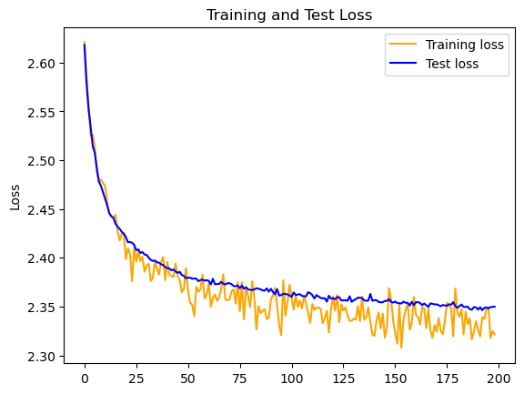
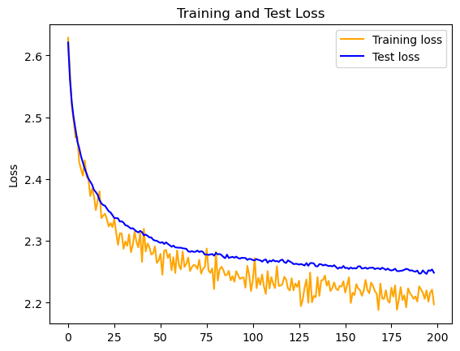
Results
 | Bigram | Trigram | MLP | WaveNet | RNN | GRU | Transformer
Loss | 2.725 | 2.496 | 2.363 | 2.213 | 2.1814 | 2.1372 | 2.0695
Inference | paruis, joa, ftrtx, ts, halloum | tics, nutelamic, prel, tovil, reelesto | rid, forcend, welluma, cloudson, rantown | socience, homeline, keyibas, intellavids, alphars | bantist, talense, cooco, webtue, revicore | saitway, wineta, legomain, techips, creetap | techboundry, playmax, fisions, lightsoft, spreetware
PLACEHOLDER FOR TRANSFORMER LOSS FUNCTION
Loss Functions on train/test sets for RNN, GRU and Transformer respectively.
Notes:
Here, I will compare models/architectures and mention their pros/cons and bottlenecks.

Slide 11
Training on small corpus of Azerbaijani names (for fun)
Loss:
train: 1.5607 test: 2.0848
Cangül
Elmizə
Sərban
Rəyalə
Gəlincam
Timayət
Dəryac
Çeşmibəyid
Xudalba
Mudafər
Abadətdin
Nakizə
Sərzad
Qatibə
Rafimə
Gövdül
Salibə

Slide 12
Conclusion
Bottlenecks of each architecture.
Wide choice of models.
The system can be used to train on various domains/languages.
Allows non-experts to leverage the power of language modelling for creative tasks.

Slide 13
Future Work
More recent or complex language models
Fine-tune existing models
Expand Dataset Diversity
Interface Improvement
Deployment and Scalability

Slide 14
Thanks for your attention!
Any questions?

