Slide 1


Name Generation with Autoregressive Character-level Language Modeling
Eljan Mahammadli
Prof. Steve Kaisler, Prof. Jamaladdin Hasanov
6917
03/08/2023

Slide 2
Project Objective & Heilmeier Questions
What are you trying to do?
Automate name generation.
How is it done today, and what are the limits of current practice?
Manual, random or basic rule-based systems.
What is new in your approach and why do you think it will be successful?
Encapsulating multiple deep learning models in a single, flexible system trainable on any name collection.
Who cares?
Entrepreneurs, writers, and marketers
What are the risks and payoffs?
Name quality and originality; the payoff is an automated, versatile, and creative name-generation tool.
How much did it cost?
Primarily time and deep learning expertise, minimal financial cost. Trained models on Kaggle GPU kernels.
How long did it take?
Two months from inception to completion.
What are the midterm and final “exams” to check for success?
Midterm: successful development and testing of initial models. Final: completed all targeted models and combined them in single system. Additionally, tested model on different datasets to prove its versatility.
Notes:
Comprehensive Study: Conducted a thorough investigation of various types of language models, spanning from traditional models like Bigrams to state-of-the-art architectures like Transformers.
Developed a system for training and generating words using character-based language modelling.
Built multiple models including Bigram, MLP, Wavenet, RNN, GRU, and Transformer (GPT-2).
Encapsulated all the models in a Python script with a command-line interface.
Trained and tested these models on a dataset of company names.
Created a system that can be easily applied to any name collection for name generation.

Slide 3
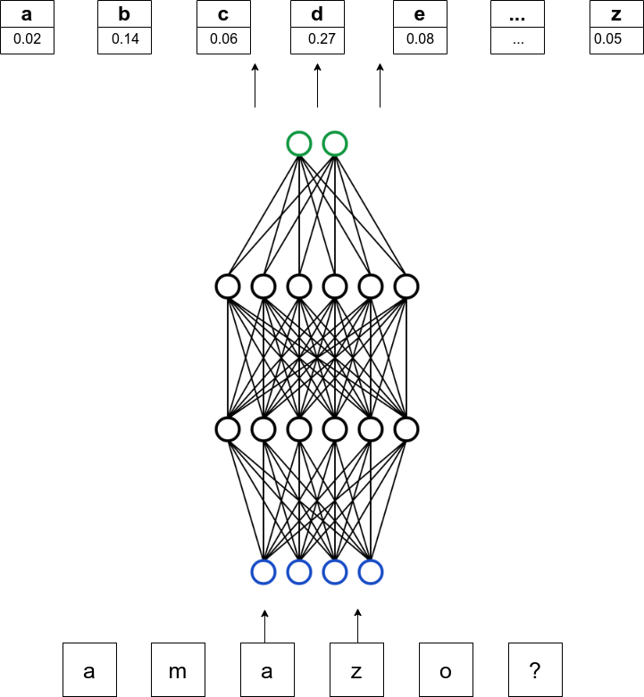
What is Character-level Language Model?
Language models can predict the next token in a sequence.
Probability is typically dependent on the preceding n tokens.
Generate novel and valid names.
P(w₁,w₂, …,w_{T}) = ∏ P(w_{t} | w₁, ..., w_{t-1}) for t=1 to T
P: Joint probability of the sequence of characters
wt: target token
When predicting the character after "a m a z o", the model is estimating the probability P('?' | 'a', 'm', 'a', 'z', 'o').

Slide 4
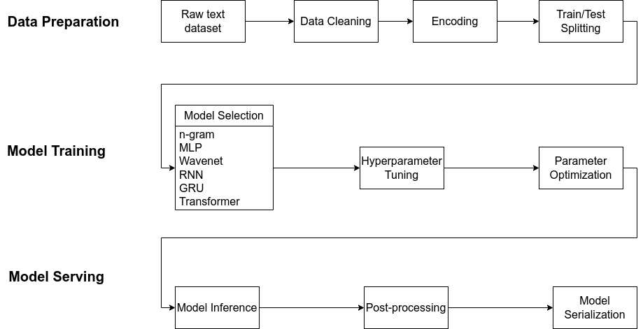
System Architecture

Slide 5
Key steps
Explored, developed, and conducted analyses of pivotal models and architectures that have significantly influenced the evolution of language modelling.
N-gram (1970s for LM) - probability distribution of pairs of consecutive characters
MLP (Bengio et al. 2003) - 10-d feature vector, 200 hidden neurons, 3 block size, 11 897 total parameters.
Wavenet (DeepMind WaveNet 2016) - 24-d character embedding space, 128 neurons in each hidden layer, 76 579 total parameters
RNN (Mikolov et al. 2010) - 4 layers, and 64 nodes per layer and hidden neurons, 11 803 total params
GRU (Kyunghyun Cho et al. 2014) - same as RNN, 28 315 total parameters
Transformer (Vaswani et al. 2017 ) - 200K total parameters

Slide 6
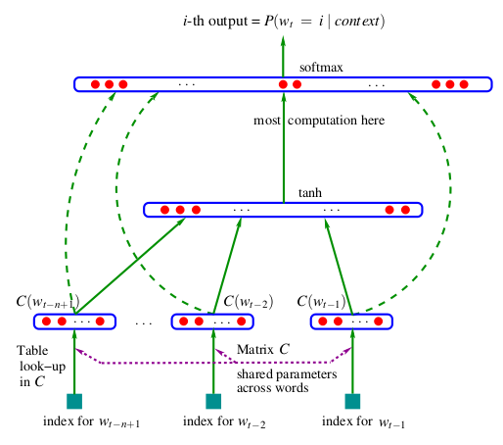
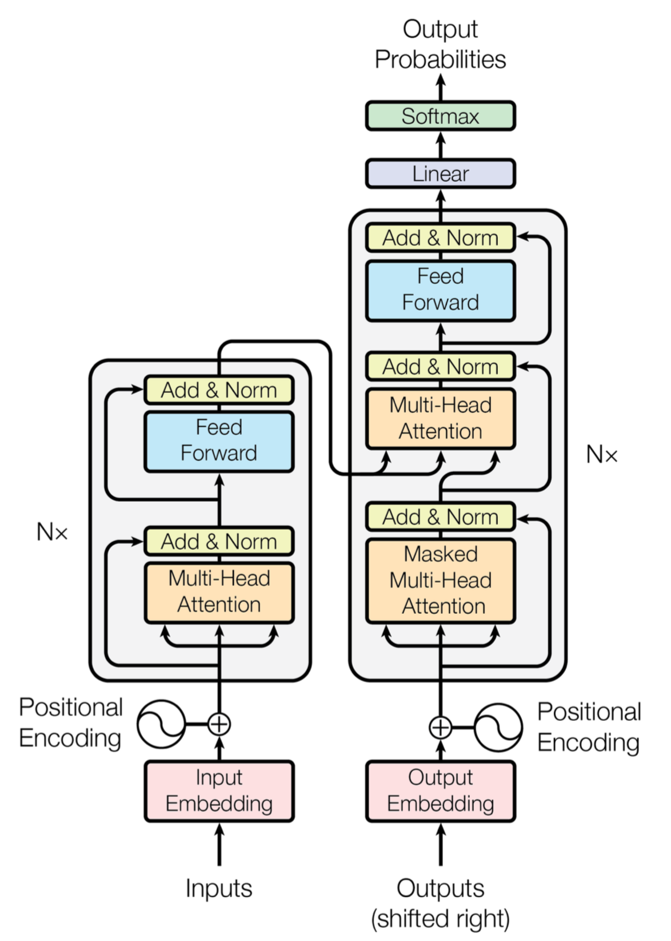
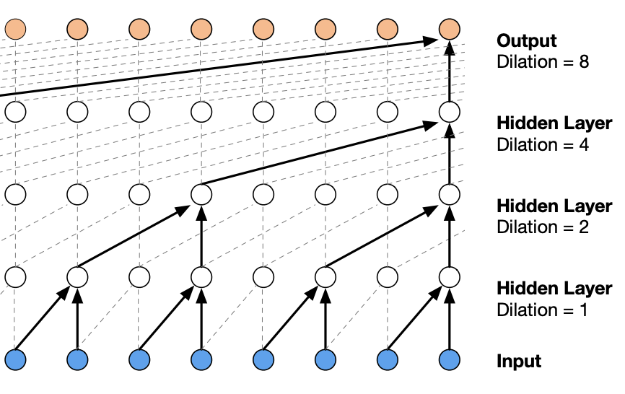
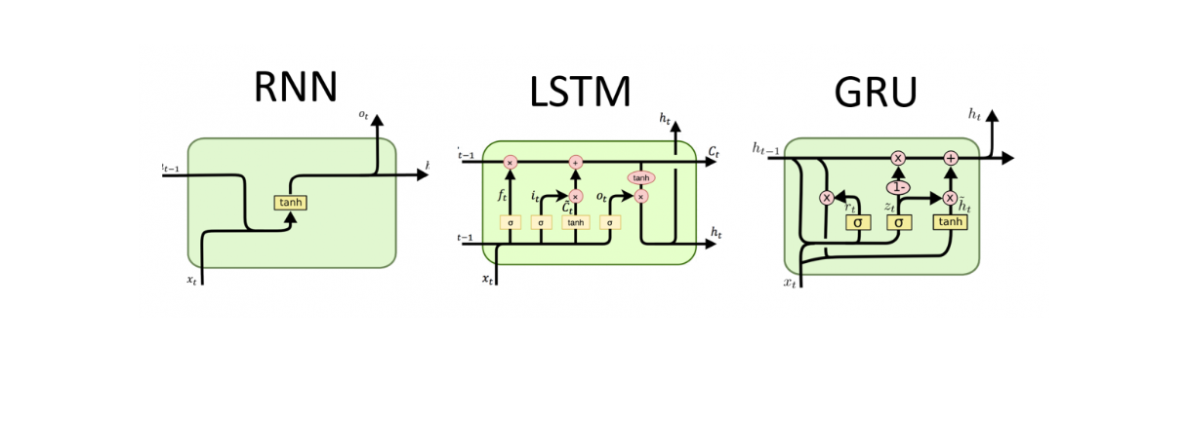
Model Architectures
MLP
WaveNet
Transformer
RNN
GRU

Slide 7
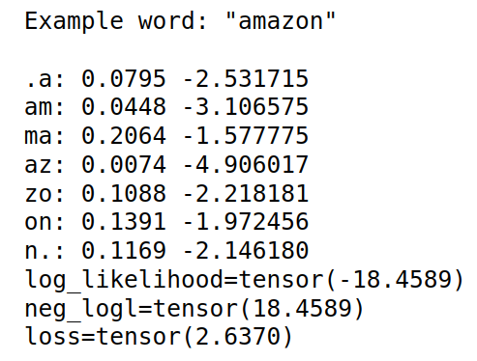
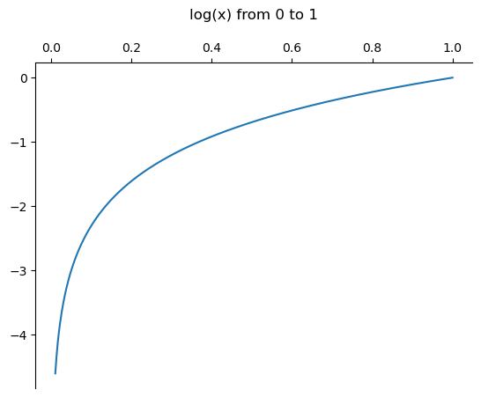
Loss Function
In order to measure the quality of the model we need a single number which is used to improve its parameters during training.
Objective:
Maximize probabilities assigned to the true characters that occur in the dataset.
Maximize Log Likelihood.
Minimize negative log likelihood.
Minimize average negative log likelihood.
Negative log likelihood = -1/N * Σ (y_{i} * log(p(y_{i})))

Slide 8
What is innovative about the research?
Comparison Across Architectures
Model Adaptation
Versatile Tool
User-friendly Interface
Flexible and Scalable Design
Notes:
Comparison Across Architectures: Provided a unique comparative study of different model architectures on the same task, providing insights into the strengths and weaknesses of each model.
Model Adaptation: Adapted complex architectures such as WaveNet and Transformers, originally designed for different tasks, to the task of name generation.
Versatile Application: Developed a system capable of generating names in any domain or language by training on an appropriate dataset. This opens up wide-ranging applications beyond company names.
User-friendly Interface: Integrated all components into a centralized, user-friendly command-line interface, making advanced language modelling techniques accessible to non-experts.
Flexible and Scalable Design: Designed the system to easily incorporate new models or algorithms, making it adaptable to future advancements in language modelling.

Slide 9
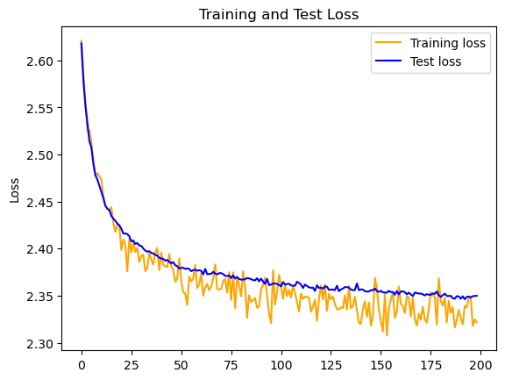
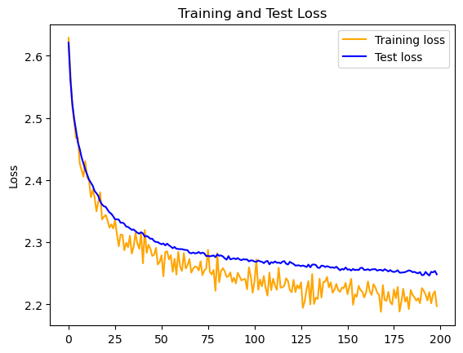
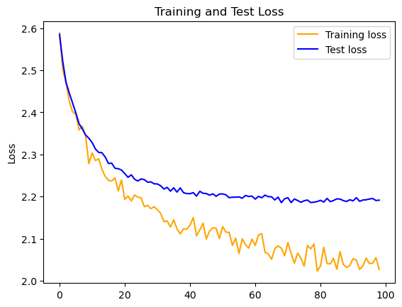
Results
 | Bigram | Trigram | MLP | WaveNet | RNN | GRU | Transformer
Loss | 2.725 | 2.496 | 2.363 | 2.213 | 2.1814 | 2.1372 | 2.0695
Inference | paruis, joa, ftrtx, ts, halloum | tics, nutelamic, prel, tovil, reelesto | rid, forcend, welluma, cloudson, rantown | socience, homeline, keyibas, intellavids, alphars | bantist, talense, cooco, webtue, revicore | saitway, wineta, legomain, techips, creetap | techboundry, playmax, fisions, lightsoft, spreetware
Loss Functions on train/test sets for RNN, GRU and Transformer respectively.
Notes:
Here, I will compare models/architectures and mention their pros/cons and bottlenecks.

Slide 10
Training on small corpus of Azerbaijani names (for fun)
Dataset: Trained on a 6K words.
Loss: train 1.5607, test 2.0848
Some example samples from the model:
Cangül
Elmizə
Sərban
Rəyalə
Gəlincam
Timayət
Nuranə
Firəddin
Suray
Mudafər
Əlihman
Nakizə
Sərzad
Qatibə
Rafimə
Gövdül
Salibə

Slide 11
Command-line Interface
Users can easily input a name list and customize model behavior through optional arguments.
Input/output: --input-dir, --output-dir, --resume, --inference, etc.
Model Configurations: --model, --n-layer, --n-embd, …
Optimizations: --learning-rate, --batch-size, --weight-decay
etc
Example commands:
$ python3 main.py -i dinosaurs.csv -o output -model transformer -n-head 4
$ python3 main.py -i names.txt -o output --inference
Notes:
The system allows users to simply input a list of names via a CSV or TXT file, and customize model training and sampling with optional arguments as desired.

Slide 12
Conclusion
Bottlenecks of each architecture.
Bigram: Inability to capture long-range dependencies
MLP: Fixed context length
Wavenet: High computation due to the stack of convolution layers.
RNN: Suffer from vanishing or exploding gradients
GRU: Still struggle with very long sequences.
Transformer: Memory requirement scales quadratically with sequence length
Wide choice of models.
The system can be used to train on various domains/languages.
Allows non-experts to leverage the power of language modelling for creative tasks.

Slide 13
Future Work
More recent or complex language models
Fine-tune existing models
Expand Dataset Diversity
Interface Improvement
Deployment and Scalability

Slide 14
Thanks for your attention!
Any questions?

