Slide 1



CSCI6917: Guided Research Methods Summer 2023 Stephen H. Kaisler, D.Sc. (GWU) Jamaladdin Hasanov, Ph.D. (ADA)
Data Privacy and Security in Database System
Student: Gunay Maharramli
8 August 2023

Slide 2
Heilmeier Questions
What are you going to do? | The aim of researching data privacy and security in database systems is to address the pressing concerns and challenges surrounding the protection of sensitive information in the digital age.
How is it done today? Current Limitations? | Access controls, encryption, and regular security audits Limitations persist, such as the potential for insider threats, evolving cybersecurity threats, and the challenge of balancing privacy with data usability.
What is new in your approach and why do you think it will be successful? | Implementing LDAP authentication can bolster data privacy and security in database systems by providing centralized user authentication and access control management. By leveraging LDAP, organizations can streamline user management, enforce strong password policies, and enable secure authentication across multiple systems.
Who will benefit from your work? Why? | The work on data privacy and security in database systems benefits a wide range of stakeholders. Organizations gain protection against data breaches and regulatory penalties, ensuring business continuity and customer trust.Database administrators (DBAs) can also reap several benefits from the work on data privacy and security in database systems
How long will it take? | 2 months

Slide 3
Project Objectives
Implement Authorization Mechanisms - Develop and integrate strong authentication methods
Deploy Lightweight Directory Access Protocol (LDAP) or Active Directory: Integrate and configure the chosen directory service
Establish Auditing and Monitoring Mechanisms: Implement auditing and monitoring features within the database system to track and log all user activities and access attempts, enabling real-time detection of suspicious or unauthorized actions and ensuring compliance with security policies.
Regularly Review Logs and Reports: Conduct periodic reviews of audit logs and monitoring reports to analyze patterns

Slide 4
Key Steps
Research related to the database attacks
Implementation of Internal Authentication
LDAP set up and Configuration
Provide RLS in the PostgreSQL database
Set Up & enable security for EFK
For log mechanism

Slide 5

Technical Approach
Attacks based on Confidentiality of
Data and Privacy of Data
Injection Attacks
Concrete Attacks
Snapshot Leaks
Full System Compromise
Identification Attacks

Slide 6
Technical Approach Internal Authentication - PostgreSQL

Slide 7
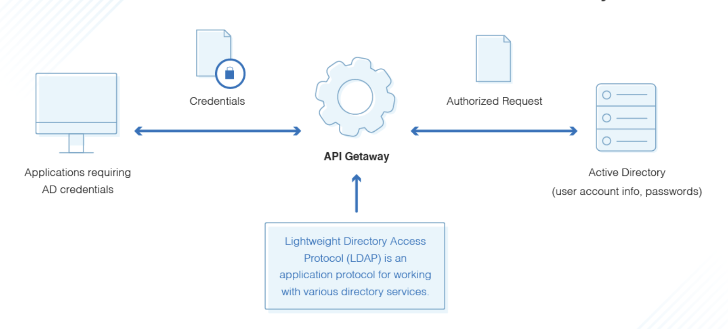
Technical Approach - LDAP

Slide 8
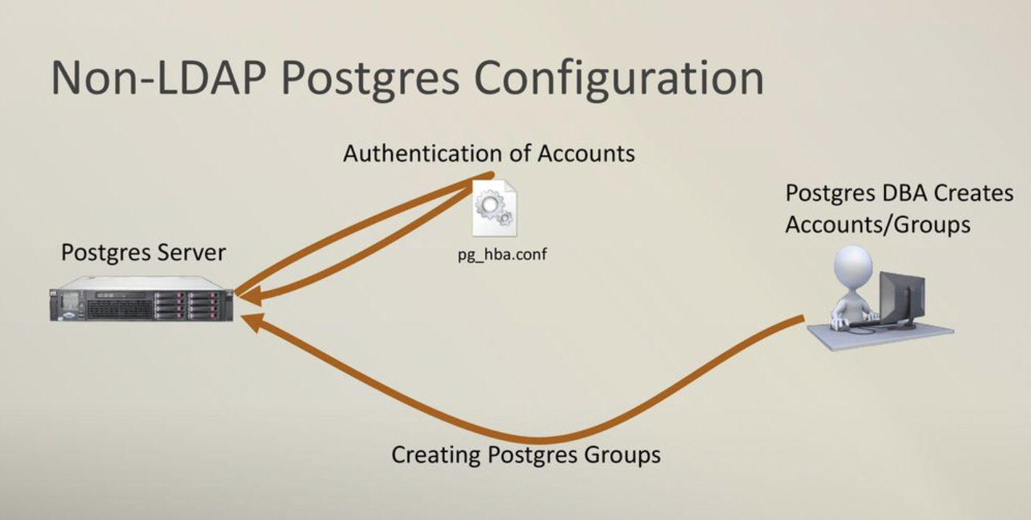
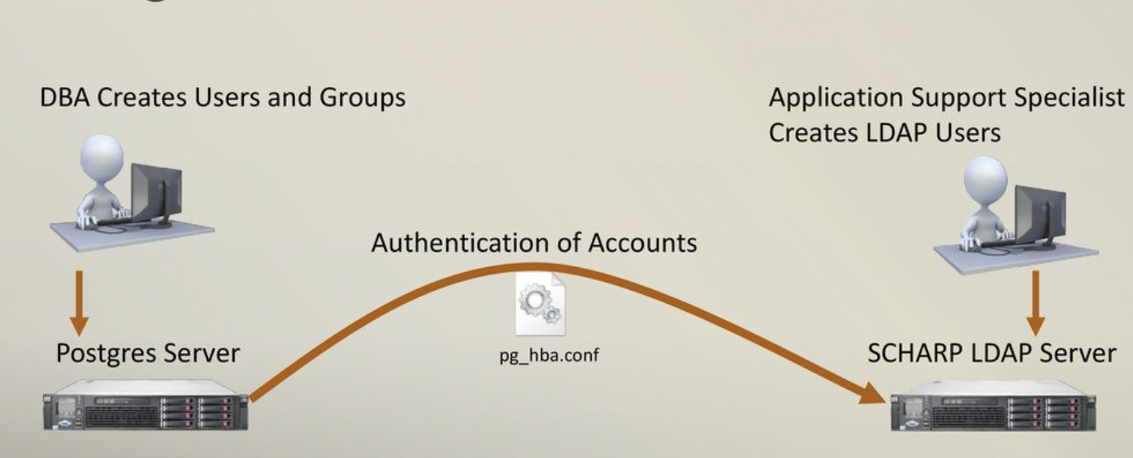
LDAP - Difference

Slide 9
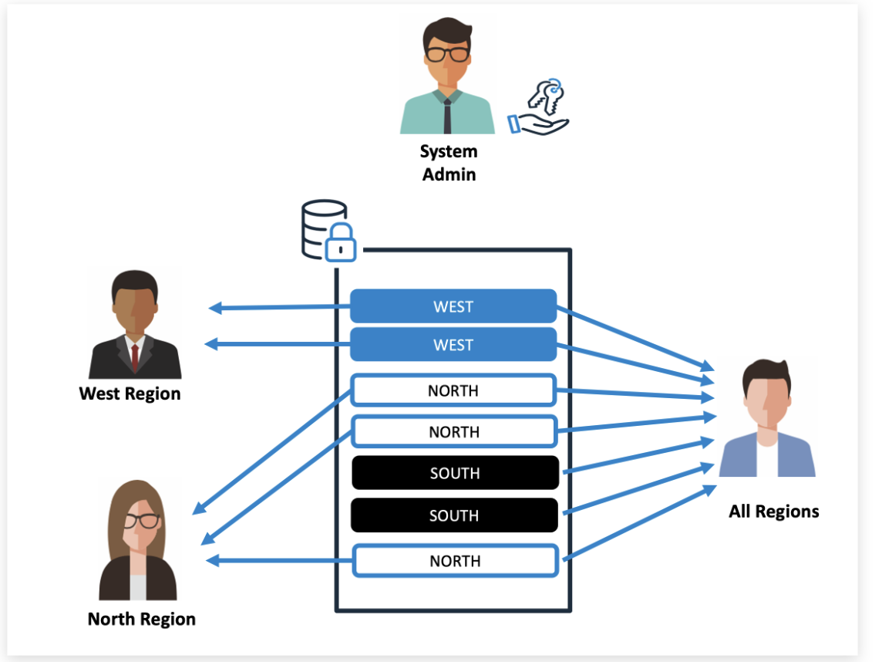
ROW Level Security
RLS is a technology available in Postgres that allows you to define policies that limit the visibility of rows in a table to certain roles.

Slide 10
Technical Approach - Auditing and Monitoring Mechanisms
Authentication and Access Control Auditing: Process of identifying the information of who accessed which systems and what components, including when and how.
Subject/user Auditing: Process of identifying what activities (e.g., insert, update, delete etc.) have been performed by the users/administrators of the database system.
Security Activity Monitoring: Process of identifying and flagging any suspicious, abnormal or unusual activity/ access to sensitive data.
Vulnerability and Threat Auditing: Process of identifying the vulnerabilities in the database and monitor for users attempting to exploit them.
Change Auditing: Implementing baseline policy for different database objects, configurations, schemas, users and privileges and then track deviations from that baseline.

Slide 11
EFK configuration for logs

Slide 12
Example logs

Slide 13
Results
Authorization mechanisms are functioning correctly, ensuring secure access control
The security of the LDAP setup is validated against best practices and industry standards
User access is restricted based on their roles, groups, or specific conditions defined in the security policies.
EFK stack has been successfully installed and configured for log aggregation and analysis.

Slide 14
Conclusion
The implementation of LDAP authentication, row-level security, auditing, and monitoring in the database system ensures robust data privacy and security. LDAP authentication guarantees that only authorized users can access the database, while row-level security restricts access to sensitive information. Auditing and monitoring provide real-time insights and traceability, allowing proactive detection and response to potential security threats.

Slide 15
Future Work
Configure alert rules and anomaly detection in Elasticsearch to swiftly detect and respond to security incidents and potential threats
Set Up Kafka and Kafka Connect between Elasticsearch and Server
Test other third party tools

Slide 16
Thank you for Attention!

Slide 17
Backup

