Slide 1


Simple Object Storage
Distributed object storage optimized for small files
Nijad Huseynov
Advisors: Dr. Stephen H. Kaisler, Dr. Jamaladdin Hasanov
SEAS GW University, SITE ADA University
Course: Guided Research 6917
3 August 2023

Slide 2
Outline
Heilmeier Questions
Project objective
Features
Key ideas for optimizing for small files
System Design
Data node components
Needle - unit of data in the system
Implementation
Object write flow
Object read flow
Evaluation
Conclusion
Future work

Slide 3
Heilmeier Questions
What are you going to do?
Distributed object storage optimized for small files
How is it done today? Current Limitations?
Either for large files, or trying to do both at the same time, hard to deploy to production.
What is your idea to do something better?
Simple interface, yet very powerful for small files
Who will benefit from your work? Why?
Enterprises , Businesses, Backup and Recovery solutions
Costs
No out of pocket costs, took about 2 months to implement

Slide 4
Project Objectives
Designing and implementing a distributed object storage based on the ideas from the Facebook haystack paper
Optimizing the object storage for large volumes of small files
Minimizing the metadata operations on small files, thus improving the read performance of the system

Slide 5
Features
The system is optimized for small objects and implemented for horizontal scalability
ID generation for objects
Volume manager. It is rule based periodic job that checks the statistics of the volumes from data node
Object read and write
Heartbeat mechanism

Slide 6
Key ideas for optimizing for small files
In memory mapping of object id to the offset
Merge small files into one large file
Keeping file descriptor open for each volume to reduce the disk IO requests to O(1)
Hashmap data structure is used.
Key is the object id and the value is offset of the object in the volume file.
Lot of small files will have lots of metadata in local filesystem and it will be hard to cache those metadata. Thus we create one large file and append the object.
Since we will have one large file, it will be easy to cache metadata of the file in ram, thus reducing the disk IO to 1
Notes:
How many disk IO is needed for the single file retrieval from the file system?
Merging itself does not improve performance. But the opposite, searching files can be inefficient thus in memory caching is implemented

Slide 7
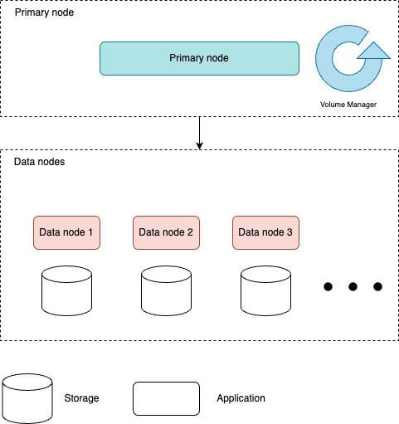
System design
Primary node is responsible for managing volumes
Volume manager
ID generator
Cluster info
Data node is responsible for storing data
Stores the objects in volumes as “needles”
Read and write apis for objects
Heartbeat process to primary node

Slide 8
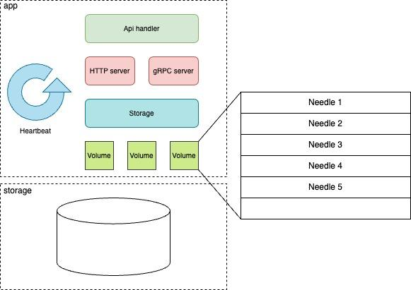
Data node components
Api handler is responsible for the api calls. In this layer, there will be no logic apart from some input sanity checks. It will basically parse request params and pass it to the server layer
Server layer will be responsible for the translation of the incoming requests to the storage layer like constructing the needle to the format storage layer understands and so on.
Storage layer is responsible for the management of the volumes.
Volume will contain some number of small objects(needles).

Slide 9
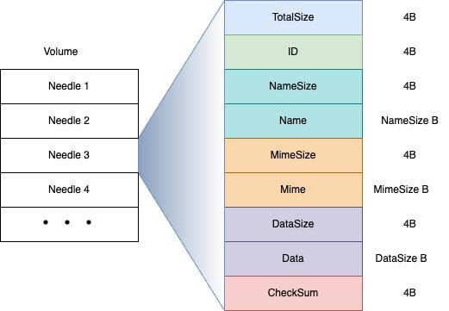
Needle - unit of data in the system
type Needle struct {
TotalSize uint32 # Total size of Needle
Id uint32 # Id of the writtent obj
NameSize uint32 # Number of bytes in name
Name []byte # Obj name
MimeSize uint32 # Obj mime size
Mime []byte # Obj mime type name
DataSize uint32 # Obj content size
Data []byte # Obj’s content in bytes
Checksum uint32 # Checksum of the obj
}

Slide 10



Implementation
Golang is used for the implementation
Simple
Fast
Concurrent
Portable
Following open source golang libraries are used
Echo - for the http server
gRPC Go - for the gRPC server
Cobra - for the command line interface implementation
Logrus - for the logging

Slide 11
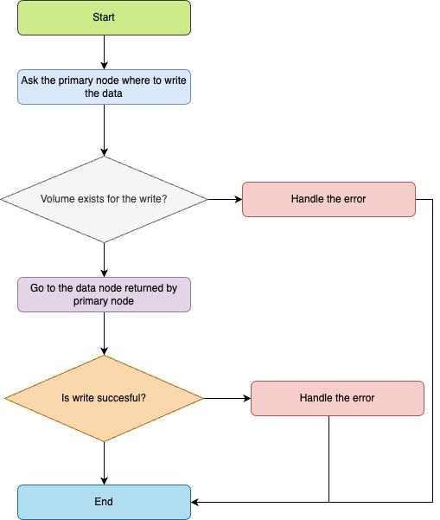
Object write flow
Step 1. Client asks the location to write the object from the primary node
Step 2. Primary node returns the address of the data node which object can be written
Step3. Client writes the object to the given data node.
Notes:
How many disk IO is needed for the single file retrieval from the file system?
Merging itself does not improve performance. But the opposite, searching files can be inefficient thus in memory caching is implemented

Slide 12
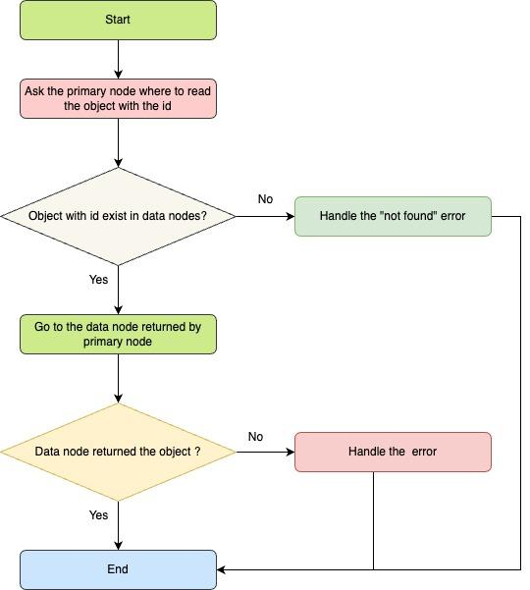
Object read flow
Step 1. Client asks the location of the object from the primary node
Step 2. Primary node returns the address of the data node which has the object
Step 3. Client requests the object from the data node.

Slide 13
Evaluation
Setup
Apple M1 chip, 8 cores
8GB RAM
256 SSD with APFS
Workloads
Read/Write performance of the systems against local file system with 1KB files
Read/Write performance of the system with different bytes of data

Slide 14
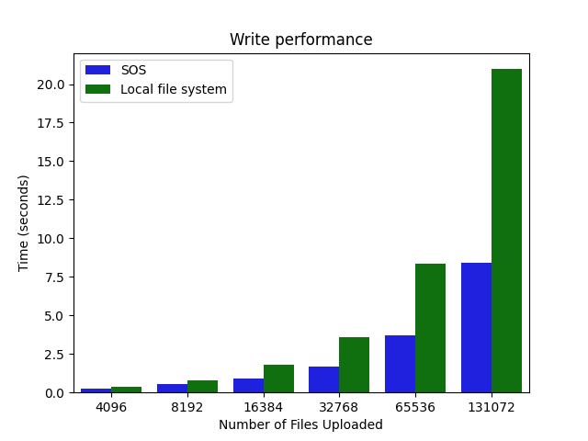
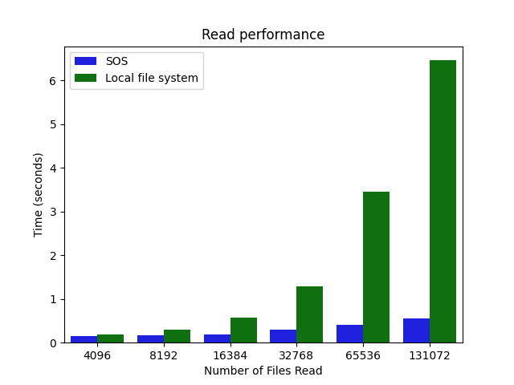
Results: Local File System vs SOS on 1KB data

Slide 15
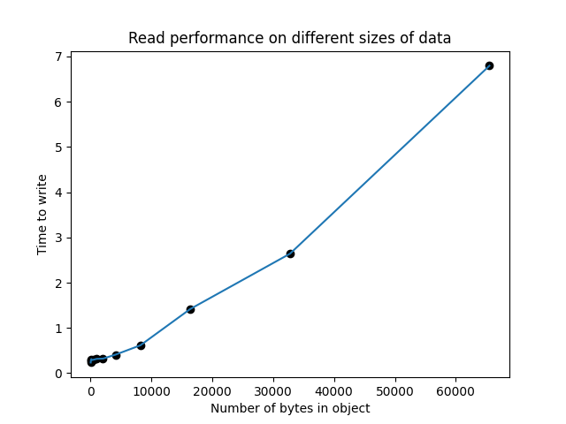

Results: Read/Write performance on different bytes of data
Number of files in each test case: 100,000
Data size: 32 B, 64 B, 128 B, 256 B, 512 B, 1024 B, 2048 B, 4096 B, 8192 B, 16384 B, 32768 B, 65536 B

Slide 16
Conclusion
Distributed Object storage is implemented for small files
It is horizontally scalable
Heartbeat mechanism is implemented as an healthcheck
Evaluation shows that system performs well on small sized data compared to local file system

Slide 17
Future work
Object deletes/updates
Garbage collection
Index for the object id to offset mapping
Batched writes to take advantage of the HDDs

Slide 18
Any Questions?

Slide 19
Backup

Slide 20
Starting the system
To start the primary node
./sos primary --port=8080 --grpc_port=1234
To start the data node
./sos data --vol_dir="tmp/node1"
--primary_node="localhost:1234"
--port="8081"
--grpc_port="1235"
--node_id="1"

Slide 21
APIs
Primary Node
GET /primary/volume
GET /primary/search?id=12
GET /primary/cluster-info
Data Node
POST /data/:fid
GET /data/:fid

