Slide 1


Simple Object Storage
Distributed object storage optimized for small files
Nijad Huseynov
Advisors: Stephen H. Kaisler, Jamaladdin Hasanov
SEAS GW University, SITE ADA University

Slide 2
Outline
Project objective
System Design
Data node components
Implementation
Features
Evaluation
Conclusion
Future work

Slide 3
Project Objectives
Designing and implementing a distributed object storage based on the ideas from the Facebook haystack paper
Optimizing the object storage for large volumes of small files
Minimizing the metadata operations on small files, thus improving the read performance of the system

Slide 4
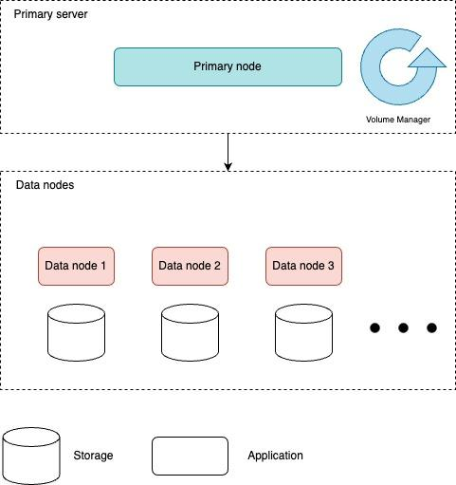
System design
Primary node is responsible for managing volumes
Data node is responsible for storing data

Slide 5
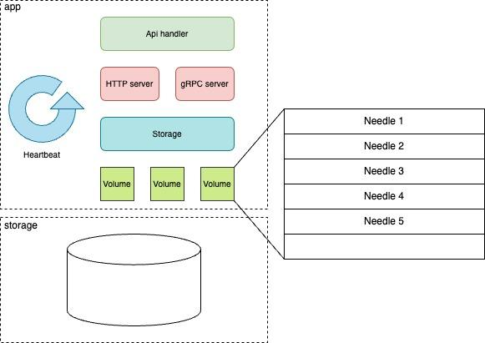
Data node components
Stores the objects in volumes as “needles”
Read and write apis for objects
Heartbeat process to primary node

Slide 6
Implementation
Golang is used for the implementation
Simple
Fast
Concurrent
Portable
Following open source golang libraries are used for the implementation
Echo - for the http server
gRPC Go - for the gRPC server
Cobra - for the command line interface implementation
Logrus - for the logging

Slide 7
Key ideas for optimizing small files
Merge small files into one large file
In memory mapping of object id to the offset
Keeping file descriptor open for each volume to reduce the disk IO requests to O(1)
Notes:
How many disk IO is needed for the single file retrieval from the file system?
Merging itself does not improve performance. But the opposite, searching files can be inefficient thus in memory caching is implemented

Slide 8
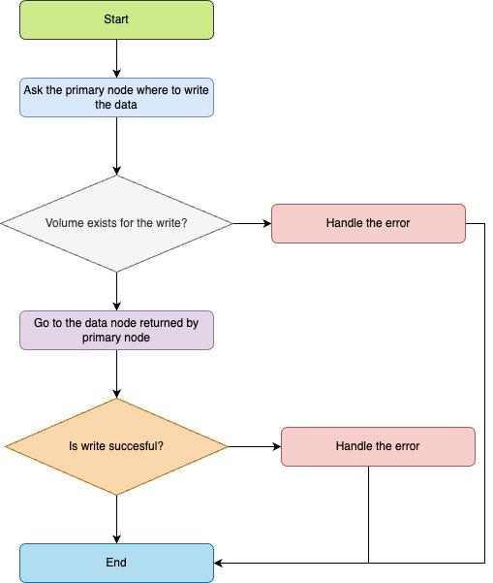
Object write flow
Step 1. Client asks the location to write the object from the primary node
Step 2. Primary node returns the address of the data node which object can be written
Step3. Client writes the object to the given data node.
Notes:
How many disk IO is needed for the single file retrieval from the file system?
Merging itself does not improve performance. But the opposite, searching files can be inefficient thus in memory caching is implemented

Slide 9
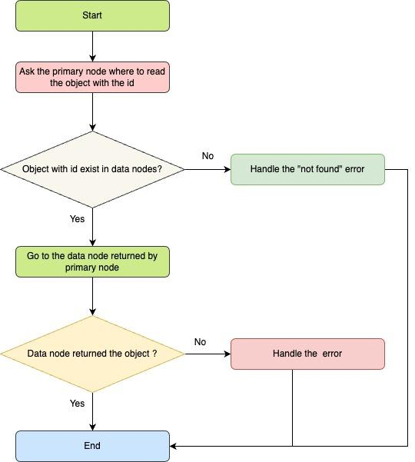
Object read flow
Step 1. Client asks the location of the object from the primary node
Step 2. Primary node returns the address of the data node which has the object
Step3. Client requests the object from the data node.

Slide 10
Features
The system is optimized for small objects and implemented for horizontal scalability
ID generation for objects
Volume manager. It is rule based periodic job that checks the statistics of the volumes from data node
Object read and write
Heartbeat mechanism
Object corruption detection on read

Slide 11
Evaluation
Setup
Workloads

Slide 12
Conclusion

Slide 13
Future work
Object deletes/updates
Garbage collection
Index for the object id to offset mapping

Slide 14
Backup

