Slide 1


UX EVALUATION METHODS
Prof. Stephan Kaisler and Prof. Jamaladdin Hasanov
202302 Guided Research Grad I
Mujgan Aliyeva
08.08.2023

Slide 2
Project Objectives
Evaluate the relationship between usability and user satisfaction in mobile banking applications using UEQ questionnaires, focusing on aspects like attractiveness, perspicuity, efficiency, dependability, stimulation, and novelty.
Explore the UX flow in mobile banking apps by analyzing UEQ responses related to attractiveness, stimulation, and novelty, aiming to understand user engagement and motivation.
Gain insights into users' perceptions of usability and UX in mobile banking apps by analyzing survey responses and demographic data to identify variations in preferences and expectations among different user groups.
Support customer satisfaction and continuous app usage by obtaining data on UX and usability, helping banks and developers optimize their offerings to attract and retain users.
Notes:
We have identified a need to analyze what UX evaluation methods are currently available, which are missing, and to specify development needs for UX evaluation methods. Presumably, a clear overview can reveal where the gap lies and inform the future development of these methods. Hence, we are convinced of the need to identify the current state of UX evaluation methods, especially their characteristics and qualities, and are motivated to achieve this aim through various approaches.

Slide 3
What We Tried to Do
The study aimed to evaluate the UX and usability of mobile banking apps in Indonesia using UEQ metrics, focusing on usability, attractiveness, perspicuity, efficiency, dependability, stimulation, and novelty aspects.
UEQ questionnaires were distributed to at least 4 users of each selected mobile banking app, gathering demographic data, including usage, gender, and age (20-40 years).
The 26-item UEQ measured attractiveness, perspicuity, efficiency, dependability, stimulation, and novelty, providing insights into users' general perception and motivation to use the apps.
Data collection involved distributing questionnaires via Google Forms and scoring UEQ responses on a scale of 1 to 7.
The study aimed to identify app strengths and weaknesses, guiding developers for better user experiences and supporting customer satisfaction and continuous app usage.
Notes:
As the initial step, we searched the literature for overviews of UX evaluation methods. Collections and categorization of UX evaluation methods are rare. Those we found either include other tools and methods besides UX evaluation methods [1, 8, 12] or focus on certain types of evaluation such as assessing momentary emotions [11]. Furthermore, as the research area of UX is evolving rapidly, it is important for us to collect the most recently developed methods from both researchers and practitioners.

Slide 4
Brief Answers to Heilmeier Questions
What are you trying to do?
We are trying to evaluate the user experience (UX) and usability of several mobile banking applications in Indonesia using UEQ metrics.
What is new in your approach, and why do you think it will be successful?
Our approach is to use both the UEQ metrics to comprehensively assess UX and usability. By combining these two evaluation methods, we can gain deeper insights into various aspects of user perception, leading to a more comprehensive understanding of the applications' strengths and weaknesses.
Who are interested?
Mobile banking application developers, financial institutions, and users care about this research. Developers and institutions can use the findings to improve their applications, while users will benefit from enhanced usability and user experiences.

Slide 5
Brief Answers to Heilmeier Questions
If you're successful, what difference will it make?
If successful, this research will lead to improved mobile banking applications with better usability and user experiences. This, in turn, will result in higher user satisfaction, increased customer retention, and more efficient banking transactions.
What are the risks and the payoffs?
The risks include potential challenges in collecting sufficient and diverse data from mobile banking users. However, the payoffs are significant as the research can contribute valuable insights to the field of UX and usability, leading to better-designed mobile banking applications with enhanced user experiences.
How long will it take?
The duration of the project will depend on the timeline for data collection, analysis, and report writing. It is expected to take several months to complete the research.

Slide 6
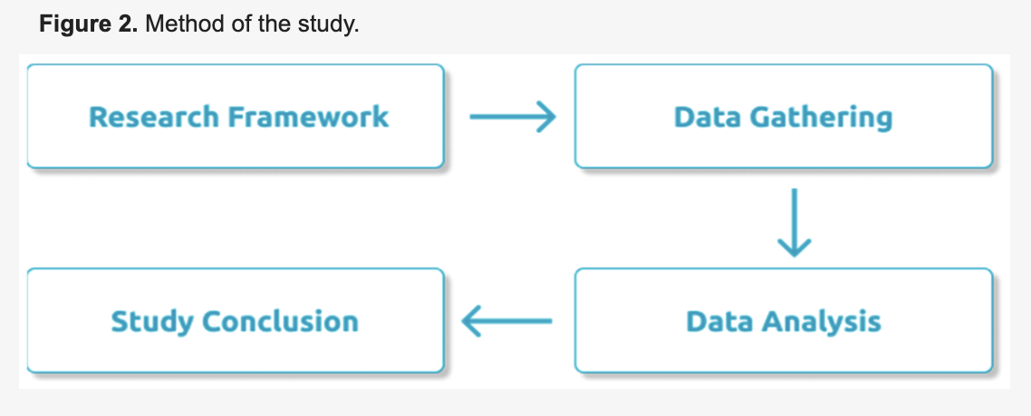
Technical Approach/Architecture Diagram
The flow of this study is presented in Figure 2. UEQ questionnaires were distributed to mobile banking users. There were four mobile banking applications set as the objects of this study.

Slide 7
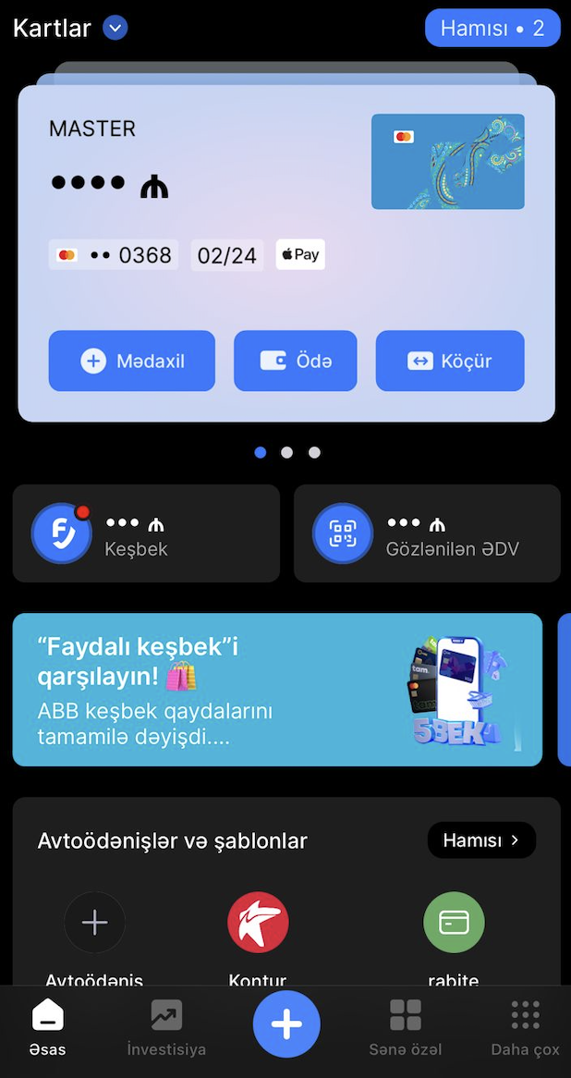
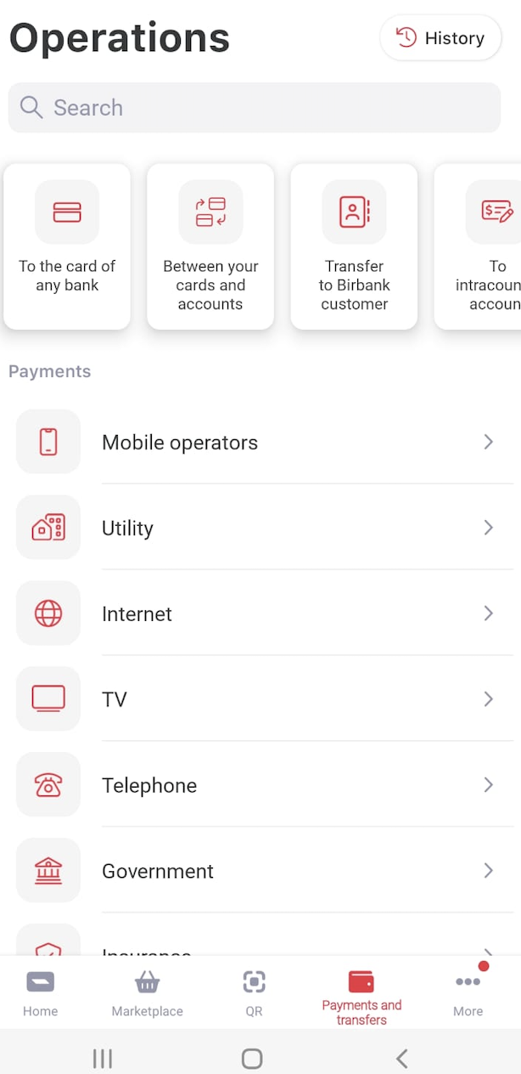
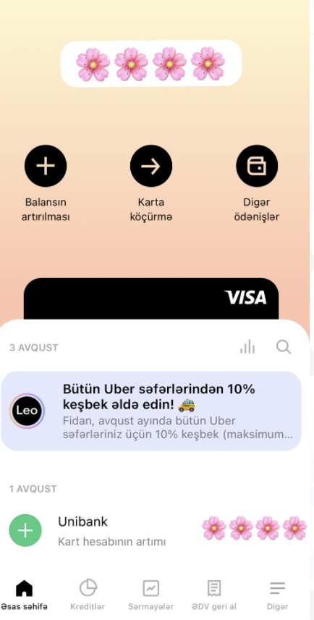
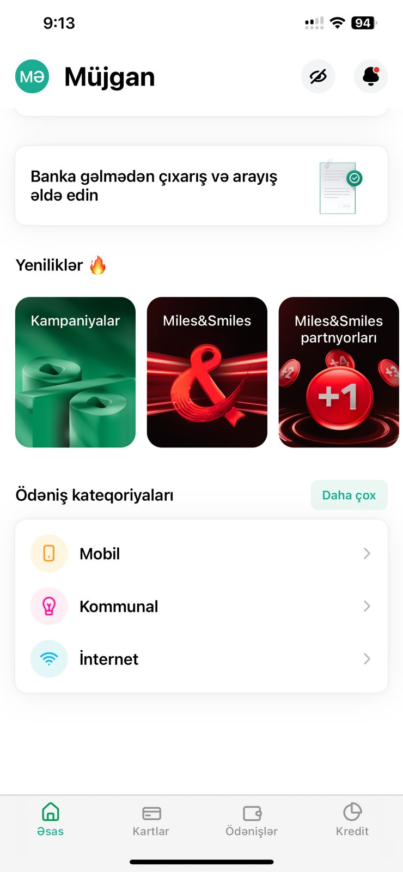
4 Banking applications

Slide 8
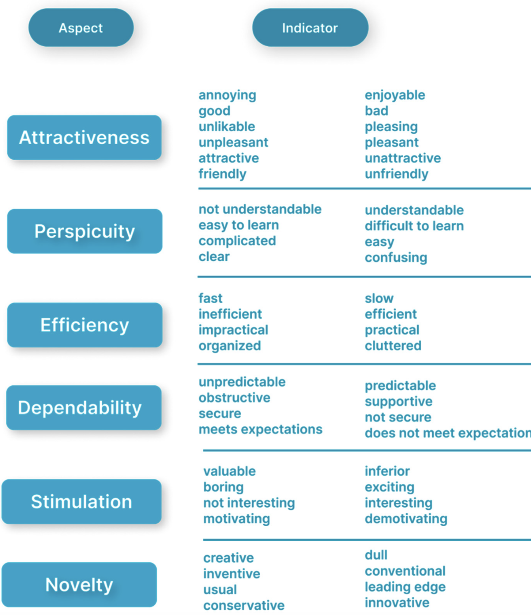

Technical Approach/Architecture Diagram
The aspects measured in UEQ questionnaires are shown in Figure 3.

Slide 9
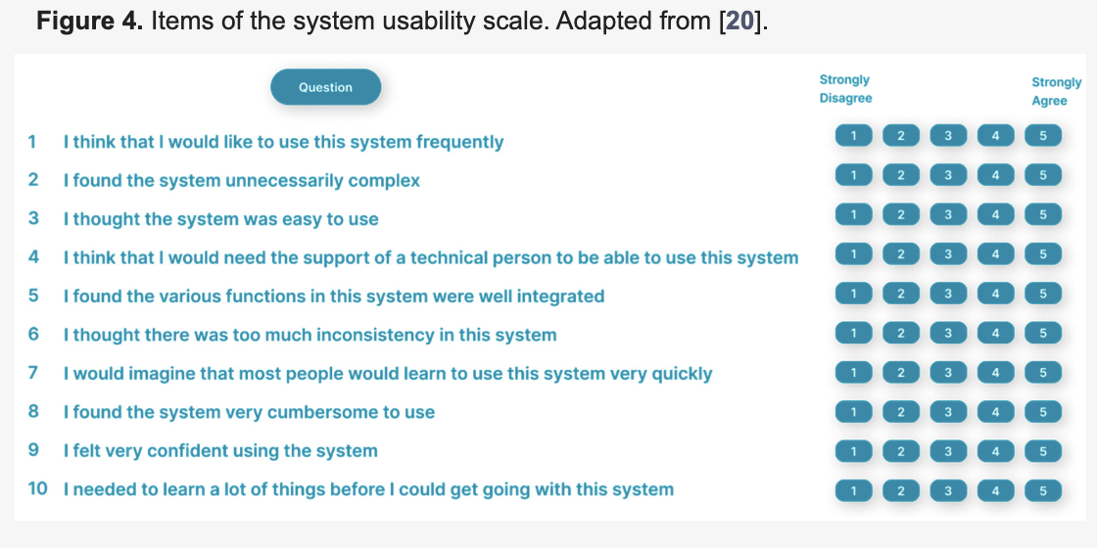
Technical Approach/Architecture Diagram
The aspects measured in UEQ questionnaires are shown in Figure 4. In the data-gathering process, the questionnaires were distributed through Google forms, which results were then analyzed based on UEQ metrics. The score of the answers for each UEQ question ranged from 1 to 7 according to the indicators of each aspect.

Slide 10
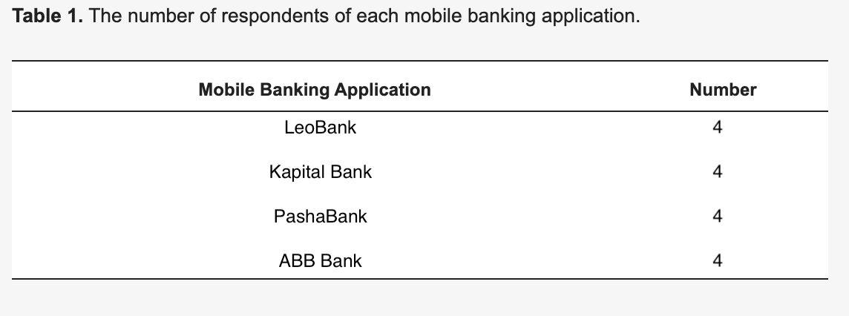
Results and discussions
Questionnaires were filled out by respondents, and results were processed using UEQ metrics. Table 1 presents the number of respondents of each mobile banking application.

Slide 11
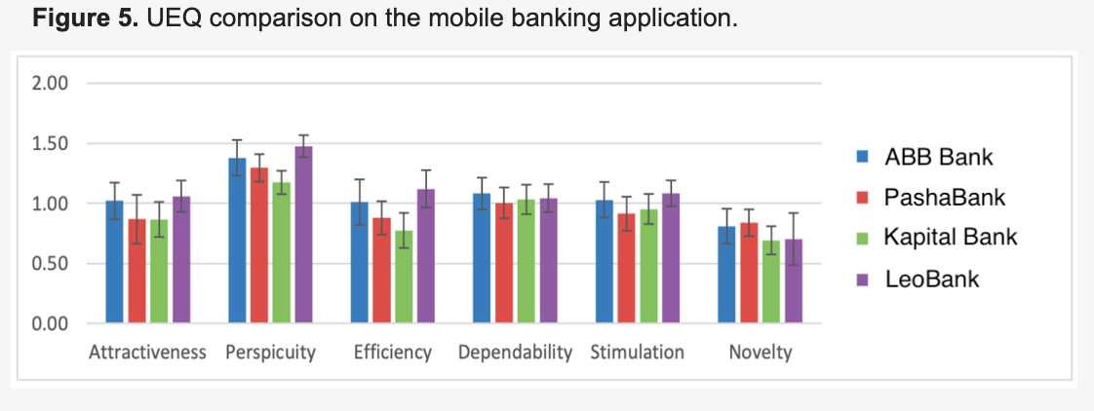
Results and discussions
Figure 5 shows that all mobile banking applications have slightly different values in functionality and interaction concepts. t-Test calculation at Alpha level 0.05 indicates “Significant Differences” in the Perspicuity and Efficiency aspects of Kapital Bank, LeoBank and PashaBank. Kapital Bank’s Perspicuity compared with the one of ABB Bank also shows a “Significant Difference”, whereas the results of other comparisons show “No Significant Difference”.

Slide 12
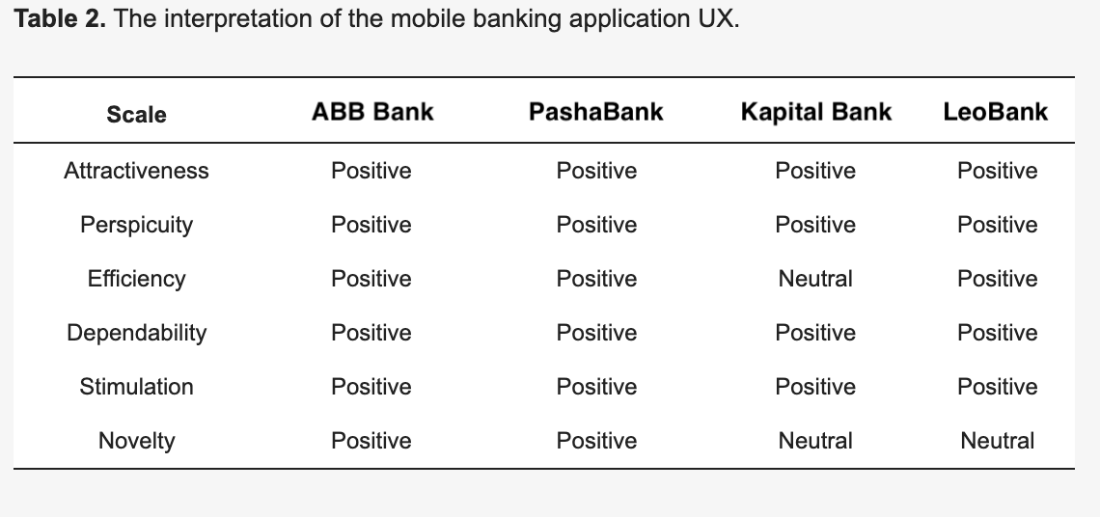
Results and discussions
Table 2 presents the interpretation of the UEQ scale for each mobile banking application, with an average value of −0.8 to 0.8 (neutral), value > 0.8 (positive), and an average value < −0.8 (negative)
Based on the UX and usability evaluation of mobile banking applications, all applications have a neutral and positive UX design, as well as good usability. Users also accept the usability of the four mobile banking applications.

Slide 13
Key Steps in Research: What Did We Do?
In this research study, we aimed to assess the user experience (UX) and usability of four mobile banking applications in Azerbaijan using the User Experience Questionnaire (UEQ) metrics. The purpose was to understand how users perceive and interact with these applications, with a specific focus on their general impression, usability, and novelty aspects. Through a series of structured evaluations and analyses, we sought to gain valuable insights into the strengths and weaknesses of each mobile banking application.
Objective Formulation: The research began with a clear articulation of our objectives. We aimed to evaluate the UX of four mobile banking applications and determine the usability levels across these applications. Additionally, we wanted to identify any potential areas for improvement, particularly in terms of novelty.
Selection of Mobile Banking Applications: We carefully selected four prominent mobile banking applications available in Azerbaijan to ensure a representative sample. The chosen applications were Kapital Bank, LeoBank, PashaBank, and ABB Bank.
Data Collection: To measure the UX and usability, we employed the User Experience Questionnaire (UEQ) metrics. This method allowed us to gather quantitative data on user perceptions across various aspects, such as attractiveness, efficiency, perspicuity, novelty, and stimulation.
Quantitative Evaluation: Using the UEQ metrics, we collected user feedback from participants who had experience using the selected mobile banking applications. Participants were asked to rate their experiences based on predefined scales related to the identified UX aspects.

Slide 14
Key Steps in Research: What Did We Do?
Data Analysis: After data collection, we performed a thorough analysis of the obtained results. We examined the ratings and identified patterns, trends, and significant differences between the mobile banking applications in terms of their UX and usability.
Identification of Positive Impressions: Our analysis revealed that users had a positive general impression of the mobile banking applications. The UX aspects received ratings falling under the "Neutral" category, indicating overall user satisfaction.
Focus on Novelty Aspect: However, it was noted that the Novelty aspect of Kapital Bank and LeoBank received ratings in the "Neutral" category. This finding pointed to the need for further examination and improvement of the Novelty aspect to enhance user evaluation.

Slide 15
Key Steps in Research: What Did We Do?
Comparative Analysis: To gain deeper insights into the usability differences between the applications, we conducted T-Tests comparing the Perspicuity and Efficiency aspects of Kapital Bank with LeoBank and PashaBank with LeoBank. The analysis revealed "Significant Differences" in these aspects, indicating specific areas for potential improvement.
Implications and Future Work: Based on our findings, we proposed future work to address the Novelty aspect, conduct in-depth qualitative analysis, implement iterative design changes, and consider user persona development, among other key steps. These recommendations aim to enhance the mobile banking applications' overall user experience and usability.

Slide 16
What is Innovative About Our Research?
Our research adopts a comprehensive evaluation approach by using both the User Experience Questionnaire (UEQ). This combined method allows us to gain a deeper understanding of the user experience and usability aspects of mobile banking applications, providing a more holistic perspective compared to traditional evaluation approaches.
By categorizing the aspects measured by the UEQ into pragmatic (goal-directed) and hedonic (not goal-directed) quality attributes, we go beyond traditional usability evaluations. This classification enables us to explore not only the efficiency and effectiveness of the applications but also the hedonic aspects related to user satisfaction and motivation.

Slide 17
Conclusion
This study measured the UX and usability of four mobile banking applications in Azerbaijan using UEQ metrics. The minimum category for every UX aspect of the four mobile banking applications is NEUTRAL with GOOD usability. These results show that the general impression of users on the mobile banking application is positive. In addition, users have “accepted” the usability of the mobile banking applications that they used. Kapital Bank and LeoBank were rated NEUTRAL in terms of Novelty. Therefore, the Novelty aspect of Kapital Bank and LeoBank needs to be reviewed and improved for more positive evaluation. The T-Test showed that the Perspicuity and Efficiency aspects of Kapital Bank with LeoBank and PashaBank with LeoBank have a “Significant Difference”. Likewise, Kapital Bank’s Perspicuity when compared with that of ABB Bank is significantly different which can be further improved.

Slide 18
Future Work
In-depth Qualitative Analysis: Conducting qualitative research such as interviews or focus groups with users to gain deeper insights into their experiences and perceptions of the mobile banking applications. This qualitative data can complement the quantitative findings from the UEQ metrics and provide a more holistic understanding of user preferences and pain points.
Iterative Design and Testing: Based on the feedback and evaluation results, implement design improvements to address the Novelty aspect of Kapital Bank and LeoBank. After making these changes, conduct further usability testing to validate the effectiveness of the improvements.
User Persona Development: Create user personas to better understand the diverse needs and preferences of different user groups. Tailor the mobile banking applications to meet the specific requirements of these personas, ensuring a more personalized and targeted user experience.
Competitive Analysis: Perform a comparative analysis of mobile banking applications from other regions or countries, considering those that have received positive user feedback and high ratings. Identify innovative features or design elements that can be adopted or adapted to enhance the overall user experience.
Accessibility Assessment: Evaluate the accessibility features of the mobile banking applications to ensure they are inclusive and usable by people with disabilities. Address any accessibility issues and consider implementing universal design principles.

Slide 19
Future Work
Longitudinal Study: Conduct a longitudinal study to track changes in user perceptions and experiences over an extended period. This will help identify trends and potential issues that may arise as the applications evolve or new features are introduced.
Benchmarking with Industry Standards: Compare the UX and usability metrics of the mobile banking applications against industry standards and best practices. This benchmarking can highlight areas where the applications are excelling or falling short in relation to established norms.
Localization and Cultural Considerations: If the mobile banking applications are used by diverse cultural groups within Azerbaijan, consider conducting localization assessments to ensure the design and content align with cultural norms and preferences.
Security and Privacy Evaluation: Assess the security and privacy features of the mobile banking applications to instill trust and confidence in users. Address any vulnerabilities or concerns related to data protection.
User Education and Onboarding: Explore opportunities to enhance the onboarding process and provide users with better guidance and education on how to use the mobile banking applications effectively.
By pursuing these future work areas, the study can contribute to further improvements in the mobile banking applications, enhance user satisfaction, and maintain a positive impression of the applications among users.

