Slide 1
The comparative study of indexing techniques in different database systems
Student: Sokrat Bashirov
Instructors: Steve Kaisler and Jamaladdin Hasanov
Class: CSCI_6917_10
Date: 8/10/2023

Slide 2
Project Objective
a comparative study of indexing techniques
MySQL and PostgreSQL database systems
compare the query performance of MySQL and PostgreSQL databases with and without indexes to understand the influence of indexing on query execution.
approach involves systematically testing both databases without any indexes and then introducing indexes incrementally to study their impact.
Notes:
The primary objective of this project is to conduct a comparative study of indexing techniques in two popular database systems, MySQL and PostgreSQL. We aim to evaluate the impact of indexing on query performance using a database.

Slide 3
valuable to database administrators, developers, and researchers who seek to optimize database performance for their applications.
a better understanding of the impact of indexing on query execution time, enabling users to make informed decisions about index usage in their databases.

Slide 4
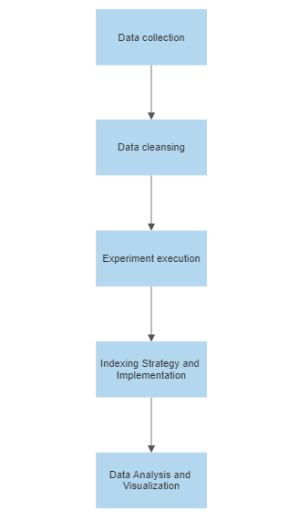
Research plan
Notes:
Technical Approach
Data collection – Database used: 6tables. Over 2Million rows in salaries
Data cleansing – deleting PK,FK and indexes. For what?

Slide 5
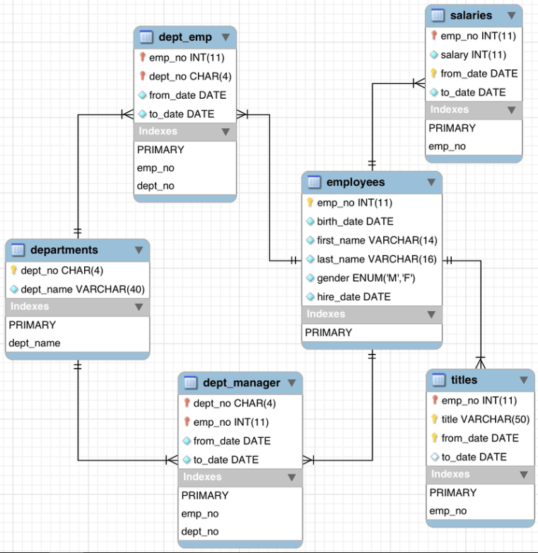

Slide 6
SELECT emp_no, COUNT(*) AS count FROM employees GROUP BY emp_no;
SELECT * FROM salaries WHERE salary = 94443 OR salary = 59571;
SELECT E.*, S.* FROM employees E JOIN salaries S ON E.emp_no = S.emp_no WHERE E.first_name = 'Duangkaew';
SELECT * FROM titles WHERE title LIKE 'senior%';
SELECT E.*, T.* FROM employees E JOIN titles T ON E.emp_no = T.emp_no WHERE E.first_name = 'Duangkaew';

Slide 7
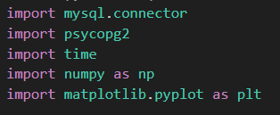
Python because:
Ease of Use
Rich Ecosystem
Data Analysis Capabilities
Database Connectivity
Platform Independence
Metrics: Time taken by each query to execute in both MySQL and PostgreSQL databases with and without any indexes.
Notes:
Rich Ecosystem: Python has a vast ecosystem of libraries and packages that cover a wide range of applications, including database interactions, data analysis, and visualization. Python offers robust libraries like mysql.connector and psycopg2 that allow seamless connections to popular databases like MySQL and PostgreSQL.
Data Analysis Capabilities: Python has become a popular choice for data analysis and scientific computing. Libraries such as NumPy, Pandas, and Matplotlib facilitate data manipulation, statistical analysis, and visualization, which are essential for research projects involving large datasets.
Others: Interdisciplinary Usage: Python is widely used across various domains, including data science, machine learning, web development, scientific research, and more. This interdisciplinary nature fosters collaboration and knowledge exchange.
Community Support: Python has a thriving and supportive community of developers, researchers, and enthusiasts. This ensures that there are ample resources, tutorials, and forums available to seek help and share knowledge.

Slide 8
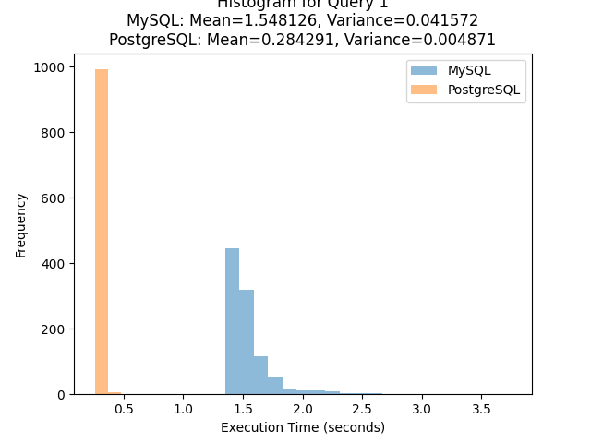
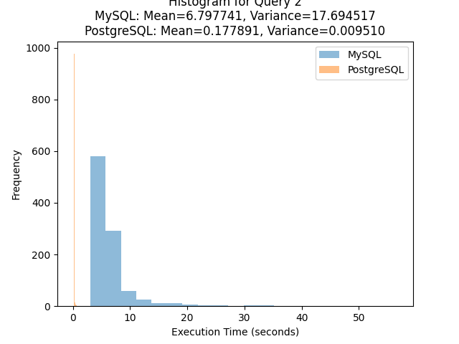
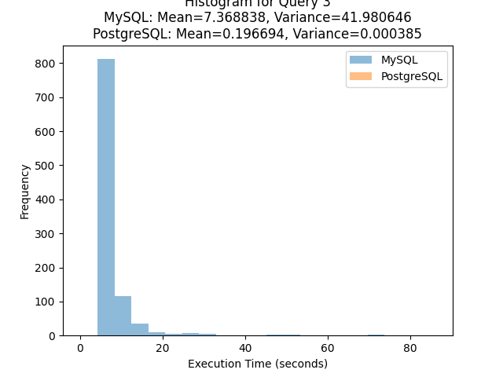
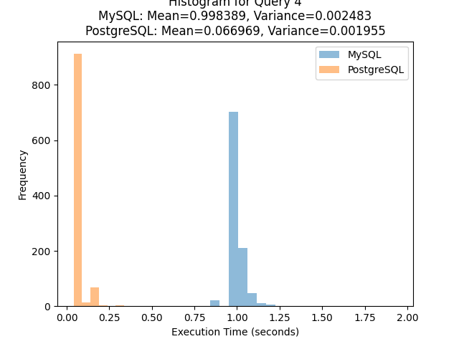
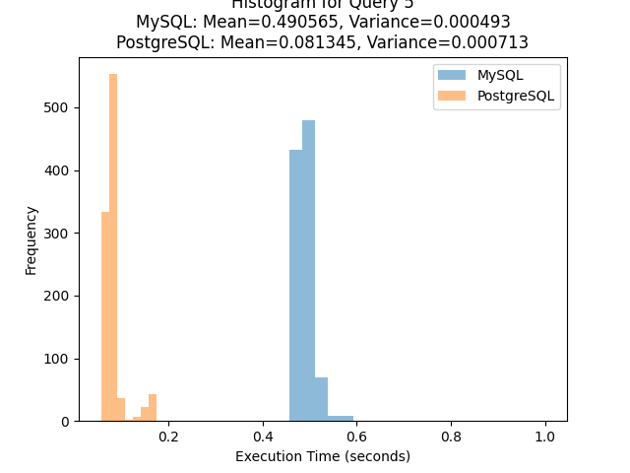
Query run without indexes

Slide 9
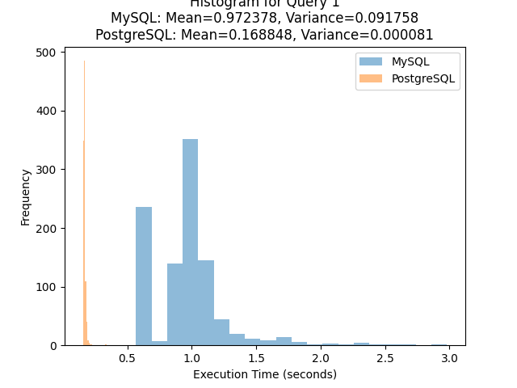
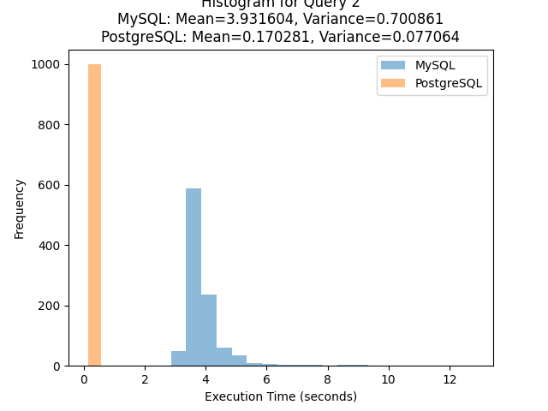
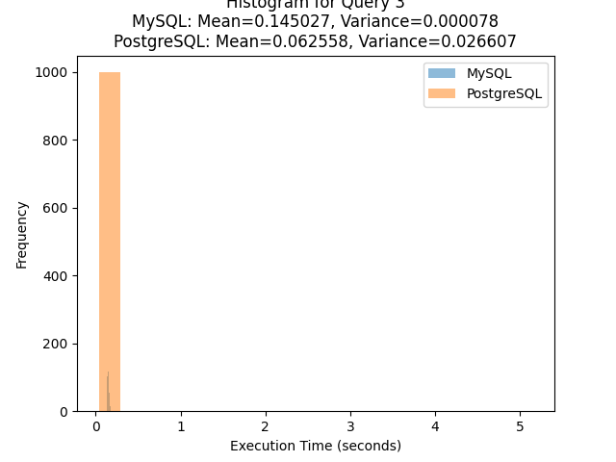
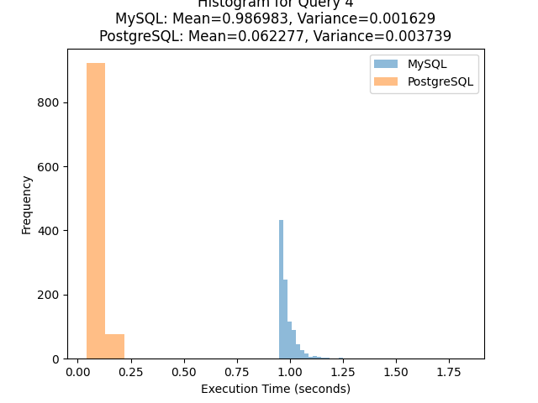
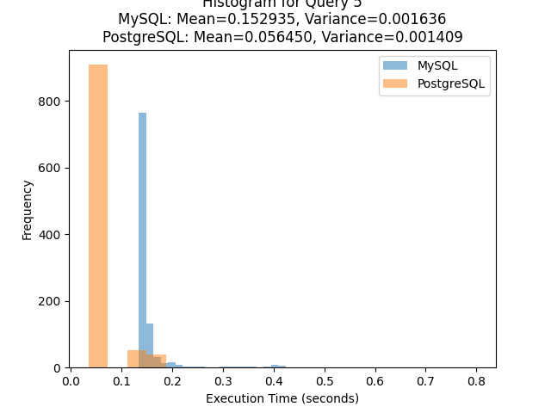
Query run with PK, FK

Slide 10
Results
 | No Index |  | PK, FK
 | MySQL | PostgreSQL | MySQL | PostgreSQL
Query 1 | M=1.548126, V=0.041572 | M=0.284291, V=0.004871 | M=0.972378, V=0.091758 | M=0.168848, V=0.000081
Query 2 | M=6.797741, V=17.694517 | M=0.177891, V=0.009510 | M=3.931604, V=0.700861 | M=0.170281, V=0.077064
Query 3 | M=7.368838, V=41.980646 | M=0.196694, V=0.000385 | M=0.145027, V=0.000078 | M=0.062558, V=0.026607
Query 4 | M=0.998389, V=0.002483 | M=0.066969, V=0.001955 | M=0.986983, V=0.001629 | M=0.062277, V=0.003739
Query 5 | M=0.490565, V=0.000493 | M=0.081345, V=0.000713 | M=0.152935, V=0.001636 | M=0.056450, V=0.001409

Slide 11
Key Findings:
Without Indexes: PostgreSQL consistently outperformed MySQL in query execution time, indicating its inherent optimization and advanced query processing capabilities.
With Indexes: The introduction of indexes in both databases led to significant improvements in query execution time, reducing the overall response time for queries.

Slide 12
Conclusion
The comparative study of indexing techniques in MySQL and PostgreSQL databases has provided valuable insights into the impact of indexing on query performance. We executed a set of representative queries 1000 times in both databases without indexes and with indexes added, enabling a thorough evaluation of their respective performances.

Slide 13
Future Work
Adding appropriate indexes to the tables. The aim is to further optimize query performance and reduce execution times in both MySQL and PostgreSQL databases. The inclusion of indexing structures is expected to play a crucial role in narrowing the performance gap between the two database systems.
Future Work Possibilities:
Fine-tuning Indexing Strategies
Benchmarking with Other Databases
Scale Testing
Notes:
Fine-tuning Indexing Strategies: Investigate different indexing strategies, such as composite indexes and partial indexes, to determine their impact on specific query scenarios.
Benchmarking with Other Databases: Expand the study to include other popular database systems to compare their performance with MySQL and PostgreSQL.
Scale Testing: Extend the experimentation to larger datasets to evaluate the scalability and performance of the databases under increased workloads.

Slide 14
Thank you for your attention!

