Slide 1
The comparative study of indexing techniques in different database systems
Student: Sokrat Bashirov
Instructors: Steve Kaisler and Jamaladdin Hasanov
Class: CSCI_6917_10: Guided Research Methods
Date: 8/10/2023

Slide 2


Project Objective
The primary objective of this project is to conduct a comparative study of query performance in MySQL and PostgreSQL databases with and without indexes. Aiming to evaluate the impact of indexing on query execution time using a real-world dataset and identify the performance differences between the two database systems.

Slide 3
Heilmeier questions:
What are you trying to do?
Comparing the query performance of MySQL and PostgreSQL databases with and without indexes to understand the influence of indexing on query execution.
How is it done today, and what are the limits of current practice?
The extent to which indexes influence query performance is not always well understood. My research aims to provide clear insights into the effectiveness of indexes and their limitations.
What is new in your approach, and why do you think it will be successful?
Approach involves systematically testing both databases without any indexes and then introducing indexes incrementally to study their impact.
Who cares?
Database administrators, developers, and researchers who seek to optimize database performance for their applications.
What are the risks and the payoffs?
Potential complexities in data collection, analysis, and accurately reflecting real-world workloads.
How much will it cost? How long will it take?
The cost involves computational resources, database hosting
What are the midterm and final exams to check for success?
Successfully executing and comparing queries without indexes. A comprehensive evaluation of queries with indexes added, supported by data analysis and visualization.
Why now?
The increasing reliance on databases for applications

Slide 4
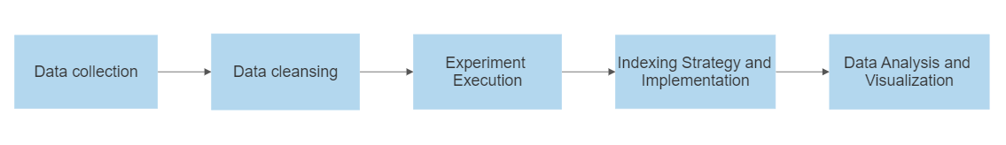
Research plan
Notes:
Technical Approach
Data collection – Database used: 6tables. Over 2Million rows in salaries
Data cleansing – deleting PK,FK and indexes. For what?

Slide 5
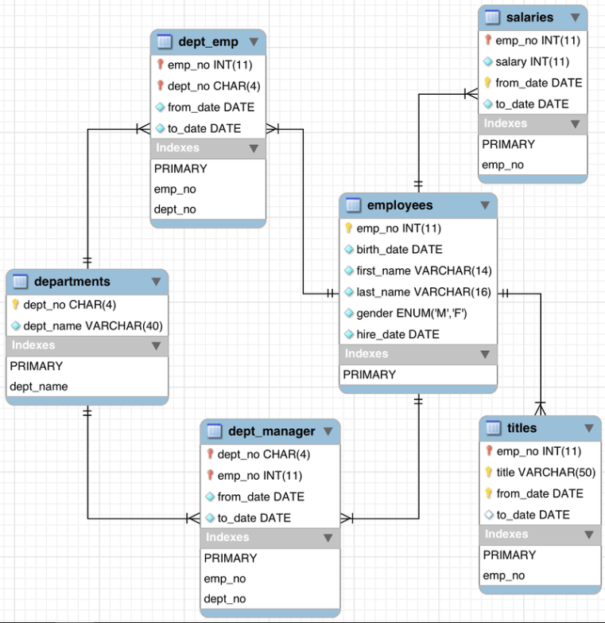
Database

Slide 6
SELECT emp_no, COUNT(*) AS count FROM employees GROUP BY emp_no;
SELECT * FROM salaries WHERE salary = 94443 OR salary = 59571;
SELECT E.*, S.* FROM employees E JOIN salaries S ON E.emp_no = S.emp_no WHERE E.first_name = 'Duangkaew';
SELECT * FROM titles WHERE title LIKE 'senior%';
SELECT E.*, T.* FROM employees E JOIN titles T ON E.emp_no = T.emp_no WHERE E.first_name = 'Duangkaew';

Slide 7
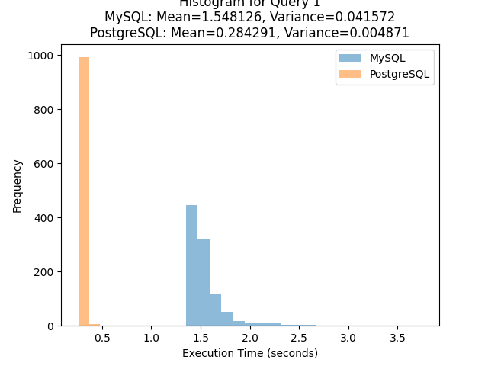
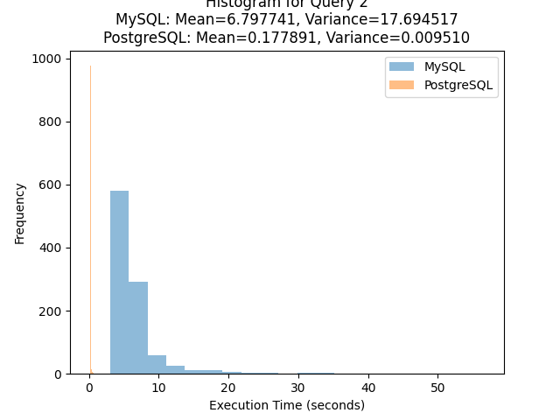
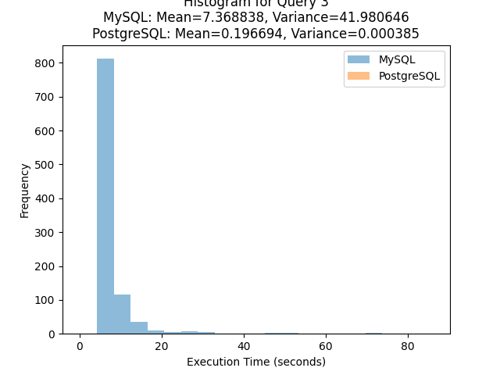
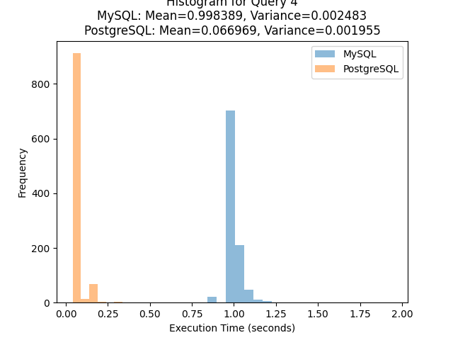
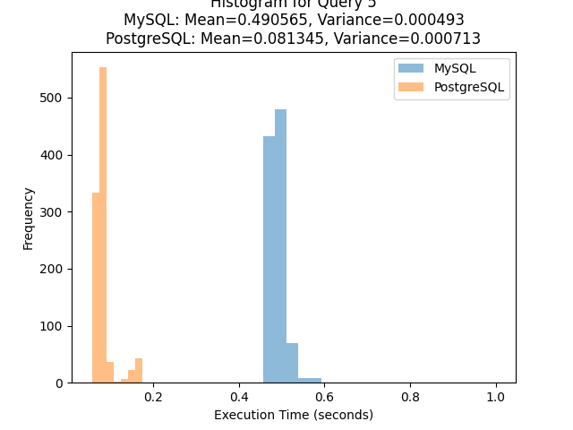
Query run without indexes

Slide 8
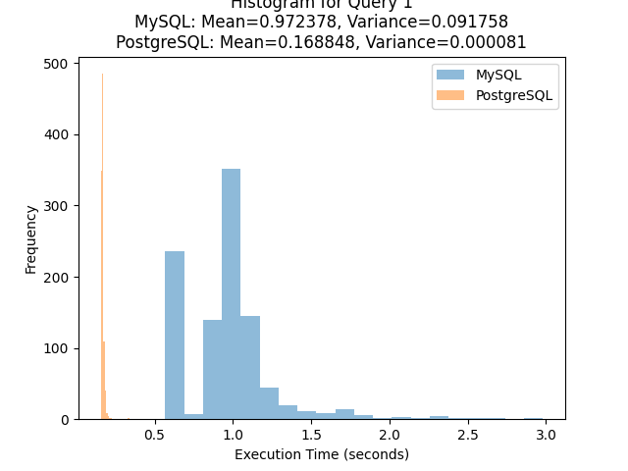
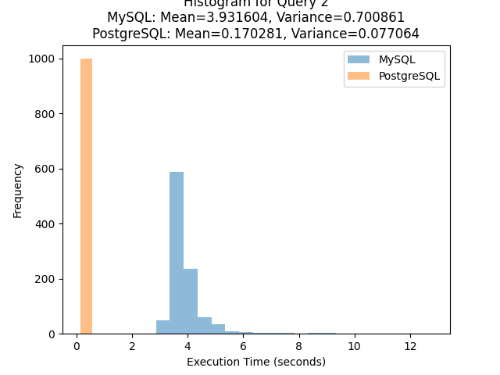
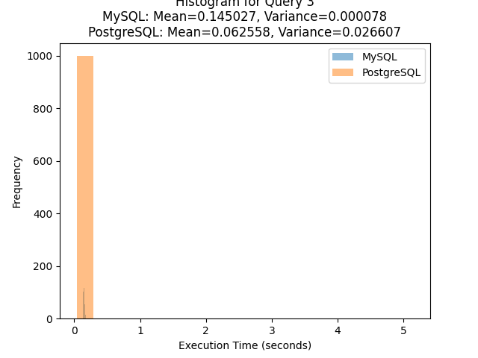
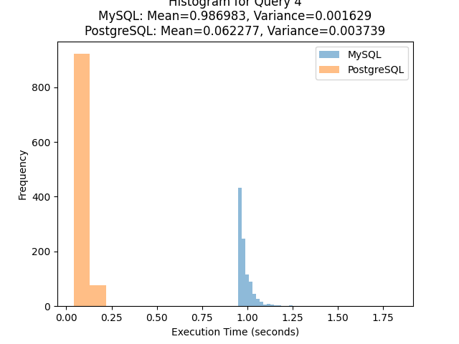
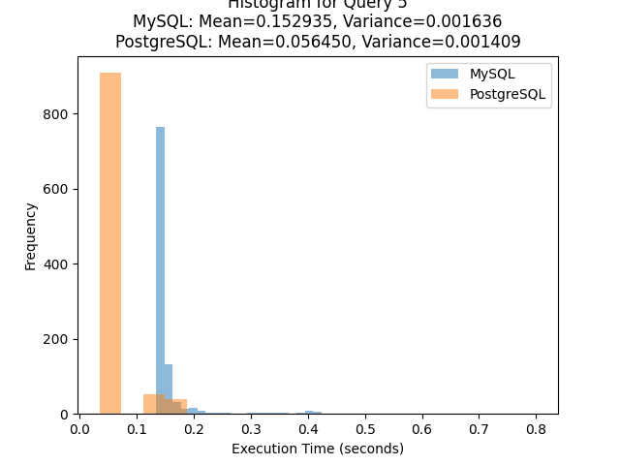
Query run with PK, FK

Slide 9
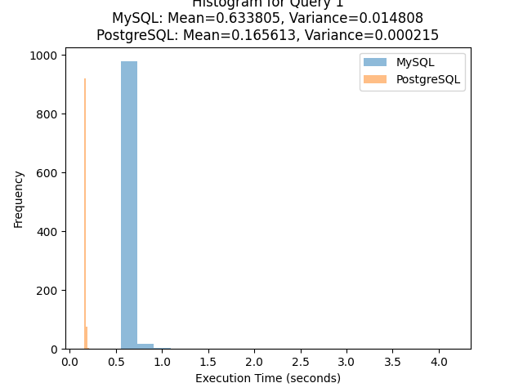
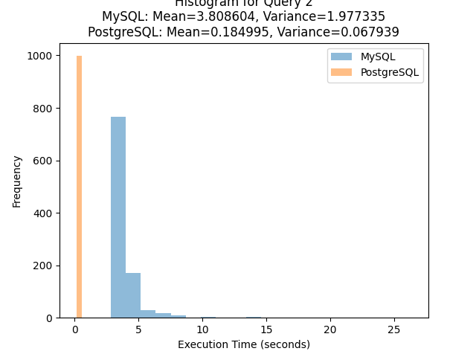

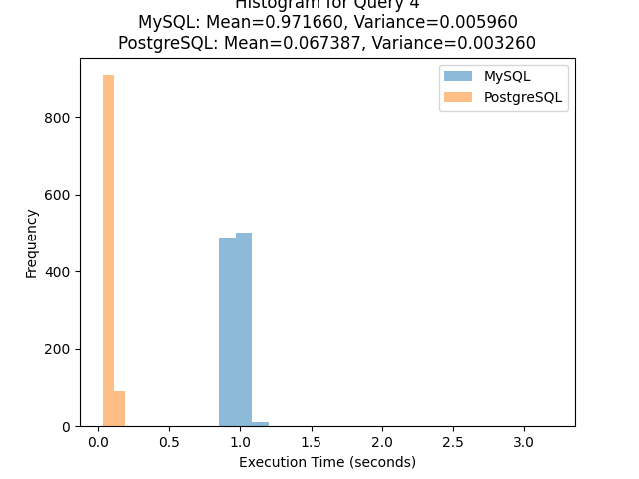
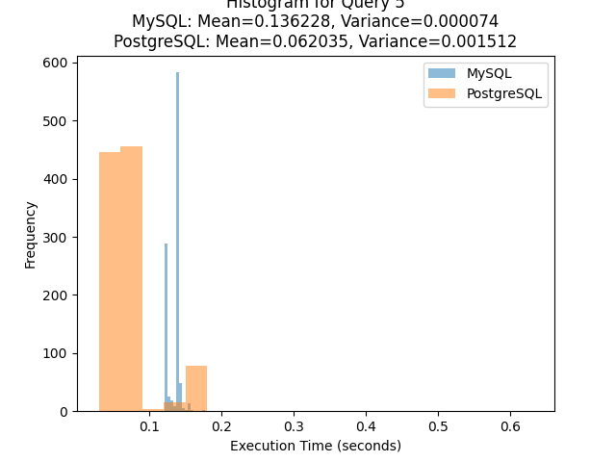
Query run with index

Slide 10
Results
 | No Index |  | PK, FK |  | Index
 | MySQL | PostgreSQL | MySQL | PostgreSQL | MySQL | PostgreSQL
Query 1 | M=1.548126 V=0.041572 | M=0.284291 V=0.004871 | M=0.972378 V=0.091758 | M=0.168848 V=0.000081 | M=0.633805 V=0.014808 | M=0.165613 V=0.000215
Query 2 | M=6.797741 V=17.694517 | M=0.177891 V=0.009510 | M=3.931604 V=0.700861 | M=0.170281 V=0.077064 | M=3.808604 V=1.977335 | M=0.184995 V=0.067939
Query 3 | M=7.368838 V=41.980646 | M=0.196694 V=0.000385 | M=0.145027 V=0.000078 | M=0.062558 V=0.026607 | M=0.140308 V=0.000199 | M=0.074244 V=0.038325
Query 4 | M=0.998389 V=0.002483 | M=0.066969 V=0.001955 | M=0.986983 V=0.001629 | M=0.062277 V=0.003739 | M=0.971660 V=0.005960 | M=0.067387 V=0.003260
Query 5 | M=0.490565 V=0.000493 | M=0.081345 V=0.000713 | M=0.152935 V=0.001636 | M=0.056450 V=0.001409 | M=0.136228 V=0.000074 | M=0.062035 V=0.001512

Slide 11

Key Findings:
Without Indexes: PostgreSQL consistently outperformed MySQL in query execution time, indicating its inherent optimization and advanced query processing capabilities.
With Indexes: The introduction of indexes in both databases led to significant improvements in query execution time, reducing the overall response time for queries.
Notes:
Cost-Based Query Optimizer: PostgreSQL employs a sophisticated cost-based query optimizer that evaluates multiple execution plans and selects the most efficient one based on estimated costs. This feature enables PostgreSQL to adapt to varying query complexities and data distributions, optimizing query execution plans.

Slide 12
Performance advantages
Parallel Query Execution: While both databases support parallelism, PostgreSQL's implementation of parallel query execution allows queries to be split into smaller tasks that are executed concurrently, potentially speeding up query performance for certain workloads.
Advanced Indexing Techniques: PostgreSQL offers features like Generalized Inverted Indexes (GIN) and Generalized Search Tree (GiST) indexes, which provide specialized indexing methods for complex data types like arrays, full-text search, and geometric data. These indexing options can be particularly useful for applications that require advanced search capabilities.
Materialized Views: PostgreSQL supports materialized views that store precomputed results, reducing the need for repeated complex calculations. This feature accelerates query performance by retrieving data directly from the materialized view.
Concurrency Control: PostgreSQL's advanced concurrency control mechanisms, such as Multi-Version Concurrency Control (MVCC), mitigate locking and contention issues, enabling efficient multi-user access. Effective concurrency control mechanisms to ensure efficient multi-user access without sacrificing performance.

Slide 13
Conclusion
The comparative study of indexing techniques in MySQL and PostgreSQL databases has provided valuable insights into the impact of indexing on query performance. I have executed a set of representative queries 1000 times in both databases without indexes and with indexes added, enabling a thorough evaluation of their respective performances.

Slide 14



Future Work
Fine-tuning Indexing Strategies
Benchmarking with Other Databases
Scale Testing
Notes:
Fine-tuning Indexing Strategies: Investigate different indexing strategies, such as composite indexes and partial indexes, to determine their impact on specific query scenarios.
Benchmarking with Other Databases: Expand the study to include other popular database systems to compare their performance with MySQL and PostgreSQL.
Scale Testing: Extend the experimentation to larger datasets to evaluate the scalability and performance of the databases under increased workloads.

Slide 15
Thank you for your attention!

