Slide 1
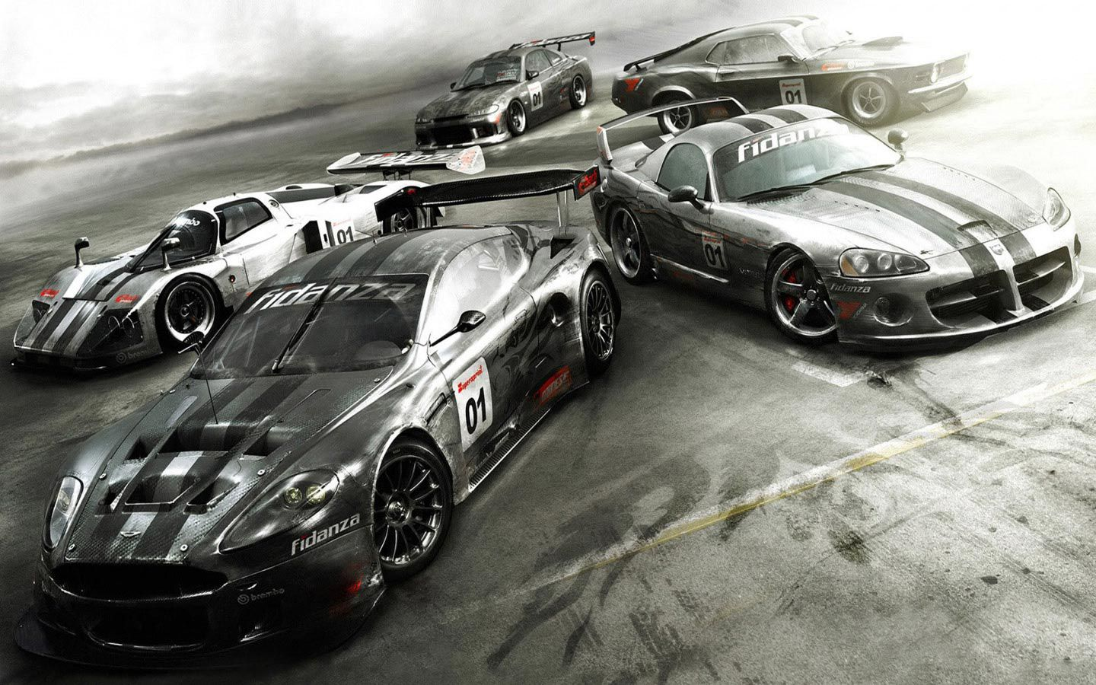
Race in Baku F1 Circuit “A RACE ISN’T WON UNTIL IT’S OVER”
Game Pitch Presentation (Homework No.4)
Project team: Game OPS
Instructor: Dr. Araz Yusubov

Slide 2

2
Team contribution
Team member | Contribution to this homework (NOT the project) | Estimated %
Musadiq Aliyev | Introduction, Questions Overview, Quest | 25%
Habil Gadirli | Main Character and Opponents | 25%
Elvin Ahmadov | Environment, Menus | 25%
Kanan Ali | Controls, Sounds, Summary | 25%
Free PowerPoint Templates

Slide 3

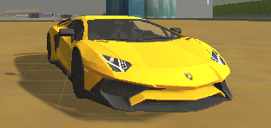
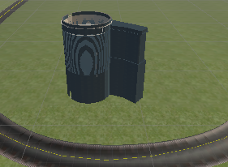
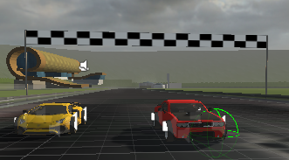
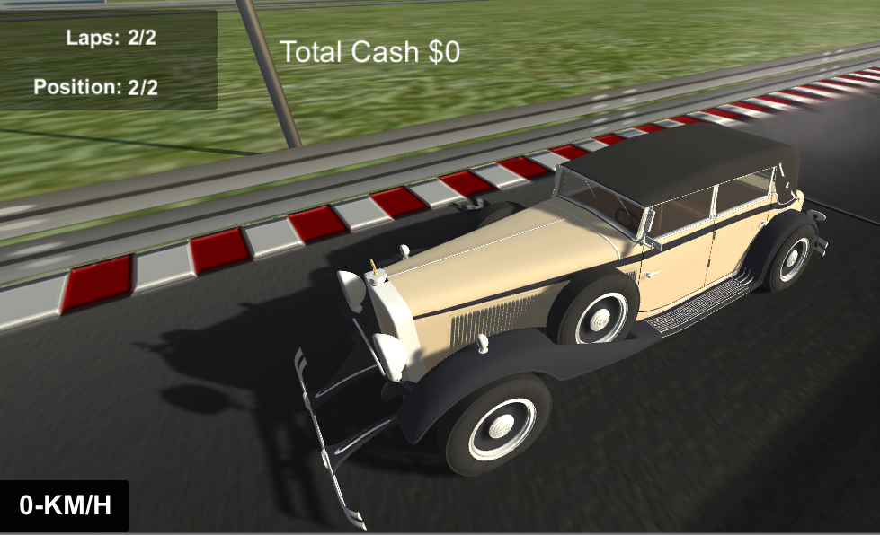
3
Introduction
Single player, competitive, non-violent, and extremely exciting that take place in Baku, Azerbaijan.
Our 3D models include central streets of Baku, modern buildings and old towers of the city.
The theme of our game is to compete with the other opponents that are controlled by computer in a racing tournament.
The player’s goal is to reach to the destination as soon as possible while trying to avoid bumping to other cars or road objects, which slows down speed of the car.
Free PowerPoint Templates

Slide 4




4
Questions
Which method did you use to generate your gameplay?
How well (or not) it worked? Which Unity functionality was used?
OnTriggerEnter was used in Unity
What you thought would be easy that turned out hard or thought would be hard that turned out easy?
Fixing Bugs after changing functionality is hardest part of this project
What you think was the coolest thing you discovered or produced during this project?
Presenting Our country’s national values to other
ex:Buildings, Cityview
Free PowerPoint Templates

Slide 5



5
Game Description: Overview
The territory will be based on three-dimensional model of real-world location of the circuit, which is in Baku, Azerbaijan. Furthermore, our 3D models include central streets of Baku, modern buildings and old towers of the city.
The theme of our game is to compete with the other opponents that are controlled by computer in a racing tournament, the player’s goal is to reach to the destination as soon as possible while trying to avoid bumping to other cars or road objects, which slows down speed of the car
Free PowerPoint Templates

Slide 6

6
Game Description: The Quest
Obstacles
> AI drivers
> Barriers
Final objectives
>1st place
Reward
> Cash
> Unlock Car
Free PowerPoint Templates

Slide 7
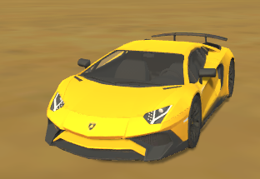
7
Game Description: Main Character
Type
Acceleration
Buy new Car
Color
Free PowerPoint Templates

Slide 8
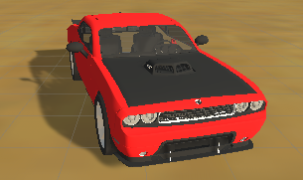
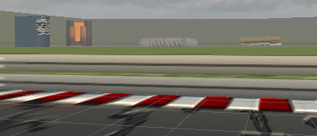
8
Game Description: Opponents
Static opponent: barrier
Dynamic opponent: AI driver
Free PowerPoint Templates

Slide 9

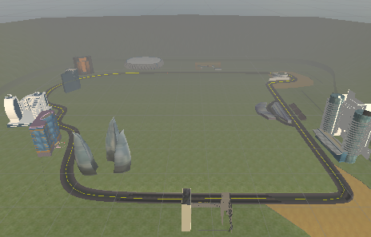

9
Game Description: Environment
Baku city
Formula 1 track
Old and modern buildings
Free PowerPoint Templates

Slide 10
10
Game Description: Menus
Play game
Settings
Quit
Credits
Cash
Start the game
Sound
Display
Exit the game
Game developer’s name
Total cash
Free PowerPoint Templates

Slide 11
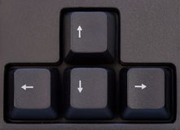
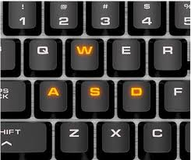


11
Game Description: Controls
Control with W,A,S,D of the keyboardz
Control with arrow key of the keyboard
Control with W,A,S,D of the keyboard
Pause the game with “esc” and “P”
Switch camera view with “C”
Free PowerPoint Templates

Slide 12
12
Game Description: Sounds:
Menu music
Car - sound
In race music
The_punisher
RaceFinish
Countdown FX
Applause FX
Run_the_drum
Engine sound
Acceleration sound
Crash sound
Brake sound
Free PowerPoint Templates

Slide 13



13
Summary
Free PowerPoint Templates

Slide 14
Behind the Scenes and Demo
Demo gameplay video
https://www.facebook.com/Ahmadov.Elvin/videos/2764056110486671/
https://youtu.be/xu7iVcxGSHE
Behind the Scenes
https://www.facebook.com/Ahmadov.Elvin/videos/2764063577152591/

