Slide 1


LIBERATION OF GARABAGH
Ya Qarabağ, ya ölüm!
Game Pitch Presentation (Homework No.4)
Project team: Gamers
Instructor: Dr. Araz Yusubov

Slide 2
Team contribution
Team member | Contribution to this homework (NOT the project) | Estimated %
Zohrab Musayev | Collision, Azerbaijani tank shooting, Antagonistic Pathfinding | 25 %
Arzu Mammadova | Design, features | 25 %
Nezir Yunuszade | Antagonistic shooting, blender, Shusha Fortress | 25 %
Samad Samaadzada | Sounds | 25 %

Slide 3

Introduction
Introduction
Azerbaijani tank shooting
Collision
void OnCollisionEnter(Collision c){}
Antagonistic pathfinding
Antagonistic pathfinding creator

Slide 4
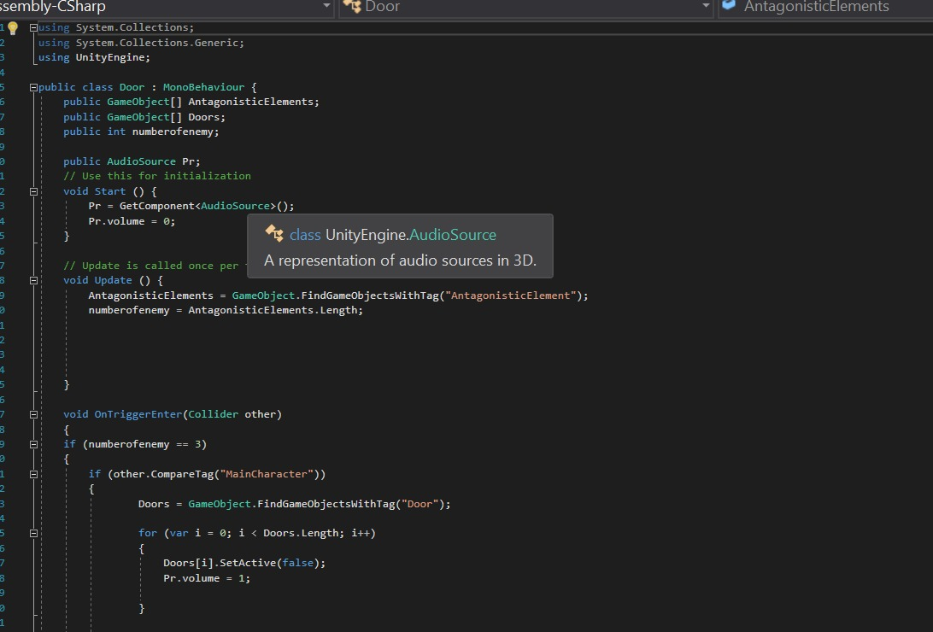
Antagonistic Pathfinding

Slide 5
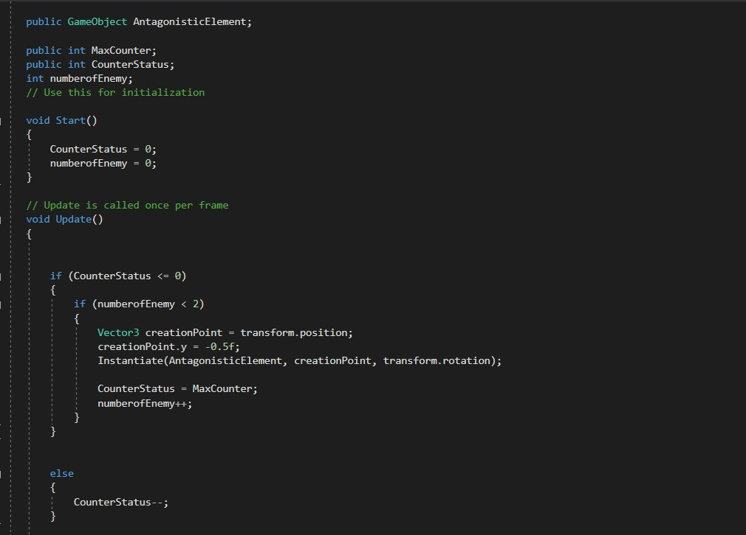
Antagonistic element creator

Slide 6
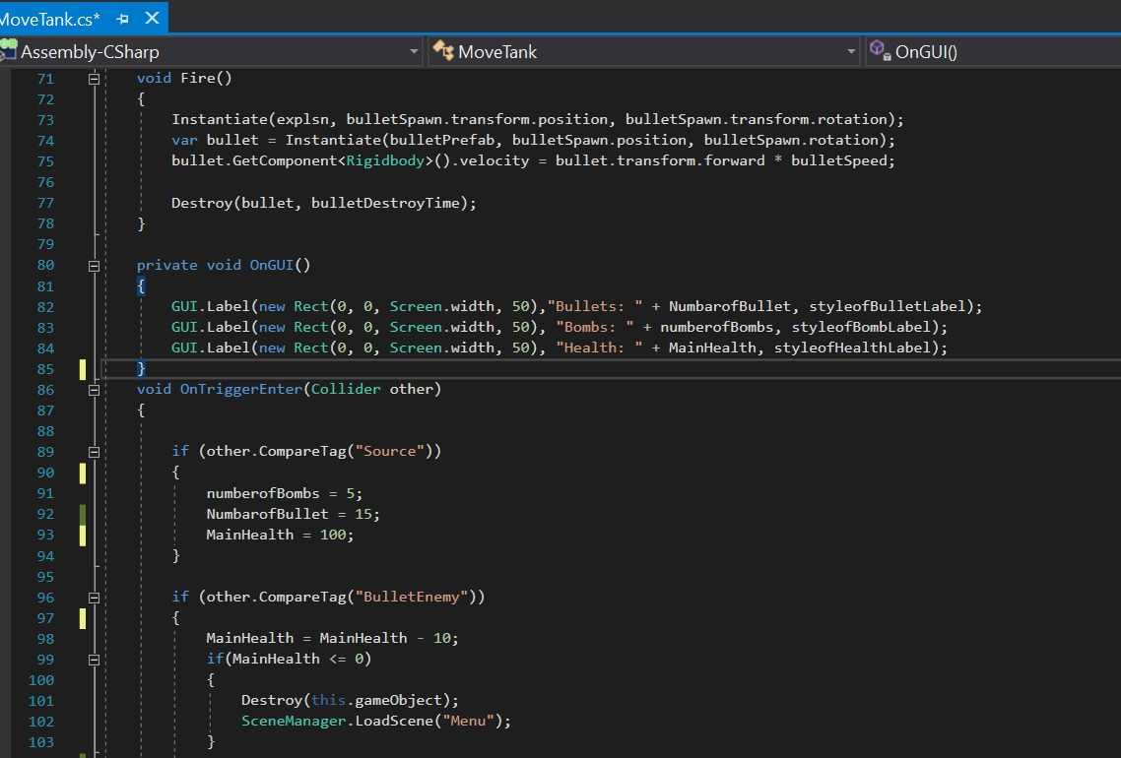
Functions of our tank

Slide 7
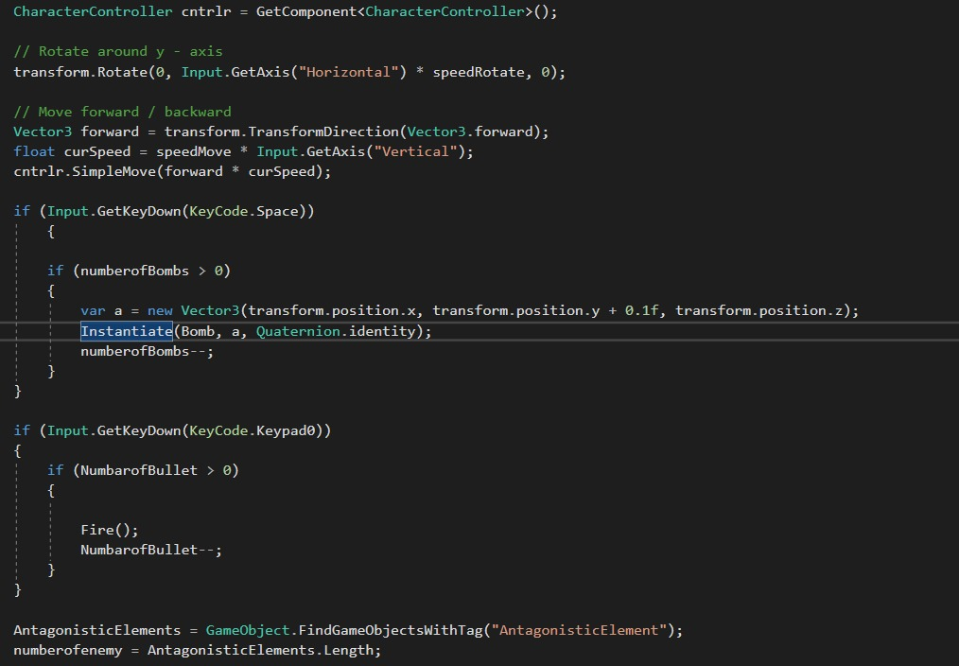

Slide 8
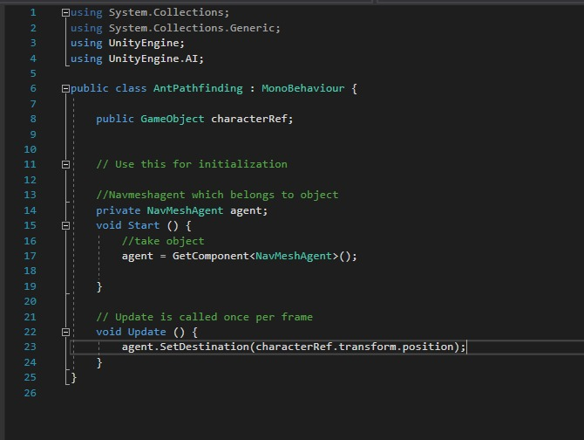

Slide 9
Design
URL to the game play : https://drive.google.com/open?id=1qT7tgonjvwjSr4T0MELLPW-uN-2zL5hc

Slide 10
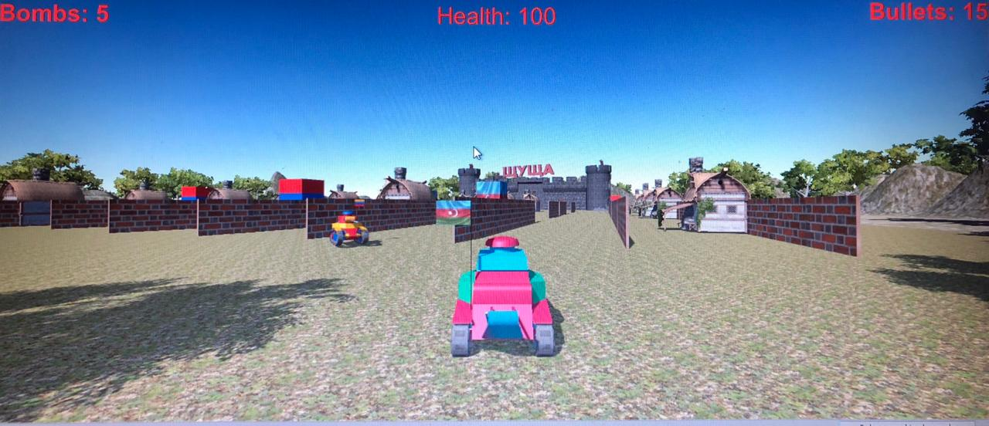
The playing screen
Hiding/Obstacle wallls
Trees, mountains

Slide 11
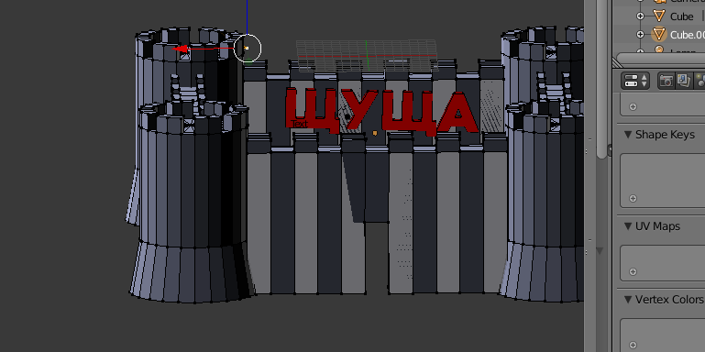
Modeling Example Using Blender

Slide 12
Tanks
Enemy
Armenian Tank
 | Armenian flag colors added
 | Flag rod
Enemy
Armenian Stand
 | Tanks coming out
Player
Azerbaijani Tank
 | Azerbaijani flag colors added
 | Flag rod
Shusha Fortress
Final Stage
 | Real Shusha Fortress with a Shusha title/label on it

Slide 13
Features to invest
Target audience:
every patriot citizen
The concept of game:
awake interests in patriotic feelings
Free game

Slide 14
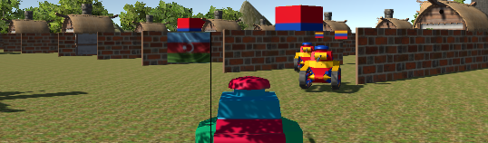
Antagonistic Elements

Slide 15
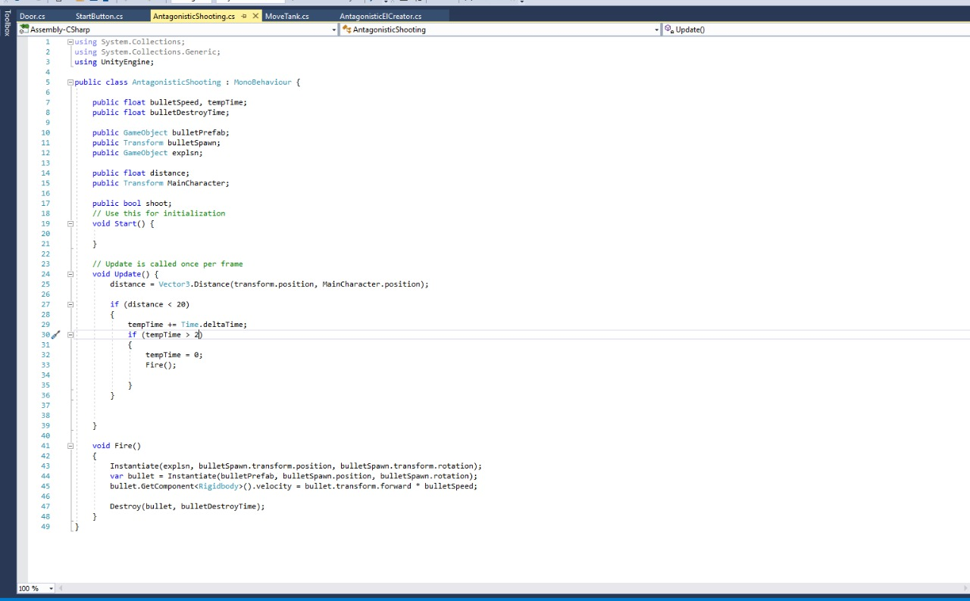
Antagonistic Elements Shooting

Slide 16
Game Controls
Moving – Up, Down, Right, Left(W,S,A,D)
Fire – Keypad 0
To put a bomb- Space Bar

Slide 17
Thank You

