Slide 1
Frozen Summer Finish them! If you can…
Game Pitch Presentation (Homework No.4)
Project team: Rush B
Instructor: Dr. Araz Yusubov

Slide 2
Team contribution
Team member | Contribution to this homework (NOT the project) | Estimated %
Nurana Mahmudzada | Introduction, Overview | 25
Sabuhi Yusifzada | The Quest, Main Character, Menu | 25
Kamran Ahmadzada | Menu, Controls, Sound | 25
Davud Ismayilov | Environment, Pain points, Proudest Moments | 25

Slide 3
Introduction
According to the [1] statistics shooter genre are most popular (32%) among the US and Asian gamers.
Players who have some shooter game experience will be familiar with gameplay and are expected to have less adaptation process than others.
No violation, therefore there is no age restriction and any graphical content.

Slide 4
Game Description: Overview
Frozen Summer is a single player game which is inspired from Azerbaijani fairy tales.
Main player has to destroy all snowmen in a given time.
Baybecan can use objects in the map for defense.

Slide 5
Game Description: The Quest
Main goal of the Frozen Summer is surviving from snowmen in a given time and collecting scores by hitting the buckets of the snowmen.
Different techniques can be used to successfully finish the game.
Main player can find perfect spot in the map in order to destroy snowmen more easily.

Slide 6
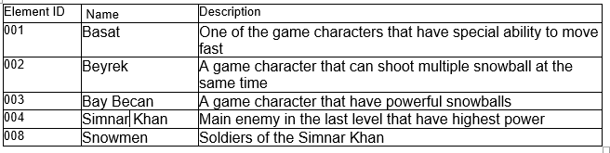
Game Description: Main Character
Main character is dressed with national outfit. He has ability to shoot snowball which is one headshot is enough to kill one snowmen. First Person shooter view.

Slide 7
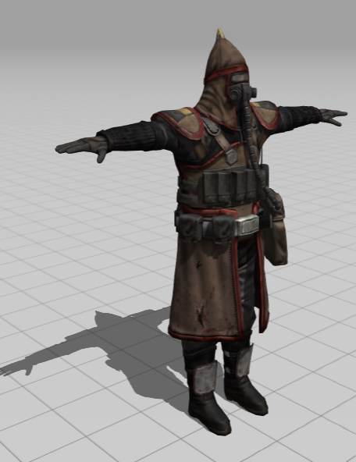
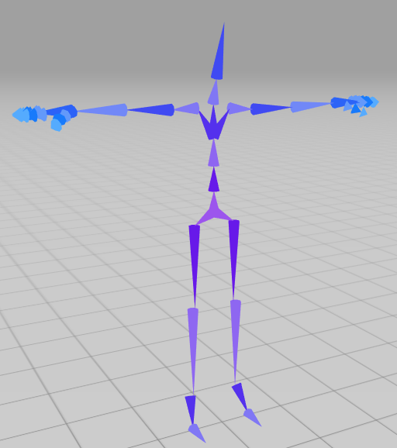
Game Description: Main Character

Slide 8
Game Description: Opponents
Main opponents are snowmen. In order to hide from your enemy you have a opportunity to use objects in the middle of the map.

Slide 9
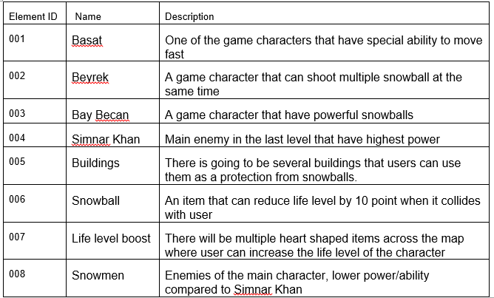
Game Matrix

Slide 10
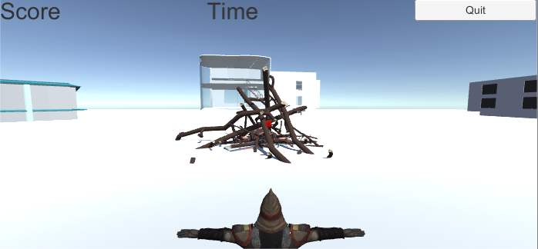
Game Description: Environment
Realistic place. Snow themed gameplay. Events happening in ADA University

Slide 11
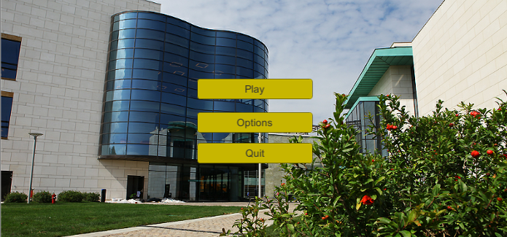
Game Description: Menus

Slide 12
Game Description: Menus
Menu
Play Game
Options
Sound Slider
Quit

Slide 13
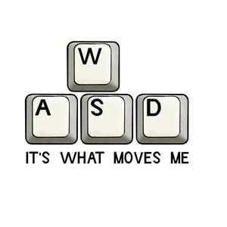

Game Description: Controls
W, A, S, D and Up, Down, Left, Right arrows are used to simplify the work of the gamer, other controls such as mouse controls are more or less same with all of the famous games in the market.

Slide 14
Game Description: Sounds:
Sound of Snowmen(Like a zombies)
Sound of running
Sound of hitting the snowmen’s bucket
Background Theme Sound

Slide 15
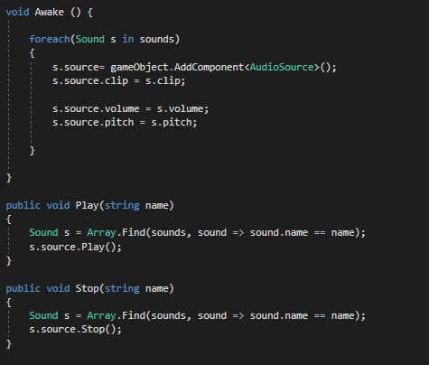
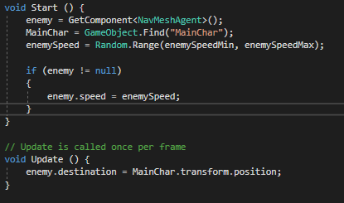
Some of the Used Methods

Slide 16
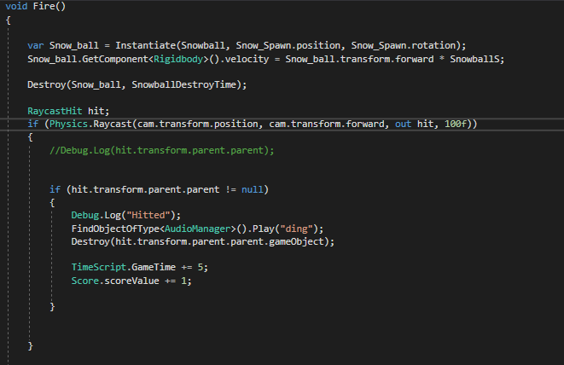
How We Solved It (Coolest Moment)
Issues We Had
Collision Detection

Slide 17
Summary
Frozen Summer is one of the unique Azerbaijani games which have realistic buildings with national dressed main player. Our game include some national elements from fairy tales which can increase knowledge and understanding of our country’s history among young generations of 21st century.

Slide 18
References
1) https://www.statista.com/statistics/189592/breakdown-of-us-video-game-sales-2009-by-genre/

Slide 19
Game Play and Behind the Scenes
Youtube video:
https://www.youtube.com/watch?v=fffaPuK4edI
https://www.youtube.com/watch?v=vlFoheVlj_w
Facebook post: https://www.facebook.com/sabuhi.yusifzade/posts/1880574105374647

Slide 20
Appendix
The presentation will be graded based on the following criteria:
Content 20%: from “Design content missing or completely useless.” to “All sections completed, design accurately reflects release contents. Design notes thoughtfully completed.”
Organization 20%: from “No organized presentation. The needed information is elicited with questions.” to “Information presented in a logical, interesting sequence which audience can follow.”
Delivery 20%: from “Presenters simply reads the slides, or is completely incomprehensible” to “Presenters used clear voice and correct, precise pronunciation of terms.”
Participation 20%: from “Several team members missing. Conflicts within team visible.” to “Well-planned allocation of presentation all team members.”
Design Knowledge 20%: from “Team does not have grasp of information; cannot answer questions about the design.” to “Team demonstrates full knowledge with explanations and elaboration.”

