Slide 1

Aghanatiq – The Game Xırdalana bir nəfər.
Game Pitch Presentation (Homework No.4)
Project team: Survivors
Instructor: Dr. Araz Yusubov

Slide 2
Team contribution
Team member | Contribution to this homework (NOT the project) | Estimated %
Nijat Mursali | Player, Opponent and Summary | 25%
Nuru Nurdil | Introduction and Questions | 25%
Nurana Rafizada | Overview and Quest | 25%
Durna Zeynalli | Menu, Controls and Sounds | 25%

Slide 3
Introduction
Taxi-cab Simulator with a strong reference to Azerbaijan
Other cultures and countries too
Drive to destination to pick up a passenger and then safely drive to and arrival destination
He has to obey to traffic rules || penalized

Slide 4


Questions
Which method did you use to generate your gameplay? Possibly some mathematical background.
OnCollisionEnter2D was used in Unity in order to check the collision
Time management and Unity functions made some problems to make the game
To manage to finish the first level for the game which is about Baku

Slide 5

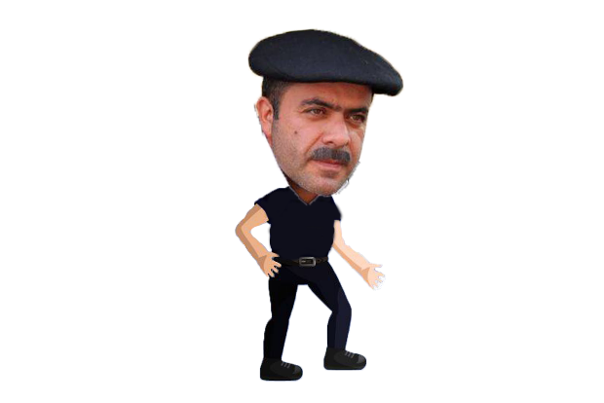
Game Description: Overview
Game will be completely in 2D perspective view
Azerbaijani buildings and icons related to our culture

Slide 6


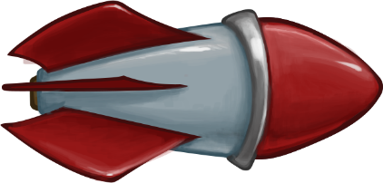
Game Description: The Quest
Obstacles – Wrecking ball, Police
Rewards – Coins (Manats), Final result

Slide 7
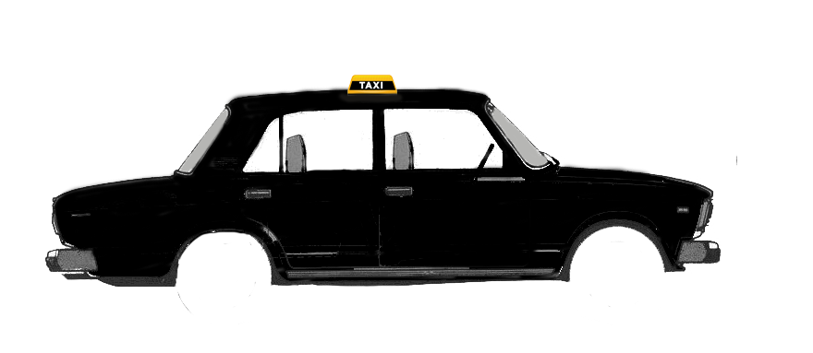
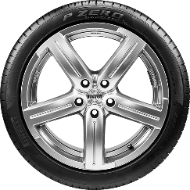
Game Description: Main Character
Aghanatiq – Main character
Normal guy who drives through the streets of Baku
Nitro – which makes player faster
After every level he can add things into the car or buy new cars

Slide 8

Game Description: Opponents
Wrecking Bowling Ball – try to hit player
Police Officer – stops player || penalize

Slide 9

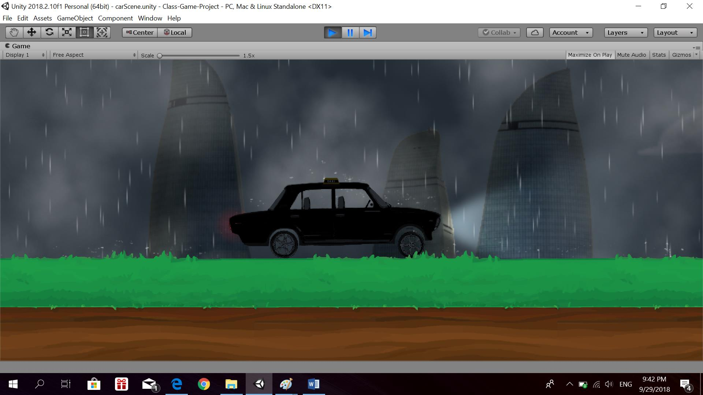
Game Description: Environment
Urban || City view throughout the game
Buildings, roads, objects (street lights)
Atmospheric weather which will be rain

Slide 10
Game Description: Menus
Splash Screen – Logo of Police Officer
Main Menu
Play Game
Settings
Quit Game
Play Game – First level for the Game

Slide 11



Game Description: Controls
Arrow Keys will be used for going left or right
Keyboard keys will be used for siren, lights and nitro

Slide 12
Game Description: Sounds:
City ambiance – to make it more realistic
Car sounds – engine start, siren
Police officer

Slide 13
Summary
Uploading the game into AppStore and Google Play
Our game describes the culture of AZ
Let’s invest in the game that is related to our culture!

Slide 14

Behind the Scenes and Demo
Behind the Scenes
https://youtu.be/DjS4_9E_05k
Demo gameplay video
https://youtu.be/XEyqirscIt0

