Slide 1
HOmework 4: System Specification/Design Phase
Sabina Veyisli
Rauf Rasulzada
Manaf Aghazada
Zaur Khudiev

Slide 2
Introduction
Online Multivendor Sales Platform
The system shall display product details, such as name, vendor, images, availability, price, and description
The system shall allow customers to browse products by category and subcategory.
The system shall allow customers to add items into cart and remove items from the cart.
The system shall ensure secure payment processing for customers to protect customer information and security.
The system shall allow vendors to register and request approval from administrator.
The system shall allow users to rate products, provide reviews, and leave comments.
The system shall ensure a refund option for products; the system shall have policy for refunding and include returning as well.

Slide 3
Architectural Design
Three-tiered client-server
STRENGTHS
Scalability
Security
Flexibility
Modularity
DEFICIENCIES
Increased complexity
Network latency
Potential security attacks

Slide 4
Components & Functions
Component state and their component behavior
User Interface Component
Registration Management Component
Vendor Store Component
Product Search and View Component
Shopping Cart Component
Payment Processing Component
Checkout Component
Feedback Component

Slide 5
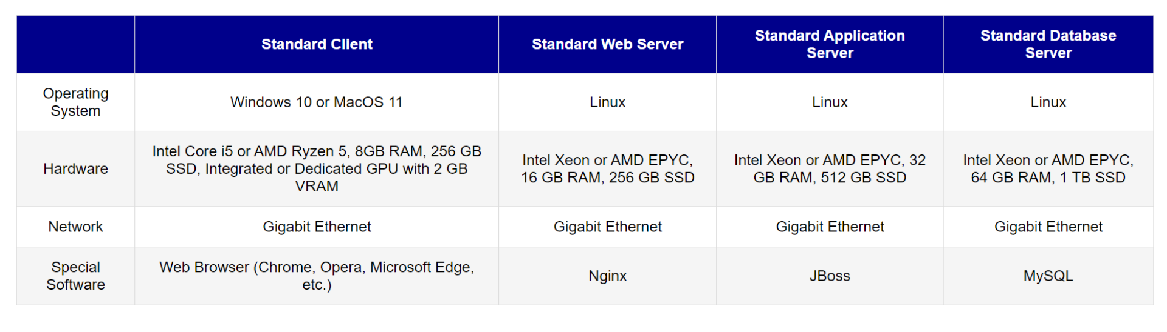
Hardware and Software Specification

Slide 6
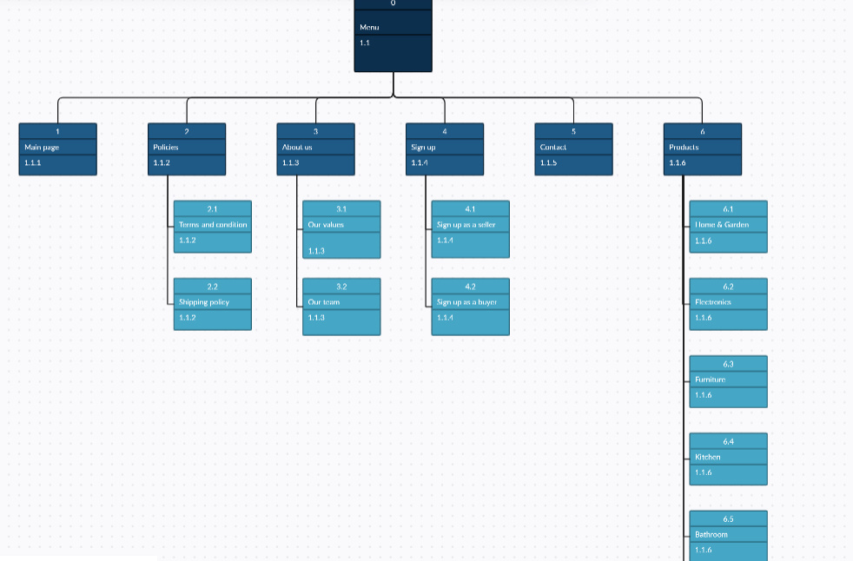
Interface Structure diagram
MENUS
REPORTS
FORMS

Slide 7
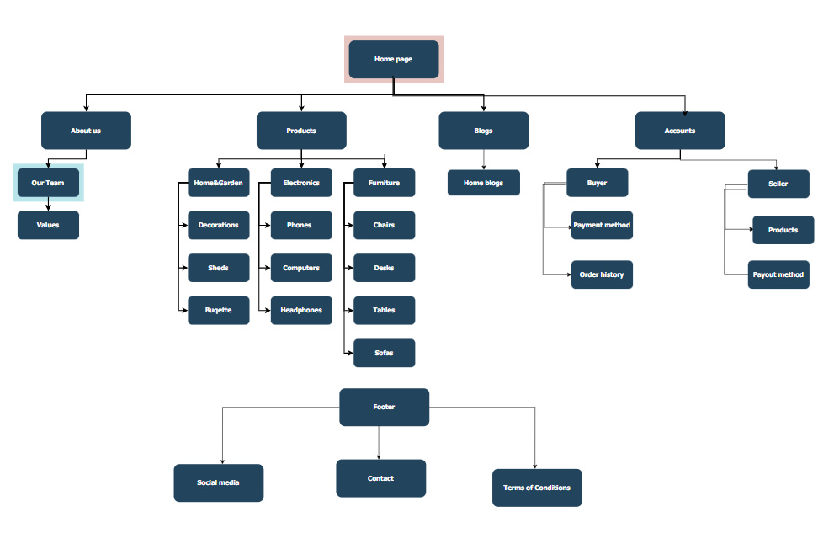
sitemap

