Slide 1
PRI – Scientific Project Meeting
MRAM-Based Microcontroller Design For Energy-Efficient Intermittent Computing
Felipe PAIVA ALENCAR
Supervised by David NOVO, Pascal BENOIT and Theo SORIANO

Slide 2















Introduction – Context
Internet of Things (IoT)
Services
IoT
We expect +20% by 2030
Notes:
Context
Focus edge computing
Part of Internet of Things
IoT = extension of the internet …
[click]
IoT strongly criticized
Energy for IoT in the world
More than 2 times the overall energy consumption of France
[click]
We expect a 20% increase by 2030

Slide 3













Introduction – IoT Benefits
Detect anomalies to prevent risks
Better understand the world around us
More efficient production
Resource management
Notes:
However IoT also have some benefits …

Slide 4
Introduction – Non-volatile Memory Technologies
Normally-off computing paradigm
Power
Active
Inactive
Event
Time
Emerging non volatile memory technologies
S
RRAM
MRAM
FRAM
Sensor nodes
What is the relevance of the integration of emerging non-volatile memories in the edge computing context?
Notes:
To increase energy efficiency we need application specific solution
So we need to study how these nodes works
[click]
SN often embed event-based application -> Inactive by default
Following periodic or aperiodic trigger events
-> node perform some tasks during short active phases
Define activity rate = ratio between time spent in active phases over the total time
When activity rate is very low -> system is most of the time inactive
Thus these devices operates in the normally-off computing paradigm
[click]
SotA -> Numerous work ENVM such as RRAM - MRAM – FRAM in sensor node
And this to reduce energy consumption
[click]
They exploit NV properties -> to minimise power consumption during long standby phases
PB -> They target basic sensor nodes with basic computing and storage in the cloud computing context
[click]
We can wonder: What is the relevance of ENVM in edge computing with more storage and processing?
[click]
For that we have to do memory design space exploration

Slide 5
Current Literature – Overview
Non-Volatile Logic (NVL) and System on Chip (SoC) Integration
S. Khanna, S. C. Bartling, M. Clinton, S. Summerfelt, J. A. Rodriguez and H. P. McAdams, "An FRAM-Based Nonvolatile Logic MCU SoC Exhibiting 100% Digital State Retention at VDD= 0 V Achieving Zero Leakage With < 400-ns Wakeup Time for ULP Applications," in IEEE Journal of Solid-State Circuits, vol. 49, no. 1, pp. 95-106, Jan. 2014, doi: 10.1109/JSSC.2013.2284367
Spin-Orbit Torque Magnetic Random-Access Memory (SOT-MRAM)
G. Prenat et al., "Ultra-Fast and High-Reliability SOT-MRAM: From Cache Replacement to Normally-Off Computing," in IEEE Transactions on Multi-Scale Computing Systems, vol. 2, no. 1, pp. 49-60, 1 Jan.-March 2016, doi: 10.1109/TMSCS.2015.2509963
Ferroelectric Random-Access Memory (FeRAM) for Energy-Harvesting Applications
M. Qazi, A. Amerasekera and A. P. Chandrakasan, "A 3.4pJ FeRAM-enabled D flip-flop in 0.13µm CMOS for nonvolatile processing in digital systems," 2013 IEEE International Solid-State Circuits Conference Digest of Technical Papers, San Francisco, CA, USA, 2013, pp. 192-193, doi: 10.1109/ISSCC.2013.6487695

Slide 6
Current Literature – Research Gaps
Exploration Combining NVL and NVM
Limited research on the synergistic integration of Non-Volatile Logic (NVL) and Non-Volatile Memories (NVM) in MCUs.
Lack of a Tailored Low-Power Architecture
Absence of a reference low-power architecture specifically designed for intermittent computing.
Intermittent Computing Benchmarking
Scarcity of benchmarking studies using real-world applications for intermittent computing.

Slide 7
Conclusion – Scientific Question
How can MRAM technologies be efficiently integrated and managed in MCUs for intermittent computing applications, considering the specific demands of machine learning workloads and the event-based nature of applications?
Notes:
Our hypothesis posits that the efficient integration and management of MRAM technologies can optimize energy consumption in MCUs during intermittent computing applications. To test this, we introduced a design space exploration methodology, which includes proposing a RISC-V microcontroller RTL generator, building activity-based energy models, evaluating the energy consumption of the system running a representative keyword spotting application, and studying the impact of the duty cycle between active and inactive phases on determining the optimal integration strategy. Let’s explore the methodology and findings in detail.

Slide 8
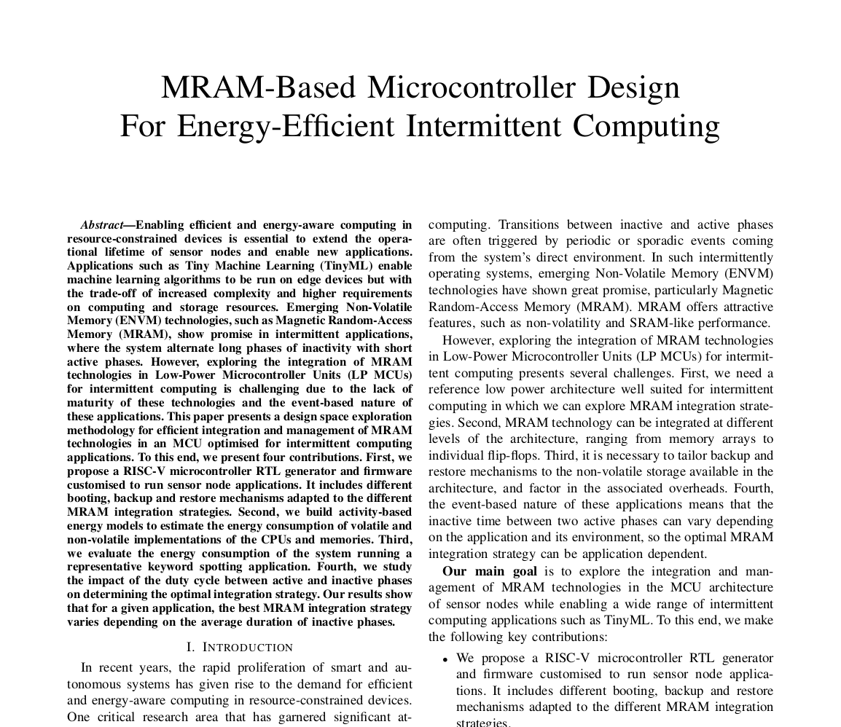
Conclusion
Notes:
Our hypothesis posits that the efficient integration and management of MRAM technologies can optimize energy consumption in MCUs during intermittent computing applications. To test this, we introduced a design space exploration methodology, which includes proposing a RISC-V microcontroller RTL generator, building activity-based energy models, evaluating the energy consumption of the system running a representative keyword spotting application, and studying the impact of the duty cycle between active and inactive phases on determining the optimal integration strategy. Let’s explore the methodology and findings in detail.

