Slide 1
I-ON Communications
In Prague

Slide 2
Agenda
iCS6 Distributed web content management system
Gaia I-ON Content Repository
Aradon Everything-As-A-Service
iCafe Service Delivery Platform

Slide 3
iCS6 I-ON Content Server 6

Slide 4
Concept Map
I-ON Content Server Concept Map
Acquisition
Management
Categorization
Composition
Delivery
Authoring Tool
Taxonomy
Web
Internet, Intranet, Extranet
Word Processor
Content Management
Editing, Revision Tracking, Workflow, Versioning
Medias
Creating The User Experience
WWW, SMS, WAP, PDA
Embedded Editor
Print
PDF, Word, Excel
Search
Thin Client
E-Mail
Alerts, Newsletter
A single online platform that consolidates the overall content management from creation to publication


Unified Repository
Multi-Format Rendering Engine


Content Management System
On-Line Based Workflow System

Slide 5
Reasons for iCS6
Accelerated Time-to-Market of Website and Efficient Use of Human Resource
Management of Variations in Content/ Site
Development of Systematic and Efficient Management System
Development of the Base for Continuous Reuse of Accumulated Content
Improved Service Reliability and Enhanced Service Experience

Slide 6
Main Features
Complete separation of Content/design/programming
Once content, use in various locations
Convenient User Interface
Collaboration According to Approval rule
Provide built-in visual HTML editor
Cross-link Analysis
PURE HTML Publishing
Deploy-only module for Strengthen Content Transfer
Web Service Supported

Slide 7
Distributed Architecture
ICS6 Server
Rest
icssearcher
Web Server
ICS Web Admin
Searcher
Indexer
TCP/IP
socket
Deploy Client
Rest
Index File System
File i/o
File System [ HTML, JS ]
publisher
Virtual File System
Publisher
Deploy Engine
Rest
jdbc
jdbc
thoth
ajax, js
DB Server
jdbc
Database
(Oracle)
dynamic
Content Hub
jdbc
Dynamic
Rest
jdbc

Slide 8

이노베이션 사업본부
Structure of iCS6
Presentation
Layer
Content Management
Layer
HTML/XML/VXML/ WAP/i-Mode
On-Line Service Building
Repository Layer
Versioning
History
Workflow Design
Site Map Generatoin
Content Input Layer
RDBMS, File System
XML
Agent
DB2DB
Input By Contents Creator
Site Publishing
Content Structure and Management
Content Archive
Content Generate/Update/Eliminate

Slide 9
Gaia I-ON Content Repository

Slide 10
Agenda
Main Features
Architecture
Server configuration
Demo

Slide 11
Main Features
Standard Content Repository Functions
Java Content Repository 1.0 and 2.0
Accessibility
Restful API
WebDAV
FTP
Scalability
Repository Clustering
Distributed Data Store
Authentication
LDAP
Oauth
Data Indexing on Lucene
File Conversion over 400 kinds
Unstructured data scheme
No need to define data structure
Just throw your data to repository and retrieve your data

Slide 12
Architecture
Applications
Legacy Systems/Application Developers
Repository
Explorer
Document Management
Workflow
Multimedia Content Management
Web Content Management
e-Form& Cataloging
Apps
Apps
Repository Server Clustering
RESTful Repository Service/Extension Service
OAuth
Search Indexer
Data Encryption Module
Document
Converter/Extractor
Media Transcoder
Business Logic
Integrator
WebDAV/FTP Server
Distributed Computing
Hadoop
(Binary Store)
Hbase
(Metadata Store)
Zookeeper
(Distributed Coordinator)

Slide 13
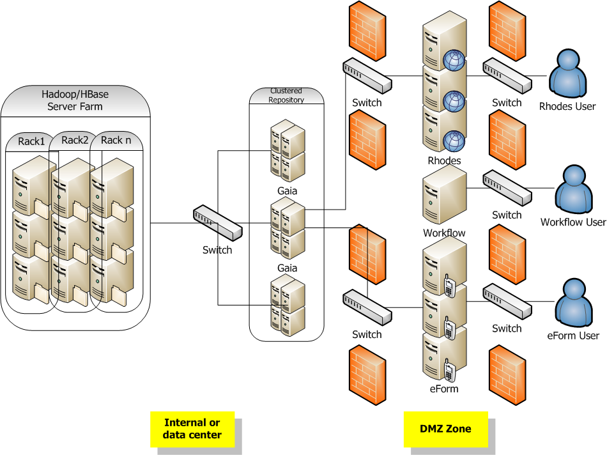
Server configuration

Slide 14
Demo
Repository Explorer
Node and property
Node type
Query
Rest API Test Environment
EDMS
Action triggering on node
Web-based Workflow
Process designing

Slide 15
Aradon
Notes:
Abstract/ RESTful/ Aspectual Centralization/ Distributed/ Open source/ Neutral eco system platform

Slide 16
Why?
Google Chrome browser for service client platform
New device (smart phone & pad) in the improved network infrastructure
Supports HTML5
Not a solution but a SaaS
Platform as a Service
Google App Engine, Amazon, Salesforce.com
Expand EaaS (Everything as a Service)
Ecosystem Service(as Platform)

Slide 17
Quick Overview
Fun & Productive
Cut out the time you spend waiting for your Java application to restart, increase your productivity and complete your projects faster.
Service DIP(Dependency Inversion Principle)
Service Layering
Distributed Stateless Model
Aradon is a real "share nothing" system. Ready for REST, it is easily scaled by running multiple instances of the same application on several servers.
Support Embedding or Standalone Server(Distributed)
Offer 3 Core Services and Management Service
Monitor, Log, Service Injection etc
Object Repository, Search, async Server Push
Support Script Language (groovy, JavaScript, PHP, python, Ruby etc)
Edit your script file, save, refresh your browser and see the results immediately ! No need to compile, deploy or restart the server
Fix the bug and reload

Slide 18
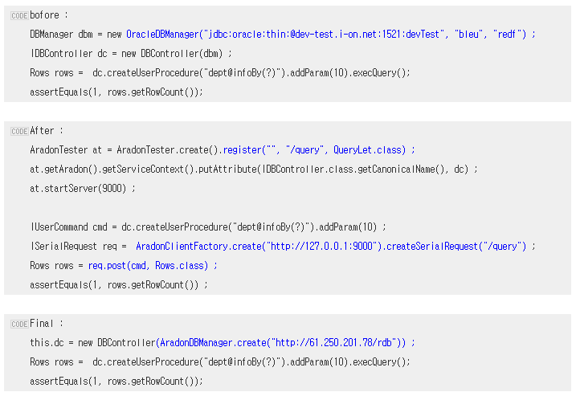
Example

Slide 19
Before & After
Before
Service Code → [call(JDBC or JDBC Framework)] → Oracle
After
Load DBService on Aradon(UpdateLet, QueryLet, HandlerLet etc)
Service Code → [call REST : Object Serialization] → Aradon → [call(JDBC or JDBC Framework)] → Oracle

Slide 20
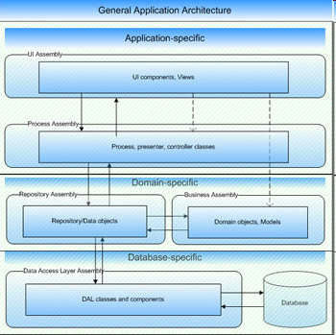
Traditional architecture

Slide 21
Architecture – Platform in Let
Let
Filters
Request
Service
Use
Context Attributes
Response

Slide 22
Architecture - Scope
Application Let
Section Let
Path Let
Let
Request
Filters
Service
Use
Context Attributes
Response

Slide 23
iCAFE

Slide 24
History and Key issues
2006.01 iCafe 1.0
2004.11 Odin/Thoth
Today Up Versioning
2009.05 iCafe 2.0
Delivery & Service
Mgmt & Value Up
Content API for external system
Content based service thru web page generation
N-Screen supports for various devices
Creation & Collection
Metadata set for content
Object-oriented content structure modeling
Value up content for profit
Value up to the master data of company not a just data
User created content
Internal content for constructed and non-constructed content
External content
Web UI based content registration
API for integrated collection

Slide 25
Reasons to use iCAFE
Effective content application development framework environments.
Reduce time and operation cost versus 100% SI development.
Embedded custom content application development environments
Guarantee service level for using framework-based content application
Seamless upgrade of framework version adding plug-in based function

Slide 26
Main Features
- Relational Content Modeling
- Object Oriented Content Modeling
- MixIn Content Modeling
- Application Web UI Auto Generating
- Ontology based Contents Relation
- Contents Sync (Multi-Servers)
- Providing Interface APIs
- Direct Web Page Service

Slide 27
Contents Application Architecture
Application Manager
Service Manager
Business Manager
Workflow Manager
Customizing Business
Revenue Settlement
Authentication
HTML Rendering
Memory Caching
Search
Ontology based Contents Relation
Application Web UI Auto Generator
Authorization
Access Control
Tag Cloud
Contents Sync (Multi Servers)
Contents manager
Category manager
Scheduling
Contents History
Repository Manager
Interface Manager
Metadata Repository Manager
Files (Documents & Image..) Repository Manager
JDBC Interface
HTTP(REST) APIs
Customizing Interface
Oracle DBMS
Storage Area

Slide 28
이노베이션 사업본부
iCafe2.0 Framework Architecture
Client
HTML
JavaScript
Ajax
Client Cache
XML
Presentation Layer
Layout
Page
Group
Form
Link
Business Layer
Relation Service
Reference Service
Authority Service
Authentication Service
Filter Service
Render Service
History Service
Resource Service
Repository Layer
Mixin Type
Node Type
Property Type
Value Type
Cache Manager
CRUD
System Application
DBMS (Oracle 10g)
WAS (Tomcat 6.x)
OS (Linux or Unix)

Slide 29
Thank you

