Slide 1
Service Platform Aradon

Slide 2
Preface
What is Platform
Why need New Platform
Why use HTTP Protocol
What is so important
Demo(Distribute Chat)
Notes:
은하제국 같은 앱을 하나 만들려고 한다.
음. 서버가 필요하다. 서버를 어떻게 만들지 ?
http://timothyfitz.wordpress.com/2009/02/12/why-http/

Slide 3
What is Platform ?
DRY
Callback – Class Level
Framework – Component Level
Platform – Service Level
What is Common
required high scalability
quick & easy deply & Test
multi-Tenancy
Notes:
은하제국 같은 앱을 하나 만들려고 한다.
음. 서버가 필요하다. 서버를 어떻게 만들지 ?
http://timothyfitz.wordpress.com/2009/02/12/why-http/

Slide 4

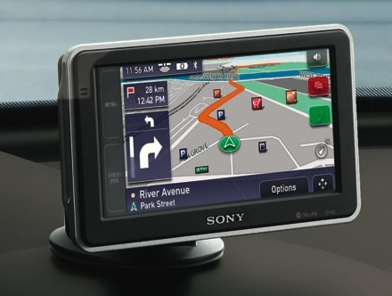
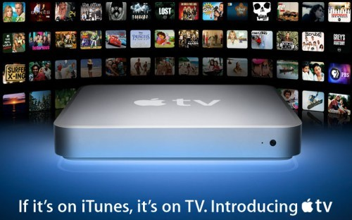
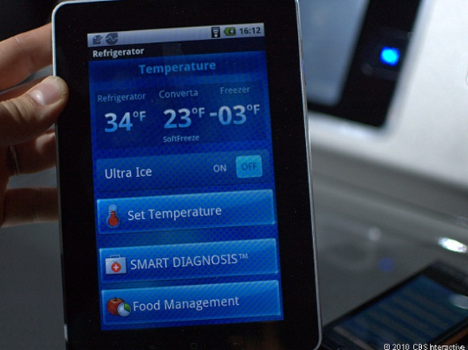
Why need New Platform
More Networked Devices
Notes:
은하제국 같은 앱을 하나 만들려고 한다.
음. 서버가 필요하다. 서버를 어떻게 만들지 ?

Slide 5
Why need New Platform
Why not based Servlet
Servlet Arch Limit : Connected Web, Streaming, Split Service, Data Serialization
Required High Scalability
Not Fun and Not Productive
Notes:
동적인 웹 페이지를 만들기 위해 나온 Servlet, JSP의 한계 - Servlet Arch Model : State Model, Disconnected Web - 서블릿이 하기 어려운 문제들 : Connected Web, Streaming Distribute & Split Service(Not Cluster) 데이터 직렬화(AVRO, Apache Thrift)
Mobile Device의 확장에 따른 시장 환경 - Required high scalability
배포와 테스트 곤란 - Servlet Model은 Test 친화적이지 않다. - View와 너무 밀접하게 연관되어 있다. - Not Fun and Not Productive - WANT to reload service

Slide 6
Why use HTTP Protocol
Servers and Clients in any language
Everyone already knows HTTP
Prior knowledge and tools
Notes:
http://timothyfitz.wordpress.com/2009/02/12/why-http/

Slide 7
What is important About Platform
Testability
Scalability
Multi tenancy
Software To Service
Notes:
Multitenancy refers to a principle in software architecture where a single instance of the software runs on a server, serving multiple client organizations (tenants). Multitenancy is contrasted with a multi-instance architecture where separate software instances (or hardware systems) are set up for different client organizations. With a multitenant architecture, a software application is designed to virtually partition its data and configuration, and each client organization works with a customized virtual application instance.

Slide 8
What Aradon ?
Aradon
Filter
Context
HTTP Extend
WrapperClient
Connection Engine
AradonClient
HttpHandler
[Async] HttpClient
Request
WebDavHandler
WebSocketHandler
Response
EventSourceHandler
Simple, Jetty, Netty, Restlet

Slide 9
Distributed Aradon
With Craken
AradonClient
AradonClient
AradonClient
AradonClient
Request Response
Horizontal Scalability
AradonNode
AradonNode
AradonNode
State Sharing (ClusterMode With Craken – DataGrid)

