Slide 1
A New Approach to Symmetric Registration of Longitudinal Structural MRI of the Human Brain
Babak Ardekani, PhD
C-BIN Advanced Image Methods and Processing Meeting
May 14, 2018

Slide 2
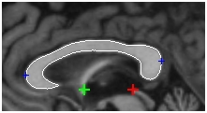
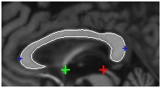
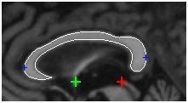
Corpus Callosum Shape Changes in AD
Bachman AH, Lee SH, Sidtis JJ, Ardekani BA. J. Alz. Disease, 2014
OAS2_0079 F

Slide 3
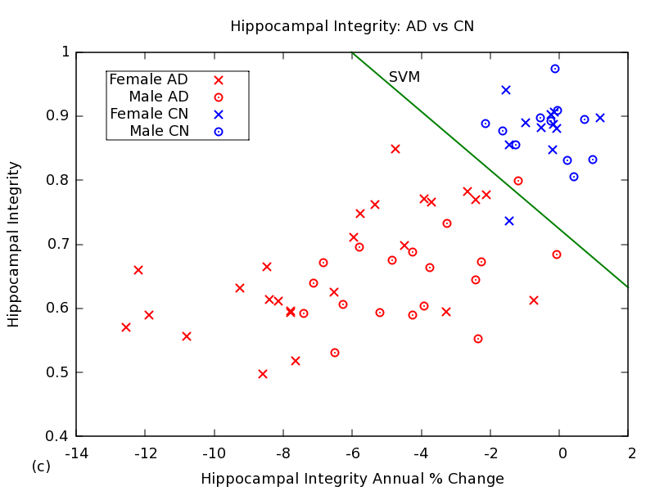
HPI: AD Patients vs. Cognitively Normal
p=0.008
Ardekani, Convit, Bachman, JAD, 2016

Slide 4
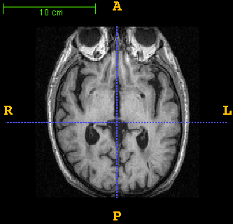
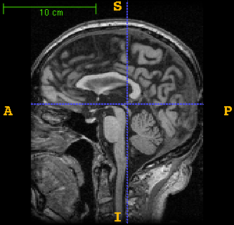
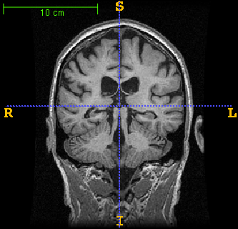
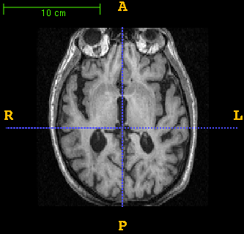
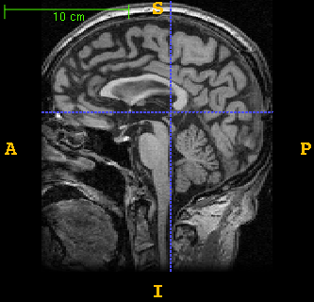
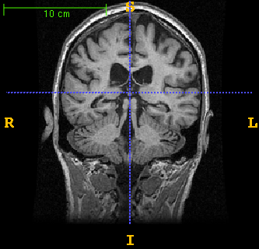
Longitudinal Image Registration
Baseline
Follow-up

Slide 5
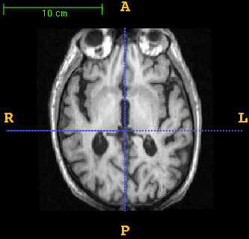
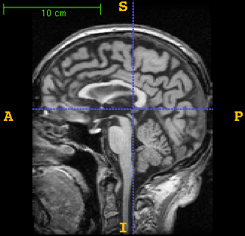
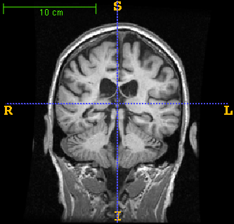

Longitudinal Image Registration
Baseline
$$T_{BF}$$
Follow-up

Slide 6
Longitudinal Image Registration
Baseline
Follow-up

Slide 7
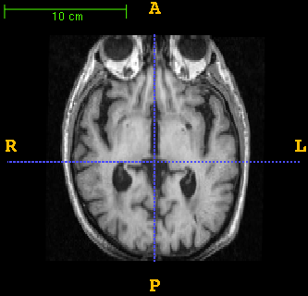
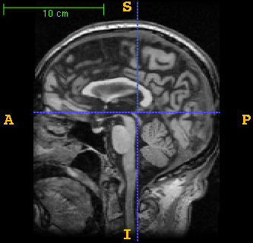
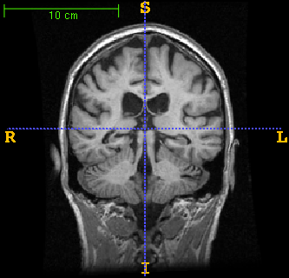

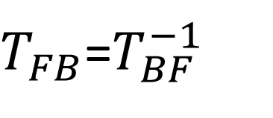
Longitudinal Image Registration
Baseline
$$T_{FB}$$
Follow-up
Inverse consistent:
$T_{FB}$=$T_{BF}^{−1}$

Slide 8
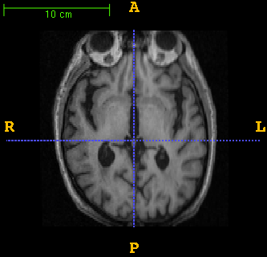
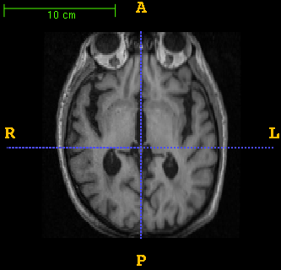
Unbiased Inverse-Consistent Registration
T
Baseline
Follow-up
T ⁻¹
T ^{1/2}
T ^{-1/2}
Baseline
Follow-up

Slide 9
Unbiased Inverse-Consistent Registration
Baseline
Follow-up

Slide 10
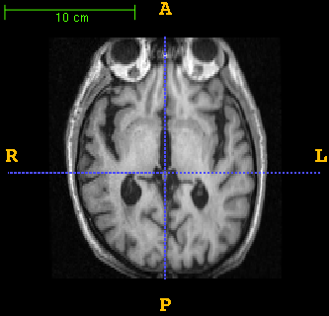
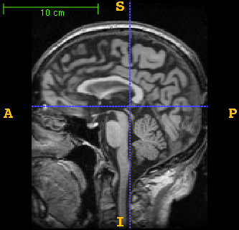
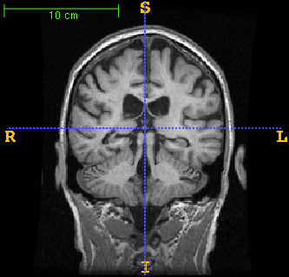

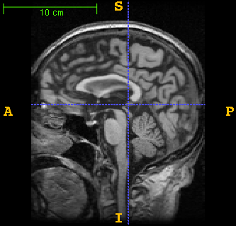
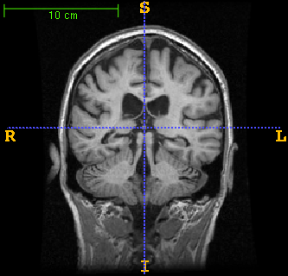
Unbiased Inverse-Consistent Registration
Baseline
T ^{1/2}
T ^{-1/2}
Follow-up

Slide 11
ATRA: Longitudinal Registration Method
Volume 1
PIL Transform
Volume 2
PIL Transform
Find LOOC Landmarks
Generalized Procrusties Analysis
T₁, T₂, T₃, T₄
Volume 3
PIL Transform
PIL brain cloud
Volume 4
PIL Transform

Slide 12
PIL Transformation

Slide 13
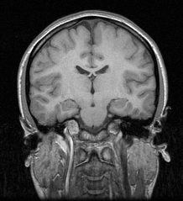
Mid-Sagittal Plane Detection
(a₃, b₃, c₃)
ax + by + cz = 1
(a₂, b₂, c₂)
(a₁, b₁, c₁)
(a, b, c) = ?
Maximize S(a, b, c)
S(a₁, b₁, c₁) = 0.5
S(a₂, b₂, c₂) = 0.6
S(a₃, b₃, c₃) = 0.95
Ardekani et al., IEEE Trans Med Imaging 1997

Slide 14
PIL Transformation

Slide 15
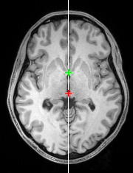
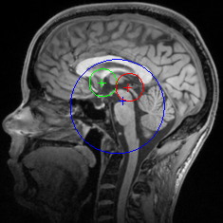
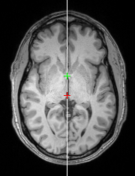
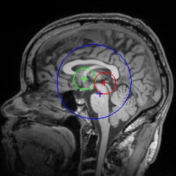
AC-PC Detection
Ardekani and Bachman, Neuroimage 2009

Slide 16
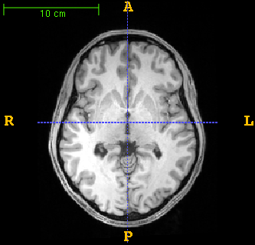
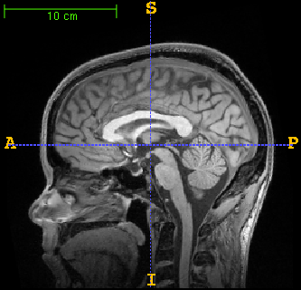
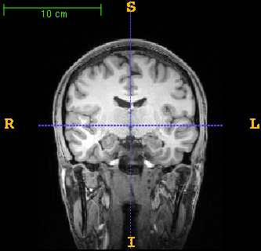
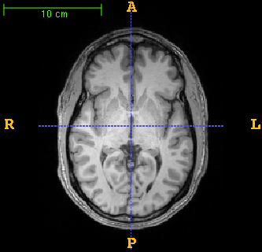
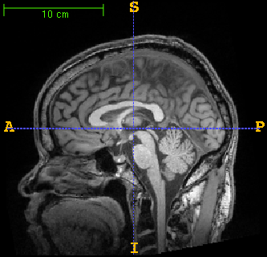
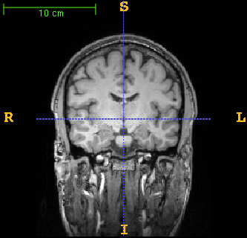
MSP/AC-PC Alignment

Slide 17
PIL Transformation

Slide 18
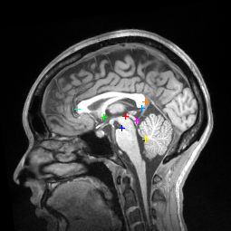
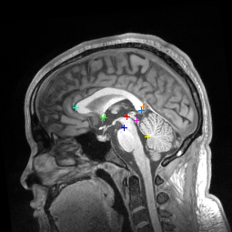
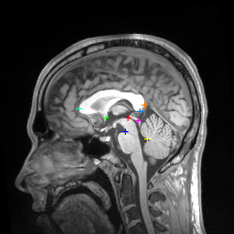
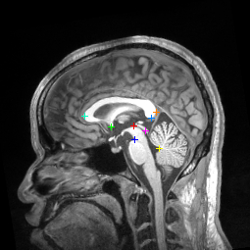
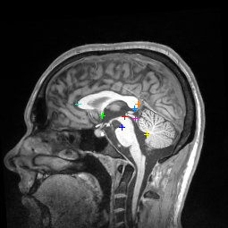
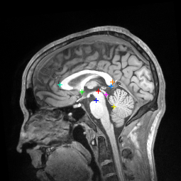
“Orion” MSP Landmarks

Slide 19
ATRA: Longitudinal Registration Method
Volume 1
PIL Transform
Volume 2
PIL Transform
Find LOOC Landmarks
Generalized Procrusties Analysis
T₁, T₂, T₃, T₄
Volume 3
PIL Transform
PIL brain cloud
Volume 4
PIL Transform

Slide 20
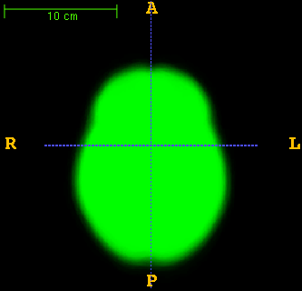
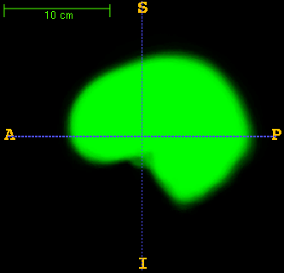
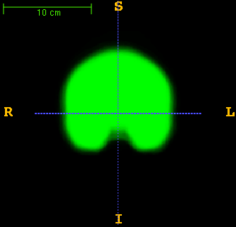
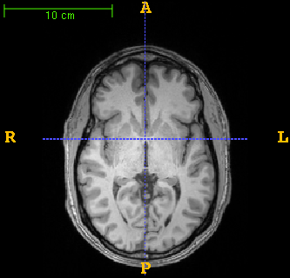
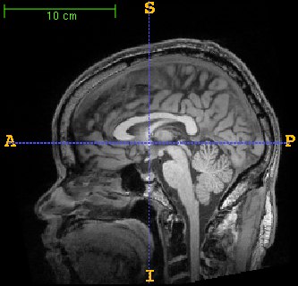
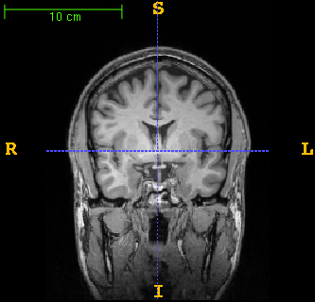
Brain Cloud

Slide 21
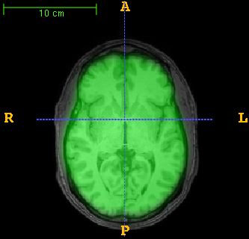
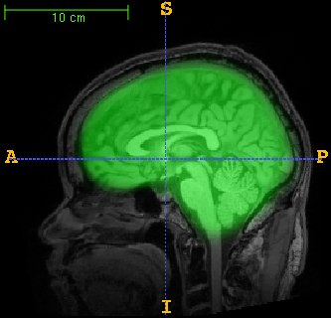
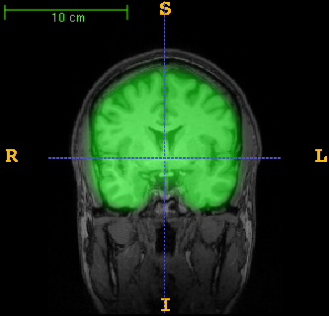
Brain Cloud

Slide 22
ATRA: Longitudinal Registration Method
Volume 1
PIL Transform
Volume 2
PIL Transform
Find LOOC Landmarks
Generalized Procrusties Analysis
T₁, T₂, T₃, T₄
Volume 3
PIL Transform
PIL brain cloud
Volume 4
PIL Transform

Slide 23





Supervised Landmark Detection
$$p_{1}$$
$$p_{2}$$
$$p_{3}$$
$$p_{4}$$
Training set:
D
Test image:
$${\hat{p}}_{t}= ?$$

Slide 24





















Leave-one-out Consistent (LOOC) Landmarks
$$p_{1}$$
$$p_{3}$$
$${\hat{p}}_{4}$$
$$p_{2}$$
$$p_{4}$$
?


$${\hat{p}}_{4}=p_{4}$$
?
$$p_{1}$$
$$p_{2}$$
$${\hat{p}}_{3}$$
$$p_{4}$$

?

?
$${\hat{p}}_{3}=p_{3}$$
$$p_{1}$$
$${\hat{p}}_{2}$$
$$p_{3}$$
$$p_{4}$$
?

$${\hat{p}}_{2}=p_{2}$$
?
$${\hat{p}}_{1}$$
$$p_{2}$$
$$p_{3}$$
$$p_{4}$$

?
?
$${\hat{p}}_{1}=p_{1}$$
The set of landmarks are LOOC with respect to algorithm D.

Slide 25









LOOC Landmark Identification
$$p_{1}$$
$$p_{2}$$
$$p_{3}$$
$$p_{4}$$
$p_{1}$= $p_{2}$= $p_{3}$= $p_{4}$


?


?

?
?

$${\hat{p}}_{1}$$
$${\hat{p}}_{2}$$
$${\hat{p}}_{3}$$
$${\hat{p}}_{4}$$

Slide 26
ATRA: Longitudinal Registration Method
Volume 1
PIL Transform
Volume 2
PIL Transform
Find LOOC Landmarks
Generalized Procrusties Analysis
T₁, T₂, T₃, T₄
Volume 3
PIL Transform
PIL brain cloud
Volume 4
PIL Transform

Slide 27
Generalized Procrustes Analysis
1
2
1
2
3
4
3
4
8
5
T₂=?
8
5
7
T₁=?
8
7
6
1
6
7
6
3
5
1
1
2
2
4
2
T₃=?
3
3
4
T₄=?
4
8
8
5
5
7
7
6
6

Slide 28

Alzheimer’s Disease Neuroimaging Initiative (ADNI)
503 subjects
Age: 72.8$±$7.3 (55-92.5)
2012 T1-weighted structural MRI scans at 3 T
scans/subject: 4 (two at baseline, two a follow-up)
observation period: 1.1$±0$.1 (range: 0.9-1.7) years
91 AD (41 F, 50 M)
271 MCI (120 F, 151 M)
141 CN (72 F, 69 M)
42 different centers

Slide 29
Stanford Data
3 subjects
40 scans/subject
20 acquisition sessions in 30 days
3 T GE

Slide 30




Results
Left column: example of a single volume
Right column: average of 40 volumes post-registration

Slide 31

Results

Slide 32




Results
Jan. 2010
March 2011

Slide 33




Results
Jan. 2010
March 2011

Slide 34




Results
Feb. 2010
Sep. 2010

Slide 35
Speed and Robustness
~30 seconds for 4 volumes
~5 minutes and 22 seconds for 40 volumes
Algorithm is amenable to parallelization
503 ADNI subjects with 2012 images resulted in 44 failures (2.2%)
Failure points were MSP detection (23 cases) and AC/PC detection (21 cases)

Slide 36
Assessment of Accuracy
20 subjects from the ADNI database (5 AD, 5 CN, 5 LMCI, 5 EMCI)
4 volumes per subject (2 at baseline and 2 at 1 year follow-up
Intra-subject registration was performed using ATRA
After registration, on of the four images is selected at random and moved by 0.5 mm in a random (x or y or z) direction or rotated by 0.5 deg. About a random (x or y or z) axis
An observer who was blind to this information correctly identified the deliberately misaligned volume in 16 of 20 cases
Binomial distribution: the probability of achieving this performance by chance is less than 1/1,000,000

Slide 37
Assessment of Accuracy

