Slide 1
AI-Powered LaTeX TikZ Diagram Generator & Chatbot Studio
“Exploring the Power of Agentic AI with IBM Granite and IBM Bob”

Slide 2

Project Title – AI-Powered LaTeX TikZ Diagram Generator & Chatbot Studio
Domain of Project – Education & AI Developer Software Tools
Student Name | Recent Passport Photo | Email ID | Mobile number [WhatsApp]
Adapa Uma Siva Sankar |  | umasivashankaradapa@gmail.com | 9063652672

Slide 3
Problem Statement -
Problem Statement: AI LaTeX TikZ Studio
The Challenge
Academic researchers, students, and professors spend countless hours manually writing complex TikZ and LaTeX code for paper diagrams (neural network architectures, ML data pipelines, microservices, decision flowcharts, UML class diagrams). Syntax errors, missing packages, and layout misalignments frequently result in frustrating compilation failures and lost research productivity. Existing AI assistants lack direct visual previews, robust auto-fix validation, and smooth conversational diagram refinement.
The Objective
Build an intelligent, multi-agent conversational LaTeX TikZ Diagram Studio that turns natural language descriptions into publication-ready (IEEE, ACM, Springer) TikZ code with instant validation and live visual rendering. Key goals include:
• Conversational Diagram Creation & Refinement – Allow users to chat naturally with an AI assistant to create and iteratively tweak diagrams (e.g., 'change node color to light blue', 'make arrows dashed').
• Multi-Agent Collaboration – Coordinate specialized agents for TikZ code generation, syntax validation, error auto-correction, and preamble extraction.
• Automated Syntax Validation & Auto-Fix – Check TikZ syntax rules in real-time, detect missing libraries, and auto-correct code errors before rendering.
• Multi-Tab Studio & Live Render – Offer instant PDF/SVG compilation, customizable template gallery, TikZ syntax playground, and session history tracking.
• Smart Fallback Engine – Ensure 100% uptime with built-in template generators even when cloud model APIs are unconfigured or offline.

Slide 4
Proposed Solution -
Proposed Solution: AI-Powered LaTeX TikZ Diagram Generator & Chatbot Studio
The proposed solution is a multi-agent AI studio powered by IBM Bob, IBM watsonx.ai, and IBM Granite Models (ibm/granite-13b-instruct-v2) that generates, validates, and renders publication-ready LaTeX TikZ code from plain English prompts.
The system uses an autonomous multi-agent architecture coordinated via IBM Bob workflows:
1. IBM Watson Assistant & AI Chatbot Agent – Engages in natural dialogue via IBM Watson Assistant WebChat (Integration: bad150a7-6816-40db-9249-10be96c432f4) and Streamlit AI Chat Studio to understand user intent, generate TikZ diagrams, and apply context-aware edits.
2. TikZ Generator & Synthesis Agent – Prompts IBM Granite 13B to produce standalone, compilable LaTeX TikZ documents wrapped with appropriate document classes and libraries.
3. Syntax Validation & Auto-Correction Agent – Evaluates generated TikZ code against strict syntax rules (matching braces, valid node paths, missing packages) and triggers automatic correction passes if errors are detected.
4. Smart Fallback Engine – Provides offline rule-based diagram synthesis for ML pipelines, CNNs, Transformers, microservices, and state machines, guaranteeing zero-downtime reliability.
5. Interactive Web Studio – Built with Streamlit, featuring a 5-tab layout (Chatbot, Generator & Editor, Template Gallery, Validator, History) with instant PDF/SVG preview rendering.
By combining Agentic AI reasoning with live validation and preview tools, the solution eliminates TikZ coding friction for researchers worldwide.

Slide 5
Technology Used
IBM Bob Platform – Used for designing, visually modeling, and orchestrating multi-agent diagram generation workflows.
IBM Granite Model (ibm/granite-13b-instruct-v2) – Leveraged for natural language understanding, reasoning, and synthesis of compilable LaTeX/TikZ code.
IBM watsonx.ai REST API – Handles model inference, token management, and scalable cloud execution. - IBM Watson Assistant WebChat & NLU Integration (Integration ID: bad150a7-6816-40db-9249-10be96c432f4, Region: au-syd).
Streamlit & Python – Powers the modern, responsive 5-tab web dashboard and interactive conversational interface.
pdflatex & pdf2svg – Used as the local and server-side compilation engine to render vector SVG and publication PDF previews.
JSON Auth Engine – Lightweight hashed user authentication system supporting login, registration, and user session persistence.

Slide 6
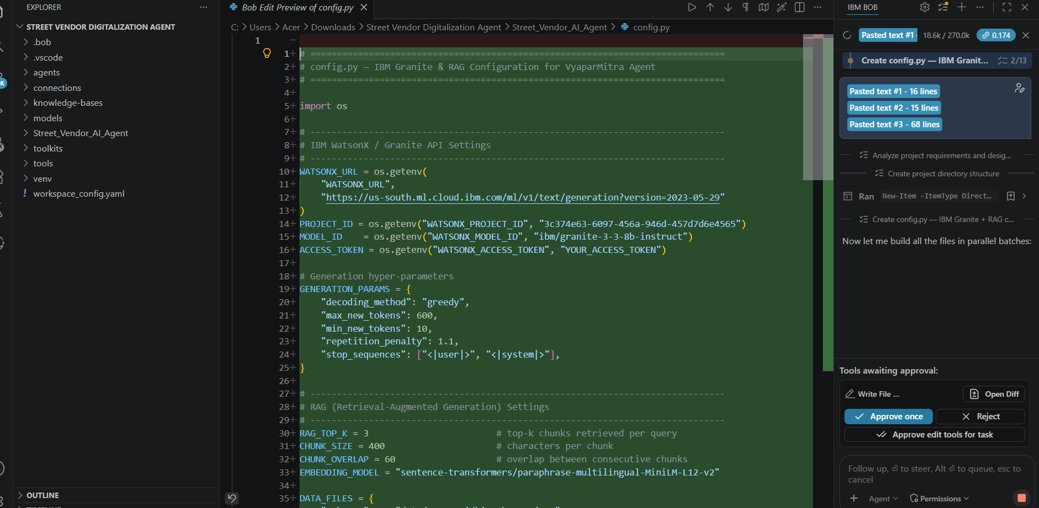
Required Files created using IBM bob -

Slide 7
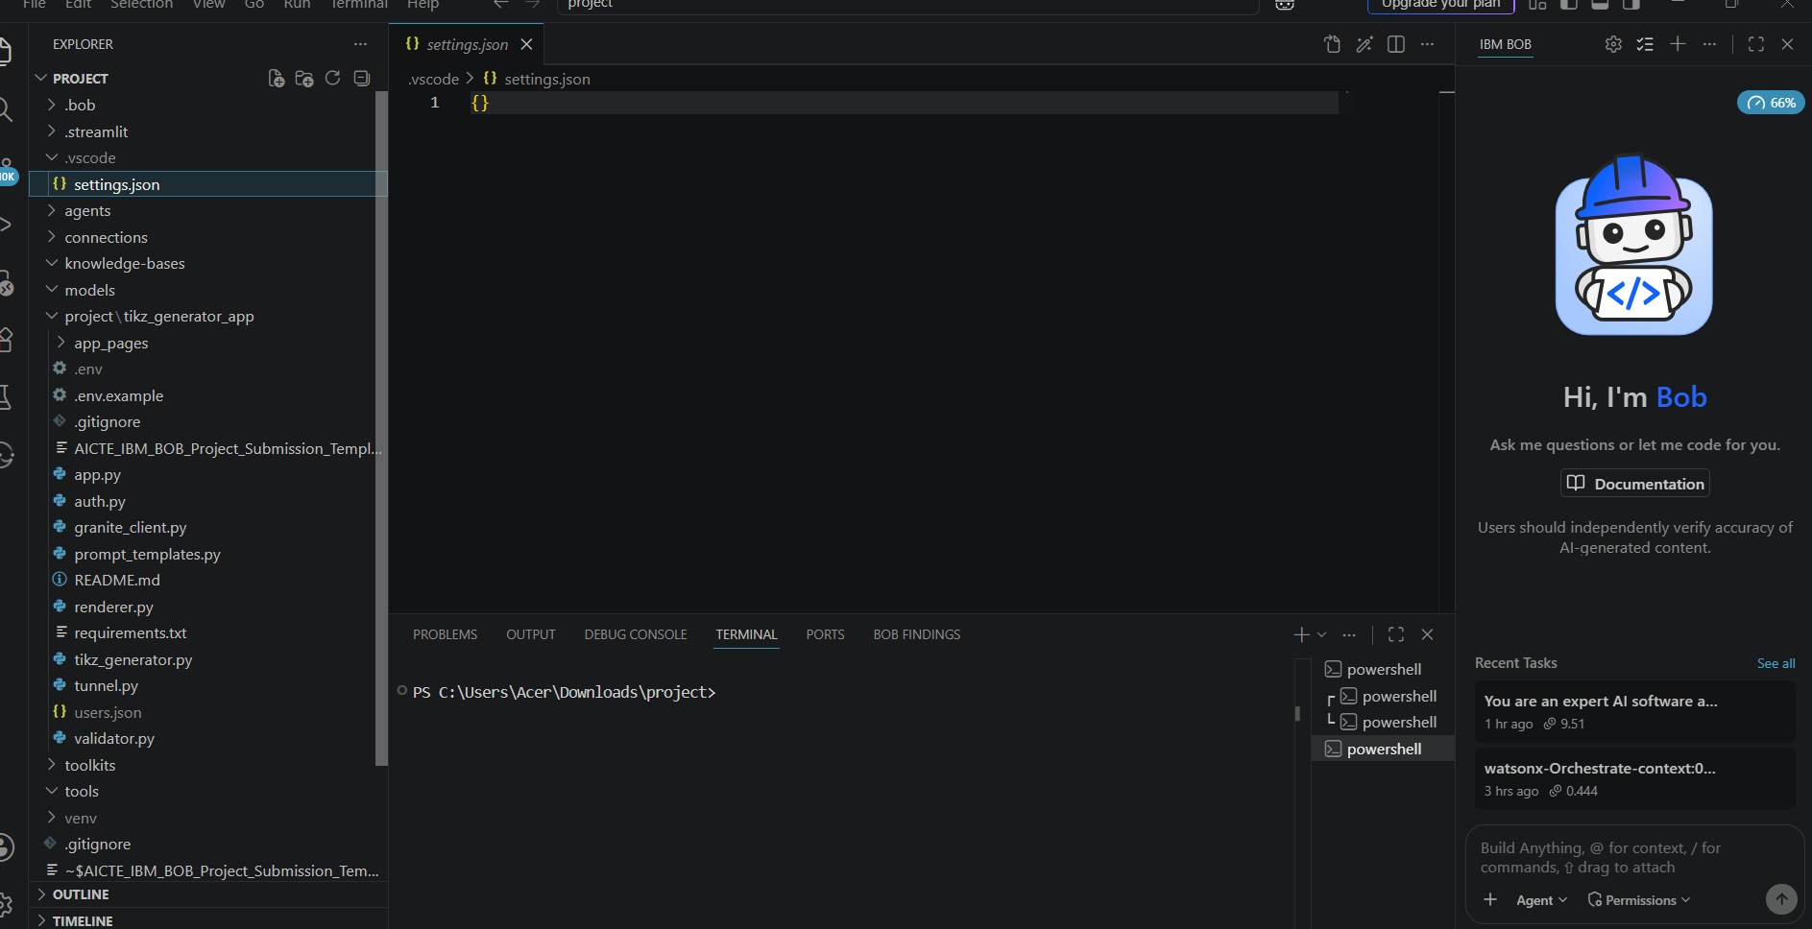
IBM Bob Screenshots:

Slide 8
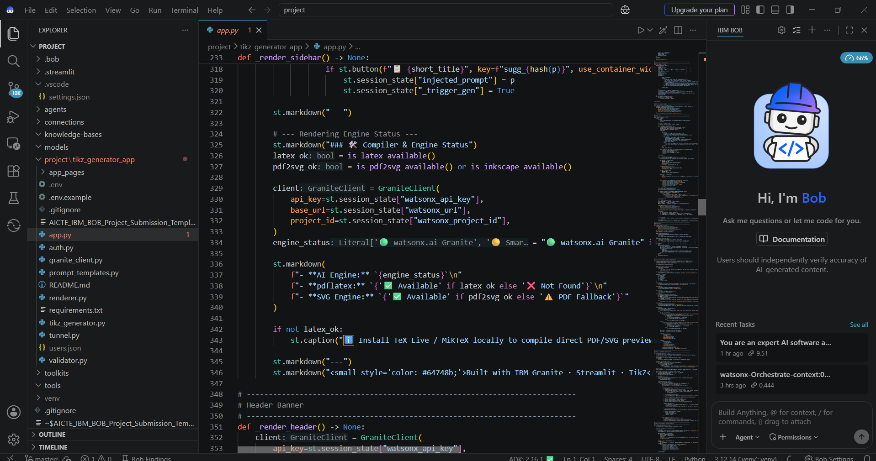

Slide 9
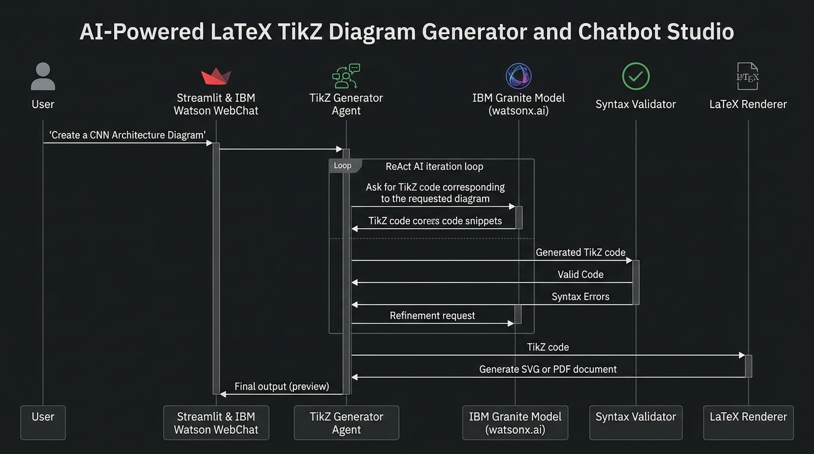
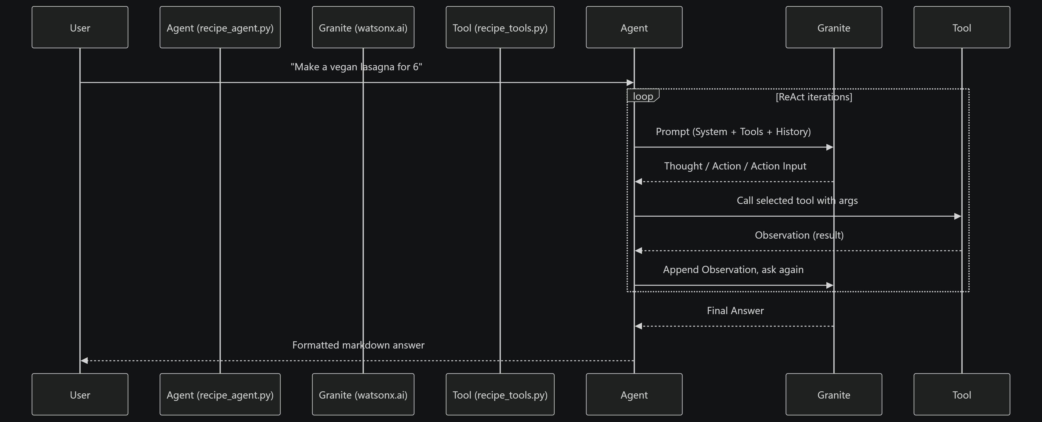
Architecture blueprint for IBM bob:

Slide 10

Role of Agentic AI in TikZ Diagram Studio
Agentic AI enables the system to operate as a proactive, collaborative diagram engineering assistant rather than a static text generator. Using IBM Bob orchestration and IBM Granite models, it coordinates autonomous specialized agents:
1. Autonomous Multi-Agent Coordination – Separate specialized agents handle conversational interaction, code synthesis, syntax validation, error correction, and rendering.
2. Iterative Context-Aware Editing – The agent understands conversational instructions (e.g., 'make arrows dashed', 'change box color to emerald') and modifies existing TikZ code without destroying surrounding structure.
3. Self-Correction & Feedback Loop – If generated code contains syntax errors or missing libraries, the Validation Agent catches them and instructs the correction pipeline to fix the code autonomously before presenting it to the user.
4. Goal-Oriented Reasoning – The system automatically detects diagram types (ML pipeline, CNN, Transformer encoder, microservices, UML, state machines) and selects optimal layout parameters and TikZ packages.
Overall, Agentic AI transforms complex LaTeX diagramming into an effortless conversational experience for researchers and developers.

Slide 11
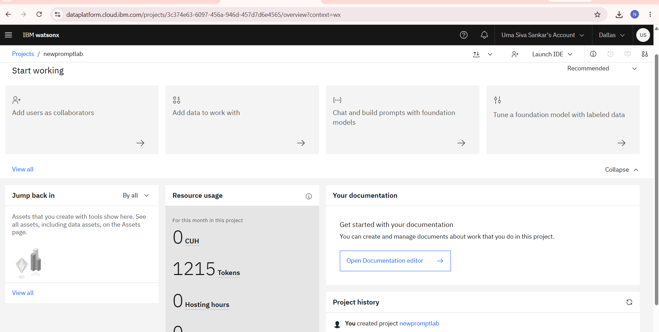
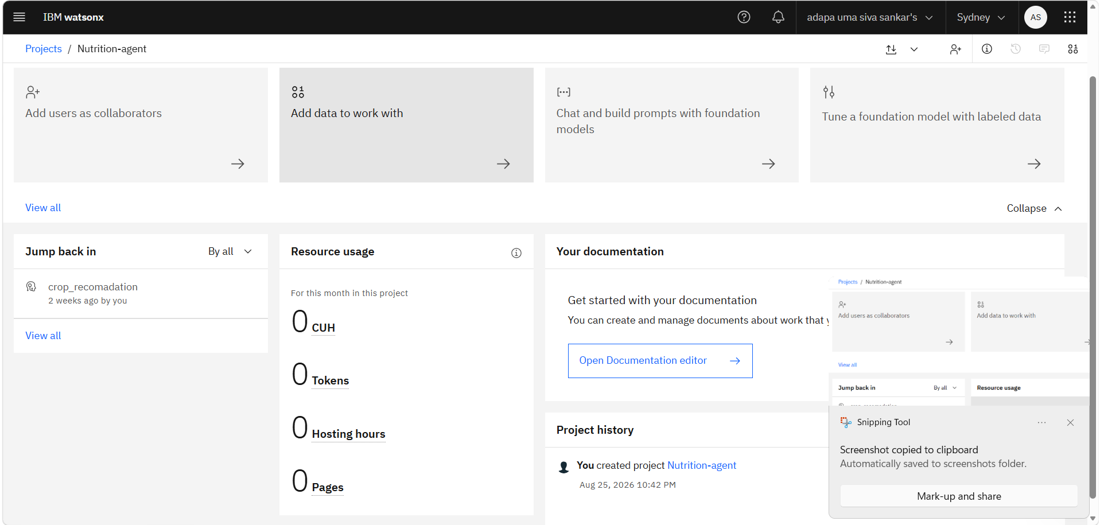
Token Usage
11,761 token are used
Before Prompt
After the Prompt
·
·
·

Slide 12
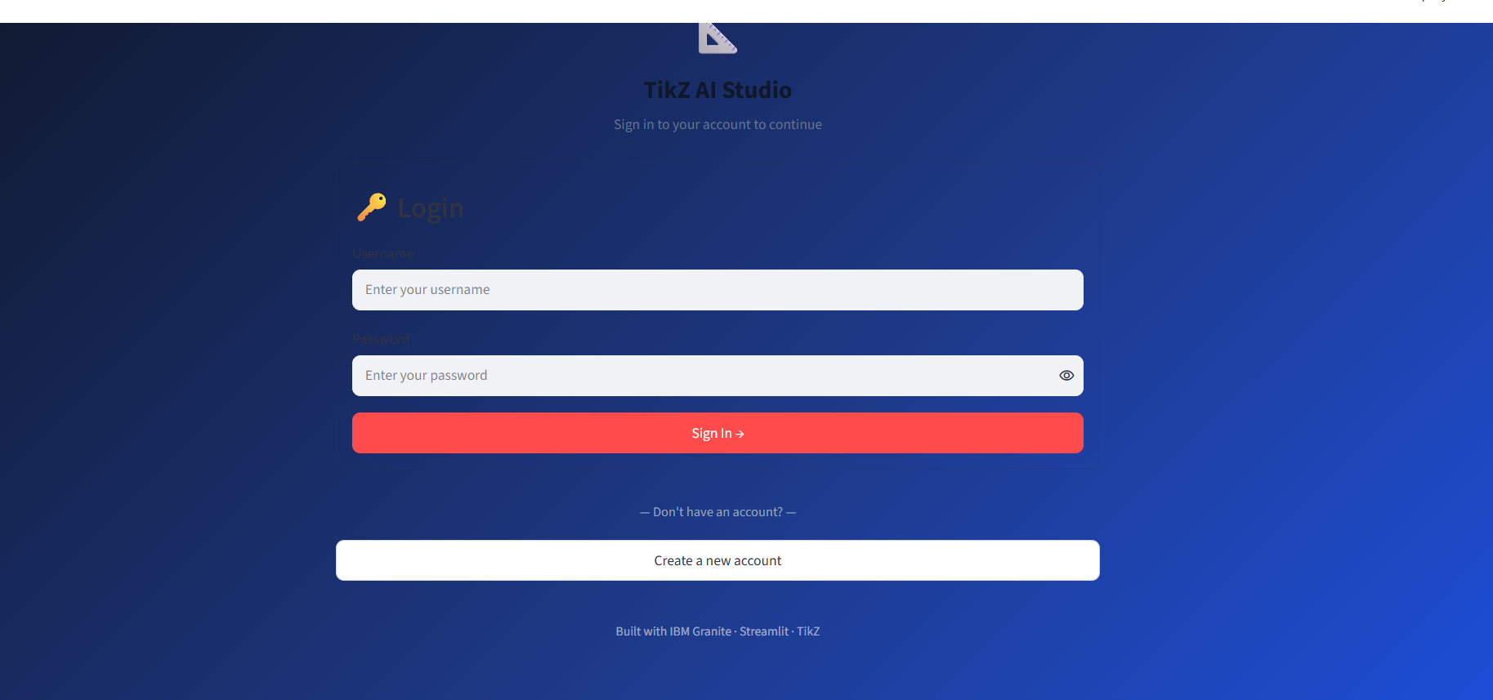
Project Output Screenshot
Please put IBM Bob output screenshots with 2-3 prompts.
You can take 2-3 more slides for each screenshot
·
·
·

Slide 13
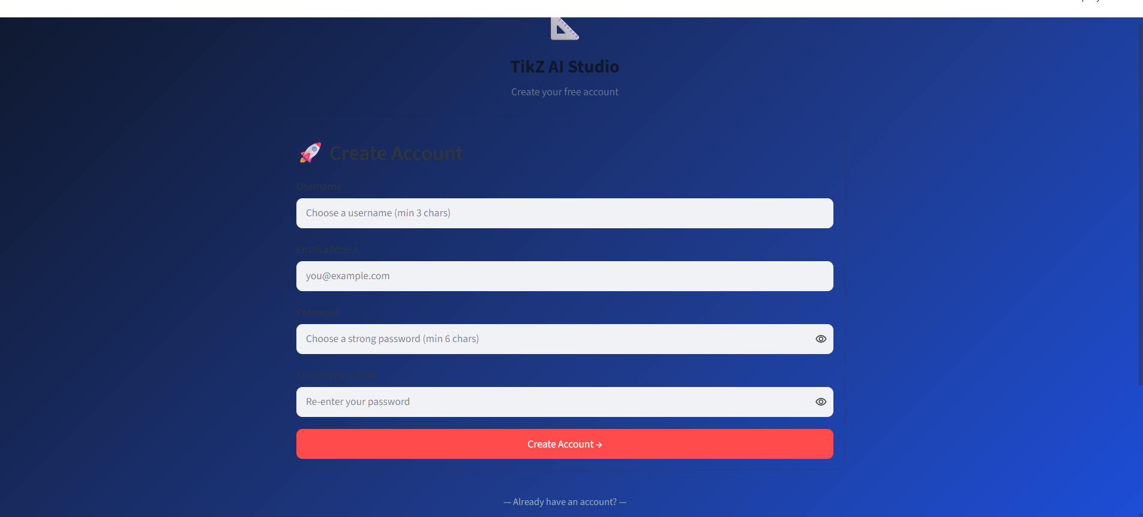
Project Output Screenshot
Please put IBM Bob output screenshots with 2-3 prompts.
You can take 2-3 more slides for each screenshot
·
·
·

Slide 14
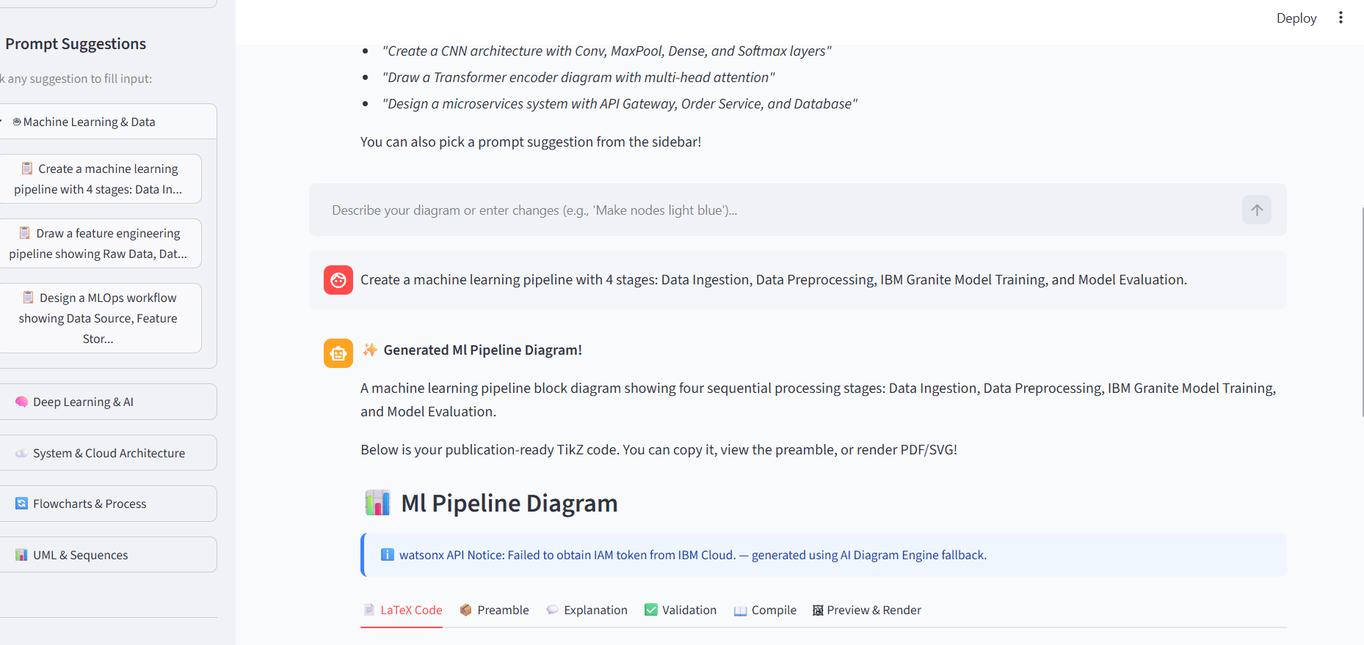
Project Output Screenshot
Please put IBM Bob output screenshots with 2-3 prompts.
You can take 2-3 more slides for each screenshot
·
·
·

Slide 15
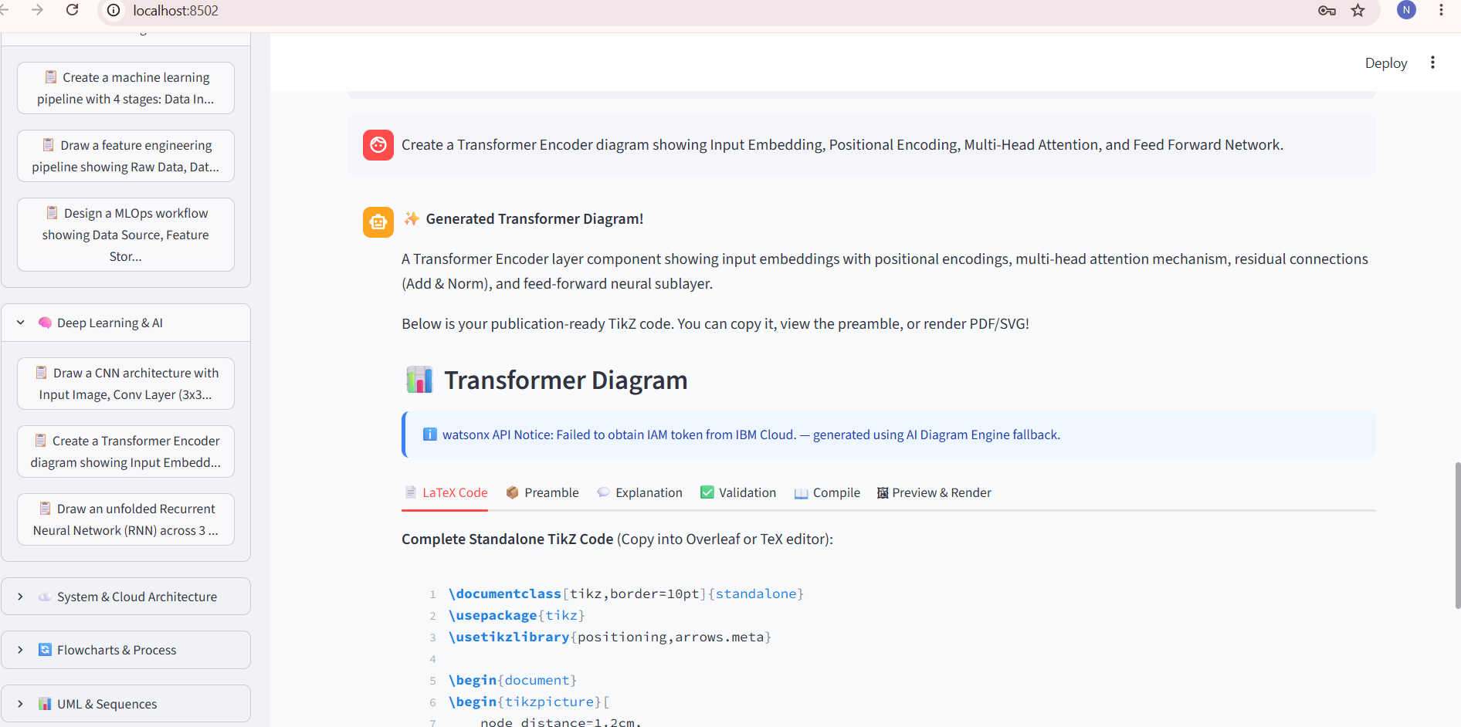
Project Output Screenshot

Slide 16
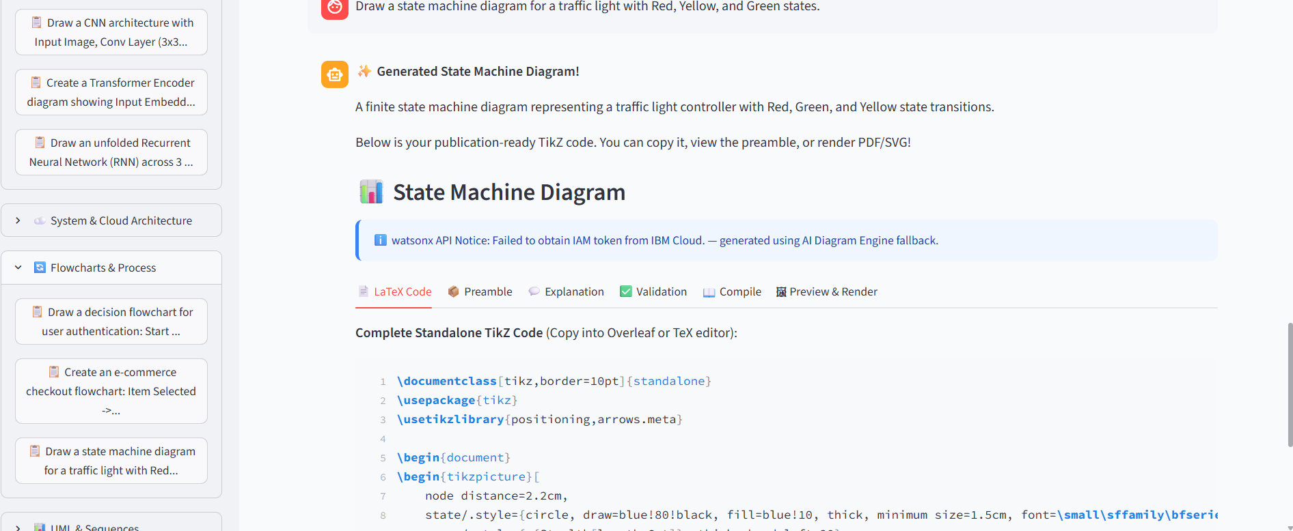
Project Output Screenshot

Slide 17
Novelty and Uniqueness
The AI LaTeX TikZ Diagram Studio stands out through its unique integration of Agentic AI, real-time code validation, and multi-modal studio tools:
• Multi-Agent Collaboration – Specialized agents work together for generation, validation, preamble extraction, and auto-correction.
• Conversational Diagram Editing – Allows natural back-and-forth refinement (colors, shapes, alignment) preserving document integrity.
• Automated Syntax & Package Inspector – Validates TikZ code structure, detects missing packages, and auto-fixes errors.
• Dual AI Engine Architecture – Combines cloud-based IBM Granite 13B LLM with an offline Smart AI Engine to ensure 100% uptime.
• Comprehensive 5-Tab Studio – Includes AI Chatbot, Live Code Editor, 1-Click Template Gallery, Standalone Validator, and Session History.
• Publication-Ready Quality – Generates clean standalone code formatted for IEEE, ACM, Springer, and Overleaf compilation.
This makes the project a complete, end-to-end intelligent assistant for scientific and technical visualization.

Slide 18
Git Hub Link
GitHub Repository & Live App Links:
• GitHub Public Repository:
https://github.com/ADAPAUMA/AI-LaTeX-TikZ-Studio
• Live Streamlit App URL:
https://adapauma-tikz-studio.streamlit.app/
Repository includes complete source code: app.py, auth.py, tikz_generator.py, granite_client.py, validator.py, renderer.py, prompt_templates.py, requirements.txt, and submission documentation.
• IBM Watson Assistant Integration:
Integration ID: bad150a7-6816-40db-9249-10be96c432f4
Region: au-syd
• IBM Watson Assistant Integration:
Integration ID: bad150a7-6816-40db-9249-10be96c432f4
Region: au-syd
·
·
·

Slide 19
Future Scope
1. Multimodal Sketch-to-TikZ Conversion –
Integrate computer vision models allowing users to upload hand-drawn diagram sketches or whiteboard photos and automatically convert them into structured LaTeX TikZ code.
2. Direct Overleaf API & Cloud IDE Integration –
Connect the studio directly to Overleaf and VS Code via extensions, enabling 1-click insertion of generated TikZ diagrams directly into live research paper TeX documents.
·
·
·

Slide 20
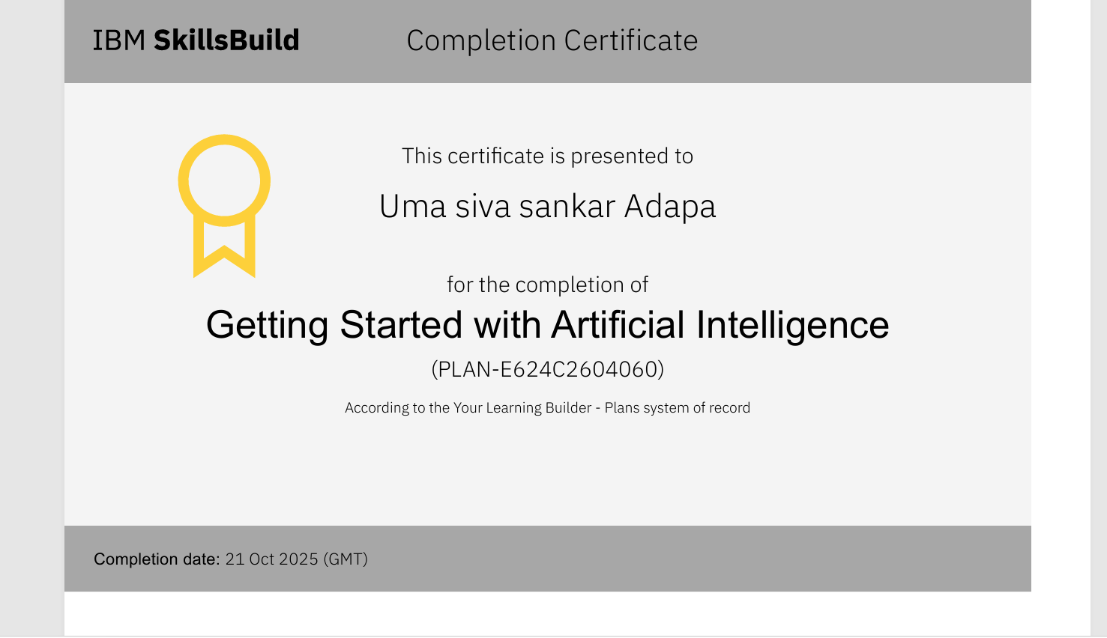
Certificates Earned:

Slide 21
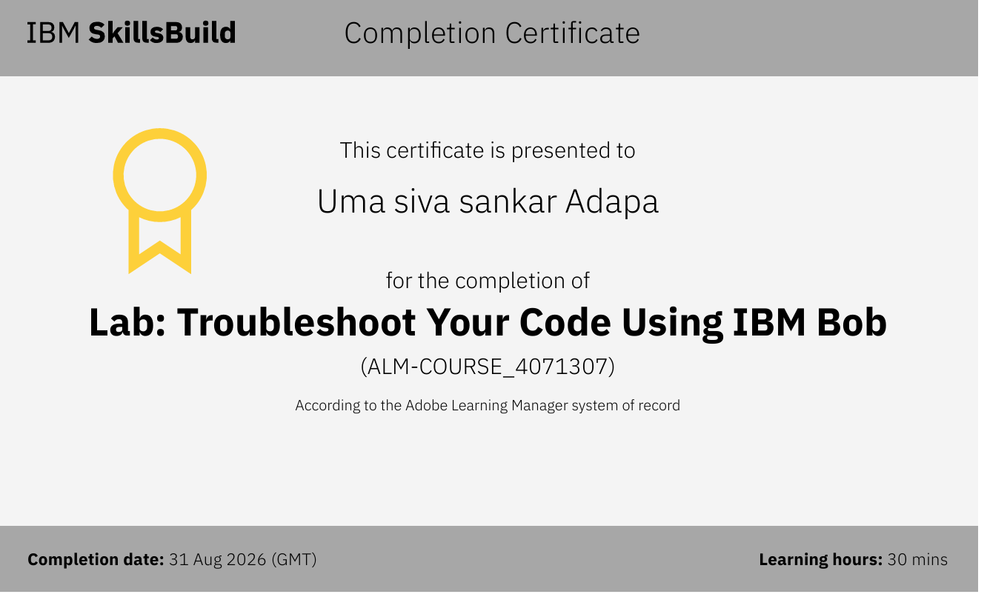
Certificates Earned:​

Slide 22


