Slide 1


Slide 2
Table of content
Our team
Idea
01
02
Process
Used technologies
03
04

Slide 3
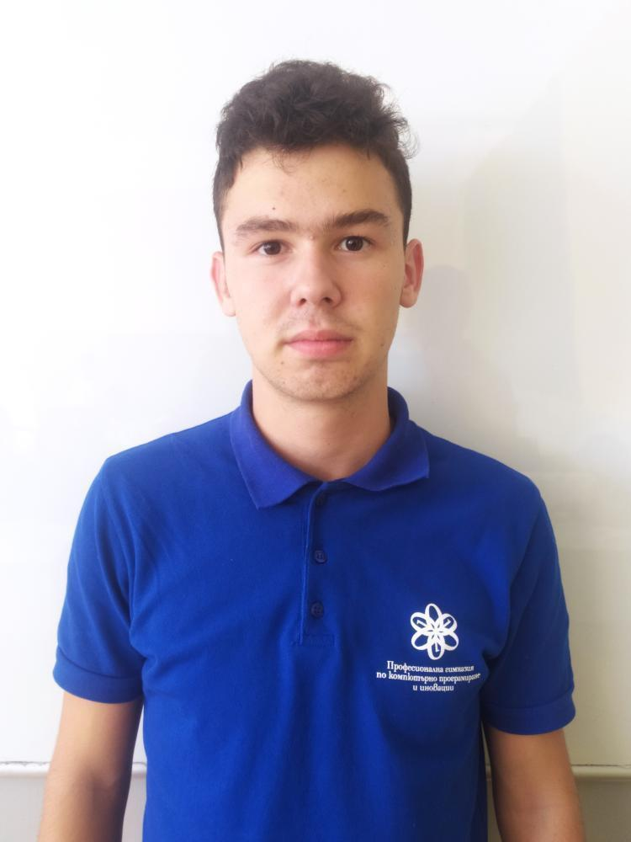
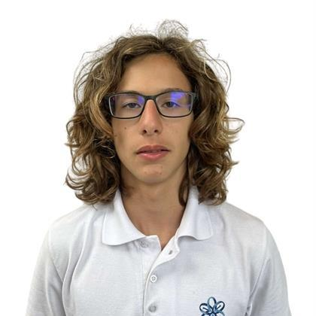
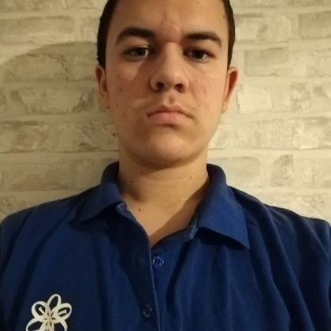
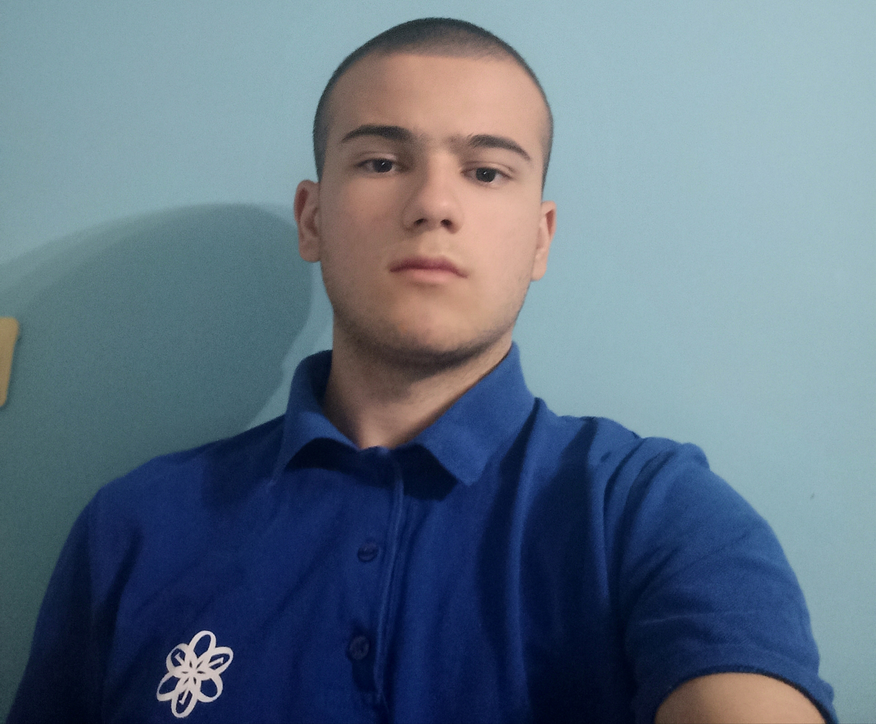
Our team
Atanas Atanasov
Scrum trainer
Kaloyan Georgiev
Back-end developer
Nikolay Stoqnov
Back-end developer
Ivo Badalov
Back-end developer

Slide 4

Idea

Slide 5
Process
Organization
Decide on the idea
Development
Present

Slide 6








Used technologies

Slide 7

Let’s jump to the app

