Slide 1
GitHub using Web Browser

Slide 2
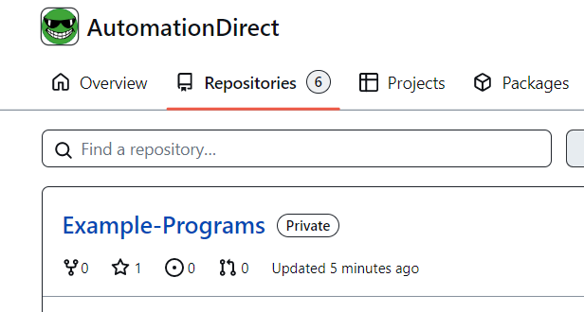
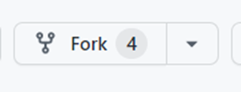
1.) Using web browser go to github.com and sign in or create a new user account.
2.) Go to githhub.com/AutomationDirect
3.) Click on Repositories tab and locate “Example Programs”
4.) Now click on Fork icon in upper right-hand corner

Slide 3
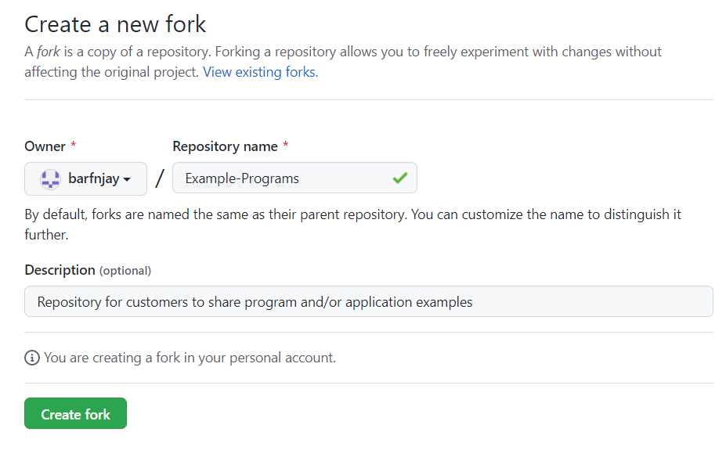
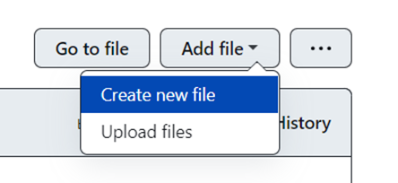
5.) Select “Create Fork”
6.) Click on Customers folder & then on the related PLC or HMI product folder you will be placing your example project.
7.) Next select Add File -> Create new file

Slide 4
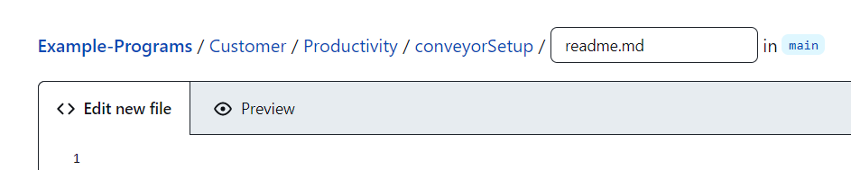


8.) Type in the title of your example project with slash then type in readme.md. This creates a file to be placed into
new project folder that can be edited to describe your project.
9.) Then scroll to the bottom and under Commit new file you can enter extended description. Leave option for commit
directly to the main branch -> then click on “Commit new File”.
10.) You can now click on Add Files -> and add any additional file(s) by uploading them to your project folder.
11.) Once all new files are added now select commit changes

Slide 5

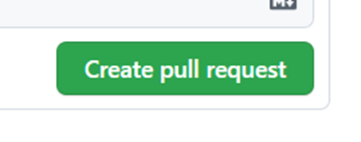
12.) On main screen select Pull Request and then select “New pull request”
13.) You will see all commits (files from previous step) located on the comparing changes screen. Select
“create pull request”
14.) Enter a title and comment on details of the changes.
15.) An email will be sent to AutomationDirect.com to look over the request.
16.) AutomationDirect will review the ‘Pull Request’ and ‘Merge’ it into the repository if it is approved.
17.) You will get email notification and then your project will be available on GitHub.

