Slide 1
Compute
Coefficients
Computational Graph
on Processor 0
NN
Parameter
Update
State Variable
Last Time Step
Next Time Step
Data Transfer
MPI Communication
Compute
Coefficients
Computational Graph
on Processor 1
NN
Parameter
Update
State Variable
Last Time Step
Next Time Step
Forward Computation
Data Transfer

Slide 2
Compute
Coefficients
Computational Graph
on Processor 0
NN
Parameter
Update
State Variable
Last Time Step
Next Time Step
Data Transfer
Manual
MPI Adjoint
Send <-> Recv
Bcast <-> Reduce
Compute
Coefficients
Computational Graph
on Processor 1
NN
Parameter
Update
State Variable
Last Time Step
Next Time Step
Gradient Backpropagation
via Automatic Differentiation
or Physics Constrained Learning
Data Transfer

Slide 3
Loss
Intermediate
Values
Inputs

Slide 4
Reverse Mode
Automatic Differentiation
Forward Mode Automatic Differentiation

Slide 5










$$L$$
mpi_sum
$$1$$
$$θ$$
$$θ^{2}$$
$$θ^{3}$$
Local Computation
$$θ$$
$$θ$$
$$θ$$
$$θ$$
mpi_bcast
$$Θ$$

Slide 6

Master
flag
Worker
for k = 1, 2, 3, …
flag = COMPUTE_OBJ
mpi_sync!(flag)
f = compute_objective_function(x)
…
flag = COMPUTE_GRAD
mpi_sync!(flag)
dx = compute_gradient(x)
…
x = x – alpha * dx
flag = OPTIMIZATION_STOP
mpi_sync!(flag)
while true
mpi_sync!(flag)
if (flag==COMPUTE_OBJ)
compute_objective_function(x)
elseif (flag==COMPUTE_GRAD)
compute_gradient(x)
else
break
end
end

Slide 7
Send
Send
Isend
Isend
Irecv
Irecv
Recv
Recv
Wait
Wait
Deadlock
No Deadlock

Slide 8
Data Exchange

Slide 9



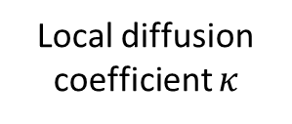
NN Weights and Biases
MPI Broadcast
NN
Local diffusion coefficient $κ$
Halo exchange for $κ$
Assemble the local coefficient matrix
Gradient
Back-Propagation
Distributed AMG solver
Local solution
vector $u$
Halo exchange
for $u$
Local loss function
MPI sum
Loss function

Slide 10
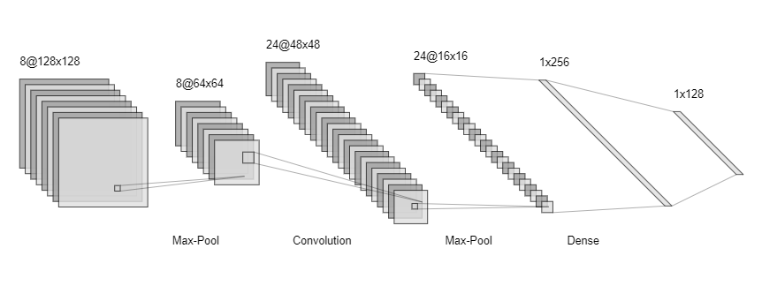

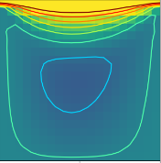
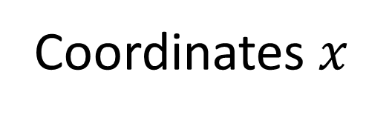
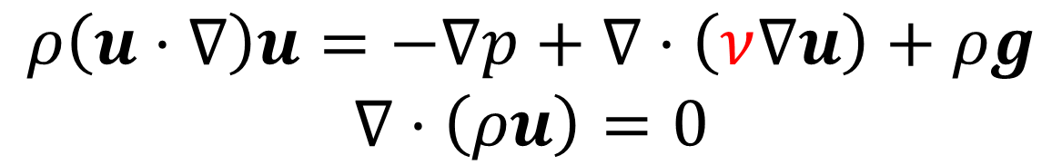
Coordinates $x$
Physical Fields
Deep Neural Network Approximation
Gradient
Back-propagation
Physical Laws
Navier Stokes Equation
$$ρ\left(u⋅∇\right)u=−∇p+∇⋅\left(ν∇u\right)+ρg$$
$$∇⋅\left(ρu\right)=0$$
Observations
Predictions

Slide 11
Original Matrix
MPI_Isend/MPI_Irecv
Transpose Each Block

Slide 12








mpi_bcast weights and biases
Time Stepping $t=t_{1}$
Time Stepping $t=t_{1}$
Halo exchange
Halo exchange
Time Stepping $t=t_{2}$
Time Stepping $t=t_{2}$
$$⋮$$
$$⋮$$
Halo exchange
Halo exchange
Time Stepping $t=t_{n}$
Time Stepping $t=t_{n}$
Local loss function
Local loss function
mpi_sum
Loss function

Slide 13
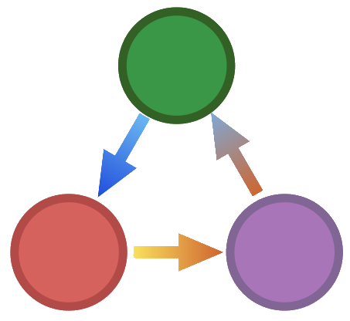





Operator
z = x * y
y = A * x
y = compute_fem_
stiffness_matrix(x, mesh)
z = x + y
y = A \ x
Granularity
Arithmetic
Tensor
Simulation
TAPENADE
MeDiPack
Adept
CoDiPack

Slide 14


ADCME/AdFem
Simulation Program

Slide 15
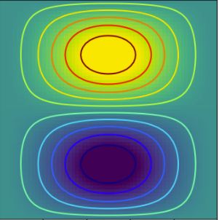
u, v, or p
Observations

Slide 16
Gradient Back-propagation
Loss Function
Forward Computation
Spatially-varying
Physical Fields
Deep Neural Network
PDE Solver
Observation

Slide 17




Computed at Compilation Time
eval_f_on_gauss_pts
compute_fem_laplace_matrix1
$$κ$$
*
$$A$$
$$F$$
compute_fem_source_term1
Linear System Solver
obs
$$u$$
Squared Loss
Forward Computation
loss
Gradient Back-propagation

Slide 18
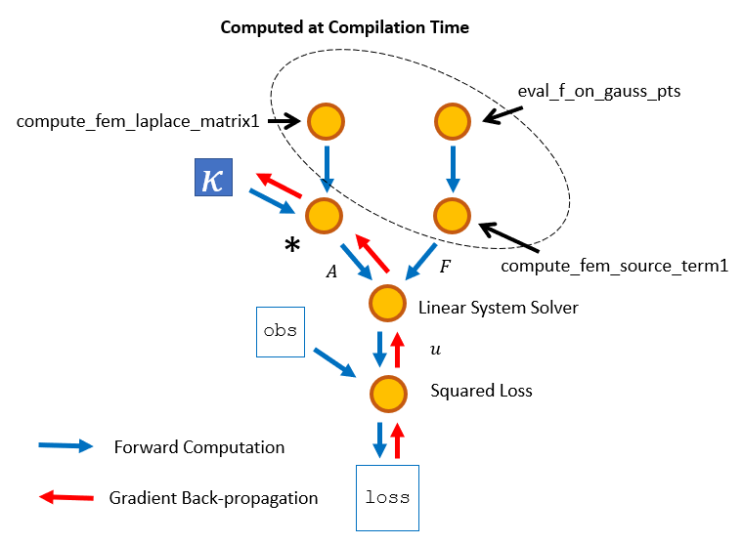
κ = Variable(1.0)
A = κ * compute_fem_laplace_matrix1(m, n, h)
F0 = eval_f_on_gauss_pts(f, m, n, h)
F = compute_fem_source_term1(F0, m, n, h)
sol = A\F
loss = sum((sol[idx] - obs[idx])^2)

Slide 19






$$\left(x_{1}, y_{1}\right)$$
1
$$1−ξ−η$$
$$η$$
$$\left(x_{0}, y_{0}\right)$$
2
$$ξ$$
0
$$\left(x_{2}, y_{2}\right)$$
Reference

Slide 21
Inter-parallelism
Operators
Inter
Thread Pool
Finished Tasks
Intra Thread Pool

Slide 22

Rank 0
Rank 1
1
1
3
3
2
2
MPI Calls
Dependency Injection
Rank 0 Task Queue
3
2
1
Executor
Rank 1 Task Queue
2
3
1
Executor

Slide 23
Rank 0
Rank 1
Rank 0
Rank 1
1
1
1
1
3
3
3
3
2
2
2
2
MPI Calls
Dependency Injection
Rank 0 Task Queue
3
2
1
Executor
Rank 1 Task Queue
3
2
1
Executor

Slide 24











SDE
FEM
PDE
DNN
Constitutive Modeling
Fluid Dynamics
Data
ODE
Solid
Mechanics
Optimization
Automatic Differentiation
Physics Constrained Learning
Backend: TensorFlow

Slide 25
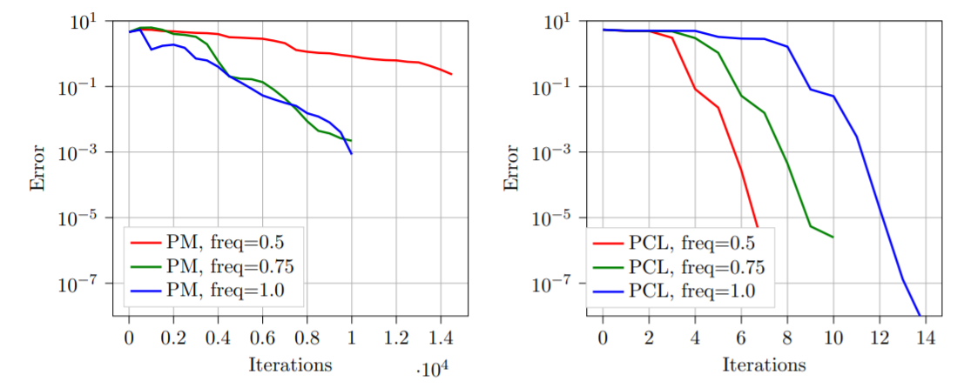
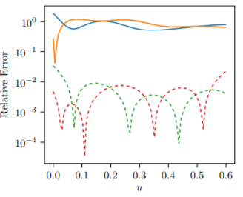
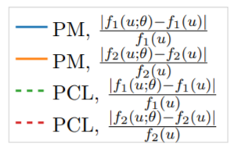
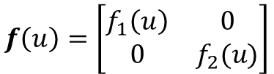
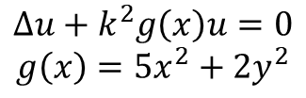

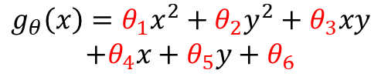
Parameter Inverse Problem
$$Δu+k^{2}g\left(x\right)u=0$$
$$g\left(x\right)=5x^{2}+2y^{2}$$
$$g_{θ}\left(x\right)=θ_{1}x^{2}+θ_{2}y^{2}+θ_{3}xy$$
$$+θ_{4}x+θ_{5}y+θ_{6}$$
Approximate Unknown Functions
using DNNs
$$−∇⋅\left(f\left(u\right)∇u\right)=h(x)$$
$$f\left(u\right)=\left[\begin{matrix}f_{1}\left(u\right) & 0 \\ 0 & f_{2}(u)\end{matrix}\right]$$

Slide 26









DNN: Explicit
$$b$$
$$W$$
$$x$$
$$y$$
$$y=σ(Wx+b)$$
Numerical Schemes:
Implicit, Iterative
$$θ$$
$$f$$
$$y$$
$$A\left(y,θ\right)y=f$$

Slide 27
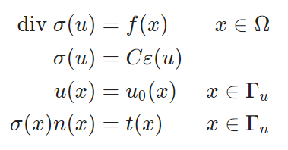
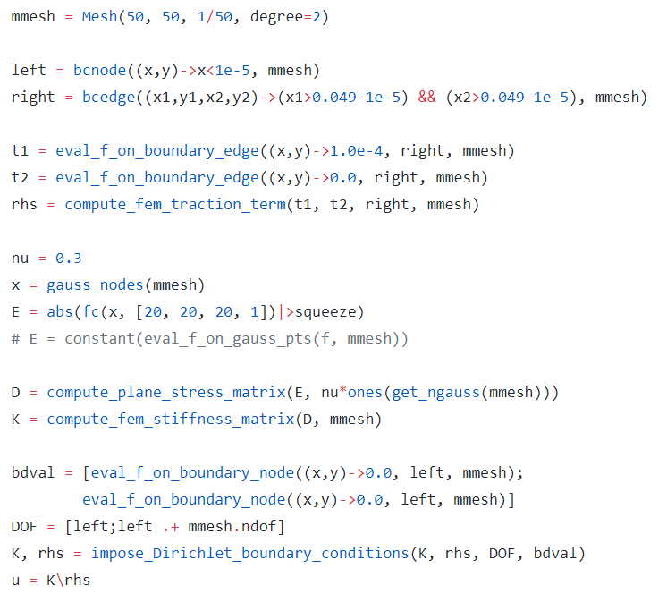



ADCME
CPU
GPU
TPU
Heterogenous
Task-based
Parallel Runtime
AD-Capable
Numerical Simulator Engines

Slide 28



PML Domain
$$n$$
$$0$$
$$n$$

Slide 30
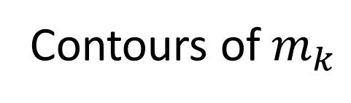



Trust Region Step
Contours of $m_{k}$
$$x_{k}$$
$$x^{∗}$$
Trust Region
Contours of $f$
Line Search Direction
(BFGS, Newton’s Method…)

Slide 31










$$v_{m}$$
$$\overline{v_{m}}$$
$$I$$
$$f$$
$$\overline{G}$$
$$∇^{2}f$$
$$G$$
$$x$$
$$\overline{x}$$
$$∇^{2}v_{m}$$
Forward
Problem
Adjoint
Update
Hessian
Update

Slide 32
Gauss Points
DNN
Stiffness Matrix Assembly
Impose Boundary Conditions
Sparse Matrix Solver
Quadratic Loss Function
Loss Function

Slide 33














$$\overline{v_{5}}$$
$$φ_{5}$$
$$\overline{v_{4}}$$
$$φ_{4}$$
$$\overline{v_{2}}$$
$$\overline{v_{3}}$$
$$φ_{2}$$
$$φ_{3}$$
$$\overline{v_{1}}$$
$$φ_{1}$$
$$\overline{v_{−3}}$$
$$\overline{v_{−2}}$$
$$\overline{v_{−1}}$$
$$\overline{v_{0}}$$

Slide 34










$${\dot{v}}_{5}$$
$$φ_{5}$$
$${\dot{v}}_{4}$$
$$φ_{4}$$
$${\dot{v}}_{2}$$
$${\dot{v}}_{3}$$
$$φ_{2}$$
$$φ_{3}$$
$${\dot{v}}_{1}$$
$$φ_{1}$$
$${\dot{v}}_{−3}$$
$${\dot{v}}_{−2}$$
$${\dot{v}}_{−1}$$
$${\dot{v}}_{0}$$
$$t$$

Slide 35








$$u_{x}$$
$$x$$
$$u$$
$$u_{y}$$
$${{{(u}^{t}−u}_{x}−u_{y}) }^{2}$$
$$y$$
$$t$$
$$u_{t}$$

Slide 36
Chapter 7 Chapter 8 Chapter 9
Chapter 2 Chapter 3 Chapter 4
Chapter 5 Chapter 6
Part II
Implementations
Part III
Applications
Part I
Algorithms

Slide 37



Data
Index
Meta Info
Application
Programs
SQLite Database

Slide 38
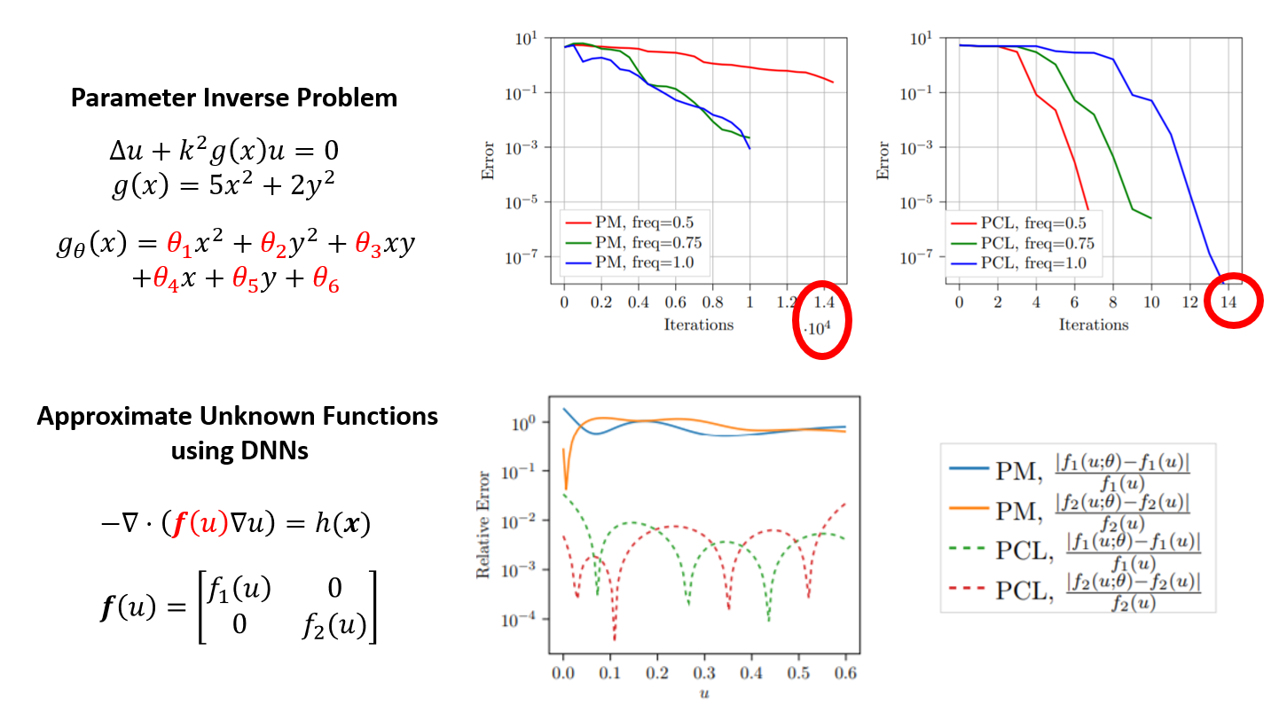
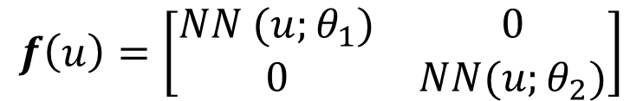
$$f\left(u\right)=\left[\begin{matrix}NN (u;θ_{1}) & 0 \\ 0 & NN(u;θ_{2})\end{matrix}\right]$$

