Slide 1
Compute
Coefficients
Computational Graph
on Processor 0
NN
Parameter
Update
State Variable
Last Time Step
Next Time Step
Data Transfer
MPI Communication
Compute
Coefficients
Computational Graph
on Processor 1
NN
Parameter
Update
State Variable
Last Time Step
Next Time Step
Forward Computation
Data Transfer

Slide 2
Compute
Coefficients
Computational Graph
on Processor 0
NN
Parameter
Update
State Variable
Last Time Step
Next Time Step
Data Transfer
Manual
MPI Adjoint
Send <-> Recv
Bcast <-> Reduce
Compute
Coefficients
Computational Graph
on Processor 1
NN
Parameter
Update
State Variable
Last Time Step
Next Time Step
Gradient Backpropagation
via Automatic Differentiation
or Physics Constrained Learning
Data Transfer

Slide 3
Loss
Intermediate
Values
Inputs

Slide 4
Reverse Mode
Automatic Differentiation
Forward Mode Automatic Differentiation

Slide 5










$$L$$
mpi_sum
$$1$$
$$θ$$
$$θ^{2}$$
$$θ^{3}$$
Local Computation
$$θ$$
$$θ$$
$$θ$$
$$θ$$
mpi_bcast
$$Θ$$

Slide 6

Master
flag
Worker
for k = 1, 2, 3, …
flag = COMPUTE_OBJ
mpi_sync!(flag)
f = compute_objective_function(x)
…
flag = COMPUTE_GRAD
mpi_sync!(flag)
dx = compute_gradient(x)
…
x = x – alpha * dx
flag = OPTIMIZATION_STOP
mpi_sync!(flag)
while true
mpi_sync!(flag)
if (flag==COMPUTE_OBJ)
compute_objective_function(x)
elseif (flag==COMPUTE_GRAD)
compute_gradient(x)
else
break
end
end

Slide 7
Send
Send
Isend
Isend
Irecv
Irecv
Recv
Recv
Wait
Wait
Deadlock
No Deadlock

Slide 8
Data Exchange

Slide 9
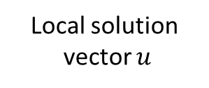

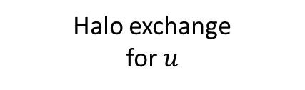
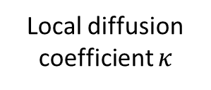
NN Weights and Biases
MPI Broadcast
NN
Local diffusion coefficient $κ$
Halo exchange for $κ$
Assemble the local coefficient matrix
Gradient
Back-Propagation
Distributed AMG solver
Local solution
vector $u$
Halo exchange
for $u$
Local loss function
MPI sum
Loss function

Slide 10
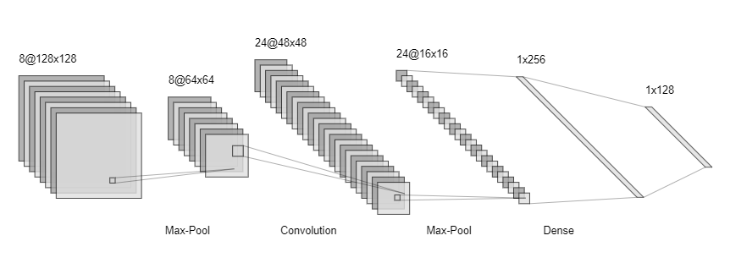

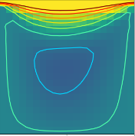
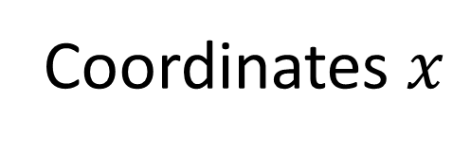
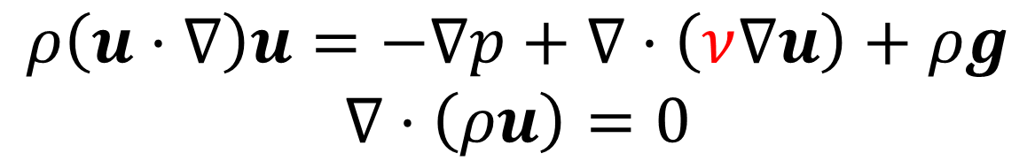
Coordinates $x$
Physical Fields
Deep Neural Network Approximation
Gradient
Back-propagation
Physical Laws
Navier Stokes Equation
$$ρ\left(u⋅∇\right)u=−∇p+∇⋅\left(ν∇u\right)+ρg$$
$$∇⋅\left(ρu\right)=0$$
Observations
Predictions

Slide 11
Original Matrix
MPI_Isend/MPI_Irecv
Transpose Each Block

Slide 12








mpi_bcast weights and biases
Time Stepping $t=t_{1}$
Time Stepping $t=t_{1}$
Halo exchange
Halo exchange
Time Stepping $t=t_{2}$
Time Stepping $t=t_{2}$
$$⋮$$
$$⋮$$
Halo exchange
Halo exchange
Time Stepping $t=t_{n}$
Time Stepping $t=t_{n}$
Local loss function
Local loss function
mpi_sum
Loss function

Slide 13
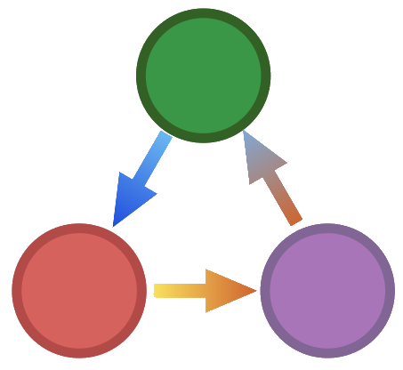





Operator
z = x * y
y = A * x
y = compute_fem_
stiffness_matrix(x, mesh)
z = x + y
y = A \ x
Granularity
Arithmetic
Tensor
Simulation
TAPENADE
MeDiPack
Adept
CoDiPack

Slide 14


PoreFlow/ADCME
Simulation Program

Slide 15
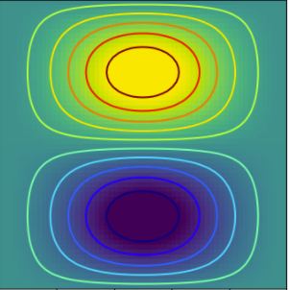
u, v, or p
Observations

Slide 16
Gradient Back-propagation
Loss Function
Forward Computation
Spatially-varying
Physical Fields
Deep Neural Network
PDE Solver
Observation

Slide 17




Computed at Compilation Time
eval_f_on_gauss_pts
compute_fem_laplace_matrix1
$$κ$$
*
$$A$$
$$F$$
compute_fem_source_term1
Linear System Solver
obs
$$u$$
Squared Loss
Forward Computation
loss
Gradient Back-propagation

Slide 18
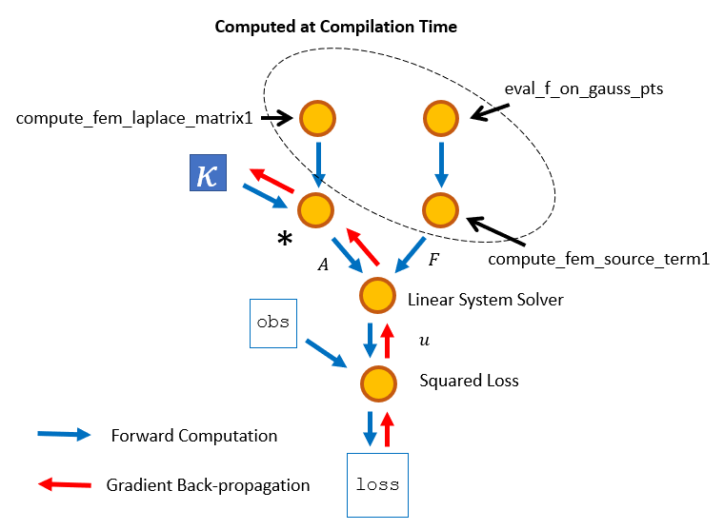
κ = Variable(1.0)
A = κ * compute_fem_laplace_matrix1(m, n, h)
F0 = eval_f_on_gauss_pts(f, m, n, h)
F = compute_fem_source_term1(F0, m, n, h)
sol = A\F
loss = sum((sol[idx] - obs[idx])^2)

Slide 19
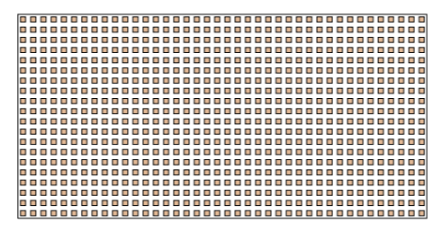
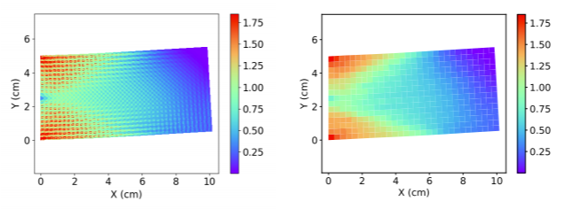
Fiber Reinforced Thin Plate
Reference von Mises stress
SPD-NN

Slide 20
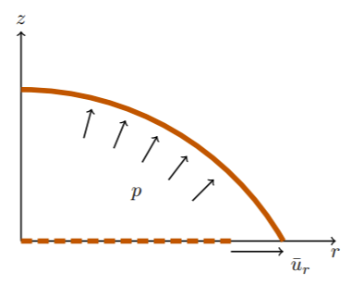
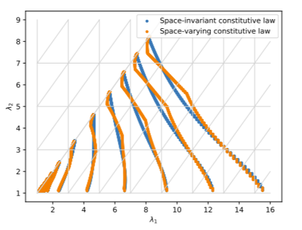
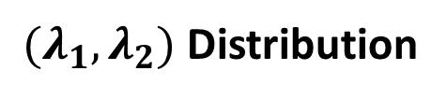


$$λ_{2}$$
$$λ_{1}$$
Rubber Membrane
$(λ_{1}, λ_{2})$ Distribution

Slide 21
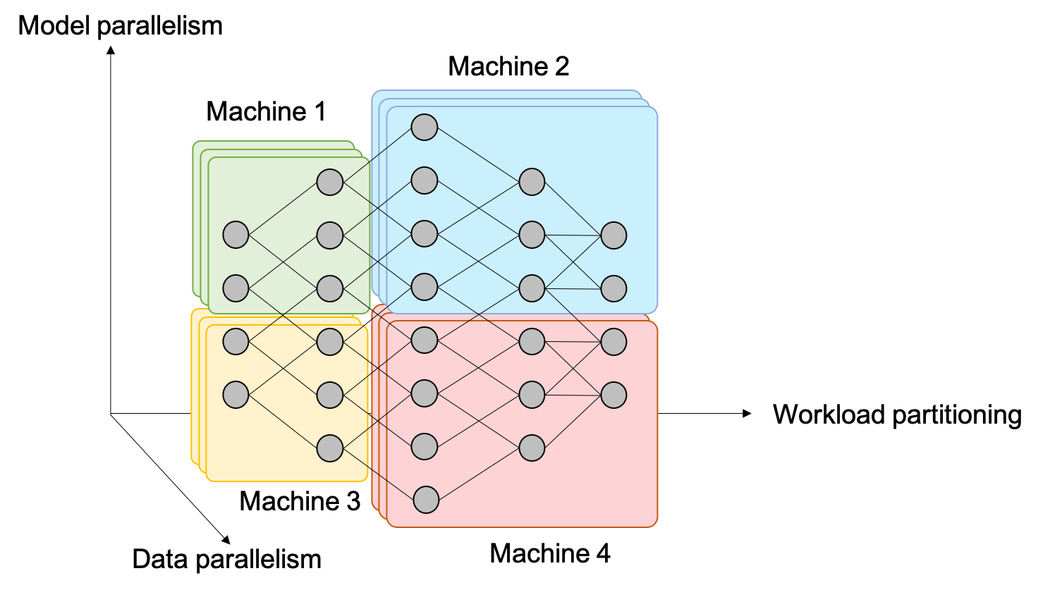
Deep Learning Data/Model Parallelism
Scientific Computing Mixed Parallelism

