Slide 1
Compute
Coefficients
Computational Graph
on Processor 0
NN
Parameter
Update
State Variable
Last Time Step
Next Time Step
Data Transfer
MPI Communication
Compute
Coefficients
Computational Graph
on Processor 1
NN
Parameter
Update
State Variable
Last Time Step
Next Time Step
Forward Computation
Data Transfer

Slide 2
Compute
Coefficients
Computational Graph
on Processor 0
NN
Parameter
Update
State Variable
Last Time Step
Next Time Step
Data Transfer
Manual
MPI Adjoint
Send <-> Recv
Bcast <-> Reduce
Compute
Coefficients
Computational Graph
on Processor 1
NN
Parameter
Update
State Variable
Last Time Step
Next Time Step
Gradient Backpropagation
via Automatic Differentiation
or Physics Constrained Learning
Data Transfer

Slide 3
Loss
Intermediate
Values
Inputs

Slide 4
Reverse Mode
Automatic Differentiation
Forward Mode Automatic Differentiation

Slide 5










$$L$$
mpi_sum
$$1$$
$$θ$$
$$θ^{2}$$
$$θ^{3}$$
Local Computation
$$θ$$
$$θ$$
$$θ$$
$$θ$$
mpi_bcast
$$Θ$$

Slide 6

Master
flag
Worker
for k = 1, 2, 3, …
flag = COMPUTE_OBJ
mpi_sync!(flag)
f = compute_objective_function(x)
…
flag = COMPUTE_GRAD
mpi_sync!(flag)
dx = compute_gradient(x)
…
x = x – alpha * dx
flag = OPTIMIZATION_STOP
mpi_sync!(flag)
while true
mpi_sync!(flag)
if (flag==COMPUTE_OBJ)
compute_objective_function(x)
elseif (flag==COMPUTE_GRAD)
compute_gradient(x)
else
break
end
end

Slide 7
Send
Send
Isend
Isend
Irecv
Irecv
Recv
Recv
Wait
Wait
Deadlock
No Deadlock

Slide 8
Data Exchange

Slide 9
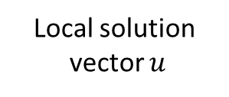

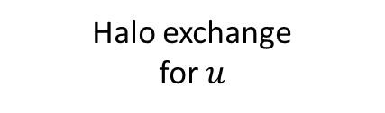
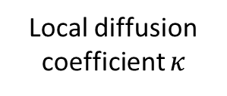
NN Weights and Biases
MPI Broadcast
NN
Local diffusion coefficient $κ$
Halo exchange for $κ$
Assemble the local coefficient matrix
Gradient
Back-Propagation
Distributed AMG solver
Local solution
vector $u$
Halo exchange
for $u$
Local loss function
MPI sum
Loss function

Slide 10
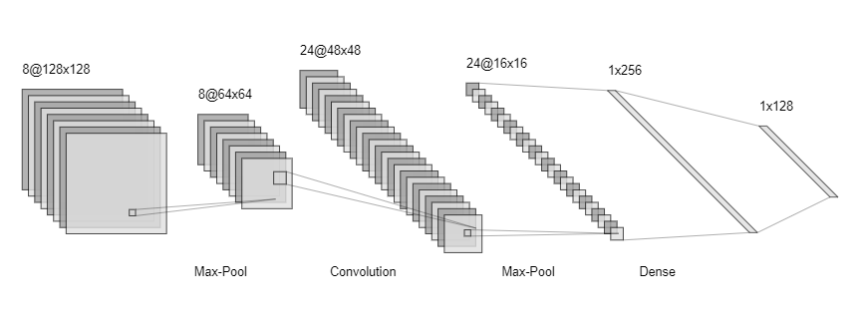

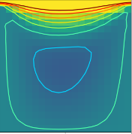
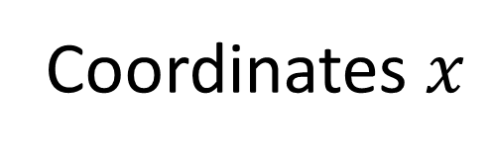
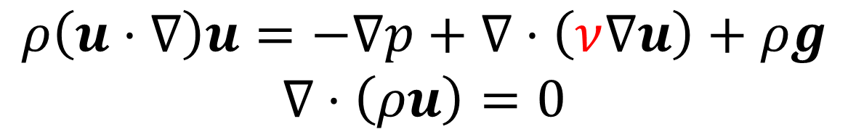
Coordinates $x$
Physical Fields
Deep Neural Network Approximation
Gradient
Back-propagation
Physical Laws
Navier Stokes Equation
$$ρ\left(u⋅∇\right)u=−∇p+∇⋅\left(ν∇u\right)+ρg$$
$$∇⋅\left(ρu\right)=0$$
Observations
Predictions

Slide 11
Original Matrix
MPI_Isend/MPI_Irecv
Transpose Each Block

Slide 12








mpi_bcast weights and biases
Time Stepping $t=t_{1}$
Time Stepping $t=t_{1}$
Halo exchange
Halo exchange
Time Stepping $t=t_{2}$
Time Stepping $t=t_{2}$
$$⋮$$
$$⋮$$
Halo exchange
Halo exchange
Time Stepping $t=t_{n}$
Time Stepping $t=t_{n}$
Local loss function
Local loss function
mpi_sum
Loss function

Slide 13
Parameter Server
Parameter Server
Parameter Server
Compute
Compute
Compute
Loss
Loss
Loss

Slide 14
Parameter
Aggregate Gradient
Compute
Compute
Compute
Loss
Loss
Loss

Slide 15



Parameter
Broadcast
Compute1
Compute1
Compute1
MPI
MPI
MPI
Compute2
Compute2
Compute2
MPI
MPI
MPI
$$⋮$$
$$⋮$$
$$⋮$$
ComputeN
ComputeN
ComputeN
Loss
Loss
Loss
Aggregated Loss

Slide 16
Degree of Freedoms
P1 Element
P2 Element

