Slide 1
Arrays
by
Jamimamul Bakas
Acknowledgment
The contents of the slides are taken from the followings:
Java- One Step Ahead by A. Seth and B.L. Juneja
The Complete Reference by H. Schildt

Slide 2
Array
An array is a structure consisting of a group of elements of the same type.
When a large number of data values of the same type are to be processed, it can be done efficiently by declaring an array of the data type.
The complete data gets represented by a single object with a single name in the computer memory.
An array is a sequence of objects of the same data type.
The type of data that the array holds becomes the type of the array, which is also called base type of the array.
An array can hold objects of a class but cannot be a mixture of different data types.

Slide 3
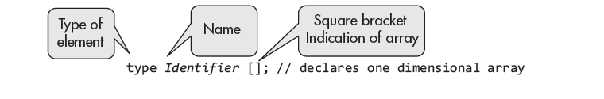
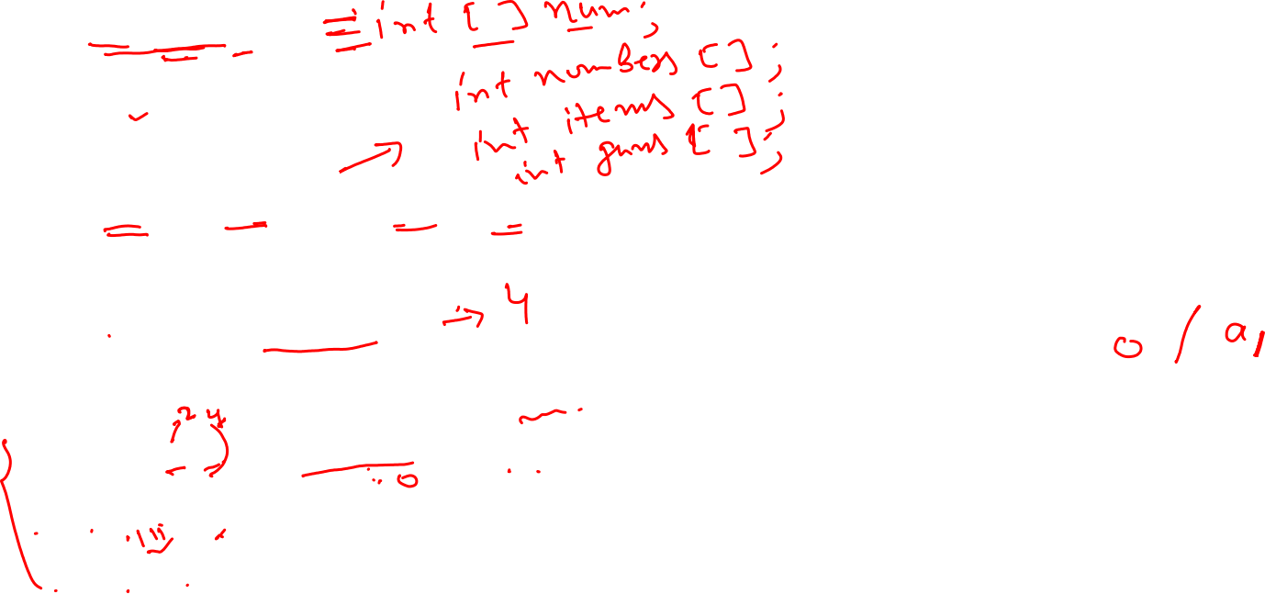
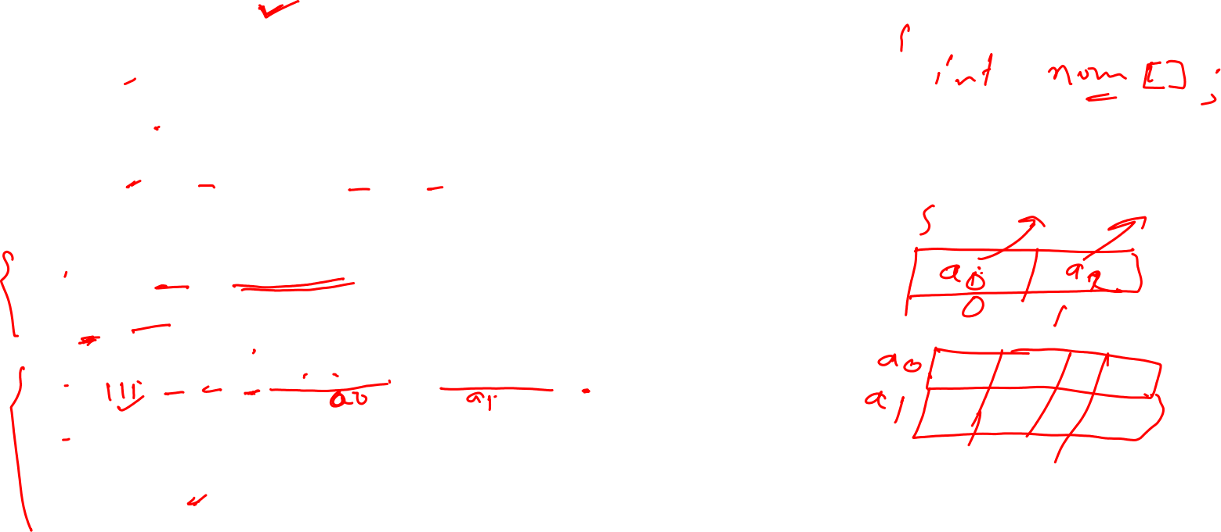
Declaration and Initialization of Arrays
Examples:
int num [];
char name [];
float rate [];
int [] numbers, items, guns; // declares three arrays
Initialization
int num [] = {4, 6, 8, 3};
Int [] num = {4, 6, 8, 3};
Int num [] [] = {{4, 6, 8, 3}, {3, 5, 2, 1}}; // 2D array
Int [] num [] = {{4, 6, 8, 3}, {3, 5, 2, 1}}; // 2D array
Int [] [] num = {{4, 6, 8, 3}, {3, 5, 2, 1}}; // 2D array

Slide 4
Storage of Array in Computer Memory
The operator new allocates memory for storing the array elements.
For example, with the following declaration
int[] numbers = new int[4];
The declaration and initialization may as well be combined as:
int numbers [] = {20,10,30,50};
A two-dimensional array may be declared and initialized as,
int [][] array2d = new int [][] {{1, 2, 3}, {4, 5, 6}};
or as int [][] array2D = {{1, 2, 3}, {4, 5, 6}};

Slide 5
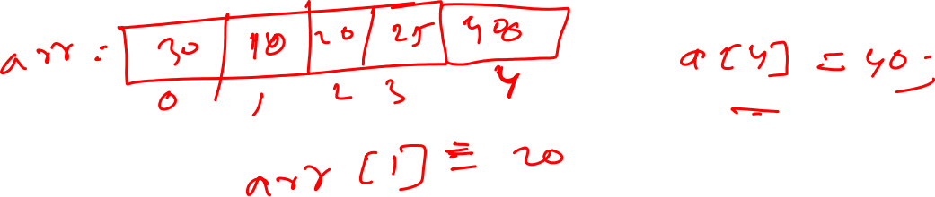
Array Elements Accessing
The individual member of an array may be accessed by its index value.
The index value represents the place of element in the array.
The first element space is represented by numbers [0], and index value is 0.
Note that the value of an array element is different from its index value.

Slide 6
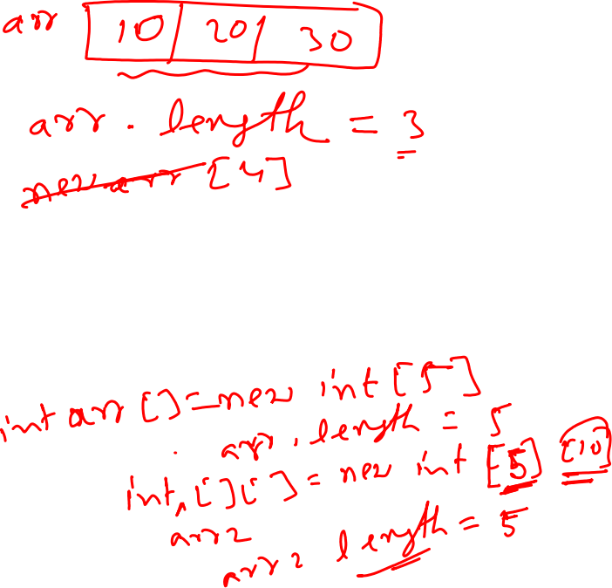
Finding Array Size
The size or length (or number of elements) of an array may be find out using the following code:
int arraySize = array_identifier.length;
The size of array numbers is determined as:
int size = num.length;
The elements of a large array may be accessed using a for loop.
For example, the elements of array numbers may be accessed as
for (int i = 0; i<size; i++)
System.out.println(num[i]);

Slide 7
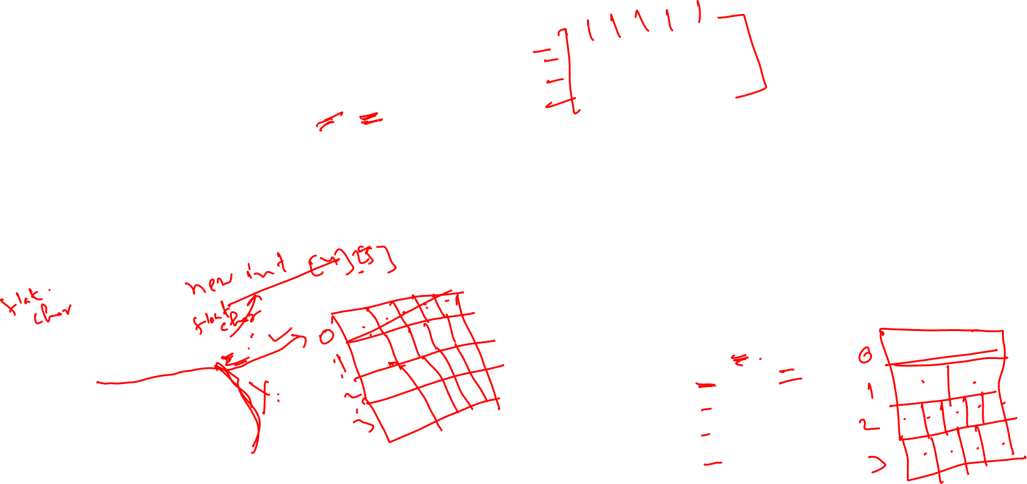
2D-Array
int twoD[][]= new int[4][5];
specification the memory for the first (leftmost) dimension is mandatory. You can allocate the remaining dimensions separately.
not need to allocate the same number of elements for each dimension.
int twoD[][] = new int[4][];
twoD[0] = new int[5];
twoD[1] = new int[5];
twoD[2] = new int[5];
twoD[3] = new int[5];
int twoD[][] = new int[4][];
twoD[0] = new int[1];
twoD[1] = new int[2];
twoD[2] = new int[5];
twoD[3] = new int[4];

Slide 8
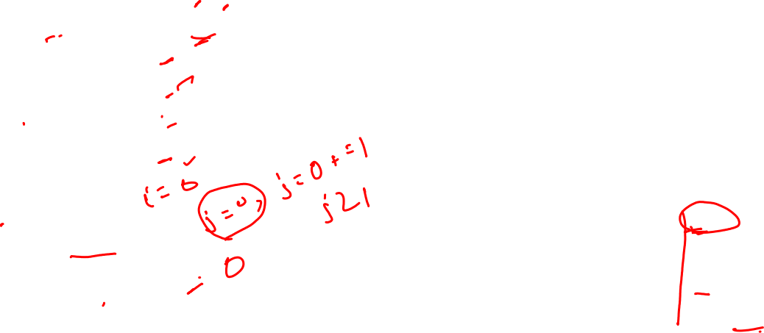
2D-Array: Example
// Manually allocate differing size second dimensions.
class TwoDAgain {
public static void main(String args[]) {
int twoD[][] = new int[4][];
twoD[0] = new int[1];
twoD[1] = new int[2];
twoD[2] = new int[3];
twoD[3] = new int[4];
int i, j, k = 0;
for(i=0; i<4; i++)
for(j=0; j<i+1; j++) {
twoD[i][j] = k;
k++;
}
for(i=0; i<4; i++) {
for(j=0; j<i+1; j++)
System.out.print(twoD[i][j] + " ");
System.out.println();
}
}
}
Output:
0
2
4 5
6 7 8 9

Slide 9
For-each loop in array
the for–each loop may be used to access each element of the array.
for (int x: numbers) System.out.println(x);
For a two-dimensional array the nested for–each loops are used.
int pArray [][]= {{1,2,3},{4,5,7}};
for(int [] y : pArray)
{ for(int x : y)
System.out.print(x + “ ”);
System.out.println();}

Slide 10
String array
1. String[] strAr1=new String[] {"Ani", "Sam", "Joe"}; //inline initialization
2. String[] strAr2 = {"Ani", "Sam", " Joe"};
3. String[] strAr3= new String[3]; //Initialization after declaration with specific size
strAr3[0]= "Ani";
strAr3[1]= "Sam";
strAr3[2]= "Joe";

Slide 11
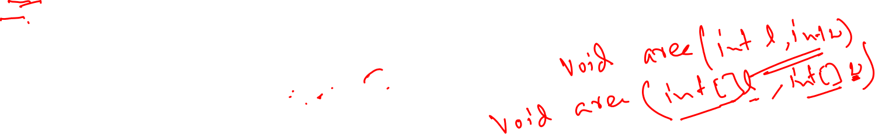
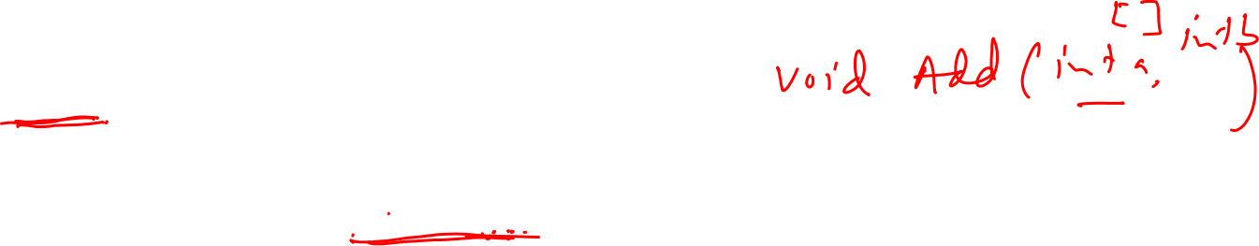
Passing Array into Method

Slide 12
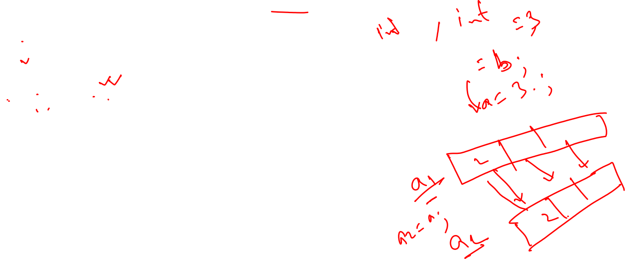
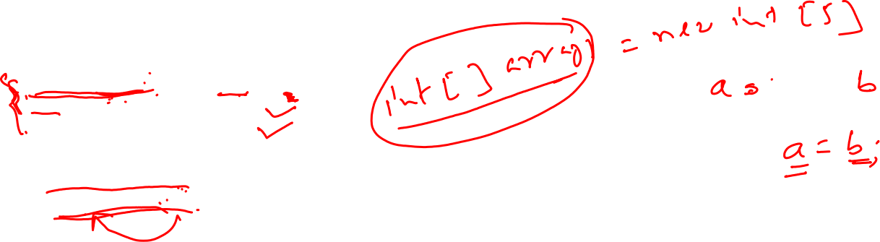
Assign array to another array

Slide 13
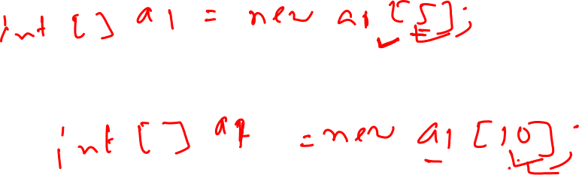
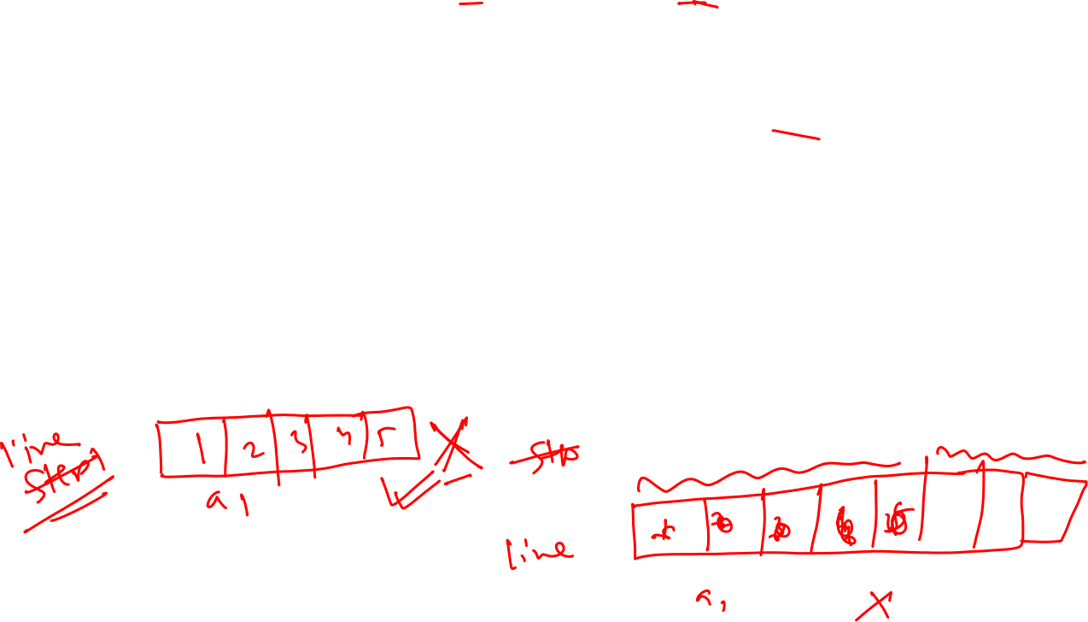
Dynamic change of array size
The number of elements (size) of the array may change during the execution of the program.
This feature is unlike C and C++.
In Java, you may change the number of elements by dynamically retaining the array name.
In this process, the old array is destroyed along with the values of elements.

Slide 14
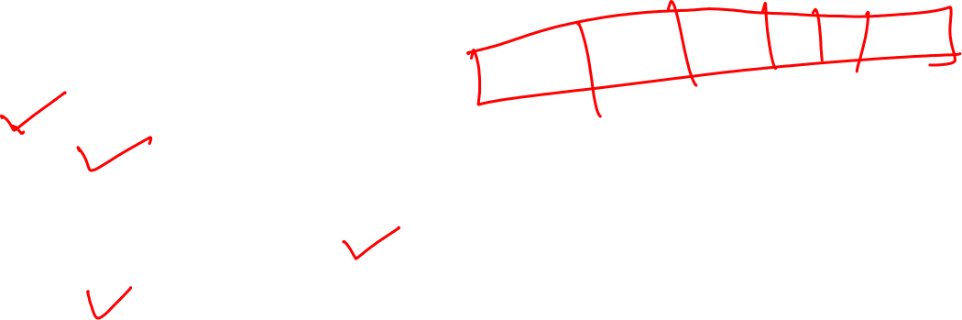
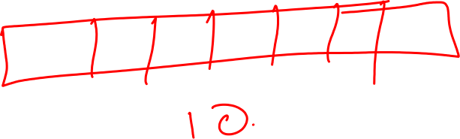
Sorting of array
Sorting of arrays is needed in many applications of arrays.
The arrays may be sorted in ascending or descending order.
Several methods are used for sorting the arrays that include the following:
1. Bubble sort
2. Selection sort
3. Sorting by insertion method
4. Quicksort

Slide 15

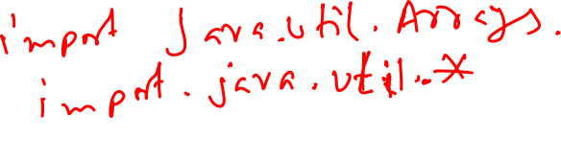
Array Class
The package java.util defines the class Arrays with static methods.
- for general processes that are carried out on arrays such as
sorting an array for full length of the array or for part of an array,
- binary search of an array for the full array or part of an array, for
comparing two arrays if they are equal or not.
- for filling a part or the full array with elements having a specified
value.
- for copying an array to another array.
The sort method of Arrays class is based on quicksort technique.
The methods are applicable to all primitive types as well as to class objects.

Slide 16

Class array: sort methods
The methods of class arrays are as follows:
Sort
The class defines several overloaded methods for sorting arrays of different types.
As per Java SE7, the sort method for int array is
(i) public static void sort (int[] array)
(ii) public static void sort(int[] array, int startIndex single pivot Quicksort method endIndex)
This method sorts the specified subset of the array of type int from startIndex to endIndex.

Slide 17

Class array: various methods
Binary Search: public static int binarySearch(int [] array, int key)
Equals: public static boolean equals (int [] a, int [] b)
The output is a Boolean value—it returns true, if the elements and their order in the two arrays are same; otherwise, it returns false.
Fill: The two versions of method fill defined in class Arrays are as follows.
public static void fill (byte [] array, byte value)
The method fills the entire array with a specified value.
2. public static void fill(byte [] array, int startIndex, int endIndex, bytevalue)
The method fills the specified subset of an array with the specified value

Slide 18


Class array: copyof methods
CopyOf
This method was added in Java SE 6.
public static byte [] copyOf(byte [] original, int length)
The method copies the array into a new array of specified length
2. copyOfRange
public static char [] copyOfRange( char [] original, int fromIndex, int
toIndex)

Slide 19
toString() Method
If you want to represent any object as a string, toString() method comes into existence.
The toString() method returns the String representation of the object.
If you print any object, Java compiler internally invokes the toString() method on the object.
So overriding the toString() method, returns the desired output, it can be the state of an object etc. depending on your implementation.

Slide 20
Vectors
Similar to Arrays, vectors are another kind of data structure that is used for storing information.
Using vector, we can implement a dynamic array.
The following are the vector constructors:
Vector(int size) creates a vector whose initial capacity is specified by size.
Example is
Vector vec = new Vector(5); // declaring with initial size of 5
Vector(int size, int incr) creates a vector with initial capacity specified by size and increment is specified by incr.
The increment is the number of elements added in each reallocation cycle.

Slide 21
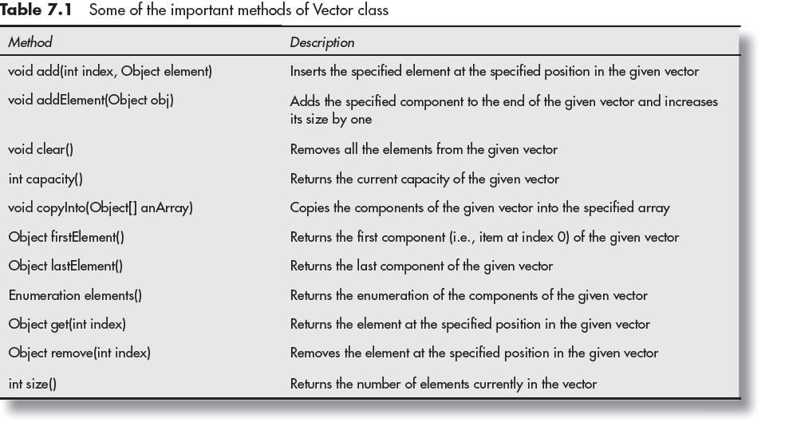

Some methods of vector class

Slide 22

Vector: Example

Slide 23
ArrayList
Java ArrayList class uses a dynamic array for storing the elements.
It is like an array, but there is no size limit. We can add or remove elements anytime.
It is found in the java.util package.

Slide 24
ArrayList: Declaration
1. ArrayList list=new ArrayList();//creating old non-generic arraylist
2. ArrayList<String> list=new ArrayList<String>();//creating new generic arraylist
import java.util.*;
public class ArrayListExample1{
public static void main(String args[]){
ArrayList<String> list=new ArrayList<String>();//Creating arraylist
list.add("Mango");//Adding object in arraylist
list.add("Apple");
list.add("Banana");
list.add("Grapes");
//Printing the arraylist object
System.out.println(list);
}
}

Slide 25
Some methods of ArrayList
Method | Description
void add (int index, E element) | It is used to insert the specified element at the specified position in a list.
boolean add(E e) | It is used to append the specified element at the end of a list.
void clear() | It is used to remove all of the elements from this list.
E get(int index) | It is used to fetch the element from the particular position of the list.
E remove(int index) | t is used to remove the element present at the specified position in the list.
boolean remove(Object o) | It is used to remove the first occurrence of the specified element.
int size() | It is used to return the number of elements present in the list.

Slide 26
Thank You

