Slide 1
Exception Handling
Acknowledgment
The contents of the slides are taken from the followings:
Java- One Step Ahead by A. Seth and B.L. Juneja
The Complete Reference by H. Schildt

Slide 2
Introduction
In Java, an exception is an object of a relevant exception class.
When an error occurs in a method, it throws out an exception object that contains the information about where the error occurred and the type of error.
The error (exception) object is passed on to the runtime system, which searches for the appropriate code that can handle the exception.
The event handling code is called exception handler.
Exception handling is a mechanism that is used to handle runtime errors such as classNotFound and IO.
This ensures that the normal flow of application is not disrupted and program execution proceeds smoothly.
The exception handling code handles only the type of exception that is specified for it to handle.

Slide 3
Introduction
The appropriate code is the one whose specified type matches the type of exception thrown by the method.
If the runtime system finds such a handler, it passes on the exception object to the handler.
If an appropriate handler is not found, the program terminates.
The method that creates an exception may itself provide a code to deal with it.
The try and catch blocks are used to deal with exceptions.
The code that is likely to create an exception is kept in the try block, which may include statements that may create or throw exceptions.
The exception object has a data member that keeps information about the type of exception and it becomes an argument for another block of code that is meant to deal with the exception.
There may be more than one catch blocks.

Slide 4
Introduction
There are basically two models of exception handling.
The exception handling facility supported in Java is based on the termination model.
According to this model, when the method encounters an exception, further processing in that method is terminated and control is transferred from the point where an exception occurs to the point where its nearest matching exception handler (i.e., the catch block) is located.
This model is analogous to the real-life situation when the gas in the cylinder gets over while cooking.
Under the termination model, the cooking process will stop, whereas in resumption model, you would change the cylinder with a new one and continue with the cooking process.
Thus, the alternative approach is based on the resumption model wherein the exception handler tries to rectify the exception situation and resume the program.

Slide 5
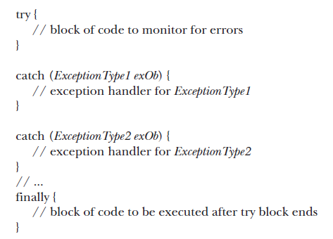
Introduction
This is the general form of an exception-handling block:
Here, ExceptionType is the type of exception that has occurred. The remainder of this chapter describes how to apply this framework.

Slide 6
Introduction
Resumption model was mostly used in earlier languages including PL/I, Mesa, and BETA.
The implementation of resumption model in contemporary languages such as C++ and Java is rarely found as the effort to implement this model is quite high.
This is because the program code becomes quite cumbersome and difficult to understand, and further, it is more error prone.
However, there are situations where the resumption model is quite useful.

Slide 7
Hierarchy of Standard Exception Classes
In Java, exceptions are instances of classes derived from the class Throwable which in turn is derived from class Object.
Whenever an exception is thrown, it implies that an object is thrown.
Only objects belonging to class that is derived from class Throwable can be thrown as exceptions.
The next level of derived classes comprises two classes: the class Error and class Exception.
Error class involves errors that are mainly caused by the environment in which an application is running.
All errors in Java happen during runtime.

Slide 8
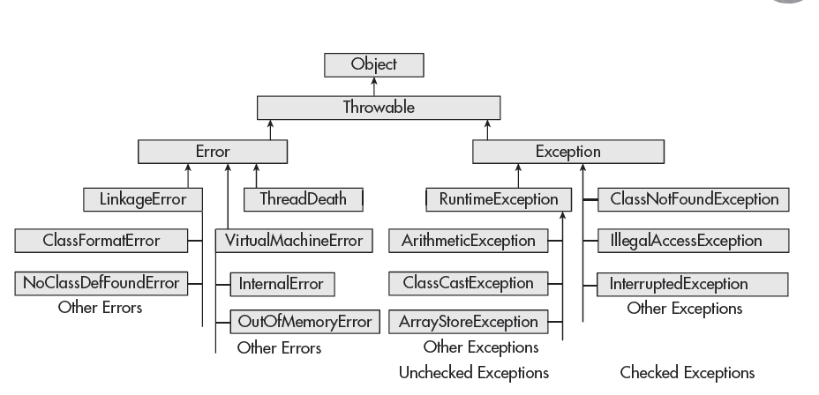
Hierarchy of Standard Exception Classes

Slide 9
Hierarchy of Standard Exception Classes
A programmer cannot do anything about these errors except to get the error message and check the program code.
A programmer can have control over the exceptions (errors) defined by several subclasses of class Exception.
The subclasses of Exception class are broadly subdivided into two categories.
Unchecked exceptions These are subclasses of class RuntimeException, derived from Exception class. For these exceptions, the compiler does not check whether the method that throws these exceptions has provided any exception handler code or not.
Checked exceptions These are direct subclasses of the Exception class and are not subclasses of the class RuntimeException. These are called so because the compiler ensures (checks) that the methods that throw checked exceptions deal with them.

Slide 10
Hierarchy of Standard Exception Classes
This can be done in two ways:
1. The method provides the exception handler in the form of appropriate try–catch blocks.
2. The method may simply declare the list of exceptions that the method may throw with throws clause in the header of the method. In this case, the method need not provide any exception handler.
It is a reminder for those who use the method to provide the appropriate exception handler.
If a method does not follow either of the aforementioned ways, the compilation will result in an error.

Slide 11
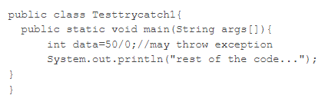
Uncaught Exceptions
Let’s try to understand the problem if we don’t use try-catch block.\
Output:
As displayed in the above example, rest of the code is not executed (in such case, rest of the code… statement is not printed). There can be 100 lines of code after exception. So all the code after exception will not be executed.

Slide 12
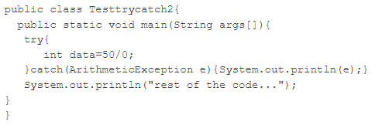

Using try and catch block
Let’s see the solution of above problem by java try-catch block.
Output:

Slide 13
try{} block
The program code that is most likely to create exceptions is kept in the try block, which is followed by the catch block to handle the exception.
In normal execution, the statements are executed and if there are no exceptions, the program flow goes to the code line after the catch blocks.
However, if there is an exception, an exception object is thrown from the try block.
Its data members keep the information about the type of exception thrown.
The program flow comes out of the try block and searches for an appropriate catch block with the same type as its argument.

Slide 14
catch{} block
A catch block is meant to catch the exception if the type of its argument matches with the type of exception thrown.
If the type of exception does not match the type of the first catch block, the program flow checks the other catch blocks one by one.
If the type of a catch block matches, its statements are executed.
If none matches, the program flow records the type of exception, executes the finally block, and terminates the program.

Slide 15
finally{} block
This is the block of statements that is always executed even when there is an exceptional condition, which may or may not have been caught or dealt with.
Thus, finally block can be used as a tool for the clean up operations and for recovering the memory resources.
For this, the resources should be closed in the finally block.
This will also guard against situations when the closing operations are bypassed by statements such as continue, break, or return.
The finally clause is optional. However, each try statement requires at least one catch or a finally clause.

Slide 16
try, catch and finally block

Slide 17
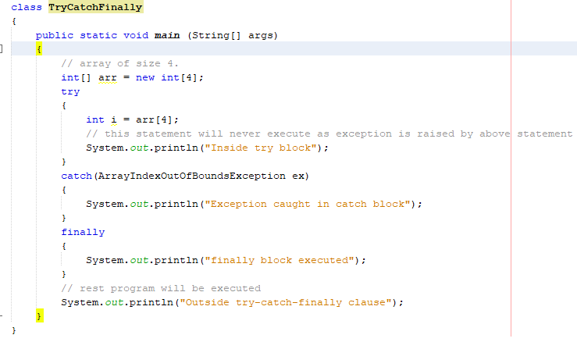
Example: try, catch and finally block

Slide 18
Internal working of java try-catch block
The JVM firstly checks whether the exception is handled or not. If exception is not handled, JVM provides a default exception handler that performs the following tasks:
Prints out exception description.
Prints the stack trace (Hierarchy of methods where the exception occurred).
Causes the program to terminate.
But if exception is handled by the application programmer, normal flow of the application is maintained i.e. rest of the code is executed.

Slide 19
Multiple Catch Clauses
Often the programs throw more than one type of exception.
The programmer has to provide a catch block for each type of exception.
At times, it is quite a cumbersome task often not liked by programmers.
Since Java 7, a modification has been done in the language so that one catch block can catch more than one type of exception.
The exception classes are connected by Boolean operator OR.
All catch blocks must be ordered from most specific to most general i.e. catch for ArithmeticException must come before catch for Exception.

Slide 20
Nested try and catch Blocks
In nested try–catch blocks, one try–catch block can be placed within another try’s body.
Nested try block is used in cases where a part of block may cause one error and the entire block may cause another error.
In such cases, exception handlers are nested.
If a try block does not have a catch handler for a particular exception, the next try block’s catch handlers are inspected for a match.
If the inner block does not catch this exception, it is passed on to the try block, where it is handled
If no catch block matches, then the Java runtime system handles the exception.

Slide 21
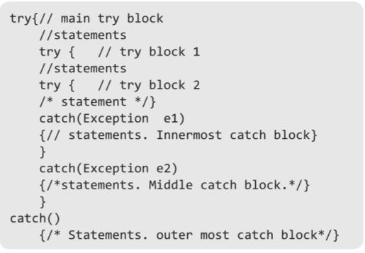
Nested try and catch Blocks

Slide 22
Some important points to remember
If you don’t handle exception, before terminating the program, JVM executes finally block(if any).
For each try block there can be zero or more catch blocks, but only one finally block.
At a time only one Exception is occurred and at a time only one catch block is executed.
All catch blocks must be ordered from most specific to most general i.e. catch for ArithmeticException must come before catch for Exception.

Slide 23
Stack Unwinding
When an exception is thrown but not caught in a particular scope, the method-call stack is "unwound," and an attempt is made to catch the exception in the next outer try block. This process is called stack unwinding.

Slide 24
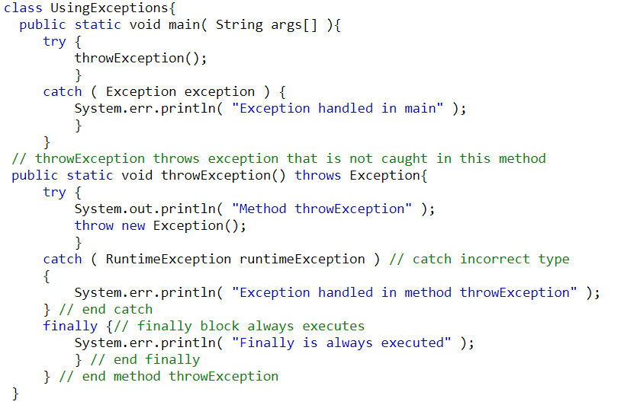
Stack Unwinding: An Example
Output:
Method throwException
Finally is always executed Exception handled in main

Slide 25
Keywords throw
So far, you have only been catching exceptions that are thrown by the Java run-time system.
It is possible for your program to throw an exception explicitly, using the throw statement.
The general form of throw is shown here:
throw ThrowableInstance;
We can throw either checked or uncheked exception in java by throw keyword.
The throw keyword is mainly used to throw custom exception.

Slide 26
Keywords throw
ThrowableInstance must be an object of type Throwable or a subclass of Throwable.
There are two ways you can obtain a Throwable object: using a parameter in a catch clause or creating one with the new operator.
The flow of execution stops immediately after the throw statement; any subsequent statements are not executed.
The nearest enclosing try block is inspected to see if it has a catch statement that matches the type of exception.
If it does find a match, control is transferred to that statement. If not, then the next enclosing try statement is inspected, and so on.
If no matching catch is found, then the default exception handler halts the program and prints the stack trace.

Slide 27
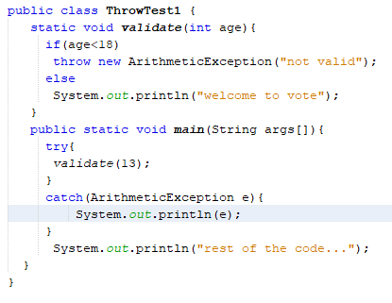
Example: Keywords throw

Slide 28
Keywords throws
The Java throws keyword is used to declare an exception.
It gives an information to the programmer that there may occur an exception so it is better for the programmer to provide the exception handling code so that normal flow can be maintained.
You do this by including a throws clause in the method’s declaration.
A throws clause lists the types of exceptions that a method might throw.
This is necessary for all exceptions, except those of type Error or RuntimeException, or any of their subclasses.
All other exceptions that a method can throw must be declared in the throws clause.
If they are not, a compile-time error will result.

Slide 29
Keywords throws
This is the general form of a method declaration that includes a throws clause:
type method-name(parameter-list) throws exception-list
{
// body of method
}
Here, exception-list is a comma-separated list of the exceptions that a method can throw.
Exception Handling is mainly used to handle the checked exceptions.
If there occurs any unchecked exception such as NullPointerException, it is programmers fault that he is not performing check up before the code being used.
Primary advantage of throws keyword is it provides information to the caller of the method about the exception.

Slide 30
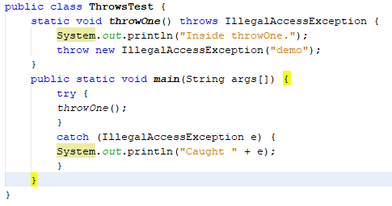
Example: Keywords throws

Slide 31
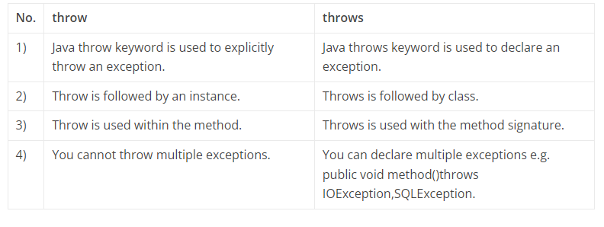
Difference between throw and throws

Slide 32
Built-in Exceptions
Inside the standard package java.lang, Java defines several exception classes.
RuntimeException exceptions need not be included in any method’s throws list.
In the language of Java, these are called unchecked exceptions because the compiler does not check to see if a method handles or throws these exceptions. The unchecked exceptions defined in java.lang are listed in Table 1.
Table 2 lists those exceptions defined by java.lang that must be included in a method’s throws list if that method can generate one of these exceptions and does not handle it itself.
These are called checked exceptions. In addition to the exceptions in java.lang, Java defines several more that relate to its other standard packages.

Slide 33
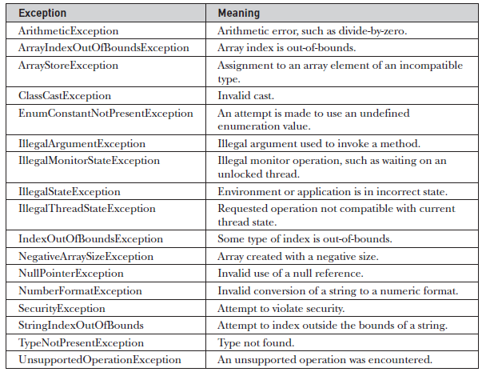
Table 1: Java’s Unchecked RuntimeException Subclasses Defined in java.lang

Slide 34
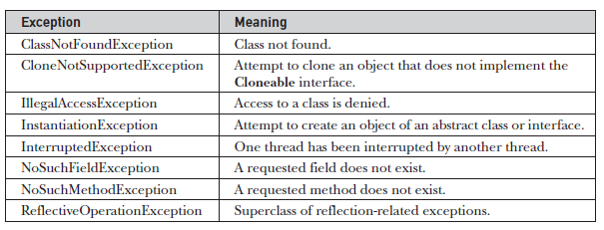
Table 2: Java’s Checked Exceptions Defined in java.lang

Slide 35
Custom(User-define) Exception
It is also called as user defined exception.
A programmer may create his/her own exception class by extending the exception class and can customize the exception according to his/her needs.
Using Java custom exception, the programmer can write their own exceptions and messages.

Slide 36
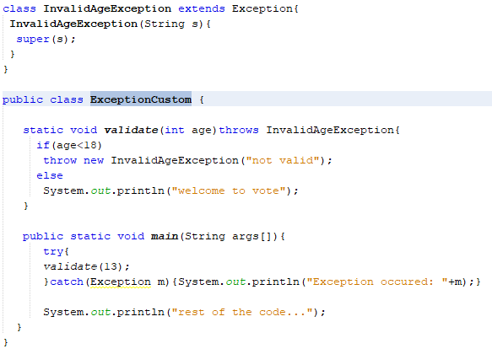
Example: Custom Exception

Slide 37
Finalize() in Exception Handling
The finalize() method is called by garbage collector thread, and thereby memory allocated to the object is reclaimed.
Any exception thrown by finalize method is ignored by the garbage collector thread and it is not logged into the log files.
The syntax for using finalize() method is given as follows:
@Override //
protected void finalize() throws Throwable
{
try{
……………….
} catch(Throwable t)
{ throw t;
}finally{
super.finalize();
}}

Slide 38
Finalize() in Exception Handling
The finalize() method is not usually used as it affects the performance of the program execution.
It takes more time for creating and destroying a simple object, compared to the case when it is not used.
Following points need to be taken into consideration when using finalize() method:
super.finalize() method is always called in finalize() method.
Time critical application logic should not be placed in finalize() method.

Slide 39
Chained Exception
Chained Exceptions allows to relate one exception with another exception, i.e one exception describes cause of another exception.
For example, consider a situation in which a method throws an ArithmeticException because of an attempt to divide by zero but the actual cause of exception was an I/O error which caused the divisor to be zero.
The method will throw only ArithmeticException to the caller. So the caller would not come to know about the actual cause of exception.
Chained Exception is used in such type of situations.
Use: We need to chain the exceptions to make logs readable.
Constructors Of Throwable class Which support chained exceptions in java :
Throwable(Throwable cause) :- Where cause is the exception that causes the current exception.
Throwable(String msg, Throwable cause) :- Where msg is the exception message and cause is the exception that causes the current exception.
Methods Of Throwable class Which support chained exceptions in java :
getCause() method :- This method returns actual cause of an exception.
initCause(Throwable cause) method :- This method sets the cause for the calling exception.

Slide 40
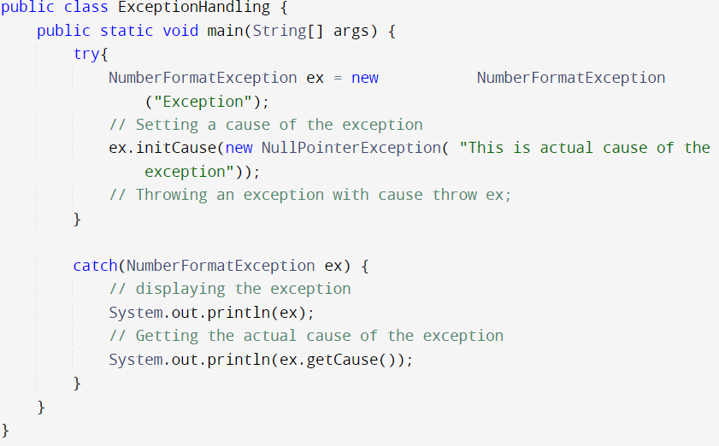

Chained Exception

Slide 41
Assertion
Assertion is a statement in java. It can be used to test your assumptions about the program.
While executing assertion, it is believed to be true. If it fails, JVM will throw an error named AssertionError.
It is mainly used for testing purpose.
It provides an effective way to detect and correct programming errors.
Syntax of using Assertion: There are two ways to use the assertion.
Syntax 1: assert expression;
where Expression is a boolean expression. When the system runs the assertion, it evaluates Expression1 and if it is false throws an AssertionError with no detail message.
Syntax 2: assert expression1 : expression2;
Where Expression1 is a boolean expression and Expression2 is an expression that has a value. (It cannot be an invocation of a method that is declared void.)

Slide 42
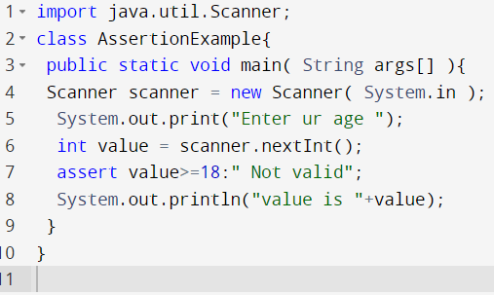
Assertion
If you use assertion, It will not run simply because assertion is disabled by default. To enable the assertion, -ea or -enableassertions switch of java must be used.
Compile it by: javac AssertionExample.java
Run it by: java -ea AssertionExample
Output: Enter ur age 11
Exception in thread "main“ java.lang.AssertionError: Not valid
Where not to use Assertion:
There are some situations where assertion should be avoid to use. They are:
According to Sun Specification, assertion should not be used to check arguments in the public methods because it should result in appropriate runtime exception e.g. IllegalArgumentException, NullPointerException etc.
Do not use assertion, if you don't want any error in any situation.

Slide 43
Try-with-resources
Support for try-with-resources (introduced in Java 7) allows us to declare resources to be used in a try block with the assurance that the resources will be closed after the execution of that block.
Using try-with-resources: Simply put, to be auto-closed, a resource has to be both declared and initialized inside the try:
try (PrintWriter writer = new PrintWriter(new File("test.txt"))) {
writer.println("Hello World");
}

Slide 44
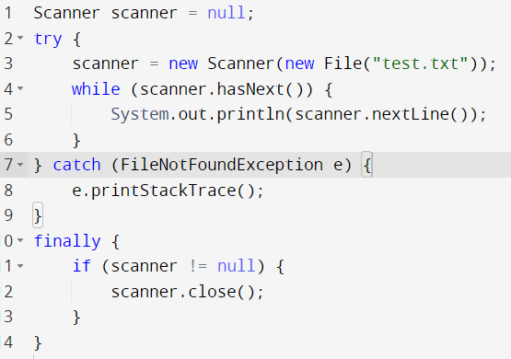
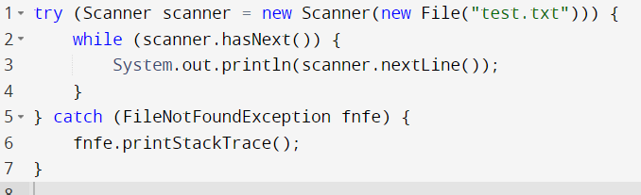
Try-with-resources
Here, we have used finally block to close the file. We can do the same thing using try-with-resources. Here no need to use finally block as below:

Slide 45
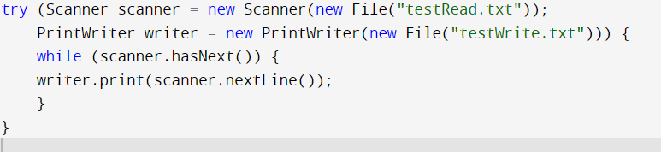
Try-with-resources with Multiple Resources
We can declare multiple resources just fine in a try-with-resources block by separating them with a semicolon:
Resources that were defined/acquired first will be closed last.

