Slide 1
I/O Stream

Slide 2
I/O Outline
I/O basics
Stream: Byte stream, Character Stream,
Reading console Input, writing console output
Reading and writing files

Slide 3
I/O Overview
I/O = Input/Output
In this context it is input to and output from programs
Input can be from keyboard or a file
Output can be to display (screen) or a file
Advantages of file I/O
permanent copy
output from one program can be input to another
input can be automated (rather than entered manually)

Slide 4
Introduction
Java programs perform I/O through streams.
stream is an abstraction that either produces or consumes information.
A stream is linked to a physical device by the Java I/O system.
Java implements streams within class hierarchies defined in the java.io package.
Java defines two types of streams: byte and character.
Byte streams provide a convenient means for handling input and output of bytes.
Byte streams are used, for example, when reading or writing binary data.
Character streams provide a convenient means for handling input and output of characters.
They use Unicode and, therefore, can be internationalized.

Slide 5
Byte Stream
At the top are two abstract classes: InputStream and OutputStream.
Byte streams are defined by using two class hierarchies.
Input stream: a stream that provides input to a program
System.in is an input stream
Output stream: a stream that accepts output from a program
System.out is an output stream
A stream connects a program to an I/O object
System.out connects a program to the screen
System.in connects a program to the keyboard
Each of these abstract classes has several concrete subclasses that handle the differences among various devices, such as disk files, network connections, and even memory buffers.
The byte stream classes in java.io are shown in Table 13-1.
A few of these classes are discussed later in this section.

Slide 6
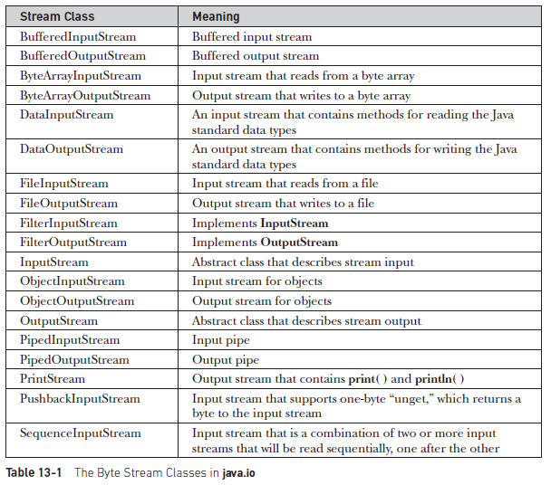
Byte Stream

Slide 7
Character Stream
Character streams are defined by using two class hierarchies.
At the top are two abstract classes: Reader and Writer.
These abstract classes handle Unicode character streams.
Java has several concrete subclasses of each of these.

Slide 8
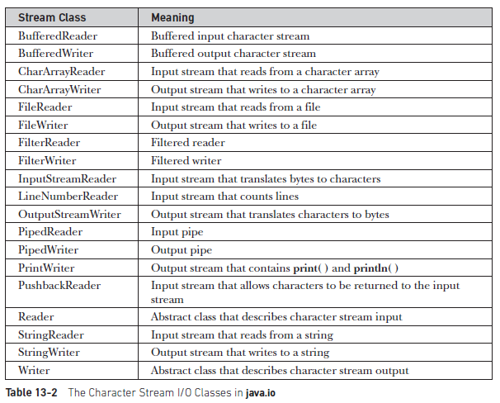
Character Stream

Slide 9
InputStreamReader Class
The InputStreamReader class of the java.io package can be used to convert data in bytes into data in characters.
It extends the abstract class Reader.
The InputStreamReader class works with other input streams.
It is also known as a bridge between byte streams and character streams.
This is because the InputStreamReader reads bytes from the input stream as characters.
For example, some characters required 2 bytes to be stored in the storage. To read such data we can use the input stream reader that reads the 2 bytes together and converts into the corresponding character.

Slide 10
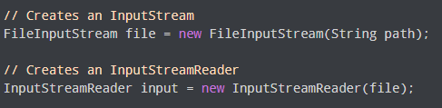
Create an InputStreamReader
To create an InputStreamReader, the java.io.InputStreamReader package must be imported first.
Here, the data in the file are stored using some default character encoding.

Slide 11
Methods of InputStreamReader
The InputStreamReader class provides implementations for different methods present in the Reader class.
read() Method:
read() - reads a single character from the reader
read(char[] array) - reads the characters from the reader and stores in the specified array

Slide 12
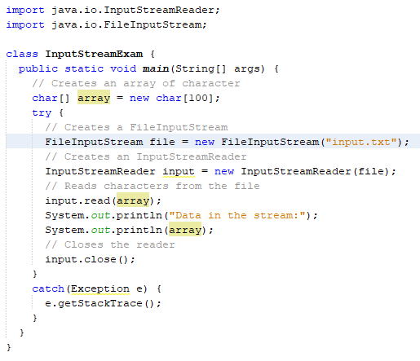
InputStreamReader: An Example
In this example, we have created an input stream reader using the file input stream. The input stream reader is linked with the file input.txt.

Slide 13
Reading Console Input
The console is the terminal window that is running the Java program
I.e., that's the terminal window where you type in the command java ProgramName
When a Java program starts running, the Java runtime system will initialize many variables in support for the running program.
One of these variables is the Java system variable: System.in
which represents the console input
In Java, console input is accomplished by reading from System.in.
To obtain a character based stream that is attached to the console, wrap System.in in a BufferedReader object.
BufferedReader supports a buffered input stream. A commonly used constructor is shown
here: BufferedReader(Reader inputReader)

Slide 14
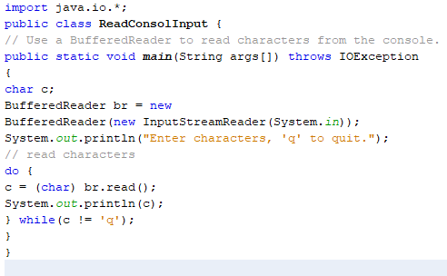
Reading Characters
To read a character from a BufferedReader, use read( ).
The version of read( ) that we will be using is
int read( ) throws IOException

Slide 15
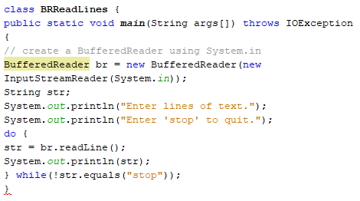
Reading Strings
To read a string from the keyboard, use the version of readLine( ) that is a member of the BufferedReader class.
Its general form is shown here: String readLine( ) throws IOException

Slide 16
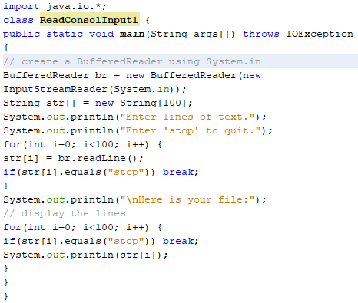
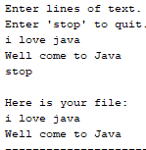
Reading Strings
Creates an array of String objects and then reads in lines of text, storing each line in the array.
It will read up to 100 lines or until you enter "stop." It uses a BufferedReader to read from the console.
Output:

Slide 17
Writing Console Output
Writing Console Output in Java refers to writing the output of a Java program to the console or any particular file.
The methods used for streaming output are defined in the PrintStream class. The methods used for writing console output are print(), println() and write().

Slide 18
Writing Console Output: print() and println()
Both print() and println() methods are used to direct the output to the console.
These methods are defined in the PrintStream class and are widely used.
Both these methods are used with the help of the System.out stream.
The basic differences between print() and println() methods are as follows:
print() method displays the string in the same line whereas println() method outputs a newline character after its execution.
print() method is used for directing output to console only whereas println() method is used for directing output to not only console but other sources also.

Slide 19
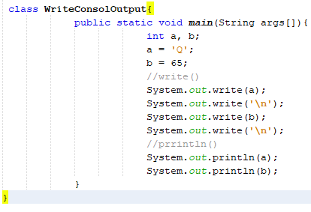
Writing Console Output: write()
Alternatively, you can make use of the write() method for directing the output of your program to the console.
The easiest syntax of the write() method is: void write(int b);
Where b is an integer of low order eight bits.
Output:

Slide 20



Writing Console Output: println() and write()
If you try to print a null value of a String with out.write() , It will throw NullPointerException while out.println() will simply print NULL as a string.
If you are using out.write(), you simply can not place arithmetic operation code but out.print() provides the support.
println() formats the output, while write() just prints the characters it is given.
println() handles many argument types, converting them into printable strings of characters with String.valueOf(), while write() just handles single characters, arrays of characters, and strings.

Slide 21
Reading and Writing Files
Two of the most often-used stream classes are FileInputStream and FileOutputStream, which create byte streams linked to files.
The following are the forms that we will be using:
FileInputStream(String fileName) throws FileNotFoundException
FileOutputStream(String fileName) throws FileNotFoundException
When an output file is opened, any preexisting file by the same name is destroyed.
Must close the open file by calling the close( ) method, which is implemented by both FileInputStream and FileOutputStream.
It is shown here: void close( ) throws IOException
Closing a file releases the system resources allocated to the file, allowing them to be used by another file.
Failure to close a file can result in “memory leaks” because of unused resources remaining allocated.

Slide 22
Reading Files
Constructors of FileInputStream Class
FileInputStream(File file): Creates an input file stream to read from the specified File object.
FileInputStream(FileDescriptor fdobj) :Creates an input file stream to read from the specified file descriptor.
FileInputStream(String name): Creates an input file stream to read from a file with the specified name.

Slide 23
Reading Files
Methods of FileInputStream Class
Methods | Description
available() | Returns an estimate of the number of remaining bytes that can be read (or skipped over) from this input stream.
close() | Closes this file input stream and releases any system resources associated with the stream.
finalize() | Ensures that the close method of this file input stream is called when there are no more references to it.
getChannel() | Returns the unique FileChannel object associated with this file input stream.
getFD() | Returns the FileDescriptor object that represents the connection to the actual file in the file system being used by this FileInputStream.
read() | Reads a byte of data from this input stream
read(byte[] b) | Reads up to b.length bytes of data from this input stream into an array of bytes.
read(byte[] b, int off, int len) | Reads up to len bytes of data from this input stream into an array of bytes.
skip() | Skips over and discards n bytes of data from the input stream

Slide 24
Reading Files
To read from a file, you can use a version of read( ) that is defined within FileInputStream.
int read( ) throws IOException
Each time that it is called, it reads a single byte from the file and returns the byte as an integer value.
read( ) returns –1 when the end of the file is encountered. It can throw an IOException.

Slide 25
Reading Files
Follow these steps to read data from a file using FileInputStream which is ultimatum the goal of FileInputClass
Step 1: Attach a file to a FileInputStream as this will enable us to read data from the file as shown below as follows:
FileInputStream fileInputStream =new FileInputStream(“file.txt”);
Step 2: NoFileInputStream fileInputStream =new FileInputStream(“file.txt”); w in order to read data from the file, we should read data from the FileInputStream as shown below:
ch=fileInputStream.read();
Step 3-A: When there is no more data available to read further, the read() method returns -1;
Step 3-B: Then we should attach the monitor to the output stream. For displaying the data, we can use System.out.print. System.out.print(ch);

Slide 26
Reading Files: An Example
//Java Program to Demonstrate FileInputStream Class
import java.io.*;
class DemoFileInputStream {
public static void main(String args[])
throws IOException
{
FileInputStream fin= new FileInputStream("file1.txt"); // Attaching the file to FileInputStream
System.out.println(fin.getChannel()); // Illustrating getChannel() method
System.out.println(fin.getFD()); // Illustrating getFD() method
System.out.println("Number of remaining bytes:“ + fin.available()); // Illustrating available method
fin.skip(4); // llustrating skip() method
System.out.println("FileContents :");
// Reading characters from FileInputStream and write them
int ch;
while ((ch = fin.read()) != -1) // Holds true till there is data inside file
System.out.print((char)ch);
fin.close(); // Close the file connections using close() method
}
}

Slide 27
Reading and Writing Files: FileReader and FileWriter
It is recommended not to use the FileInputStream and FileOutputStream classes if you have to read and write any textual information as these are Byte stream classes. It is usefull for binary files.
Java FileWriter and FileReader classes are used to write and read data from text files (they are Character Stream classes).
The FileReader automatically converts the raw bytes into characters by using the platform's default character encoding.
Use this class if you are reading from a text file that has the same character encoding as the default one.
To read a text file encoded in different character encoding then you should use InputStreamReader with specified character encoding. An InputStreamReader is a bridge between byte stream and character stream and can take a FileInputStream as a source.

Slide 28
Reading and Writing Files: FileReader
Constructors:
FileReader(File file) – Creates a FileReader , given the File to read from
FileReader(FileDescripter fd) – Creates a new FileReader , given the FileDescripter to read from
FileReader(String fileName) – Creates a new FileReader , given the name of the file to read from

Slide 29
Reading and Writing Files: FileReader
Methods:
public int read () throws IOException – Reads a single character. This method will block until a character is available, an I/O error occurs, or the end of the stream is reached.
public int read(char[] cbuff) throws IOException – Reads characters into an array. This method will block until some input is available, an I/O error occurs, or the end of the stream is reached.
public abstract int read(char[] buff, int off, int len) throws IOException –Reads characters into a portion of an array. This method will block until some input is available, an I/O error occurs, or the end of the stream is reached. Parameters: cbuf – Destination buffer off – Offset at which to start storing characters len – Maximum number of characters to read
public void close() throws IOException closes the reader.
public long skip(long n) throws IOException –Skips characters. This method will block until some characters are available, an I/O error occurs, or the end of the stream is reached. Parameters: n – The number of characters to skip

Slide 30
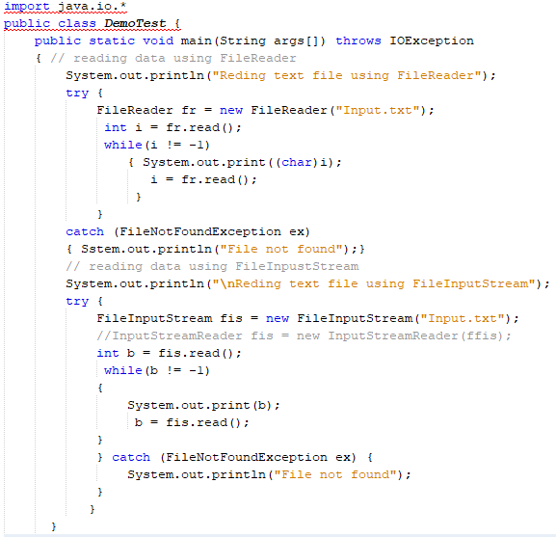
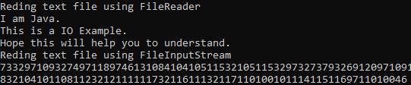
Reading and Writing Files: FileReader

Slide 31
Reading and Writing Files: FileWriter Class
Java FileWriter class is used to write character-oriented data to a file. It is character-oriented class which is used for file handling in java.
Unlike FileOutputStream class, you don't need to convert string into byte array because it provides method to write string directly
Constructors:
FileWriter(String file)- Creates a new file. It gets file name in string.
FileWriter(File file)- Creates a new file. It gets file name in File object.
Methods:
void write(String text)- It is used to write the string into FileWriter.
void write(char c)- It is used to write the char into FileWriter.
void write(char[] c)- It is used to write char array into FileWriter.
void flush()- It is used to flushes the data of FileWriter.
void close()-It is used to close the FileWriter.

Slide 32
Reading and Writing Files: FileWriter Class
import java.io.FileWriter;
public class FileWriterExample {
public static void main(String args[]){
try{
FileWriter fw=new FileWriter("D:\\testout.txt");
fw.write("Welcome to javaTpoint.");
fw.close();
}catch(Exception e){System.out.println(e);}
System.out.println("Success...");
}
}

