Slide 1
Inheritance
by
Jamimamul Bakas
Acknowledgment
The contents of the slides are taken from the followings:
Java- One Step Ahead by A. Seth and B.L. Juneja
The Complete Reference by H. Schildt

Slide 2
Introduction
Inheritance is one of the backbone of object-oriented programming.
Because it allows the creation of hierarchical classifications.
In the terminology of Java, a class that is inherited is called a superclass.
The class that does the inheriting is called a subclass.
It inherits all of the members defined by the superclass and adds its own, unique elements.
Using inheritance, an already tested and debugged class program can be reused for some other application.
Super class This is the existing class from which another class, that is, the subclass is generally derived.
In Java, several derived classes can have the same super class.
Subclass A class that is derived from another class is called subclass.
In Java, a subclass can have only one super class.

Slide 3
Inheritance

Slide 4
Advantages of Inheritance
It allows the reuse of already developed and debugged class program without any modification.
It allows a number of subclasses to fulfil the needs of several subgroups.
A large program may be divided into suitable classes and subclasses that may be developed by separate teams of programmers.

Slide 5
Types of Inheritance
The following types of inheritances are supported by Java.
1. Single inheritance
2. Multilevel inheritance
3. Hierarchical inheritance
4. Multiple inheritance using interfaces

Slide 6

Single Inheritance
Single inheritance: It is the simple type of inheritance. In this, a class extends another one class only.

Slide 7

Multilevel Inheritance
(ii) Multilevel inheritance: In this type, a derived class inherits a parent or super class;
The derived class also acts as the parent class to other class.

Slide 8
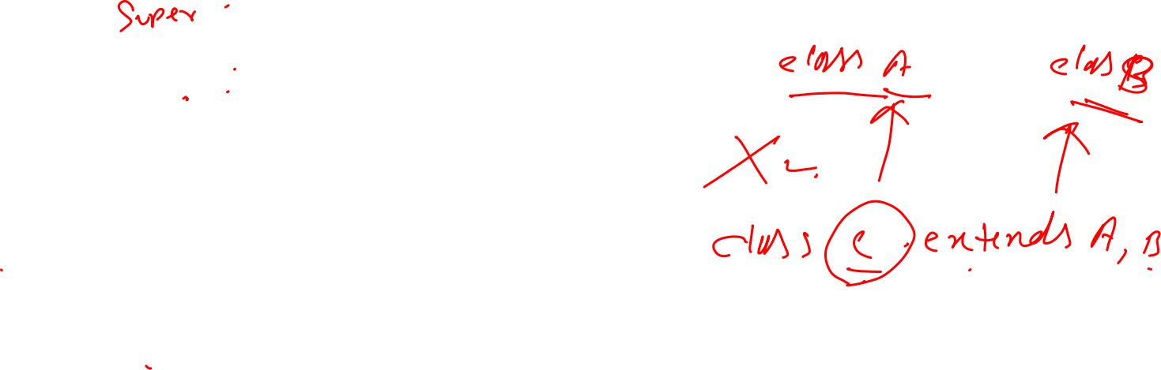
Hierarchical Inheritance
Hierarchical inheritance: In this type, one class is inherited by many sub classes.

Slide 9
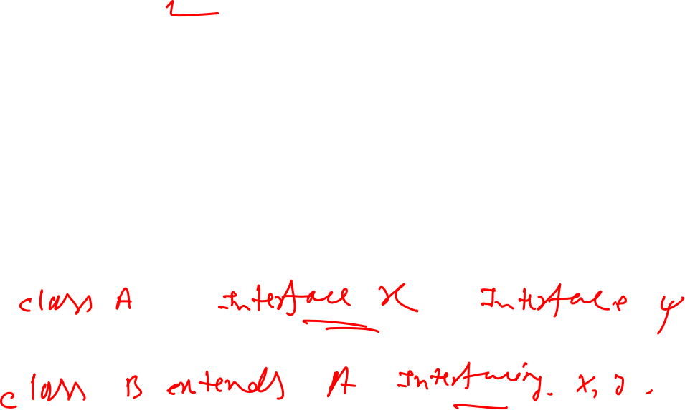
Multiple Inheritance
Multiple inheritance: In this, a class is extending more than one class.
Java does not support multiple inheritance.
This implies that a class cannot extend more than one class.
Suppose there is a method in class A. This method is overridden in class B and class C in their own way.
Since class C extends both the classes A and B.
So, if class C uses the same method, then there will be ambiguity as which method is called.

Slide 10

Types of Inheritance

Slide 11
Universal Super Class—Object Class
Object class is a special class and it is at the top of the class hierarchy tree.
It is the parent class or super class of all in Java.
Hence, it is called Universal super class.
Object is at the root of the tree and every other class can be directly or indirectly derived from the Object class.

Slide 12
Inhibiting Inheritance of Class Using Final
If a class definition is complete and if it is not required to be further sub-classed, it can be declared as final.
A class declared as final cannot be inherited further.
Class variables or instance variables are declared as constant to make local variables.
By declaring any of the aforementioned variables as final, it would always contain the same value.
When a class is inherited by other classes, its methods can be overridden.
In order to prevent the methods from being overridden, that method can be declared as final.

Slide 13
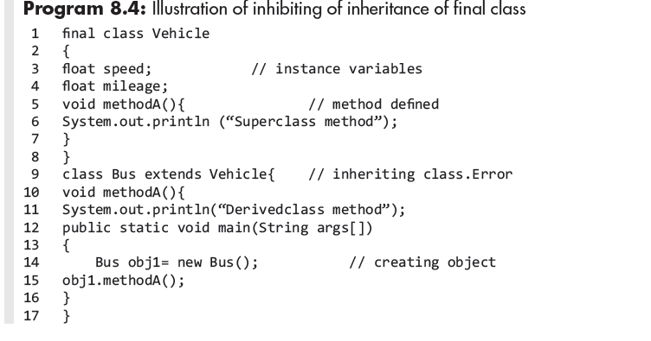

Final Class: An Example

Slide 14
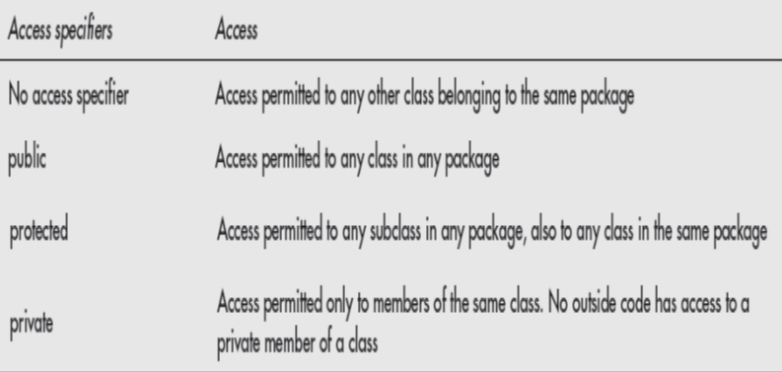
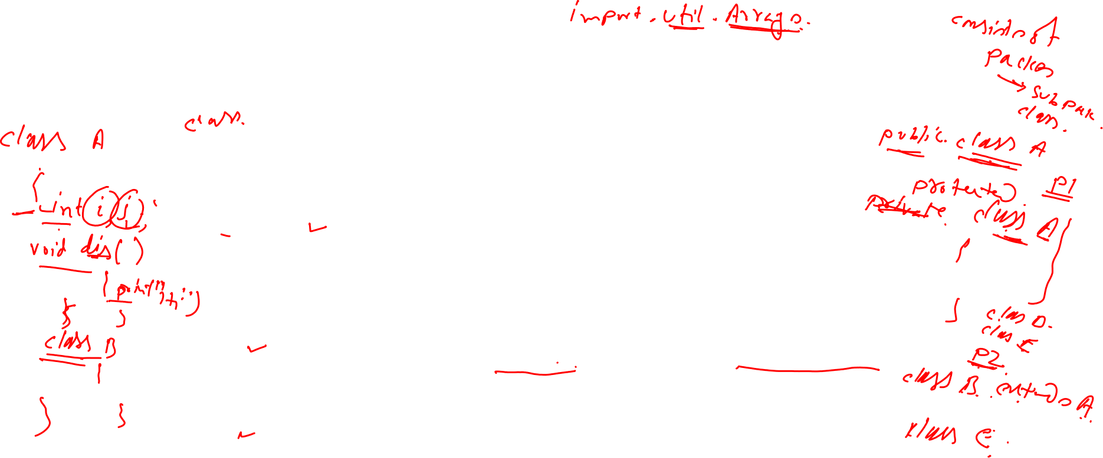
Member Access and Inheritance
A derived class access to the members of a super class may be modified by access specifiers.
There are three access specifiers, that is, public, protected, and private.
The code for specifying access is Access-specifier type member_identifier;

Slide 15
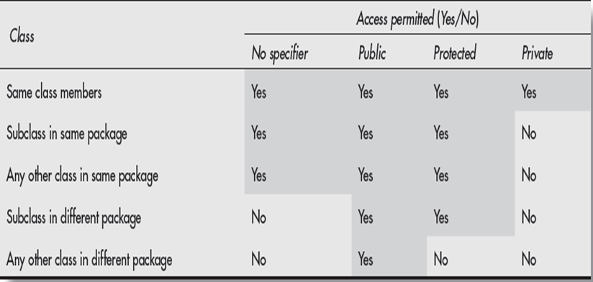
Member Access and Inheritance

Slide 16
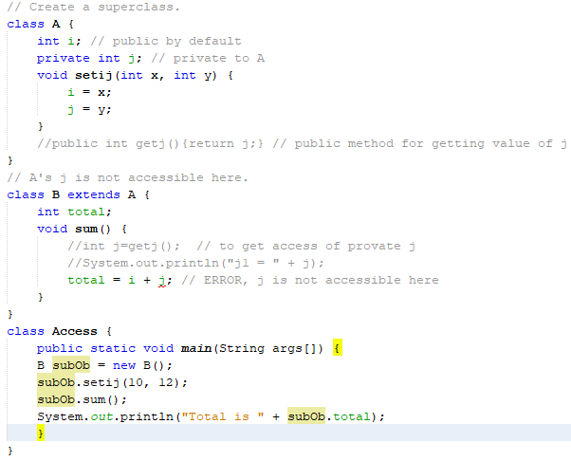
Member Access: An Example

Slide 17
Keyword ‘super’
The keyword super is used for two purposes:
First, to distinguish between the variables having the same name in super class and subclass.
When the member is called with an object of subclass, the subclass value will be presented and super class value will get hidden.
For getting super class value, the keyword super is used.
Second, it is used in defining the constructor of subclass.
Instead of repeating the assignment of variables of super class, we simply qualify the variable with super.

Slide 18
An Example

Slide 19

Constructor Method and Inheritance
For getting super class value, the keyword super is used.
Second, it is used in defining the constructor of subclass.
Instead of repeating the assignment of variables of super class, we simply qualify the variable with super.
Constructor are called in the same order in which the inheritance is defined.
Constructors of super class are not inherited by sub-class, but the constructor of super class can be invoked from sub-class using super keyword.

Slide 20
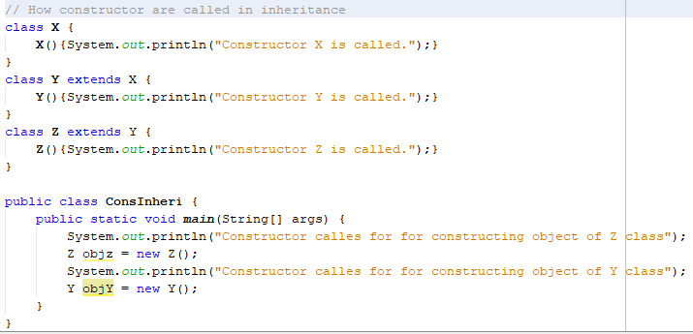
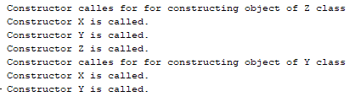
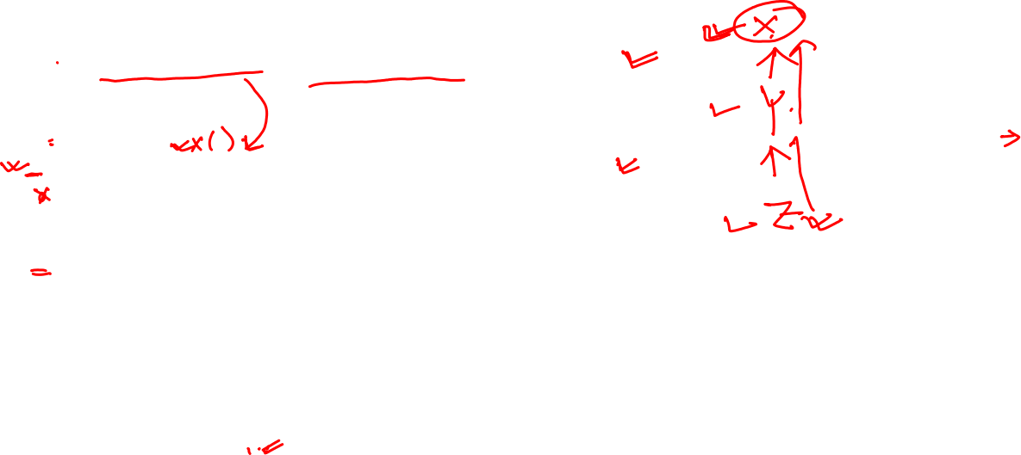
An example
Output

Slide 21
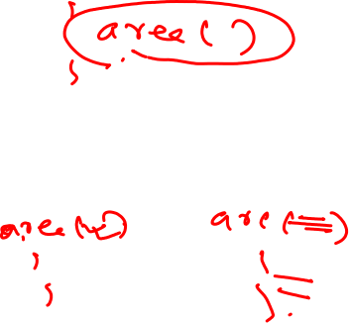
Overriding Method
It is one of the ways in which polymorphism can be implemented.
When both super class and its subclass contain a method that has the same name and type signature, the super class definition of the method is overridden by definitions in subclass.
It is different from the overloaded method in which only the name is same but parameter list has to be different either in type or in number of parameters or order of parameters.
In the case of overloaded methods, the parameter lists are matched to choose the appropriate method that may be in super class or subclass.
When two methods with the same name and type signature are defined in super (base) class as well as in subclass (derived class), the subclass definition overrides the super class definition when the method is called by object of subclass;
It will execute the method defined in subclass and hide the definition of super class.

Slide 22

An Example

Slide 23
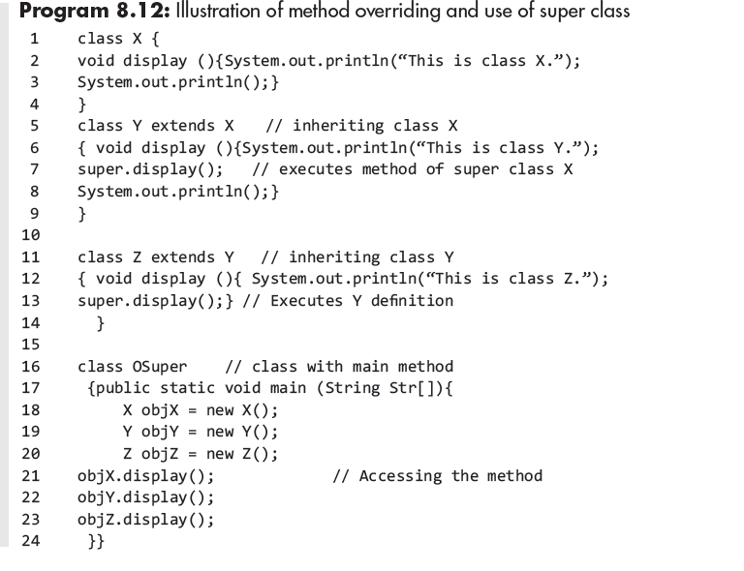
Another Example

Slide 24

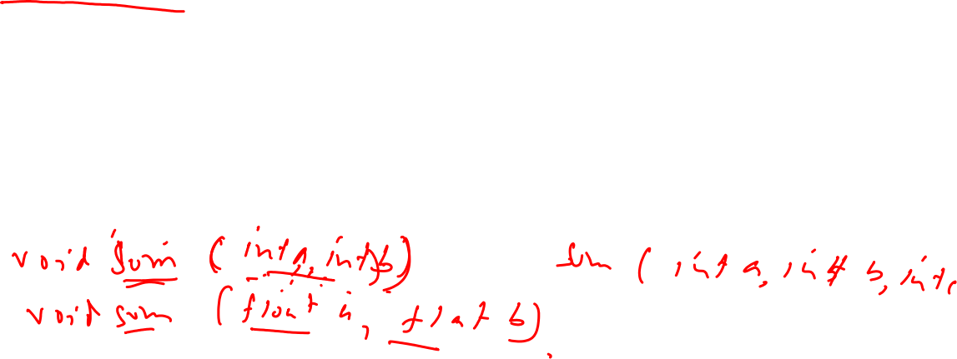
Method Overloading vs. Overriding
Don't confuse the concepts of overloading and overriding
Overloading deals with multiple methods with the same name in the same class, but with different signatures
Overriding deals with two methods, one in a parent class and one in a child class, that have the same signature
Overloading lets you define a similar operation in different ways for different data
Overriding lets you define a similar operation in different ways for different object types

Slide 25

Dynamic Method Dispatch
Dynamic method dispatch is the mechanism by which a call to an overridden method is resolved at run time, rather than compile time.
Dynamic method dispatch is important because this is how Java implements run-time polymorphism.
When an overridden method is called through a superclass reference, Java determines which version of that method to execute based upon the type of the object being referred to at the time the call occurs. Thus, this determination is made at run time.
When different types of objects are referred to, different versions of an overridden method will be called.
In other words, it is the type of the object being referred to (not the type of the reference variable) that determines which version of an overridden method will be executed.
Therefore, if a superclass contains a method that is overridden by a subclass, then when different types of objects are referred to through a superclass reference variable, different versions of the method are executed.

Slide 26
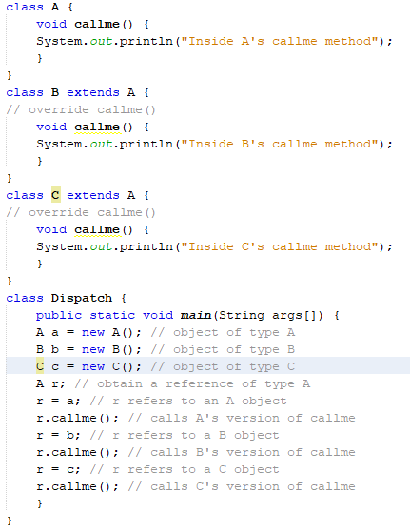
Dynamic Method Dispatch: An Example

Slide 27
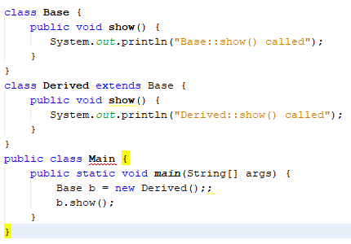

Program example
Output
Derived::show() called

Slide 28
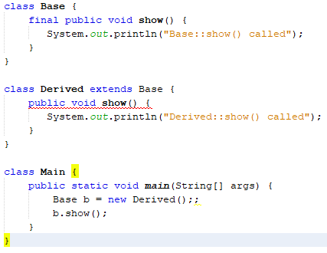

Program example
Output
Compiler error
Because final methods cannot be overridden

Slide 29
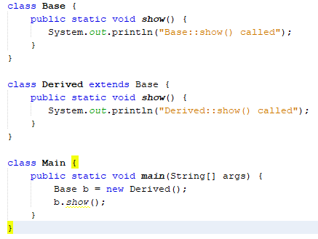

Program example
Output
Compiler error Base::show() called
Because when a function is static, runtime polymorphism doesn’t happen.

Slide 30

Abstract Classes
A Java abstract class is a class which cannot be instantiated.
The abstract methods are not fully defined in super class.
Only subclasses contain their own version of the full definition.
A class containing an abstract method has to be declared abstract.
The full definition of abstract method is only in the subclasses and each subclass has its own definition.
If a class has an abstract method, the whole class must be declared abstract.
Abstract class may contain concrete methods.
The purpose of an abstract class is to function as a base for subclasses.

Slide 31

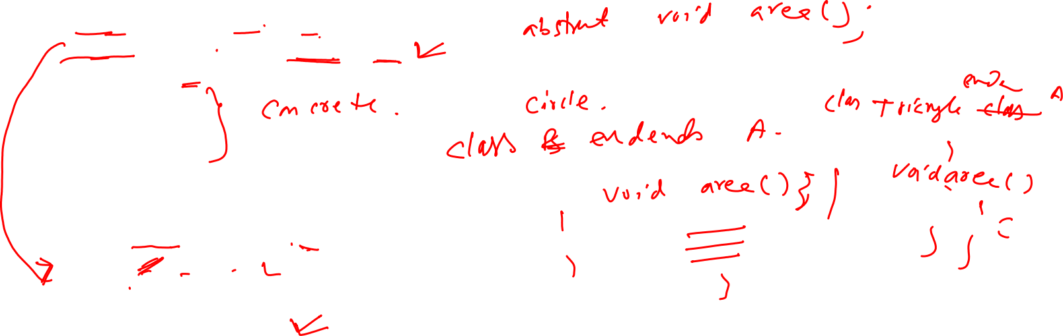
An Example

Slide 32
