Slide 1
Java Memory Management

Slide 2
Outline
What is the Structure of Memory in Java and Memory Management?
How is Memory Management in Java Done?
Stack Memory
Characteristics of Stack Memory
Methods used in the stack memory allocation in java
Java Heap Space
Characteristics of the Java Heap Memory

Slide 3
Introduction
In Java, memory management is the process of allocation and de-allocation of objects, called Memory management.
Java does memory management automatically. Java uses an automatic memory management system called a garbage collector.
So what’s the role of programmer and why a programmer needs to learn about the Java Memory Management ?
There are some objects that aren’t eligible for the automatic garbage collection.
Java memory management divides into two major parts:
JVM Memory Structure
Working of the Garbage Collector

Slide 4
JVM Memory Structure
JVM defines various run time data area which are used during execution of a program.
Some of the areas are created by the JVM whereas some are created by the threads that are used in a program.
The memory area created by JVM is destroyed only when the JVM exits.
The data areas of thread are created during instantiation and destroyed when the thread exits.

Slide 5
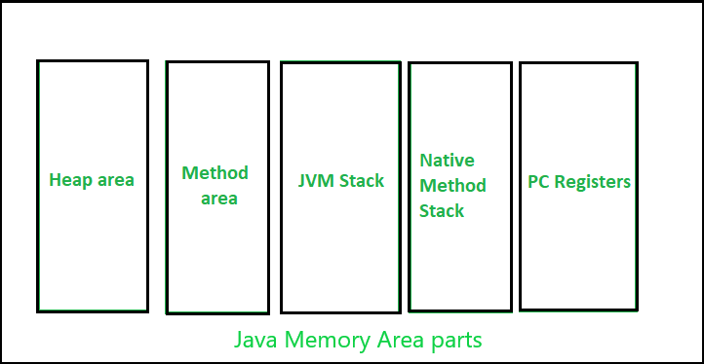
JVM Memory Structure

Slide 6
Heap Area
It is a shared runtime data area and stores the actual object in a memory.
It is instantiated during the virtual machine startup. This memory is allocated for all class instances and array.
Heap can be of fixed or dynamic size depending upon the system’s configuration.
JVM provides the user control to initialize or vary the size of heap as per the requirement. When a new keyword is used, object is assigned a space in heap, but the reference of the same exists onto the stack.
There exists one and only one heap for a running JVM process.
Scanner sc = new Scanner(System.in);
The above statement creates the object of Scanner class which gets allocated to heap whereas the reference ‘sc’ gets pushed to the stack.
Garbage collection in heap area is mandatory.

Slide 7
Method Area
Method Area is a part of the heap memory which is shared among all the threads.
It creates when the JVM starts up. It is used to store class structure, superclass name, interface name, and constructors.
The JVM stores the following kinds of information in the method area:
A Fully qualified name of a type (ex: String)
The type's modifiers
Type's direct superclass name
A structured list of the fully qualified names of super interfaces.
Note: Though method area is logically a part of heap, it may or may not be garbage collected even if garbage collection is compulsory in heap area.

Slide 8
Stack Area and Native method Stacks
A stack is created at the same time when a thread is created and is used to store data and partial results which will be needed while returning value for method and performing dynamic linking.
Stacks can either be of fixed or dynamic size. The size of a stack can be chosen independently when it is created.
The memory for stack needs not to be contiguous.
Any variable in the stack can run as long as the scope of the method exists.
In the case of full memory, the java.lang.StackOverFlowError sets off.
It is faster in access when compared to the heap memory.
Native Method Stacks
Also called as C stacks, native method stacks are not written in Java language.
This memory is allocated for each thread when its created. And it can be of fixed or dynamic nature.

Slide 9
Program counter (PC) Registers:
Each thread has a Program Counter (PC) register associated with it. PC register stores the return address or a native pointer.
It also contains the address of the JVM instructions currently being executed

Slide 10
Garbage Collector Overview
The heap is a part of memory where objects live.
It’s the only part of memory that involved in the garbage collection process. It is also known as garbage collectible heap.
All the garbage collection makes sure that the heap has as much free space as possible.
The function of the garbage collector is to find and delete the objects that cannot be reached.

Slide 11
Garbage Collector Overview
JVM decides when to perform the garbage collection.
We can also request to the JVM to run the garbage collector. But there is no guarantee under any conditions that the JVM will comply.
JVM runs the garbage collector if it senses that memory is running low.
When Java program request for the garbage collector, the JVM usually grants the request in short order. It does not make sure that the requests accept.
Garbage collection is done by daemon thread.
Garbage collection thread invokes finalize() method of that object and peforms the clean up action.
System.gc() and Runtime.gc() are the methods which requests for Garbage collection to JVM explicitly but it doesn’t ensures garbage collection as the final decision of garbage collection is of JVM only.

Slide 12
The finalize() method
Sometimes an object will need to perform some action when it is destroyed. For example, if an object is holding some non-Java resource such as a file handle or character font, then you might want to make sure these resources are freed before an object is destroyed. To handle such situations, Java provides a mechanism called finalization.
By using finalization, you can define specific actions that will occur when an object is just about to be reclaimed by the garbage collector.
To add a finalizer to a class, you simply define the finalize( ) method. The Java run time calls that method whenever it is about to recycle an object of that class.
Inside the finalize( ) method, you will specify those actions that must be performed before an object is destroyed.
The garbage collector runs periodically, checking for objects that are no longer referenced by any running state or indirectly through other referenced objects. Right before an asset is freed, the Java run time calls the finalize( ) method on the object.
The finalize( ) method has this general form:
protected void finalize( )
{
// finalization code here
}

Slide 13
When an object becomes eligible for garbage collection?
Now we can say that an object is eligible for garbage collection when no live thread can access it.
The garbage collector considers that object as eligible for deletion.
If a program has a reference variable that refers to an object, that reference variable available to live thread, this object is called reachable.

Slide 14
Can a Java application run out of memory?
The answer is yes.
The garbage collection system attempts to objects from the memory when they are not in use.
Though, if you are maintaining many live objects, garbage collection does not guarantee that there is enough memory. Only available memory will be managed effectively.

