Slide 1
Regular Expression

Slide 2
Regular Expression
A regular expression is a sequence of characters that forms a search pattern. When you search for data in a text, you can use this search pattern to describe what you are searching for.
A regular expression can be a single character, or a more complicated pattern.
Regular expressions can be used to perform all types of text search and text replace operations.
Java does not have a built-in Regular Expression class, but we can import the java.util.regex package to work with regular expressions. The package includes the following classes:
Pattern Class - Defines a pattern (to be used in a search)
Matcher Class - Used to search for the pattern
PatternSyntaxException Class - Indicates syntax error in a regular expression pattern

Slide 3
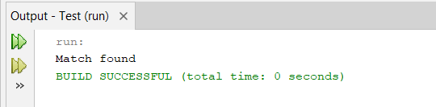
Example
import java.util.regex.Matcher;
import java.util.regex.Pattern;
public class Test {
public static void main(String[] args) throws Exception{
Pattern p = Pattern.compile("Java", Pattern.CASE_INSENSITIVE);
Matcher matcher = p.matcher("Visit Java");
boolean matchFound = matcher.find();
if(matchFound) {
System.out.println("Match found");
}
else
{
System.out.println("Match not found");
}
}
}

Slide 4
Regular Expression Patterns
The first parameter of .compile() method is pattern and it could be of following type:
Expression | Description
[abc] | Find one character from the options between the brackets
[^abc] | Find one character NOT between the brackets
[0-9] | Find one character from the range 0 to 9

Slide 5
Metacharacters
Metacharacter | Description
| | Find a match for any one of the patterns separated by | as in: cat|dog|fish
. | Find just one instance of any character
\d | Find a digit
\s | Find a whitespace character
\b | Find a match at the beginning of a word like this: \bWORD, or at the end of a word like this: WORD\b
\uxxxx | Find the Unicode character specified by the hexadecimal number xxxx

Slide 6
Quantifiers
Quantifier | Description
n+ | Matches any string that contains at least one n
n* | Matches any string that contains zero or more occurrences of n
n? | Matches any string that contains zero or one occurrences of n
n{x} | Matches any string that contains a sequence of X n's
n{x,y} | Matches any string that contains a sequence of X to Y n's
n{x,} | Matches any string that contains a sequence of at least X n's

Slide 7
Matcher class
No. | Method | Description
1 | boolean matches() | test whether the regular expression matches the pattern.
2 | boolean find() | finds the next expression that matches the pattern.
3 | boolean find(int start) | finds the next expression that matches the pattern from the given start number.
4 | String group() | returns the matched subsequence.
5 | int start() | returns the starting index of the matched subsequence.
6 | int end() | returns the ending index of the matched subsequence.
7 | int groupCount() | returns the total number of the matched subsequence.

Slide 8
Pattern Class
It is the compiled version of a regular expression. It is used to define a pattern for the regex engine.
No. | Method | Description
1 | static Pattern compile(String regex) | compiles the given regex and returns the instance of the Pattern.
2 | Matcher matcher(CharSequence input) | creates a matcher that matches the given input with the pattern.
3 | static boolean matches(String regex, CharSequence input) | It works as the combination of compile and matcher methods. It compiles the regular expression and matches the given input with the pattern.
4 | String[] split(CharSequence input) | splits the given input string around matches of given pattern.
5 | String pattern() | returns the regex pattern.

Slide 9
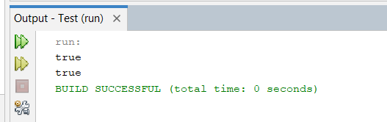
import java.util.regex.Matcher;
import java.util.regex.Pattern;
public class Test {
public static void main(String[] args) throws Exception{
// TODO code application logic here
Pattern pattern = Pattern.compile(".s");
Matcher matcher = pattern.matcher("as");
boolean b=matcher.matches();
boolean b1=Pattern.matches(".s","as");
System.out.println(b);
System.out.println(b1);
}
}

Slide 10
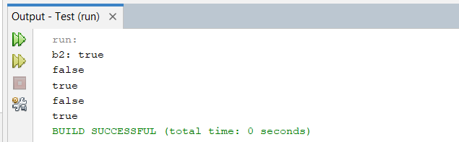
Dot Example
import java.util.regex.Matcher;
import java.util.regex.Pattern;
public class Test {
public static void main(String[] args) throws Exception{
// TODO code application logic here
Pattern p=Pattern.compile("java");
Matcher m=p.matcher("pattern java matches");
boolean b2=m.find();
System.out.println("b2: "+b2);
System.out.println(Pattern.matches("as", "it is as"));
System.out.println(Pattern.matches(".as", "has"));
System.out.println(Pattern.matches(".as", "asap"));
System.out.println(Pattern.matches("..as", "saas"));
}
}

Slide 11
Regex Character classes
No. | Character Class | Description
1 | [abc] | a, b, or c (simple class)
2 | [^abc] | Any character except a, b, or c (negation)
3 | [a-zA-Z] | a through z or A through Z, inclusive (range)
4 | [a-d[m-p]] | a through d, or m through p: [a-dm-p] (union)
5 | [a-z&&[def]] | d, e, or f (intersection)
6 | [a-z&&[^bc]] | a through z, except for b and c: [ad-z] (subtraction)
7 | [a-z&&[^m-p]] | a through z, and not m through p: [a-lq-z](subtraction)

Slide 12
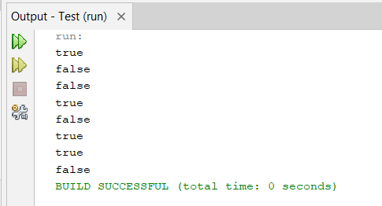
import java.util.regex.Matcher;
import java.util.regex.Pattern;
public class Test {
public static void main(String[] args) throws Exception{
System.out.println(Pattern.matches("[A-Z]", "C"));
System.out.println(Pattern.matches("[a-z]", "B"));
System.out.println(Pattern.matches("[ABC]", "ABCA"));
System.out.println(Pattern.matches("[^ABC]", "X"));
System.out.println(Pattern.matches("[^ABC]", "B"));
System.out.println(Pattern.matches("[^A-M]", "N"));
System.out.println(Pattern.matches("[A-M&&[^B]]", "D"));
System.out.println(Pattern.matches("[A-M&&[^B-F]]", "D"));
}
}

Slide 13
Regex Quantifiers
Regex | Description
X? | X occurs once or not at all
X+ | X occurs once or more times
X* | X occurs zero or more times
X{n} | X occurs n times only
X{n,} | X occurs n or more times
X{y,z} | X occurs at least y times but less than z times

Slide 14
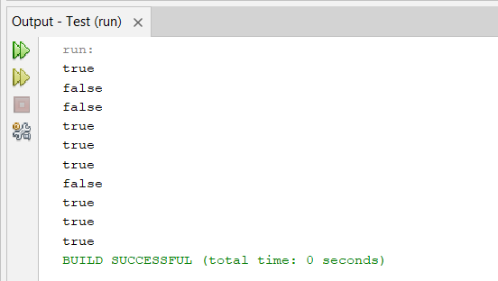
? + and *
import java.util.regex.Matcher;
import java.util.regex.Pattern;
public class Test {
public static void main(String[] args) throws Exception{
// TODO code application logic here
System.out.println(Pattern.matches("[abc]?", "c"));
System.out.println(Pattern.matches("[a]?", "aa"));
System.out.println(Pattern.matches("[ABC]?", "ABC"));
System.out.println(Pattern.matches("[ABC]+", "ABC"));
System.out.println(Pattern.matches("[ABC]+", "AAA"));
System.out.println(Pattern.matches("[ABC]+", "AAB"));
System.out.println(Pattern.matches("[ABC]+", "AABCD"));
System.out.println(Pattern.matches("[ABC]+", "AABABBA"));
System.out.println(Pattern.matches("[ABC]*", ""));
System.out.println(Pattern.matches("[ABC]*", "AABABBACCC"));
}
}

Slide 15
Regex Metacharacter
The regular expression metacharacters work as shortcodes.
Regex | Description
. | Any character (may or may not match terminator)
\d | Any digits, short of [0-9]
\D | Any non-digit, short for [^0-9]
\s | Any whitespace character, short for [\t\n\x0B\f\r]
\S | Any non-whitespace character, short for [^\s]
\w | Any word character, short for [a-zA-Z_0-9]
\W | Any non-word character, short for [^\w]
\b | A word boundary
\B | A non word boundary

Slide 16
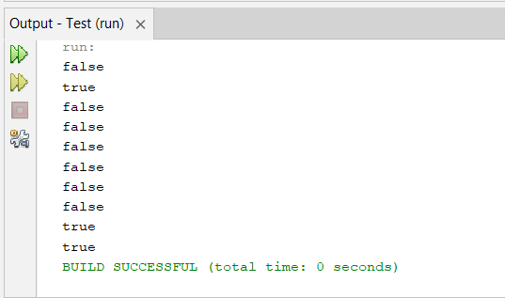
//d and //D
import java.util.regex.Matcher;
import java.util.regex.Pattern;
public class Test {
public static void main(String[] args) throws Exception{
// TODO code application logic here
System.out.println(Pattern.matches("\\d", "123"));
System.out.println(Pattern.matches("\\d", "1"));
System.out.println(Pattern.matches("\\d", "ABC"));
System.out.println(Pattern.matches("\\d", "1ABC"));
System.out.println(Pattern.matches("\\D", "123"));
System.out.println(Pattern.matches("\\D", "1"));
System.out.println(Pattern.matches("\\D", "ABC"));
System.out.println(Pattern.matches("\\D", "1ABC"));
System.out.println(Pattern.matches("\\D", "A"));
System.out.println(Pattern.matches("\\D*", "ABABAC"));
}
}

Slide 17
Practice Problem-1
Create a regular expression that accepts alphanumeric characters only.
Its length must be six characters long only.

Slide 18
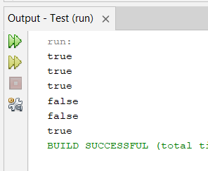
Solution
import java.util.regex.Matcher;
import java.util.regex.Pattern;
public class Test {
public static void main(String[] args) throws Exception{
// TODO code application logic here
System.out.println(Pattern.matches("[a-zA-Z0-9]{6}", "aaaaaa"));
System.out.println(Pattern.matches("[a-zA-Z0-9]{6}", "aaa123"));
System.out.println(Pattern.matches("[a-zA-Z0-9]{6}", "xyz111"));
System.out.println(Pattern.matches("[a-zA-Z0-9]{6}", "xyz11@"));
System.out.println(Pattern.matches("[a-zA-Z0-9]{6}", "xyz1111"));
System.out.println(Pattern.matches("[a-zA-Z0-9]{6}", "ab12a1"));
}
}

Slide 19
Create a regular expression that accepts 10 digit numeric characters
starting with 7, 8 or 9 only.

Slide 20
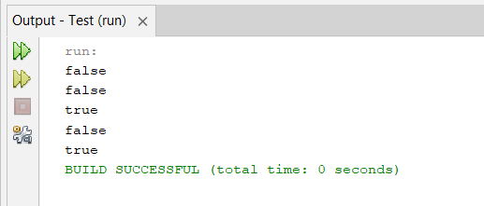
import java.util.regex.Matcher;
import java.util.regex.Pattern;
public class Test {
public static void main(String[] args) throws Exception{
// TODO code application logic here
System.out.println(Pattern.matches("[789]{1}[0-9]{9}", "123"));
System.out.println(Pattern.matches("[789]{1}[0-9]{9}", "aaa123"));
System.out.println(Pattern.matches("[789]{1}[0-9]{9}", "7894563458"));
System.out.println(Pattern.matches("[789]{1}[0-9]{9}", "1894563458"));
System.out.println(Pattern.matches("[789]{1}[0-9]{9}", "7777777777"));
}
}

Slide 21
Java Regular Expression
Enter Regular Expression to match in the text entered by user

Slide 22
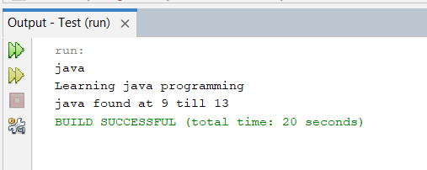
import java.util.Scanner;
import java.util.regex.Matcher;
import java.util.regex.Pattern;
public class Test {
public static void main(String[] args) throws Exception{
// TODO code application logic here
Scanner sc=new Scanner(System.in);
Pattern p=Pattern.compile(sc.nextLine());
Matcher m=p.matcher(sc.nextLine());
boolean b=false;
while(m.find())
{
System.out.println(m.group()+" found at "+m.start()+" till "+m.end());
b=true;
}
if(b!=true)
System.out.println("expression is not present");
}
}

