Slide 1


Java
One step Ahead
Anita Seth &
B.L. Juneja
© Oxford University Press 2018. All rights reserved.

Slide 2
Chapter 12
String Handing in Java
© Oxford University Press 2018. All rights reserved.

Slide 3
Introduction
Strings are treated differently in Java compared to C language;
In the latter case, it represents an array of characters terminated by null character.
In Java, a string is an object of a class, and there is no automatic appending of null character by the system.
In Java, there are three classes that can create strings and process them with nearly similar methods.
(i) class String
(ii) class StringBuffer
(iii) class StringBuilder
All the three classes are part of java.lang package.
© Oxford University Press 2018. All rights reserved.

Slide 4
Overview of Three String Classes
All the three classes have several constructors that can be used for constructing strings.
In the case of String class, an object may be created as
String str1 = “abcd”;
© Oxford University Press 2018. All rights reserved.

Slide 5
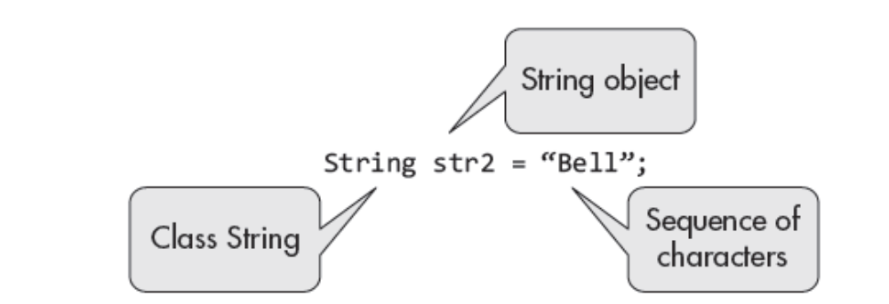
Overview of Three String Classes
The aforementioned two declarations are equivalent to the following:
char s1 [] = {‘a’, ‘b’, ‘c’, ‘d’};
char s2 [] = {‘B’, ‘e’, ‘l’, ‘l’};
© Oxford University Press 2018. All rights reserved.

Slide 6
Storage of Strings
The objects of class String have a special storage facility, which is not available to objects of other two String classes or to objects of any other class.
The memory allocated to a Java program is divided into two segments:
(i) Stack
(ii) Heap
© Oxford University Press 2018. All rights reserved.

Slide 7
Storage of Strings
The variables are stored on heap, whereas the program is stored on stack.
Within the heap, there is a memory segment called ‘String constant pool’.
The String class objects can be created in two different ways:
String strx = “abcd”;
String strz = new String(“abcd”);
© Oxford University Press 2018. All rights reserved.

Slide 8
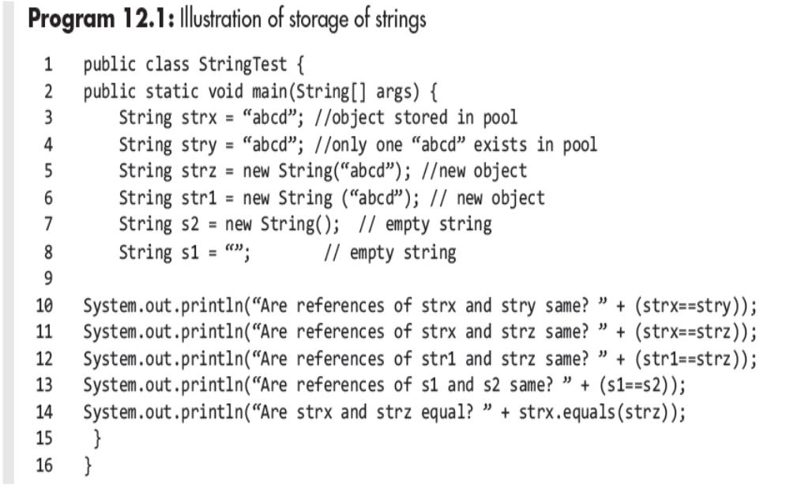
Program Example
© Oxford University Press 2018. All rights reserved.

Slide 9
Immutability
The string objects created by class String are immutable.
By immutable implies that once an object is created, its value or contents cannot be changed.
Neither the characters in the String object once created nor their case (upper or lower) can be changed.
New String objects can always be created and assigned to older String object references.
Thus, when you change the content of a string by defining a new string, the old and new remain in the memory.
The immutable objects are thread safe and so are the String objects.
© Oxford University Press 2018. All rights reserved.

Slide 10
Immutability
The objects created by class StringBuffer are mutable.
These are stored on the heap segment of memory outside the String constant pool.
The contents of StringBuffer strings may be changed without creating new objects.
The methods of StringBuffer are synchronized, and hence, they
are thread safe.
© Oxford University Press 2018. All rights reserved.

Slide 11
Immutability
The objects of class StringBuilder are also mutable but are not thread safe.
The operations are fast as compared to StringBuffer and there is no memory loss as is the case with String class.
The class StringBuilder has the same methods as the class StringBuffer.
Therefore, if multithreads are not being used, then StringBuilder class should be used to avoid memory loss.
© Oxford University Press 2018. All rights reserved.

Slide 12
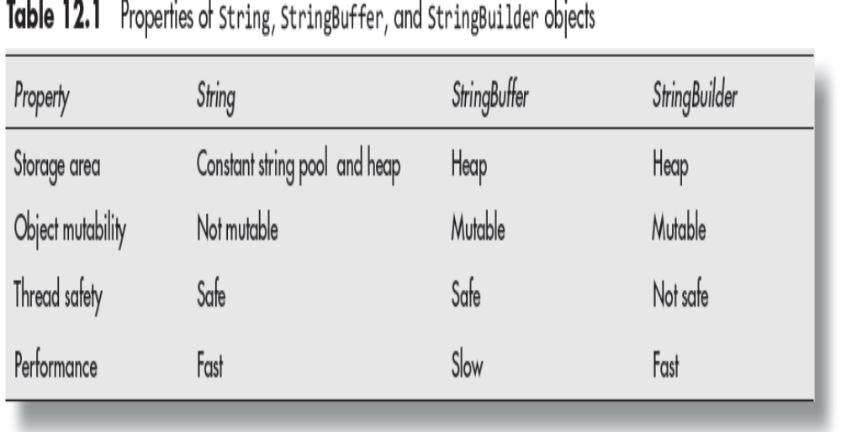

Properties of String, StringBuffer, and StringBuilder objects
© Oxford University Press 2018. All rights reserved.

Slide 13
Interface CharSequence
It is an interface in java.lang package.
It is implemented by several classes including the classes String,
StringBuffer, and StringBuilder.
It has the following four methods.
charcharAt(int index): The method returns character value at specified
index value.
(ii) int length(): This method returns the length of this (invoking) character
sequence.
(iii) CharSequence subsequence(int startIndex, endIndex): The method returns a subsequence from start index to end index of this sequence. Throws IndexOutOfBoundsException.
String to String(): The method returns a string containing characters of
the sequence in the same.
© Oxford University Press 2018. All rights reserved.

Slide 14
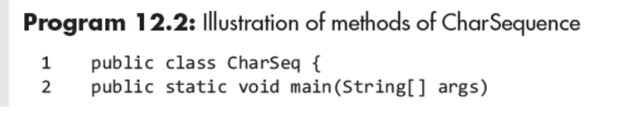
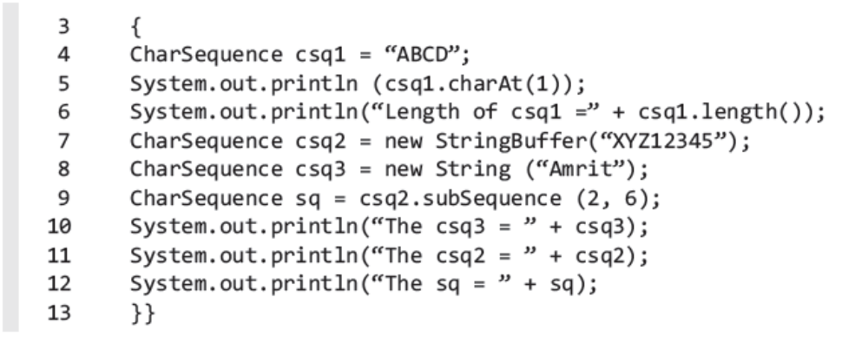
Program Example
© Oxford University Press 2018. All rights reserved.

Slide 15
Class String
The class String is used to represent strings in Java. It is declared as
The String class is final, it cannot be extended.
public final class String
extends Object
implements serializable, comparable<String>, charSequence
© Oxford University Press 2018. All rights reserved.

Slide 16
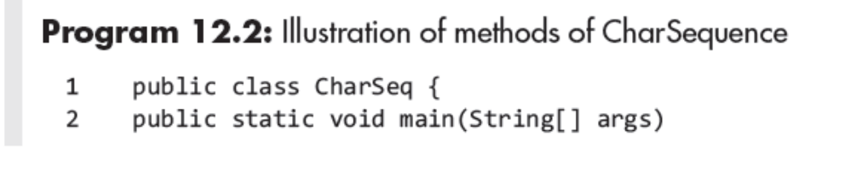
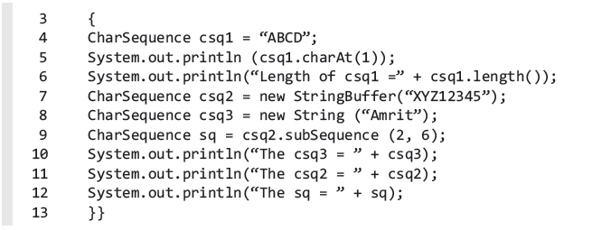
Program Example
© Oxford University Press 2018. All rights reserved.

Slide 17
Constructors of Class String
Following are the constructors of class String:
1. String()
This constructor creates a string without any characters. See the
following examples.
String str = new String();
String str1 = “”;
2. String (byte [] barray)
It constructs a new string by decoding the specified byte[] barray by
using a computer’s default character set. The following code
constructs str2 = “ABCDE”.
byte []bray = new byte[]{65, 66, 67, 68, 69};
String str2 = new String(bray);
© Oxford University Press 2018. All rights reserved.

Slide 18
Constructors of Class String
3. String (byte [] barray, Charset specifiedset)
It constructs a new string by decoding the specified byte array (bray)
by using specified character set.
Some of the Charsets supported by Java are UTF8, UTF16, UTF32, and ASCII.
These may be written in lower case such as utf8, utf16, utf32, and ascii.
4. String(byte[] bray, int offset, int length, String charsetName)
The constructor constructs String object by decoding the specified
part of byte array using specified Charset.
For example
String str4 = new String(bray,1, 3, “ascii”);
© Oxford University Press 2018. All rights reserved.

Slide 19
Constructors of Class String
5. String (byte[] barray, string charsetName}
The constructor constructs a string by decoding the byte array using
specified Charset.
String str3 = new String(bray, “UTF8”);
The method throws UnsupportedEncodingException if the given charset is not supported.
© Oxford University Press 2018. All rights reserved.

Slide 20
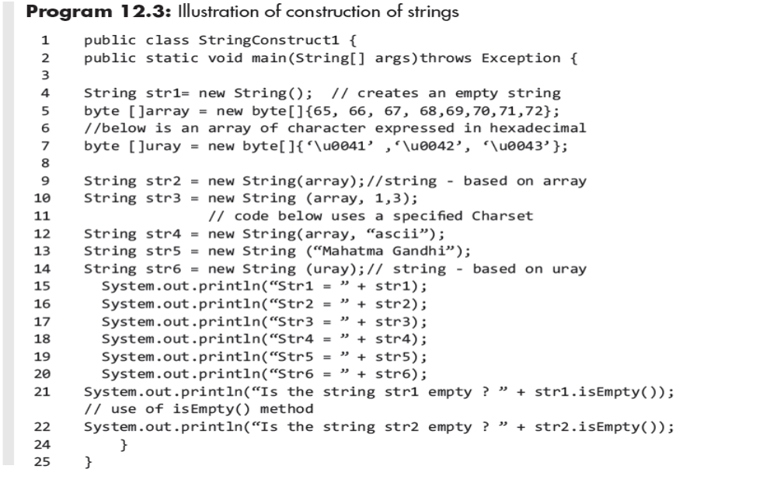
Program Example
© Oxford University Press 2018. All rights reserved.

Slide 21

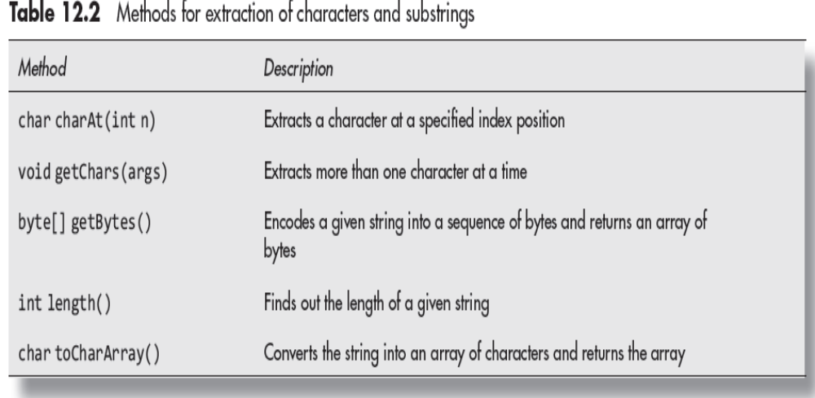
Methods for Extracting Characters from Strings
© Oxford University Press 2018. All rights reserved.

Slide 22
Methods for Extracting Characters from Strings
The signatures of the first two methods are as:
1. char charAt (int n), where n is a positive number, which gives the
location of a character in a string.
It returns the character at the specified index location.
Thus, in String ‘Delhi’ the index value of ‘D’ is 0, index value of ‘e’
is 1, ‘h’ is 3, and so on.
© Oxford University Press 2018. All rights reserved.

Slide 23
Methods for Extracting Characters from Strings
2. void getChars (int SourceStartindex, int SourceEndindex, char targetarray[], int targetindexstart)
This method takes characters from a string and deposits them in another string.
int SourceStartindex and int SourceEndindex relate to the source string.
char targetarray[] relates to the array that receives the string characters. The int targetindexstart is the index value of target array.
© Oxford University Press 2018. All rights reserved.

Slide 24
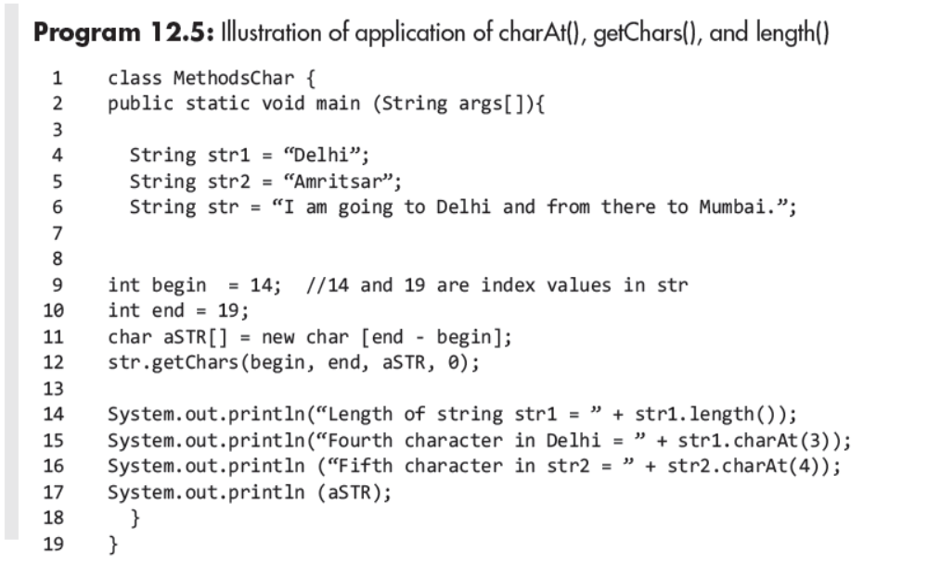
Program Example
© Oxford University Press 2018. All rights reserved.

Slide 25
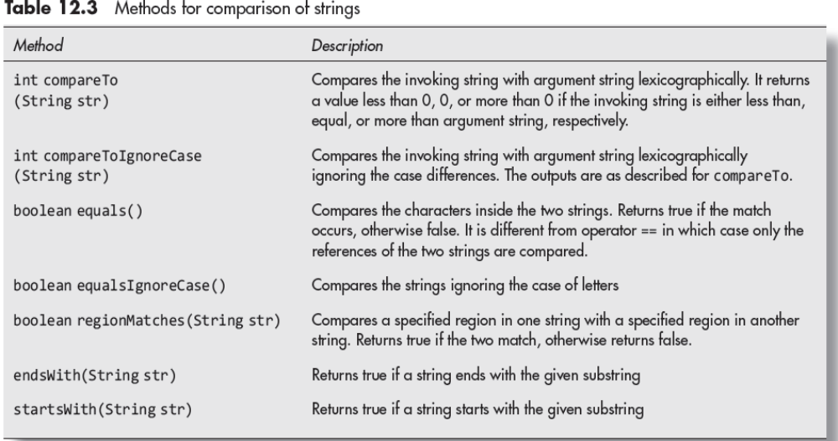
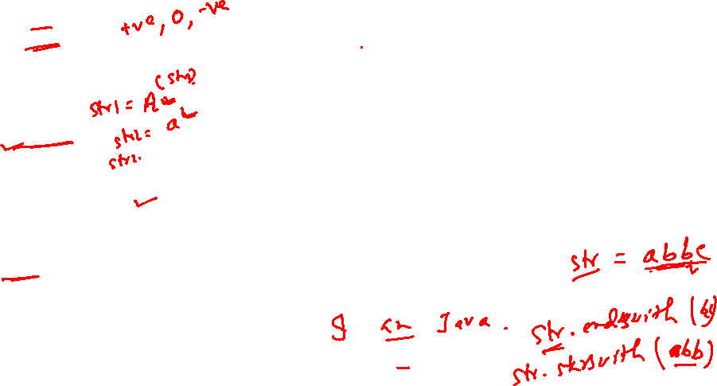
Methods for Comparison of Strings
© Oxford University Press 2018. All rights reserved.

Slide 26
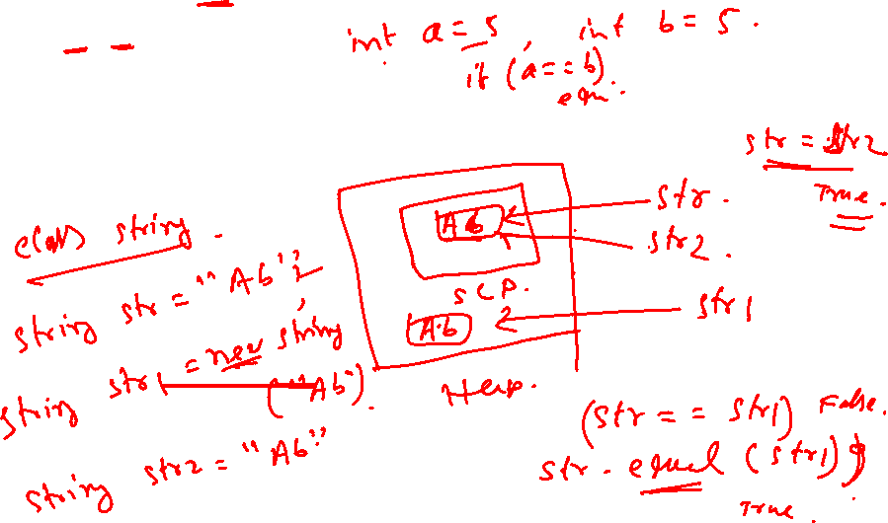
Difference between == and Method Equals()
The operator == simply compares the references. E.g.
if (str1==str2)
The contents are compared by the method equals() as
if (str1.equals(str3))
© Oxford University Press 2018. All rights reserved.

Slide 27
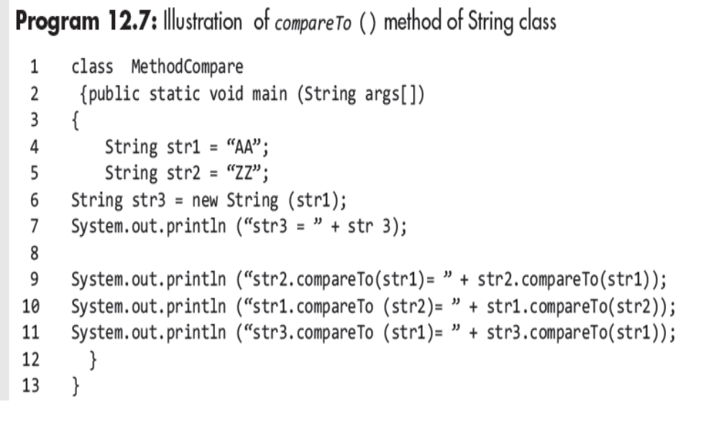
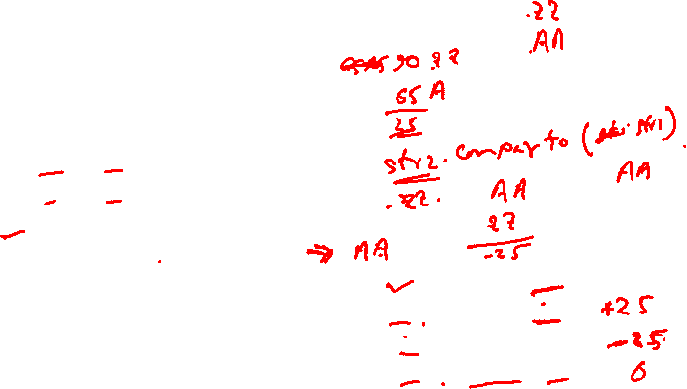
Program Example
© Oxford University Press 2018. All rights reserved.

Slide 28
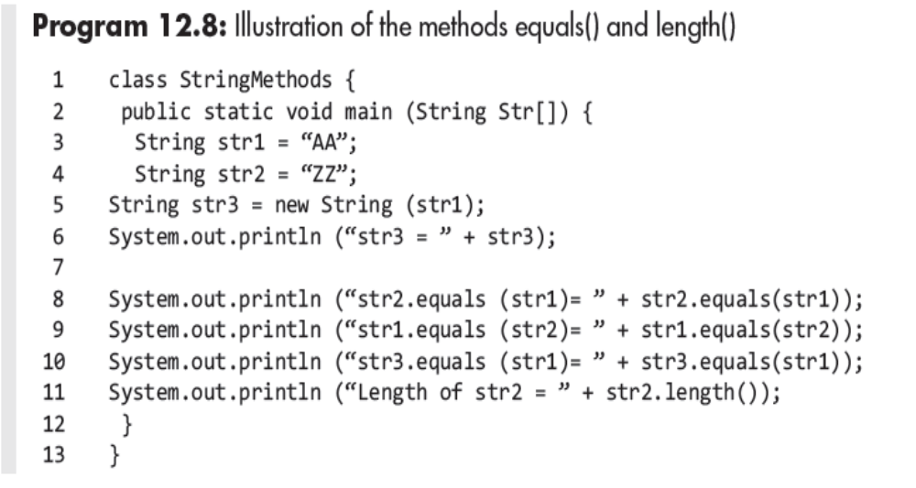
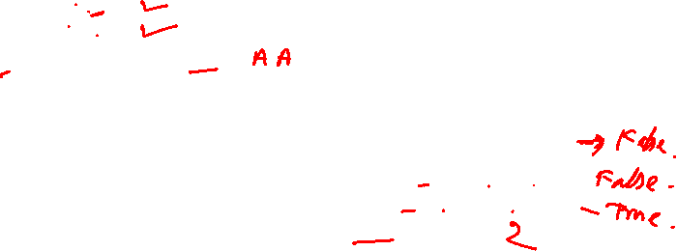
Program Example
© Oxford University Press 2018. All rights reserved.

Slide 29
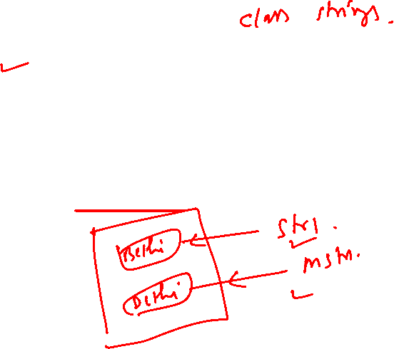
Methods for Modifying Strings
The ways to modify strings are as follows:
1. Define a new string.
2. Create a new string out of substring of an existing string.
3. Create a new string by adding two or more substrings.
4. Create a new string by replacing a substring of an existing string.
5. Create a new string by trimming the existing string.
© Oxford University Press 2018. All rights reserved.

Slide 30
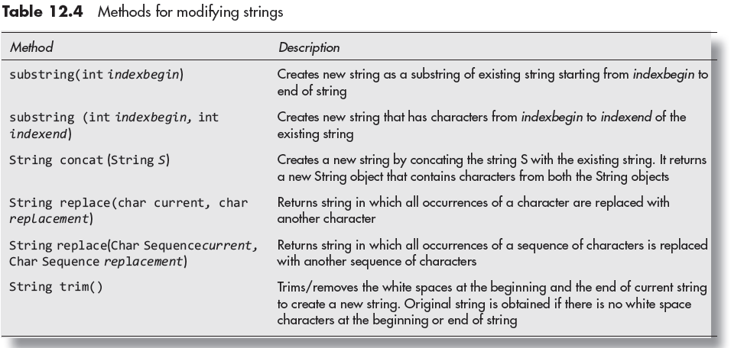
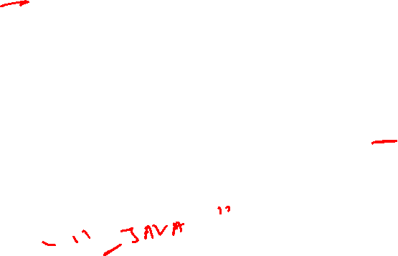
Methods for Modifying Strings
© Oxford University Press 2018. All rights reserved.

Slide 31
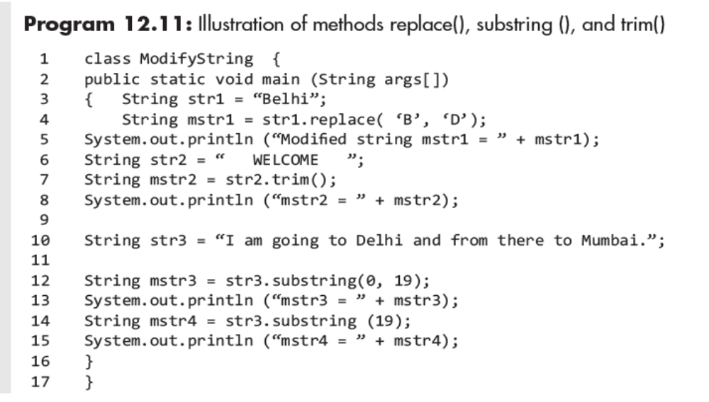
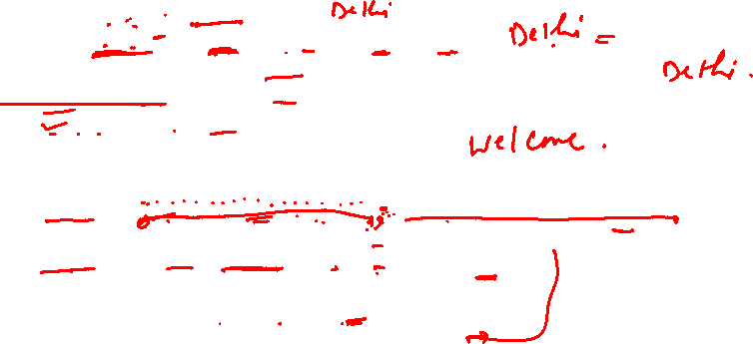
Program Example
© Oxford University Press 2018. All rights reserved.

Slide 32

Methods for Searching Strings
indexOf()
Int indexOf(int character/substring)—searches for the first
occurrence of a specified character in the string.
int indexOf(int character/substring, int index)—searches for the
first occurrence of a specified character or substring and the
search starts from the specified index value, that is, the second
argument.
© Oxford University Press 2018. All rights reserved.

Slide 33
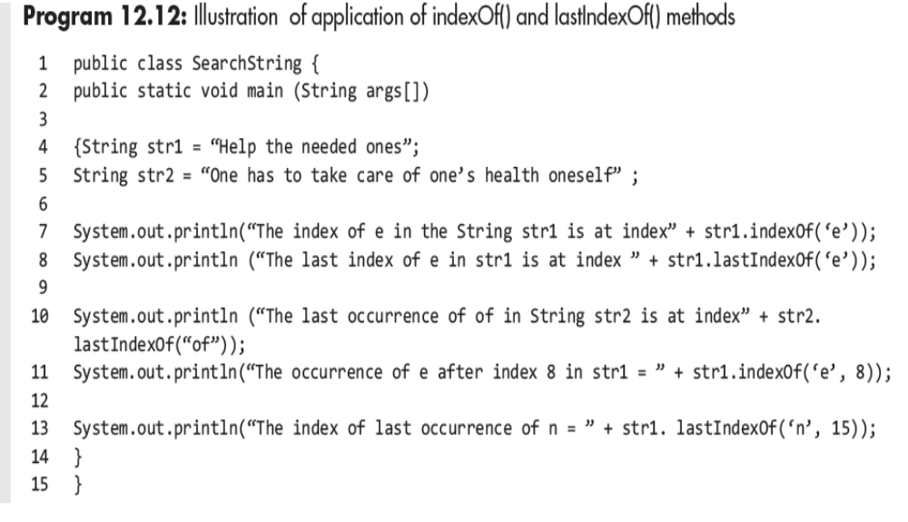

Program Example
© Oxford University Press 2018. All rights reserved.

Slide 34
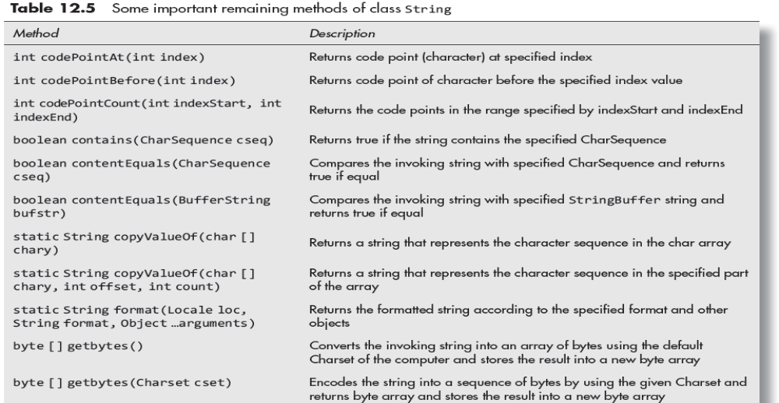
Data Conversion and Miscellaneous Methods
© Oxford University Press 2018. All rights reserved.

Slide 35
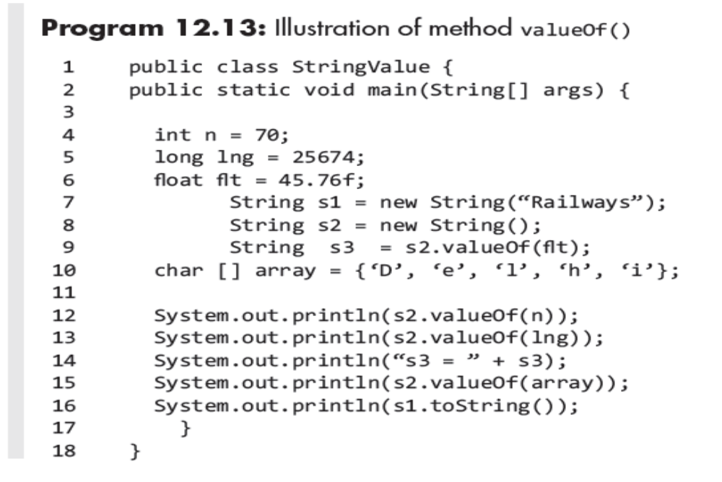

Program Example
© Oxford University Press 2018. All rights reserved.

Slide 36
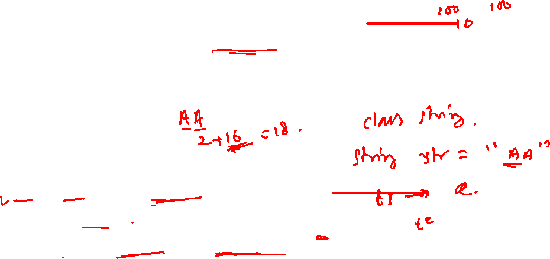
Class StringBuffer
It defines the strings that can be modified as well as the number of
characters that may be changed, replaced by another, a string that may
be appended, etc.
The strings are also thread safe. For the strings created by class StringBuffer, the compiler allocates extra capacity for 16 more characters so that small modifications do not involve relocation of the string.
The class is declared as follows:
public final class StringBuffer
extends Object
implements Serializable, CharSequence
© Oxford University Press 2018. All rights reserved.

Slide 37
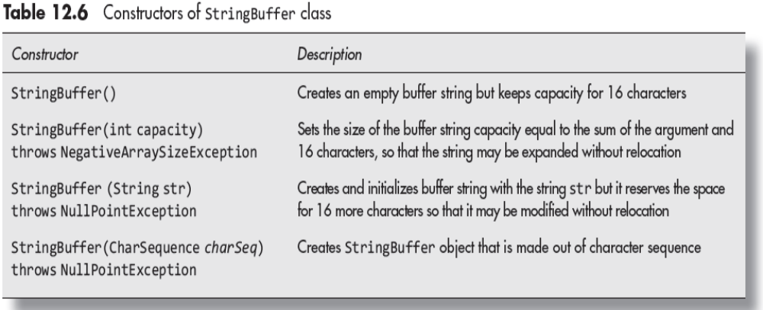
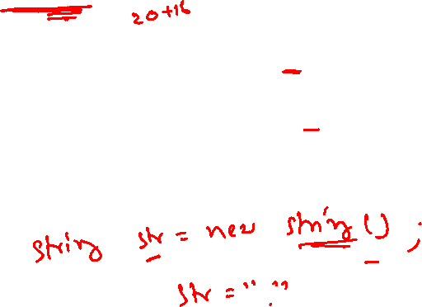
Constructors of Class Stringbuffer
© Oxford University Press 2018. All rights reserved.

Slide 38
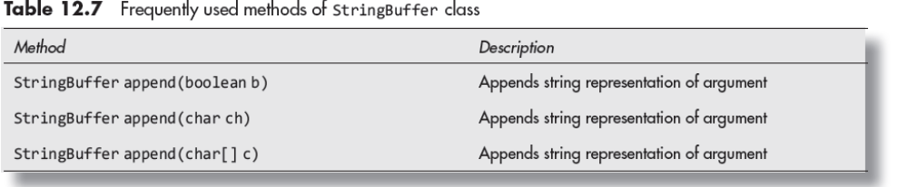
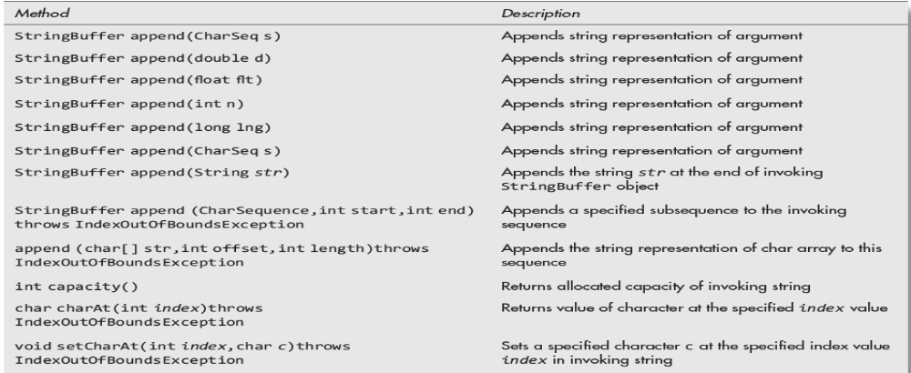
Methods of Class Stringbuffer
© Oxford University Press 2018. All rights reserved.

Slide 39
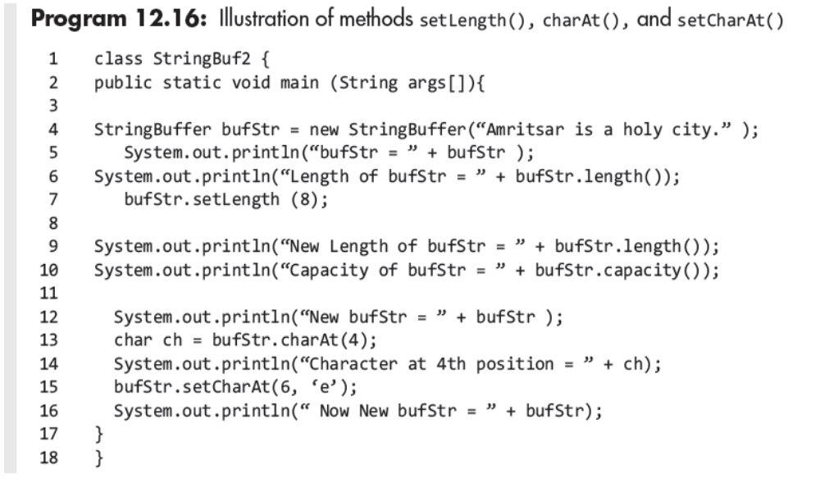
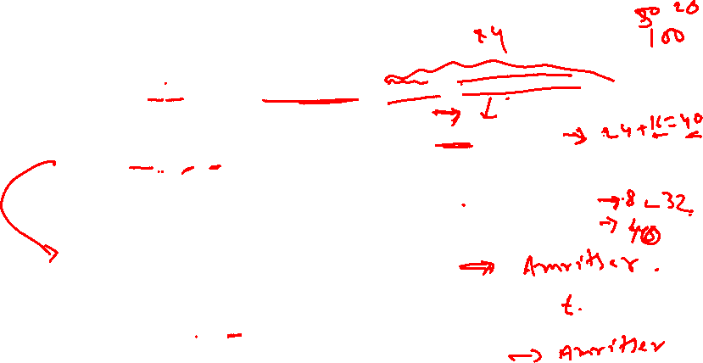
Program Example
© Oxford University Press 2018. All rights reserved.

Slide 40
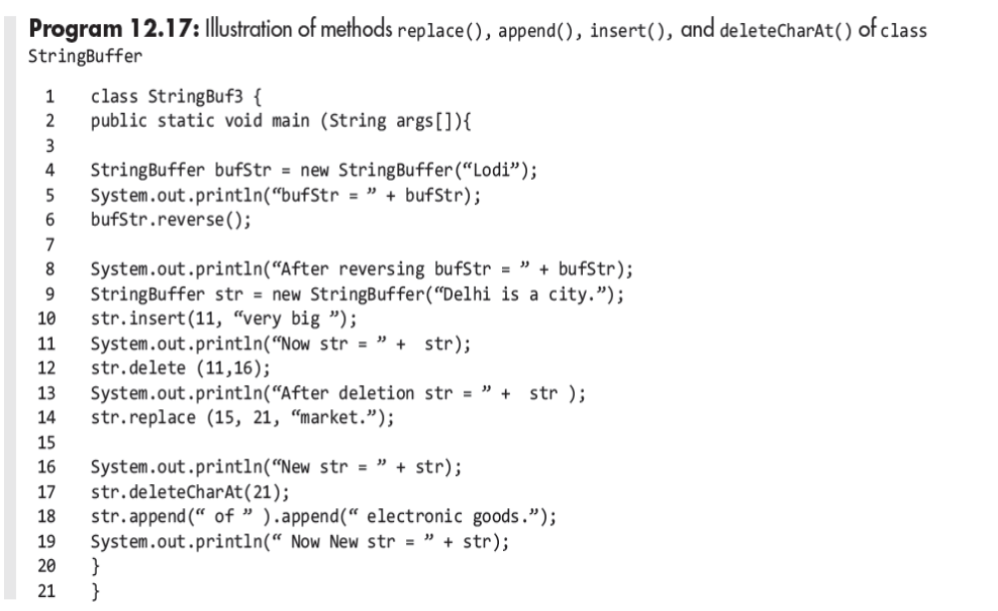
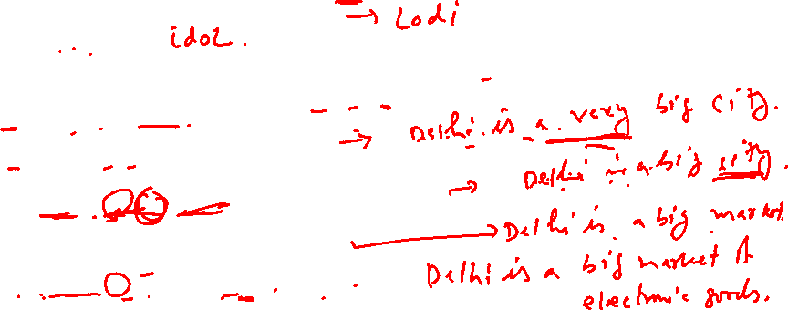
Program Example
© Oxford University Press 2018. All rights reserved.

Slide 41
Class StringBuffer
The StringBuilder class is the subclass of Object in java.lang
package.
This class is used for creating and modifying strings.
Its declaration is as follows:
public final class StringBuilder extends Object
implements Serializable, CharSequence
© Oxford University Press 2018. All rights reserved.

Slide 42
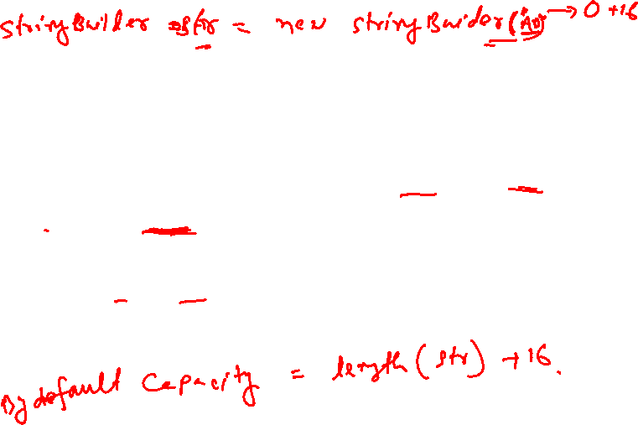
Constructors of Class StringBuilder
The four constructors of the class are described as follows:
StringBuilder()—Creates a StringBuilder object with no characters but with initial capacity of 16 characters.
2. StringBuilder(CharSequence chSeq)—Creates a StringBuilder object with characters as specified in CharSequence chSeq.
StringBuilder(int capacity)—Creates a StringBuilder object with specified capacity. It throws NegativeArraySizeException.
StringBuilder(String str)—Creates a StringBuilder object initialized with contents of a specified string. It throws NullPointException if str is null.
© Oxford University Press 2018. All rights reserved.

Slide 43
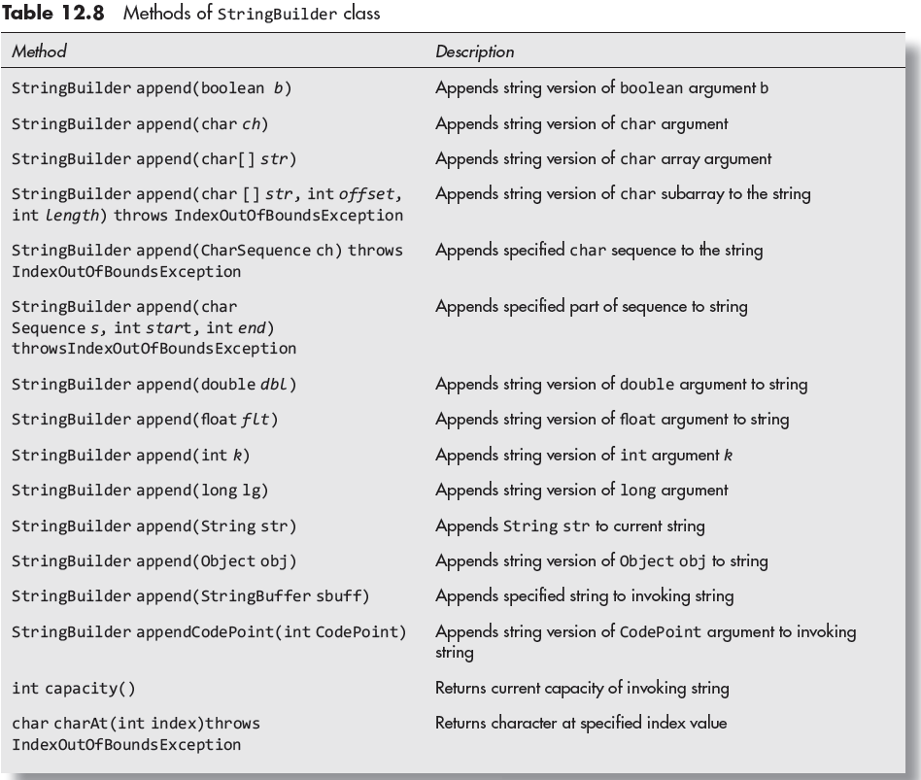
Methods of Class StringBuilder
© Oxford University Press 2018. All rights reserved.

Slide 44
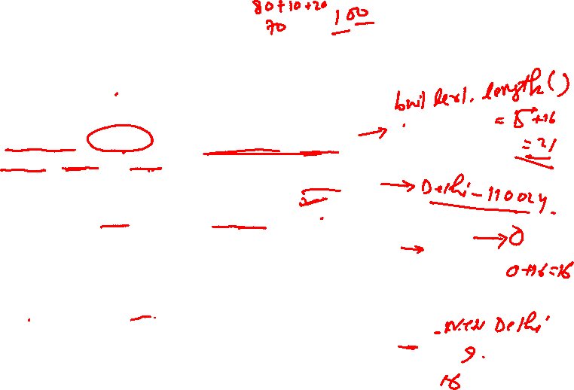
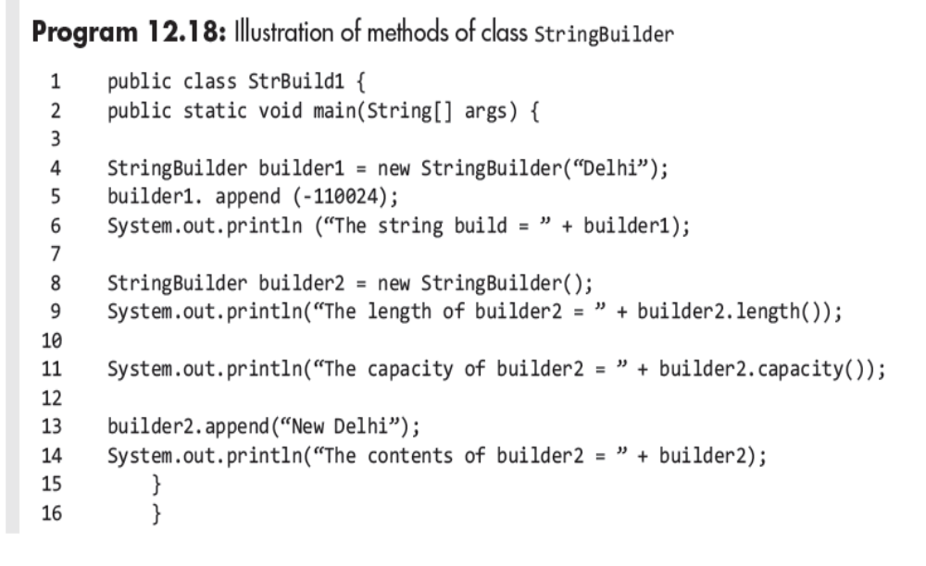
Program Example
© Oxford University Press 2018. All rights reserved.

Slide 45
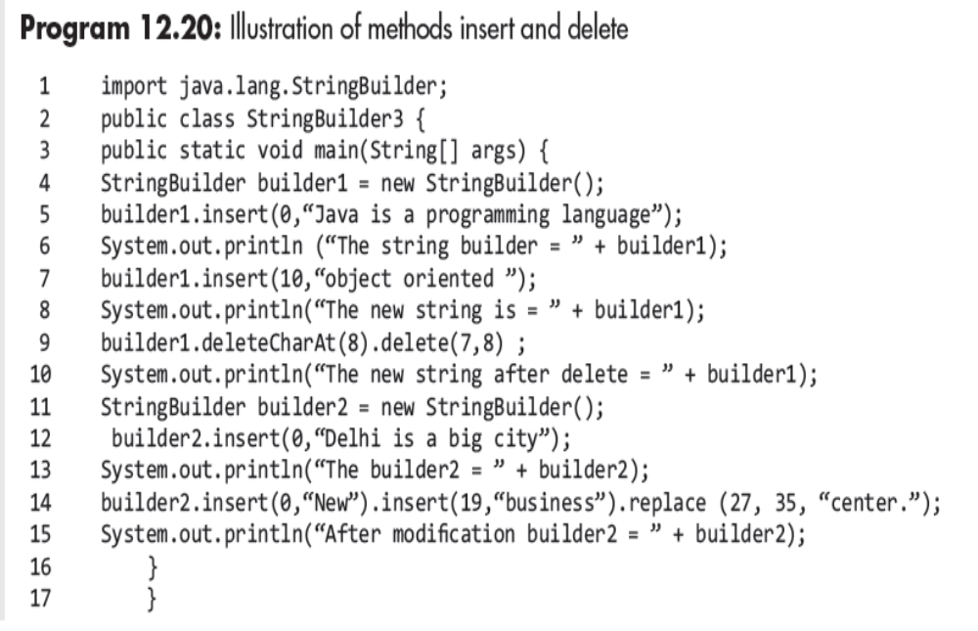
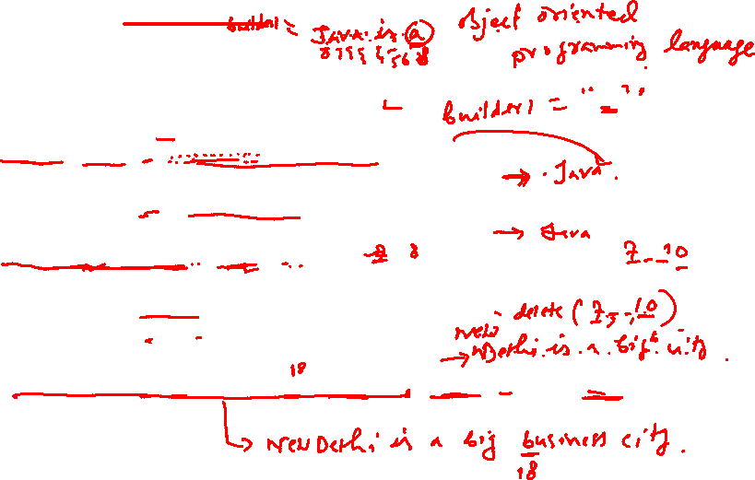
Program Example
© Oxford University Press 2018. All rights reserved.

Slide 46
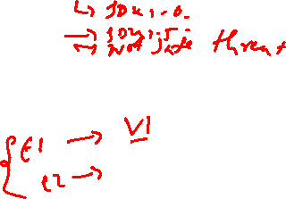
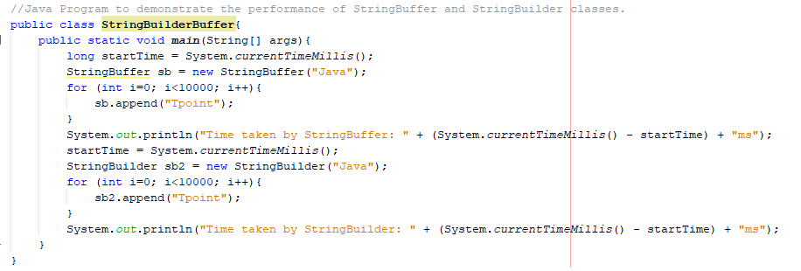

Performance: StringBuffer and StringBuilder
Output:

Slide 47
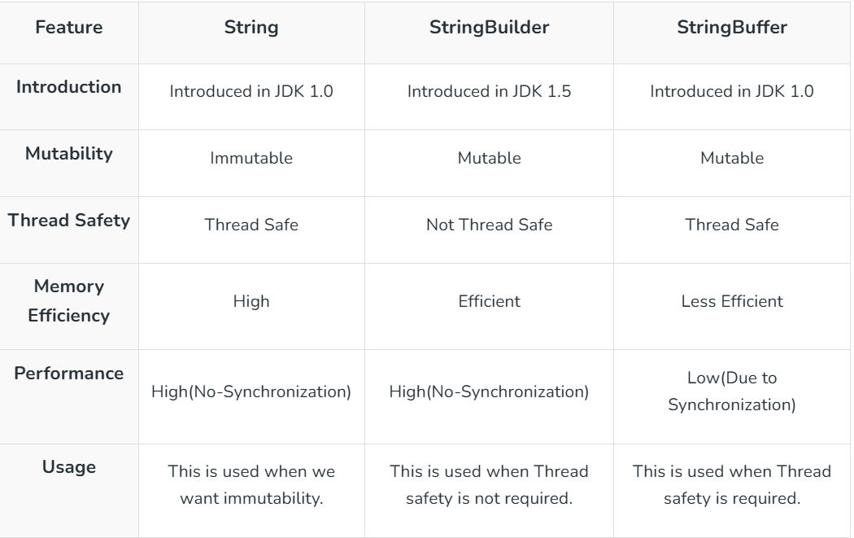
String vs StringBuilder vs StringBuffer

