Slide 1
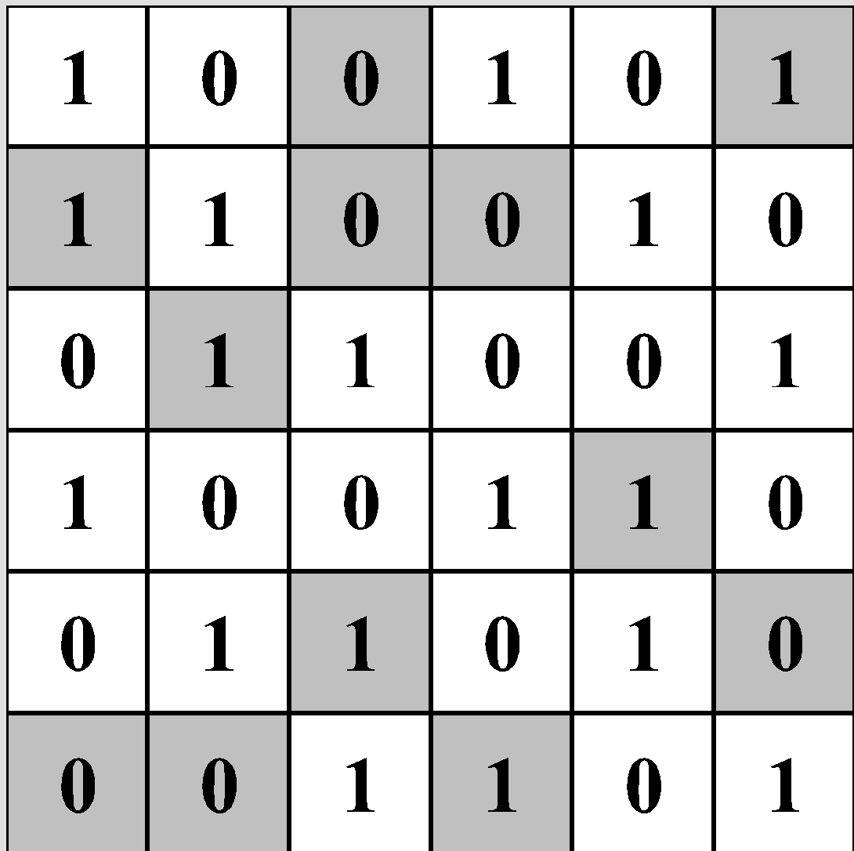
LEGUP - Binary Puzzle Progress
Brandon McCusker, Zach Bonagura

Slide 2
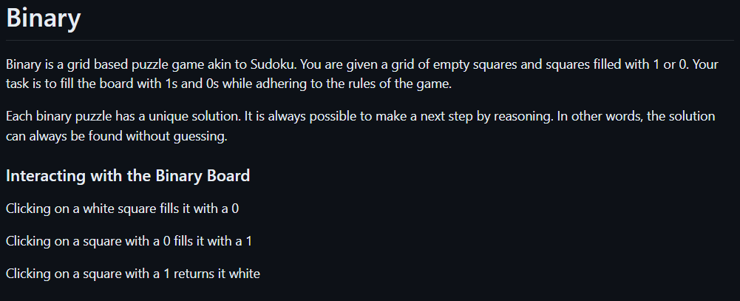
Binary Puzzle Explanation

Slide 3
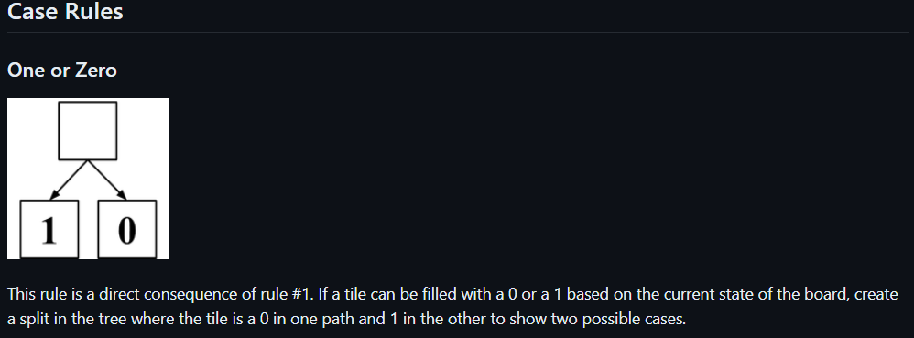
Binary Puzzle Proof Rules - Case Rules

Slide 4
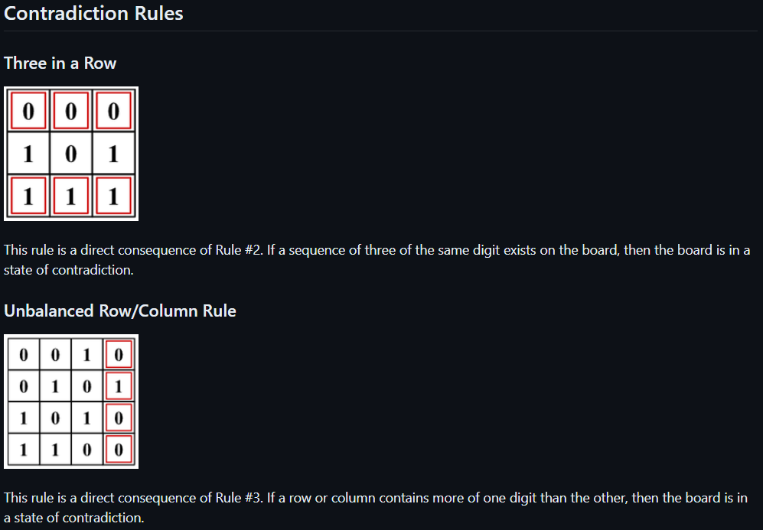
Binary Puzzle Proof Rules - Contradiction Rules

Slide 5
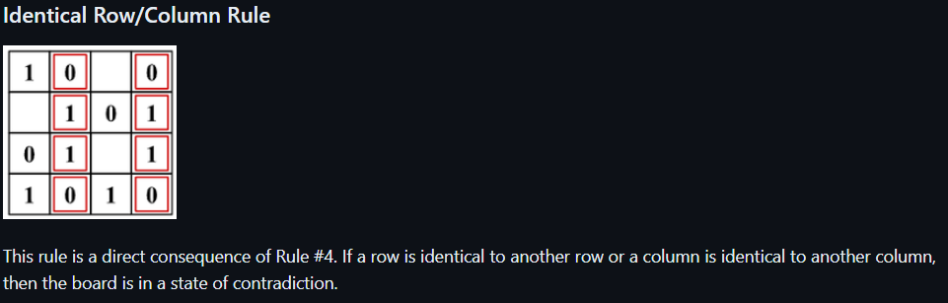
Binary Puzzle Proof Rules - Contradiction Rules

Slide 6
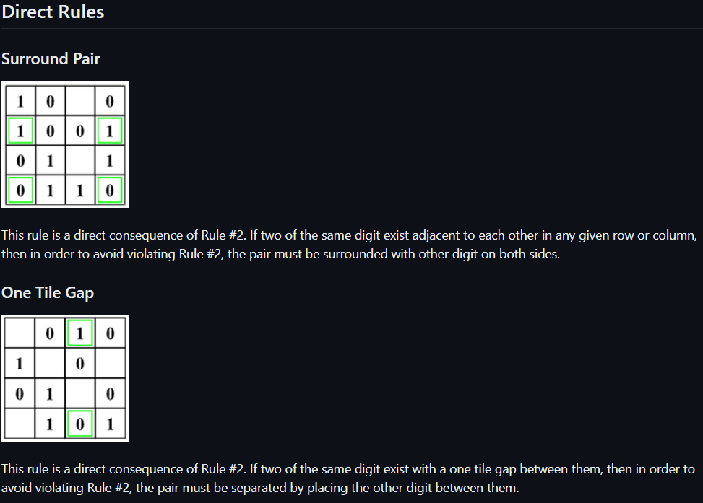
Binary Puzzle Proof Rules - Direct Rules

Slide 7
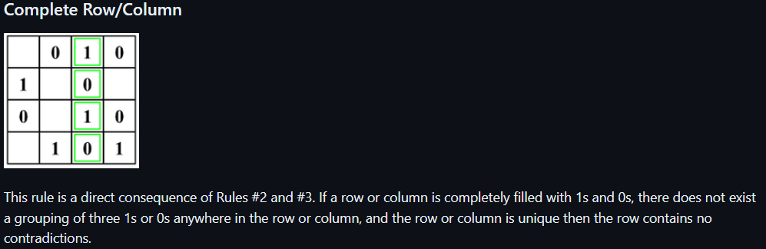
Binary Puzzle Proof Rules - Direct Rules

Slide 8
Potential Additions To Developer’s Guide
There are two config files when implementing the puzzle, one that works and one that has no effect.
Contradiction rules check each cell in the puzzle. Starting from the first row, going left to right, then the next row, and then ends in the bottom right corner.
Rules do not appear on puzzle rules tab unless there exists an image png.

Slide 9
Remaining Tasks
Develop test suite for proof rules
Begin puzzle editor implementation
Write Binary strategy guide for LEGUP wiki
Create more puzzles
Add code specifications

