Slide 1

Mechanics
of Escapement Goal Analysis in Alaska
Stock-Recruit Theory:
Introduction
Deterministic Stock Dynamics
Biological Reference Points
Two-parameter Production Models
Stock-Recruit Theory in Practice:
Process Error
SR data
Notes:
Introductions
Grand outline: Theory/Practice, Methods, Estimation. Lab and Case Studies intermixed
Theory/Practice: Lay groundwork for future sections, develop intuition, understand situations where we are data limited.
Theory: Deterministic
Practice: add variability, add complications

Slide 2
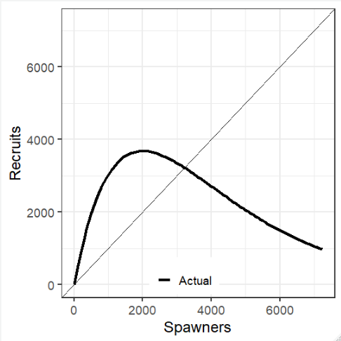
Introduction: SR Relationship
Notes:
These slide motivates the rest of the section.
We plan to talk about the relationship between the number of spawning salmon and the number returning from each spawning event (Recruits).
In the first part of this section we will talk about the black line, which is the deterministic stock-recruit relationship that we assume generates the spawning abundance data we observe.
We will talk about the shape of the line, how it is parameterized and what it means to fisheries management.

Slide 3
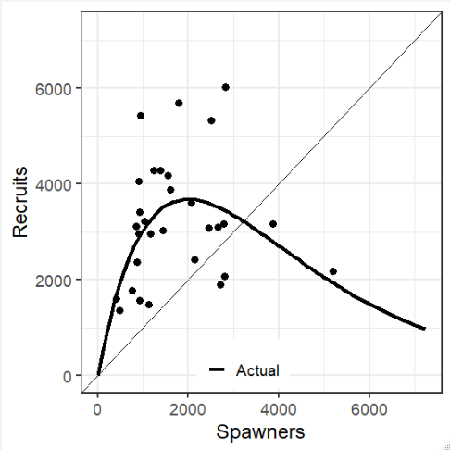
Introduction: SR data
Notes:
In the second half we will talk about the mechanisms that distribute the actual recruitments (dots) around the assumed relationship and how we parameterize those mechanisms.

Slide 4
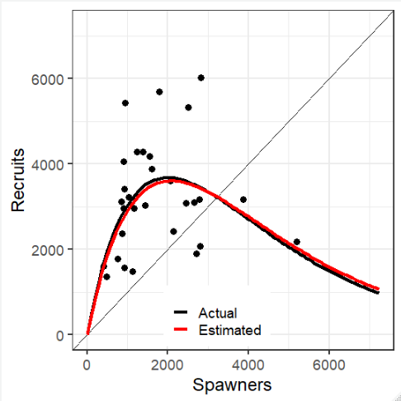
Introduction: SR estimation
Notes:
The red line is just a reminder that in practice we don’t know the SR relationship, instead we estimate it. Matt will talk about that at length.

Slide 5
Population Dynamics
Notes:
We assume a relationship between spawning abundance and subsequent recruits. (Stock-Recruit or Spawner-Recruit relationship).
There are a lot of models that could explain the relationship. This is one of the most popular for salmon and far and away the most common choice in ADF&G.
One of the first things to consider is that this relationship is recursive. In this simple example we have a single age class and no harvest.
So for any initial escapement we move up to find the predicted number of recruits (vertical line), use that number for next years escapement (horizontal line) and repeat. We see the population converges to a stable equilibrium pretty quickly.
The top side panel is the actual spawning abundance data we would have collected had we been monitoring this highly contrived population.
The bottom panel shows the number of recruits per spawner for each generation. An important thing to notice is that per capita recruitment is largest at the smallest spawning abundance and declines as the population size increases.
This change is called density dependence.
Notice that density dependence induces stability in this example.

Slide 6
Population Dynamics with Harvest
Notes:
Before we talk about density dependence it’s worth thinking about how harvest policy interacts with the SR dynamics. On the previous slide we assumed all recruits were allowed to spawn. The relationship between recruits and the resultant spawners is called the Recruit-Spawner relationship (RSR).
In this slide I show SR dynamics with 3 different but very simple RSR, all fixed harvest rates: 0%, 50 and 75%.
One the side panels we have the same two as before, spawning abundance and Recruits per spawner, and two more, annual recruitment and yield.
To map the trajectories under a fixed harvest rate, we see that instead of reflecting on the 1:1 line the spawners are some percentage of recruits.
But things get interesting on the right-hand side. Compare the spawners and recruit time series. Without harvest it’s the same graphic with a 1-year lag. With harvest recruits are higher than spawners, in fact, moderate harvest leads to higher recruitment than no harvest at all. This is because with this SRR recruitment reaches a maximum and then declines as S increases.
Now look at recruits per spawner graph. Harvest keeps the population in a state of higher per capita production than the situation with no harvest. The highest harvest rate is associated with the highest per capita production.
Now let us consider yield (number of recruits in excess of the number that spawned, vertical distance between the 1:1 line and the SR curve). Yield is higher with a moderate harvest rate than with the larger harvest rate. For the next 3 days we will talk about figuring out where yield is maximized.
In practical terms this is a pretty great situation to be in. Harvesting some fish can result in more fish returning! Stocks that are harvested compensate by increasing per capita production!

Slide 7
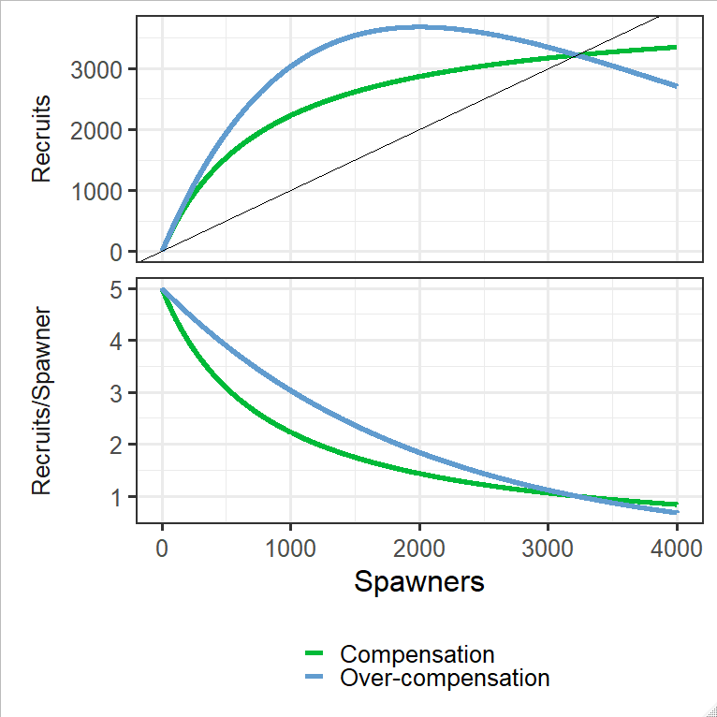
Population Dynamic Patterns (1)
Compensation: Per capita production (R/S) increases as the population size decreases.
Over-Compensation: Compensation + Recruitment decreases at very high spawning abundance.
Notes:
You will see 3 types of density dependence in the literature: compensation, over-compensation and depensation.
Over-compensation is just a special case of compensation, we will look at both of those in this slide.
Compensatory dynamics describe the situation where per capita production increases with reduced population sizes (thus “compensating” for reduced population size). Slope of R/S always negative. Notice recruitment approaches an asymptote at high abundance
Over-compensation is a special case of compensation in which R reaches a maximum and actually declines at very high abundance. Our animation was an example of over-compensation.
Recalling our previous examples compensation and over-compensation will behave similarly (and stably) at low abundances.

Slide 8
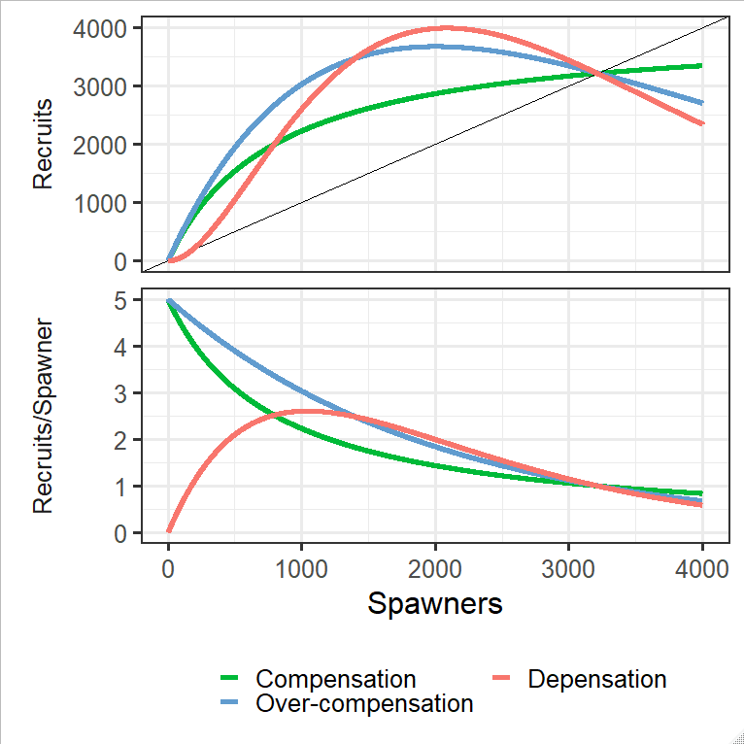
Population Dynamic Patterns (2)
Compensation: Per capita production (R/S) increases as the population size decreases.
Over-Compensation: Compensation + Recruitment decreases at very high spawning abundance.
Depensation: Per capita production (R/S) decreases as the population size decreases.
Notes:
Depensation describes a situation where per capita production decreases, rather than increases, at the smallest population sizes. The slope of R/S is positive for small populations.
This is worrisome because such a population may be slow to rebound from low spawning abundances, thus exacerbating a population decline. If recruitment dips below the replacement line at small abundances there may be a minimum threshold below which extirpation occurs.
Compared to populations with compensatory and over-compensatory dynamics, populations with depensatory dynamics will be less robust and less stable.
Because of these ramifications for population viability, depensation has received a lot of attention in the literature.

Slide 9
Depensation occurs infrequently…
An evaluation of 27 salmon populations in a single analysis with a modified B&H model and spawning abundance at 10% of the largest observed value and found marginal statistical evidence of depensation for the salmonid family.
Liermann, M., and R. Hilborn. 1997. Depensation in fish stocks: a hierarchic Bayesian meta-analysis. Can. J. Fish. Aquat. Sci. 54:1976-1984.
Individual Populations
Salmonid Family
Depensatory Parameter
(<1 indicates depensation)
Notes:
So compensation and over-compensation are frequently assumed, while depensation is rarely considered. Why?
The graph shows a parameter estimate related to depensation (<1 associated with depensation). The left-hand side shows the posterior distribution of the parameter value for the salmonid family while the right-hand side shows a histogram of point estimates for individual salmonid populations.
Note that the posterior distribution of the salmonid family is broad, and individual populations did have parameter estimates consistent with depensation.
The authors concluded that while depensation does not appear to be the norm, there isn’t enough evidence to dismiss entirely.

Slide 10
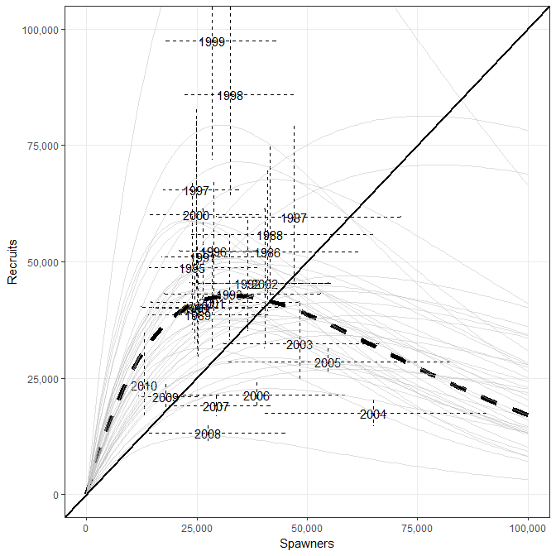
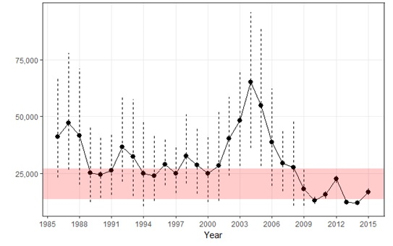
… but we see a limited range of escapements
Notes:
The safest thing to say is that depensation appears to be rare over the range of escapements we typically see. i.e. by setting escapement goals we manage against very low escapements which you would need to document depensation.
The graphs show a SR relationship and associated point estimates on the left-hand side. In the right-hand side is the same population’s annual spawning abundance estimates with the current goal range shown by the pink shaded region.
Very small escapements are infrequent, although significant management actions were sometimes necessary to reach (or approach) the lower end of the goal. Conversely, large escapement are common, i.e. escapements in the range necessary to document over-compensation occur frequently.

Slide 11
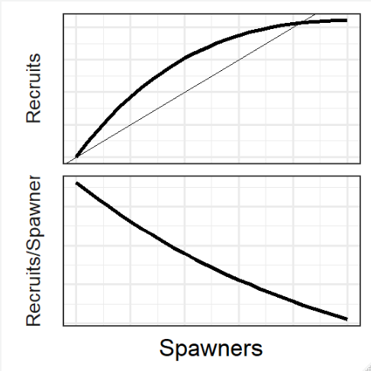
Mechanisms vs. Demographics
Depensatory mechanisms reduce survival as the population size decreases:
1) predation by an efficient predator;
2) significant effect of MDNs on juvenile survival;
3) lack of reproductive encounters among adults; or
4) loss of genetic viability.
Percent of the spawners killed by bears
Spawners
Quinn T.P. et al. 2014. Can intense predation by bears exert a depensatory effect on recruitment in a Pacific salmon population? Oecologia. 176:445-456.
Notes:
Note: This will be a hip pocket slide.
With respect to these definitions it’s useful to distinguish between a mechanism and demographic pattern. We will use depensation as an example to illustrate that point and a point about depensation in general.
A mechanism is depensatory if it reduces survival as population size decreases.
Demographic depensation show up in our SR curves as reduced per capita population growth rate with decreasing population size.
The main graph shows the probability of a salmon being killed by a bear increases as the population size decreases, this is a depensatory mechanism. If it was strong enough it might show up in the demographics.
This population did not show a demographic depensation, the authors tested for and rejected depensation with model selection. I plotted their estimated SR relationship in the smaller graphic. They explicitly tested for significance of a depensatory parameter, but we already know there is no depensation in this SR relationship; the slope of per capita recruitment vrs. spawning abundance is always negative.

Slide 12
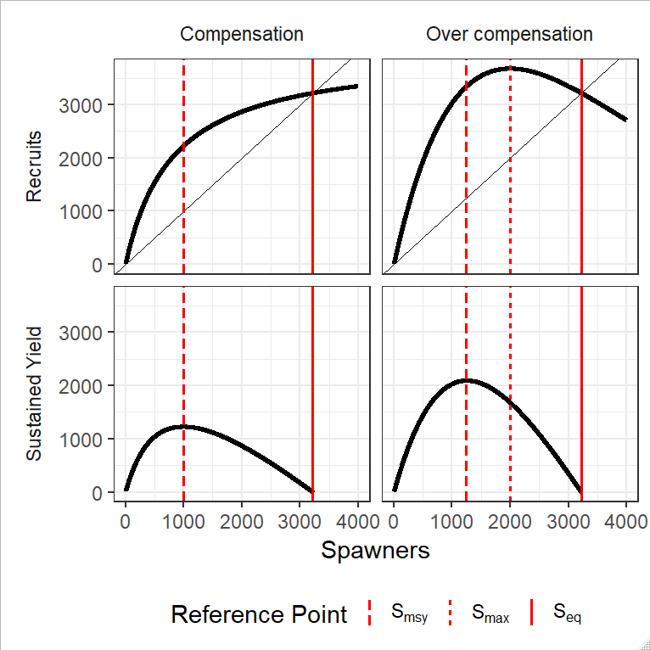
Biological Reference Points
From the shape of the stock recruit relationship we can identify some reference points that are helpful for management.
S_{eq} = equilibrium abundance
S_{max} = escapement associated with maximum recruitment
S_{msy} = escapement associated with maximum sustained yield
U_{msy} =harvest rate associated with maximum sustained yield
Notes:
In this class we will focus on compensatory dynamics, mostly overcompensation.
Our interest in these stock recruit curves is practical. There are a few points on the SR curves that are of special interest to us as fishery managers. Let’s look at the SR curves shown on the top two panels.
Seq is the point where the spawners replace themselves with recruits. “Equilibrium abundance or Unfished equilibrium”
Smax is the spawning abundance that results in maximum recruitment. With overcompensation Smax usually occurs at smaller spawning abundances than Seq. Not so with compensation (inf but Seq is an equilibrium)
Now look at the bottom panel, which is the sustained yield (number of recruits in excess of the number that spawned, vertical distance between the 1:1 line and the SR curve) associated with each spawning abundance.
Smsy is the spawning abundance associated with maximum sustained yield. It occurs at a smaller spawning abundance than Smax or Seq.
Umsy is the harvest rate associated with maximum sustained yield.
In Alaska, when possible we focus on S_msy to guide our choice of an escapement goal.
S_eq is an important quantity too. Since yield is zero at S_eq it represents an obvious maximum upper escapement goal bound.

Slide 13
Biological Reference Points (2)
To set a goal around a biological reference point we need to decide on an acceptable level of performance relative to the reference (Typically some large multiple of maximum sustained yield).
High performance requirements are associated with narrower goals, lower performance requirements are associated with wider goals.
Notes:
To change a biological reference point into a goal range we need to decide on how close we hope to get to optimal performance.
Typically, we want to be some high percentage of MSY.
The top two panels are like the last slide. The bottom panel shows the goal range under 3 separate performance expectations.
Steps:
1) Estimate the SR relationship and associated yield,
2) decide how close you want to be to maximum sustained yield,
3) your goal range comes from the spawning abundances associated with the performance you want.
In the lab we will see how to express uncertainty around this goal range. The bottom panel will take on new meaning once we do that.
Often, we won't be able to estimate the stock recruit relationship and set the goal range this directly. But we will fall back on these concepts to try and find escapements associated with surplus yield (Andrew’s section).

Slide 14
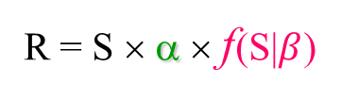
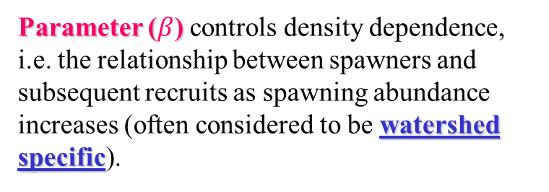
Two Parameter Production Models
R = S × (average per-adult generation of ova) ×
(average survival rate of ova to adult) ×
(discount due to competition)
R = S × α × f(S|$β$)
Parameter (α) is the expected productivity as abundance of spawners nears zero (often considered to be species and regionally specific).
Parameter ($β$) controls density dependence, i.e. the relationship between spawners and subsequent recruits as spawning abundance increases (often considered to be watershed specific).
Notes:
The most common stock-recruit relationships can be represented by two parameters; one parameter describes stock productivity at low abundances and the other parameter controls density dependence.
Tradition to call the productivity parameter alpha and the density dependance parameter beta.

Slide 15
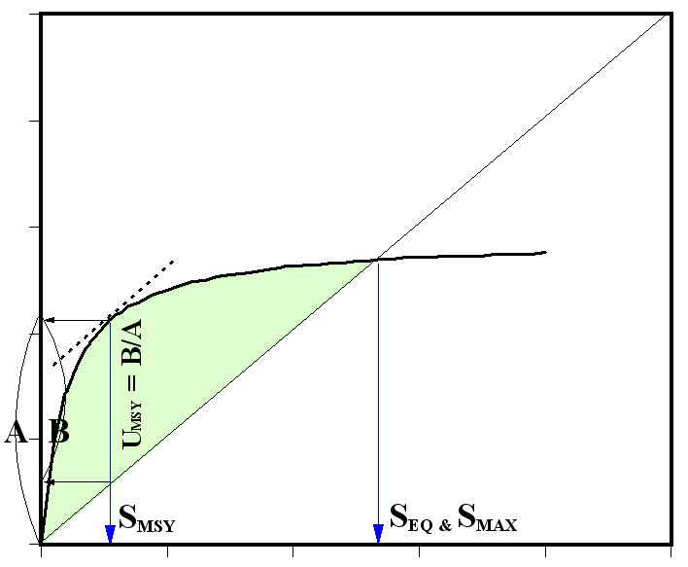


Beverton & Holt’s Model: Strict Compensation
$R=\frac{αS}{1+β_{BH}S}=αS{\left(1+β_{BH}S\right)}^{−1}$for $α$ > 1 and ${ β}_{BH}$> 0
$$S_{MSY}= \frac{\sqrt{α^{′}}−1}{β_{BH}}$$
$$S_{EQ}= \frac{α^{′}−1}{β_{BH}}$$
$$U_{MSY}= 1−\frac{\sqrt{α^{′}}}{α^{′}}$$
Note: $α^{′}$ defined on slide 27
Notes:
There are two very well known 2 parameter models.
Beverton-Holt is the model associated with compensatory dynamics.
I’m showing one parameterization here, although many parameterizations exist.
The colored equation ties the BH equation back to the general model on the previous slide.
The model can be derived by assuming mortality is a function of recruitment.
It is commonly used with Marine populations but also used in freshwater populations that do not show obvious overcompensation.
Alpha is the slope of the curve near the origin (few spawners). Notice alpha prime in the reference point formulas. We will learn about alpha prime later.
Also notice I subscripted beta to emphasize it’s a different beta than we will see for the Ricker curve on the next slide (Alpha has the exact same meaning for the Ricker model).

Slide 16
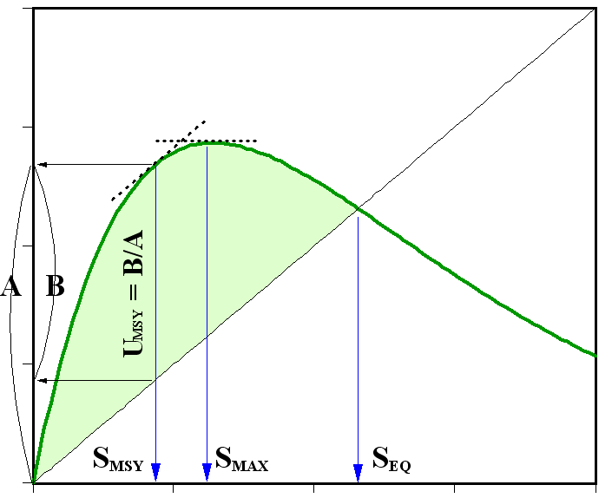
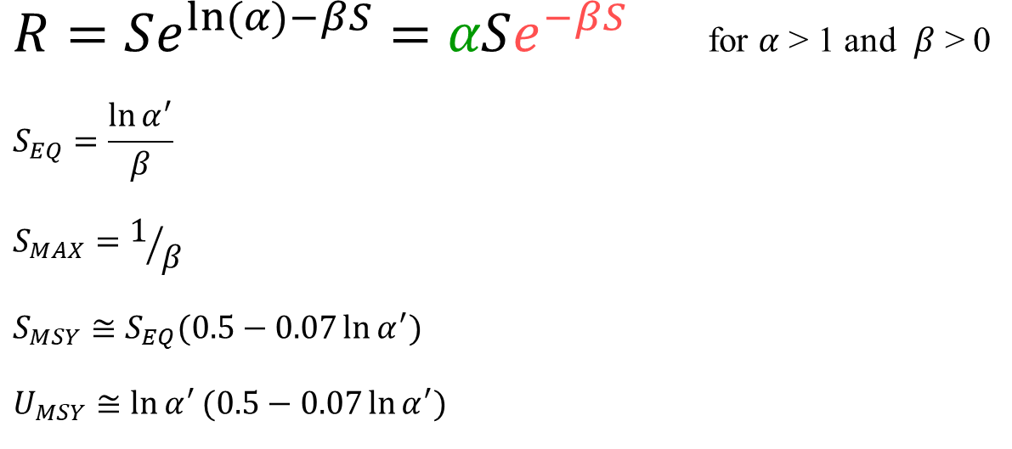
Ricker’s Model: Over-Compensation
$R=Se^{ln⁡(α)−βS}=αSe^{−βS}$ for $α$ > 1 and $β$ > 0
$$S_{EQ}=\frac{{\ln{α}}^{′}}{β}$$
$$S_{MAX}=1/β$$
$$S_{MSY}≅S_{EQ}(0.5−0.07{\ln{α}}^{′})$$
$$U_{MSY}≅{\ln{α}}^{′}(0.5−0.07{\ln{α}}^{′})$$
Hilborn, R. 1985. Simplified calculation of optimum stock size from Ricker’s stock recruitment curve. Can. J. Fish. Aquat. Sci. 42:1833-1834.
Note: $α^{′}$ defined on slide 27
Notes:
The Ricker model is the most commonly used SR relationship at ADF&G.
The colored equation ties the Ricker equation back to the general model two slides ago.
The Ricker model is associated with over-compensatory dynamics although we will see it can approximate strict compensatory dynamics as well.
Because of this flexibility and the fact that it results in precautionary management advice, it is commonly used with freshwater populations.
The model can be derived by assuming mortality is a function of spawning abundance.
This is the model we plan to work with in the lab.
You will see these reference point formulas often. We will use them extensively in the lab and they will be used with a lot of the methods Andrew will discuss in the next section.

Slide 17
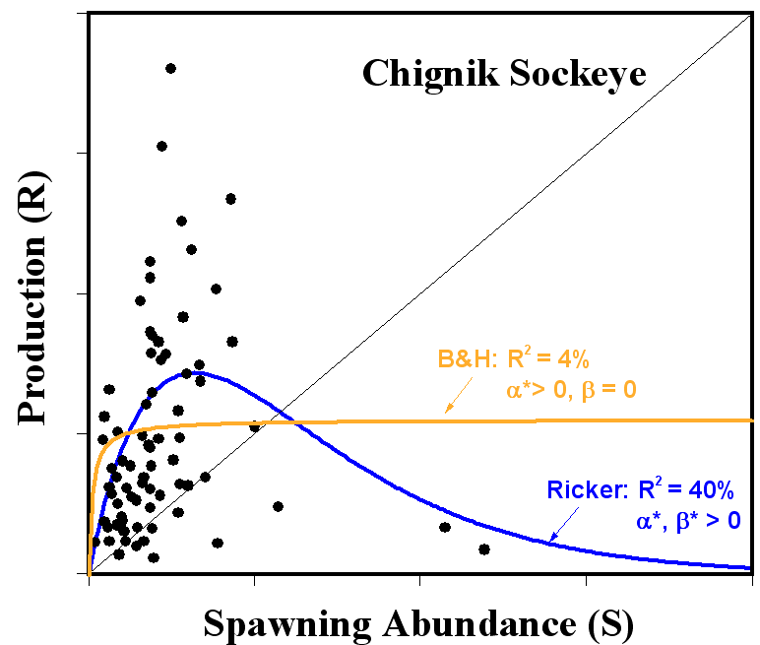
Why Choose Ricker? Over-compensation
For Alaska salmon, overcompensation is sometimes obvious; when we have observed large spawning events that resulted in very poor recruitment.
Notes:
In the literature it is common practice to fit both models and select the one with the best fit.
At ADF&G we nearly always use the Ricker model. There are three reasons.
The first reason is that overcompensation is observed frequently.
The figure shows an example for Chignik sockeye, where we have observed large spawning events that resulted in very poor recruitment.
This occurs frequently enough that when we don’t observe obvious overcompensation we often assume it exists.
This situation commonly occurs in heavily fished stocks where escapements large enough to display overcompensation occur infrequently. We will see examples of that later in the course.

Slide 18
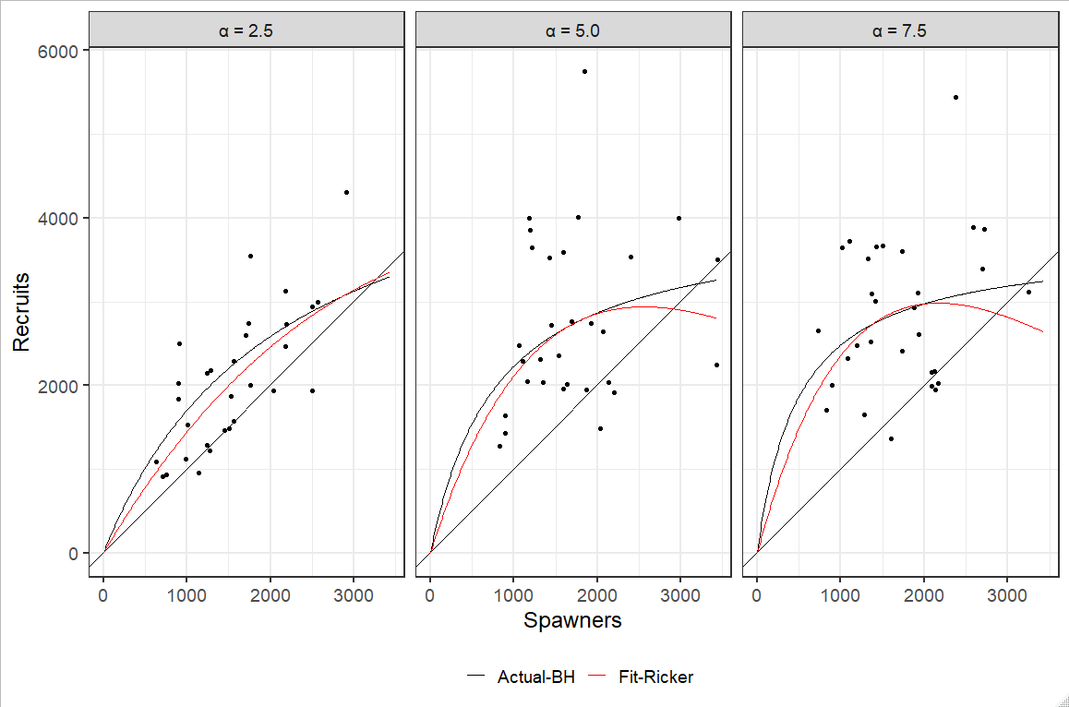
Why Choose Ricker? Flexibility
Notes:
The second reason is that the Ricker model is flexible
It does a decent job of fitting data generated with strict compensatory (Beverton-Holt) dynamics.
The graphic shows three simulated SR datasets, with different values for alpha.
The black line is the assumed SR relationship (Beverton-Holt), the black dots are the simulated recruitments and the red lines are the fitted Ricker curves.
You can see that particularly at low productivity the Ricker curve approximates the BH curve well. Even at higher values of alpha the Ricker curve is pretty close to the BH curve over the range of most escapements.

Slide 19
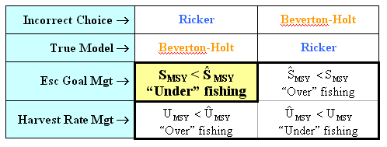
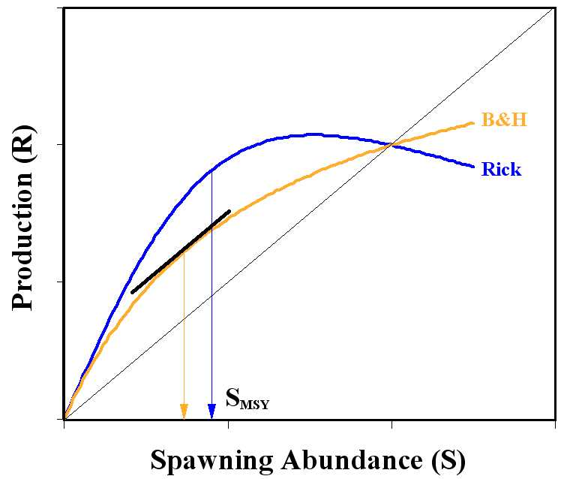
Zhou S. 2007. Discriminating alternative stock-recruitment models and evaluating uncertainty in model structure. Fisheries Research. 86. 268-279.
Why Choose Ricker? Precautionary
Ricker’s model is “precautionary” under escapement-goal management. Given a fixed intrinsic rate of increase (α) and a fixed carrying capacity (S_{EQ}), the value of S_{MSY} from Ricker’s model is the larger.
Note that yield is only reduced a few % from MSY if the wrong model is chosen under escapement goal management.
Notes:
Finally, the Ricker model is precautionary under escapement goal management.
Consider the graph first. Ricker and BH SR relationships are plotted with the same initial productivity and the same equilibrium abundance.
Think of these two curves as describing the same population but with two different assumptions about SR dynamics.
Also shown is the value for Smsy for each curve, notice Smsy is larger for the Ricker curve than it is for the BH curve.
This will result in conservative management when using an escapement goal because larger values of Smsy leads to larger escapement goal bounds and less fishing for the same run sizes.
The table shows this relationship explicitly, the yellow cell is the typical situation at ADF&G. Notice the converse situation (assuming BH dynamics when the population is Ricker will result in a lower escapement goal and excess fishing.
Not convinced? The reference supports this argument for a wide range of productivities, process errors and levels of harvest (Although not for extremely high harvest rates).

Slide 20
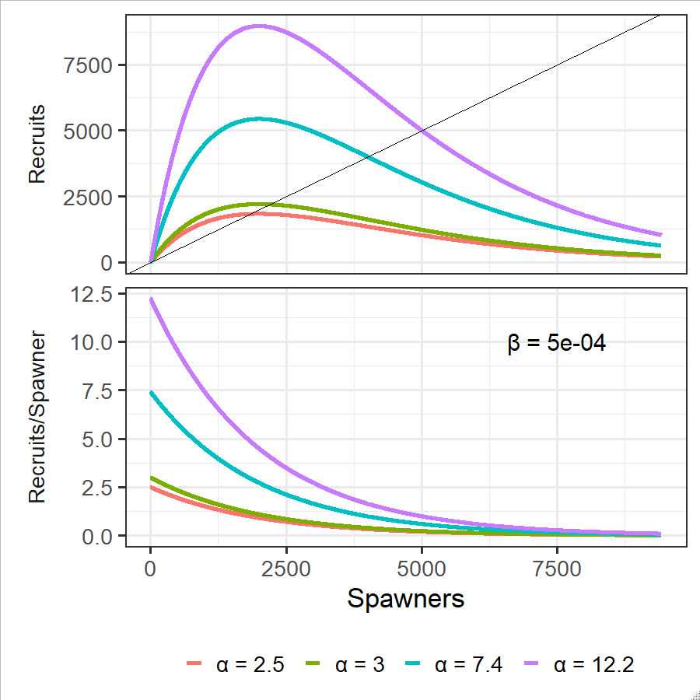
Parameter α
Parameter (α) is the expected productivity as abundance of spawners nears zero (often considered to be species and regionally specific).
Mechanisms
Fecundity
Life history (maturation, longevity, growth rates)
Average density-independent mortality
Fecundity | 4000 eggs/spawner
Ova-smolt survival | 0.015 smolt/egg
Smolt-adult survival | 0.1 recruits/smolt
alpha | 6 recruits/spawner
Notes:
We will consider the Ricker curve from here on out.
Here is another plot of the Ricker SR relationship on the top panel and per capita recruitment on the bottom panel.
The graphs show how the SR relationship changes for 4 different values alpha, all with the same beta.
Alpha describes production at small spawning abundances and has a large effect on the shape of the curve and the resulting yield.
Alpha describes the slope at intercept.
On the lower panel you can read alpha right off the y-intercept.
Recall that S_max = 1/beta.
So you can see that all four lines use the same beta in the SR plot, by seeing that all 4 curves peak at the same value of S.
The table shows that a lot of life history is wrapped up in alpha (Bradford 1995).

Slide 21
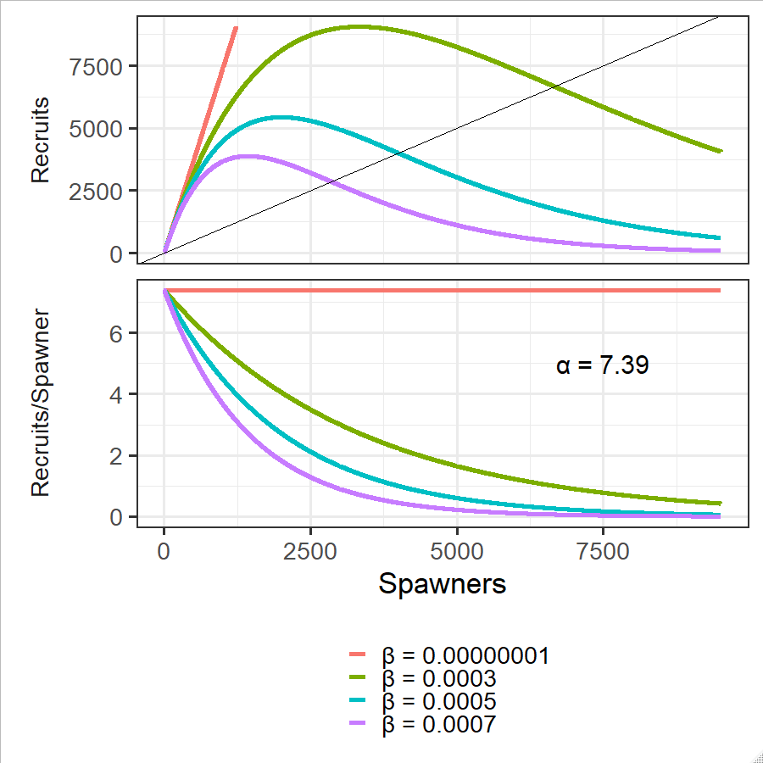
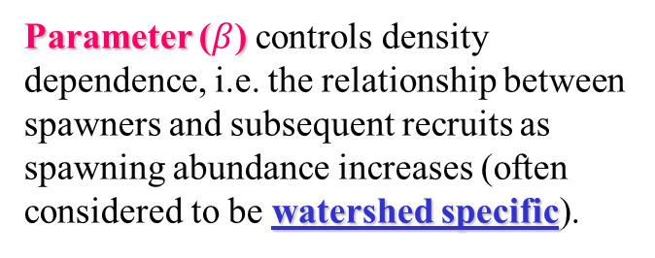
Parameter β
Parameter ($β$) controls density dependence, i.e. the relationship between spawners and subsequent recruits as spawning abundance increases (often considered to be watershed specific).
Mechanisms
Competition
Limited food
Limited rearing area
Limited spawning area
Notes:
Here is a similar plot showing the SR relationship for 4 values of beta all with the same alpha.
The Ricker SR relationship on the top panel and per capita recruitment on the bottom panel.
The cleanest way to think about beta is as controlling the rate of decline in recruits per spawners as population size increases. (see lower panel).
Smaller populations decline from the same initial productivity more quickly than larger populations.
When beta is effectively zero there is no density dependence.
Recall that alpha is the slope at the origin and or the per capita recruitment at very low spawing abundance.
So you can see all four lines use the same alpha in the SR plot, by noticing that all 4 curves have the same slope at the origin.
Or you can see it in the R/S plot by noticing that all 4 lines have the same R/S at S = 0.

Slide 22
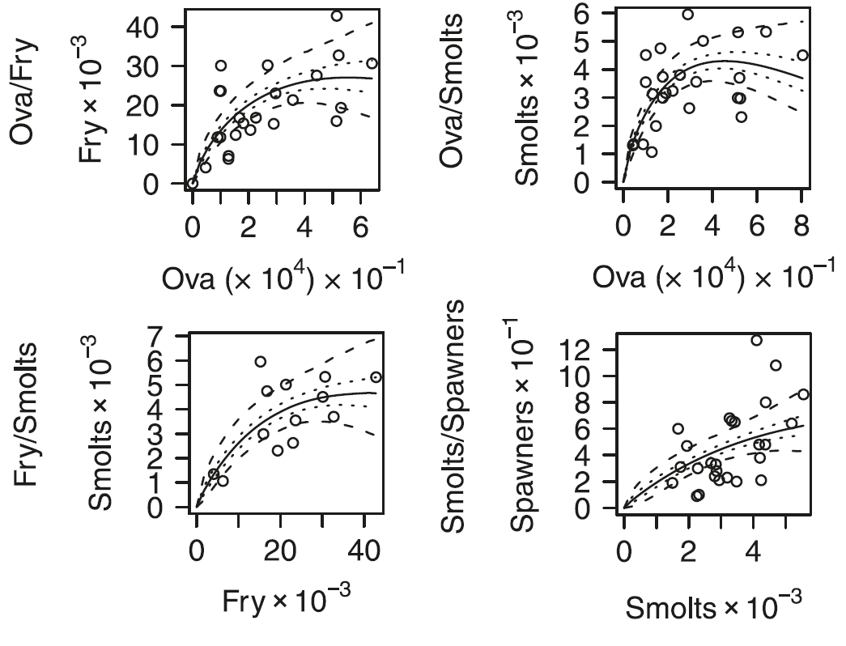
Gurney et al. 2010. Form and Uncertainty in stock-recruitment relations: observations and implications for Atlantic salmon (Salmon salar) management.. Can. J. Fish. Aquat. Sci. 67 1040-1055..
Timing of Density Dependence
Density dependence in salmonids occurs in freshwater.
Notes:
For salmonids density dependence occurs in freshwater.
The graph shows SR relationships for 3 life history phases of Atlantic salmon in Scotland.
On the top left we have a SR relationship where spawing abundance is represented by the number of eggs and recruitment is the number of emergent fry.
Looks like strict compensation.
The bottom left is the next life history stage; spawing abundance is represented by the number of emergent fry and recruitment is the number of smolts. Also looks like strict compensation.
On the top right the same population is shown for the entire freshwater life history; spawing abundance is represented by the number of eggs and recruitment is the number of smolts (or the combination of the two graphs on the right hand side).
Now the density dependence looks like over-compensation.
On the bottom right is the saltwater part of the life cycle (smolt to Adult).
Density dependence is negligible (i.e. it’s close to a strait line with a very small slope).

Slide 23
Mechanics
of Escapement Goal Analysis in Alaska
Stock-Recruit Theory:
Introduction
Deterministic Stock Dynamics
Biological Reference Points
Two-parameter Production Models
Stock-Recruit Theory in Practice:
Process Error
SR data
Notes:
Practice: add variability, add complications

Slide 24
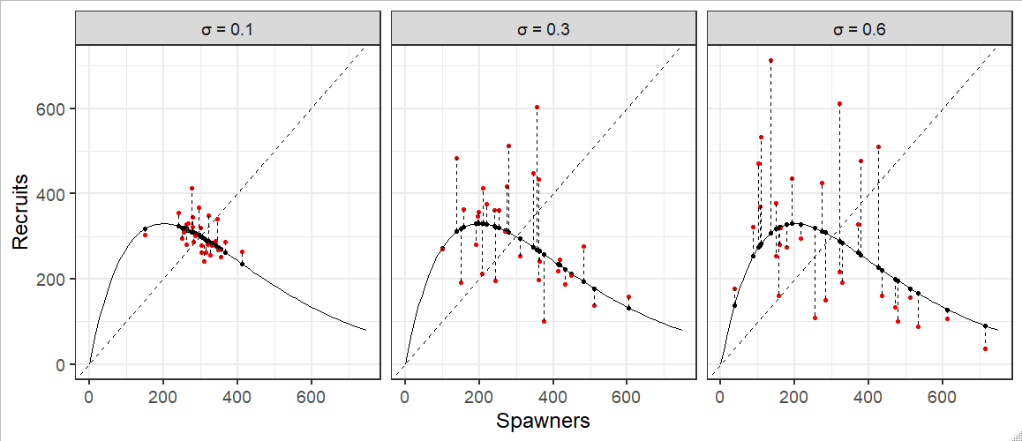
Process Error
So far we’ve mostly talked about deterministic systems; i.e. Recruitment is exactly known from the number of spawners.
Process error describes deviations from the deterministic relationship and can be visualized as vertical deviations from the curve.
Notes:
Of course these stock recruit relationships are not perfect. How could they be? We are trying to use two parameters to describe all of the factors affecting the population.
Process error describes how well the actual recruitment tracks the stock recruit relationship.
The parameter sigma controls the size of the errors (larger Sigma, larger errors).
Sigma can be thought of as the CV of R (not quite, but close for small CV).
You may notice that the range of escapements we observe increase as sigma increases as well. This is an artifact of the simulation. Think back to the deterministic dynamics we discussed. In this case we are ignoring harvest, so we are still reflecting on the 1:1 line and large process errors can take us to vey different parts of the curve.
We will characterize these errors statistically first, and then try to think about the biology.

Slide 25
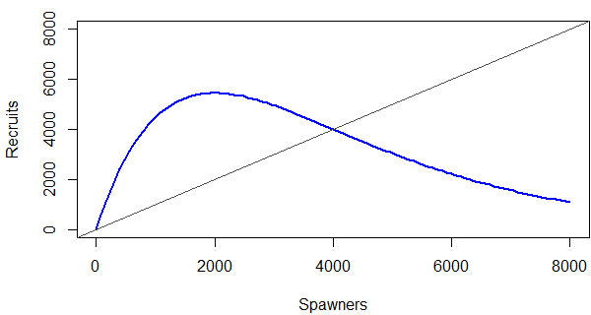
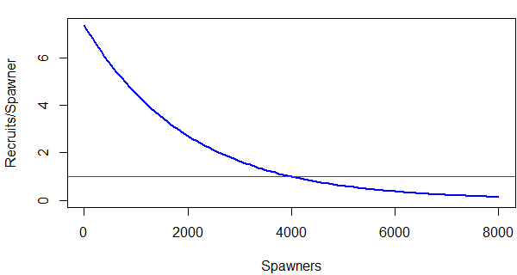
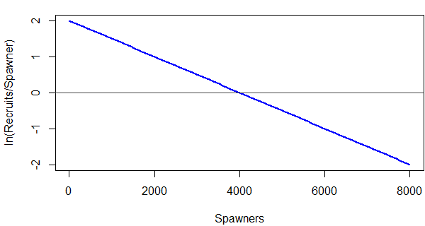
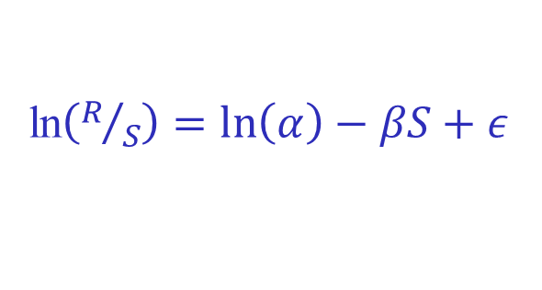
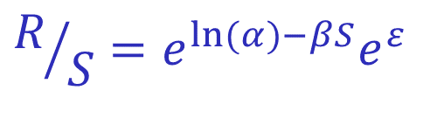

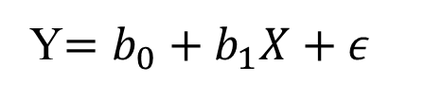
Ricker Relationship: Parameters
R
$$R=Se^{\ln{(}α)−βS}e^{ε}$$
$$R/S=e^{\ln{(}α)−βS}e^{ε}$$
R/S
ln$\left(R/S\right)=\ln\left(α\right)−βS+ε$
Y$=b_{0}+b_{1}X+ε$
ln(R/S)
“Typical” linear regression form
25
Theory - Process Error
S
25
Notes:
25
I stole this slide from the estimation section.
For now the point is that you can write the Ricker curve as a linear relationship.
Log alpha is the intercept and beta is the slope.
This is standard practice so we will see the linear form in a lot of the research.

Slide 26
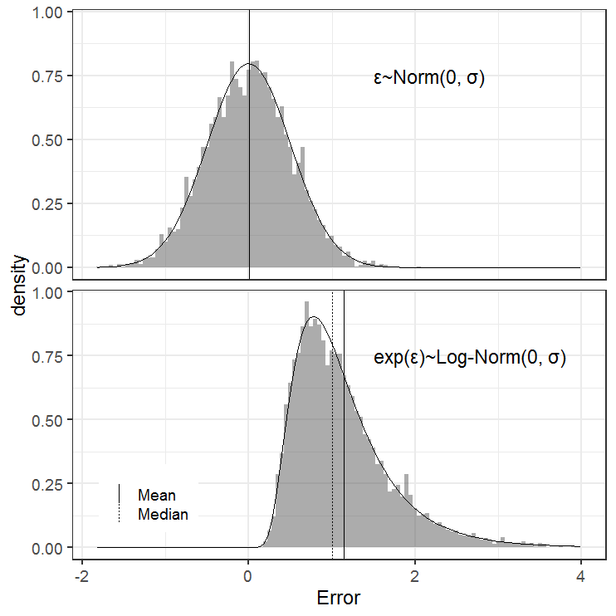
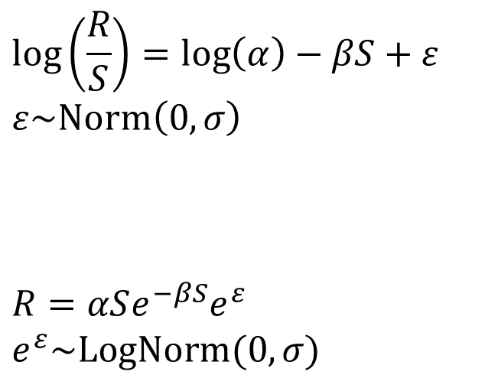
Process Error is Log-Normal
Process error is considered a log-normally distributed random variate
$$\log\left(\frac{R}{S}\right)=\log\left(α\right)−βS+ε$$
$$ε\sim Norm\left(0,σ\right)$$
$$R=αSe^{−βS}e^{ε}$$
$$e^{ε}\sim LogNorm(0,σ)$$
Process error
Peterman, R. M. 1981. Form of random
variation in salmon smolt-to-adult relations
and its influence on production estimates.
Can. J. Fish. Aquat. Sci. 38:1113-1119.
Notes:
Process error is usually treated as a Log-Normal random variate for theoretical and practical reasons.
The first equation is the linear model form of the Ricker SR equation.
The errors are assumed to follow a normal distribution with a mean of zero and standard deviation of sigma.
The top panel of the graph shows a histogram with 5000 draws from a Normal distribution. The line represents the normal PDF that generated the data. Notice that the normal distribution is symmetric and has the same mean and median (zero).
The second equation is standard Ricker SR equation. Its just algebra to get here but notice the normal errors are exponentiated.
In this form the error distribution is lognormal.
The bottom panel of the graph shows a histogram of the same with 5000 draws as the top panel with the natural exponential function applied.
The line represents the lognormal PDF with the same parameters as the normal above.
Lognormal errors derive from theory regarding multiplicative survival rates, fit the data better and ensure recruitments are positive.
Notice that the lognormal distribution is asymmetric and the mean is larger than the median. Thus we need a correction when interested in average Recruitment or Sustained Yield.

Slide 27
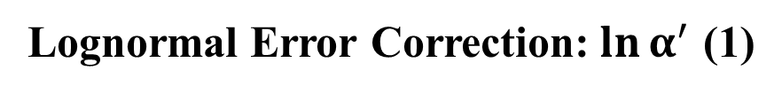
Lognormal Error Correction:${\ln{α}}^{′}$ (1)
Lognormal error correction:
Mean / Median = exp(σ²/2)
σ exp(σ²/2)
0.3 1.05 (+5%)
0.4 1.08 (+8%)
0.5 1.13 (+13%)
0.6 1.20 (+20%)
Estimated reference points use
Notes:
Here is the correction to get the mean of a lognormal random variable.
The size of the correction increases with increasing process error (sigma).
When using the Ricker equation we include the correction in log alpha.
Note the equation for log alpha prime and the use of log alpha prime in the reference point equations.

Slide 28
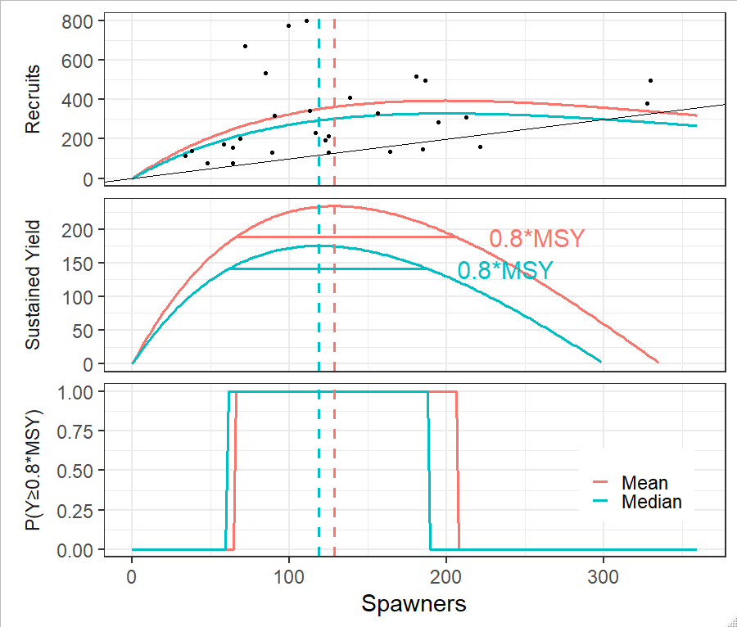
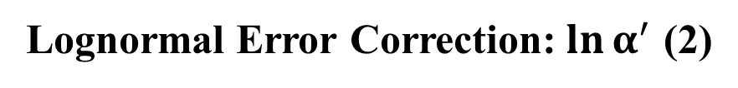
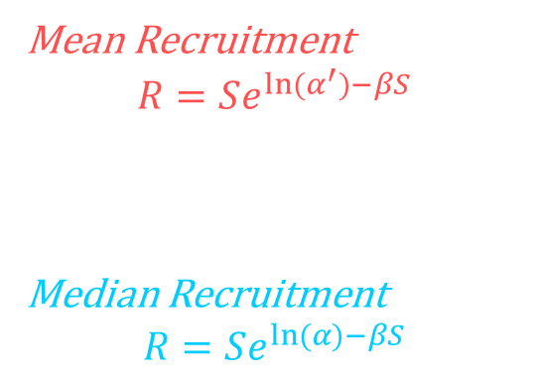
Lognormal Error Correction:${\ln{α}}^{′}$ (2)
Mean Recruitment
$$R=Se^{ln⁡(α^{′})−βS}$$
Median Recruitment
$$R=Se^{ln⁡(α)−βS}$$
Notes:
The graphs show the correction in practice, following through from the Ricker curve all the way to a goal proposal.
The pink line shows average recruitment (top), average yield (middle) and the resulting goal (bottom).
These curves/reference points were created using log alpha prime.
The teal line shows median recruitment (top), median yield (middle) and the resulting goal (bottom).
These curves/reference points were created using log alpha.

Slide 29
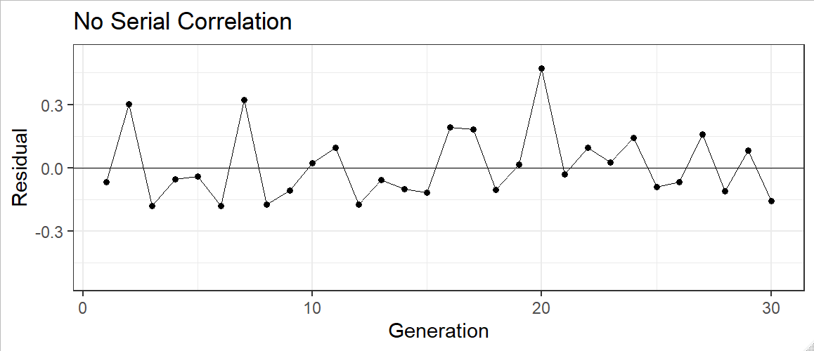
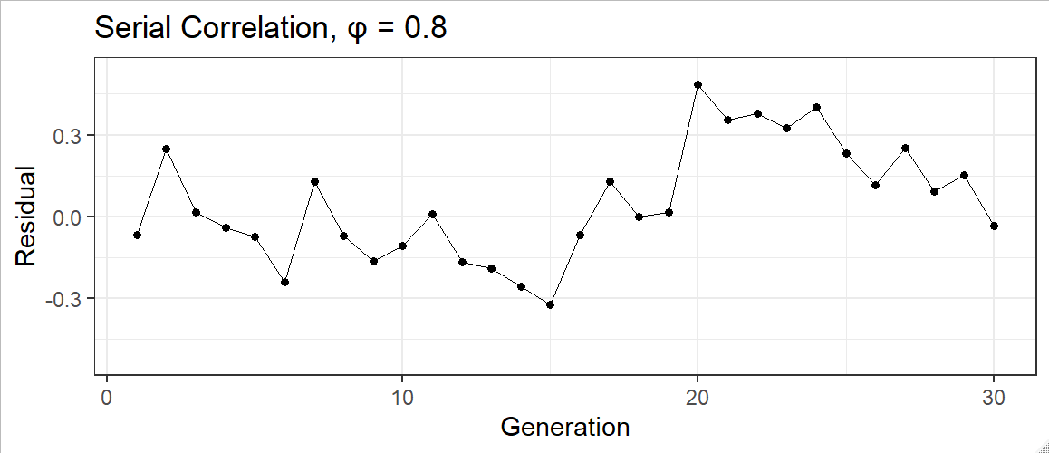

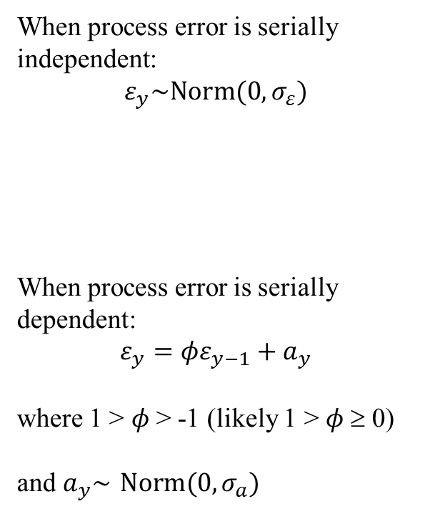
Serial correlation (1)
When process error is serially independent:
$$ε_{y}\sim Norm(0,σ_{ε})$$
When process error is serially dependent:
$$ε_{y}=φε_{y−1}+a_{y}$$
where 1 > $φ$ > -1 (likely 1 > $φ$≥ 0)
and $a_{y}\sim Norm(0,σ_{a})$
Notes:
The standard assumption is iid normal errors, i.e. the errors come from a common distribution.
Graphically, the errors are centered on zero and homoscedastic.
Serial correlation amongst the errors means the current error is a function of prior errors.
Usually use an AR(1) model… the current error is a function of the error 1 year before
Graphically, the errors trend on either side of zero.
It’s easy to think of mechanistic drivers for this pattern when generations of fish overlap in space and time.
In practice, we test for serial correlated errors and model the correlation when detected.

Slide 30
Serial correlation (2)
$ε_{y}=φε_{y−1}+a_{y}$where $a_{y}\sim Norm(0,σ_{a})$
Notes:
This animations shows how serial correlated errors manifest.
Each panel has the same random component, the same random draws a_y in the equation above.
On the left-hand side the errors are uncorrelated because phi = 0.
For each generation a new random error, centered on zero is generated.
On the right hand side we have serial correlated errors with a large value of phi.
The grey dots are 80% of the prior years error (phi*epsilon_y-1).
The dotted arrow shows the addition of a_y to the grey dot.
The black dot is the total error (epsilon_y) after random variation is applied.
The solid black line is the size of the prior years error.
Watch this for awhile and notice that each grey dot is 80% of the black dot that precedes it.

Slide 31
Process Error: Biological Interpretation
Competition
Within species
Between species
Environment
Episodic: floods, droughts, freezes
Continuous: Temperature
Escapement quality
Fraction females
Fecundity per unit size
Size composition (growth)
Age composition (maturation)
Notes:
This is not a comprehensive list but I wanted to emphasize that the process error term (potentially) contains a lot of information.
The idea is that we can use biological knowledge to identify major mechanisms and move some process error into the deterministic part of our equation.

Slide 32
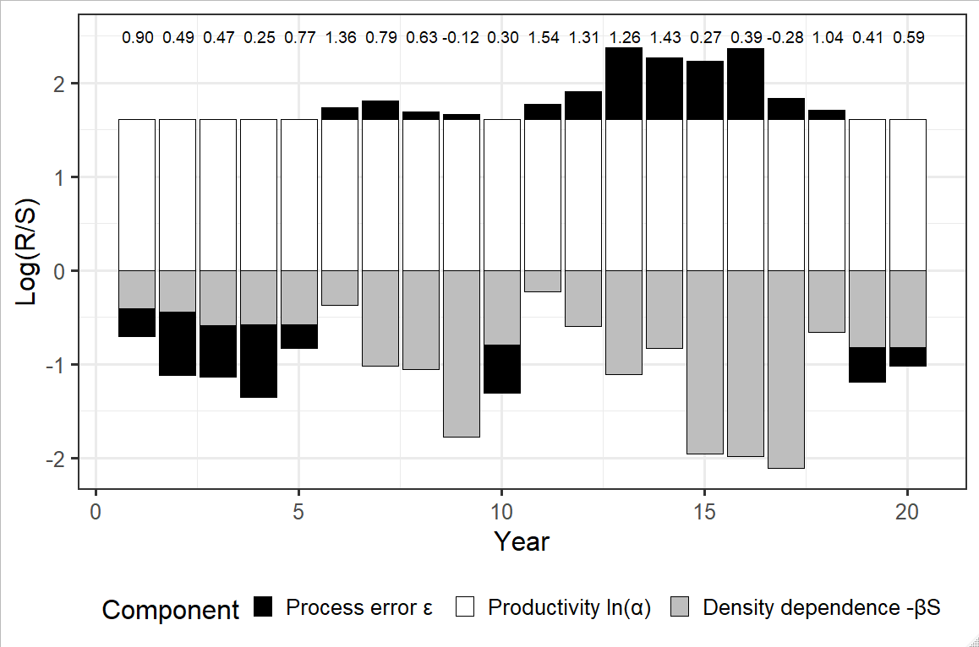
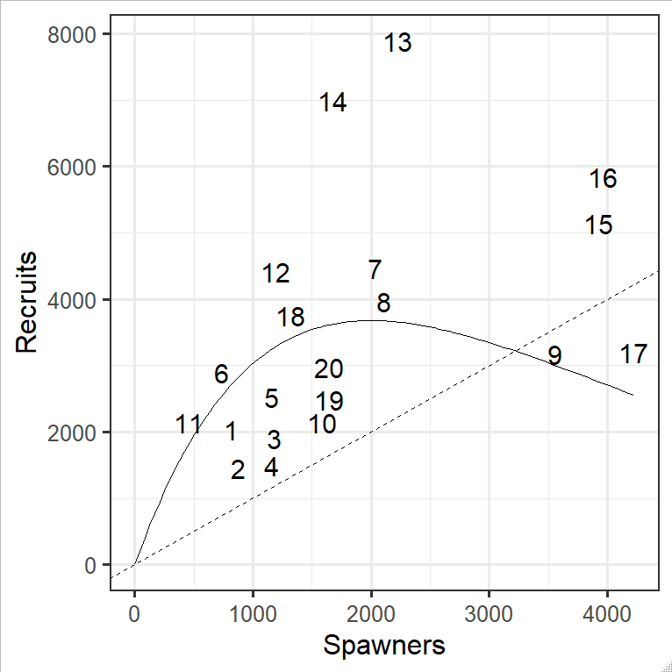

Residuals help us understand productivity
$\ln\left(α\right)−βS+ε_{t}$ $=ln\left(\frac{R}{S}\right)$
Notes:
Let’s look at the Ricker SR relationship to think about how the terms interact.
The bar chart shows the three terms in the Ricker equation; productivity in white, density dependence in grey and process error in black.
The graph is showing the magnitude and sign of each term in the linear form of the Ricker equation.
The number above each column represent s the sum of the components (ln(r/s)).
Notice that productivity is constant while density dependence varies annually through S. Process error also varies annually.
The inset shows the SR relationship where the datapoints are labeled with the year code.
Let’s look at a year 11 and year 15.
In year 11 spawning abundance was very small and actual recruitment is close the expected value (i.e. the line) but above it.
In the bar chart we expect to see a small density dependent component and a small, positive process error component.
In year 15 spawning abundance was very large and actual recruitment is far above the expected value.
In the bar chart we expect to see a large density dependent component and a large, positive process error component.
Lastly notice that the errors are patterned, with positive and negative errors clumped together (serial correlation).
We can think about these trends as describing high and low productivity periods for our stock (time-varying productivity).
For example; productivity was below average between years 1 and 5.
Why productivity? If alpha varies with time the whole Ricker curve moves up and down, if beta varies with time then effect is only felt during large escapements.

Slide 33

Process Error: Time-varying Productivity
$\ln\left(α_{t}\right)−βS+ε_{t}$ $=ln\left(\frac{R}{S}\right)$
Collie J.S. et al. 2012. A Fisheries risk-assessment framework to evaluate trade-offs among management options in the presence of time-varying productivity. CJFAS. 69. 209-223.
Notes:
The authors who produced this graphic worked with a model where log alpha varied annually.
In effect they took the low frequency variation in process error and attributed it to time varying productivity (white).
The grey is the density dependent effect.
The black is the remaining process error.
Remember alpha is the product of fecundity, freshwater survival and marine survival. It's unlikely all three of those things are constant from year to year.
Think about this graphic in terms of stocks you are familiar with.
For me, b-c are reminiscent of recent Chinook salmon productivity because there is an extended period of low productivity followed but an incomplete rebound.
Notice in c productivity declined to the point where the stock was temporarily incapable for replacing itself.
What’s different is that for these stocks the low productivity period was masked because the stocks were in a period of high abundance (large grey bars). Also, note sometimes the remaining process error compensates for low productivity (arrow in d) sometimes it magnifies it (low productivity years in fig a). Figure d is alarming productivity is trending toward 0!

Slide 34
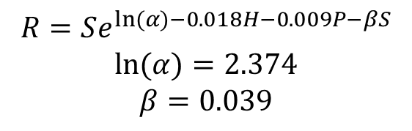
Process Error: Competition
Competition between Norton Sound chum salmon, hatchery chum salmon and pink salmon.
$$R=Se^{ln⁡(α)−0.018H−0.009P−βS}$$
$$\text{ln}(α)=2.374$$
$$β=0.039$$
Ruggerone G. et al. 2011. Evidence for competition at sea between Norton Sound chum salmon and Asian hatchery chum salmon. Environ Biol Fish.
Notes:
Once you have the idea that productivity can vary through time it’s natural to start thinking about mechanisms.
Here is an example of competition between populations/species.
This example is from Chum salmon in Norton Sound.
The authors suspect an oceanic food limitation caused by significant numbers of hatchery chum salmon and wild pink salmon sharing the ocean environment.
Suitably lagged abundances for these populations are included as covariates.
Notice both parameters are negative so abundance for these two extant populations are acting to attenuate productivity.
May only be a correlation but this model accounted for more process error than the standard Ricker.
This seems feasible. If Chum/pink have similar food requirements you could imaging a negative relationship between marine survival and their abundance.

Slide 35

Process Error: Early Marine Survival
Sea surface temperature as an environmental covariate
$$R=αSe^{γSST−βS}$$
Su Z. et al. 2004. Spatial Hierarchical Bayesian models for stock-recruit analysis of pink salmon. CJFAS. 61:2471-2486
Notes:
Here is an example of an environmental covariate (Sea surface temperature) for a Ricker relationship with several pink salmon stocks.
Environmental covariates in SR relationships have a reputation for being spurious. Most don’t stand up to reexamination.
These authors wrote a bunch of papers in support of SST as a covariate.
In general, they identified covariation in productivity (Ricker residuals) between stocks on a scale of ~500km.
They then found an environmental covariate (SST) that varied on approximately the same scale.
The left-hand graph shows a measure of model fit for 24 models they tried.
Lower numbers are better and every model that included SST was a better fit to the data than every model without it.
With does SST have to do with productivity?
The authors speculate SST is correlated with early marine survival because this is the time period when geographically proximate stocks would be similarly affected.
What’s interesting is that the SST parameter estimate was patterned.
In Southern regions increases in SST attenuated productivity (negative parameter).
In Northern regions increases in SST accentuated productivity (positive parameter).

Slide 36
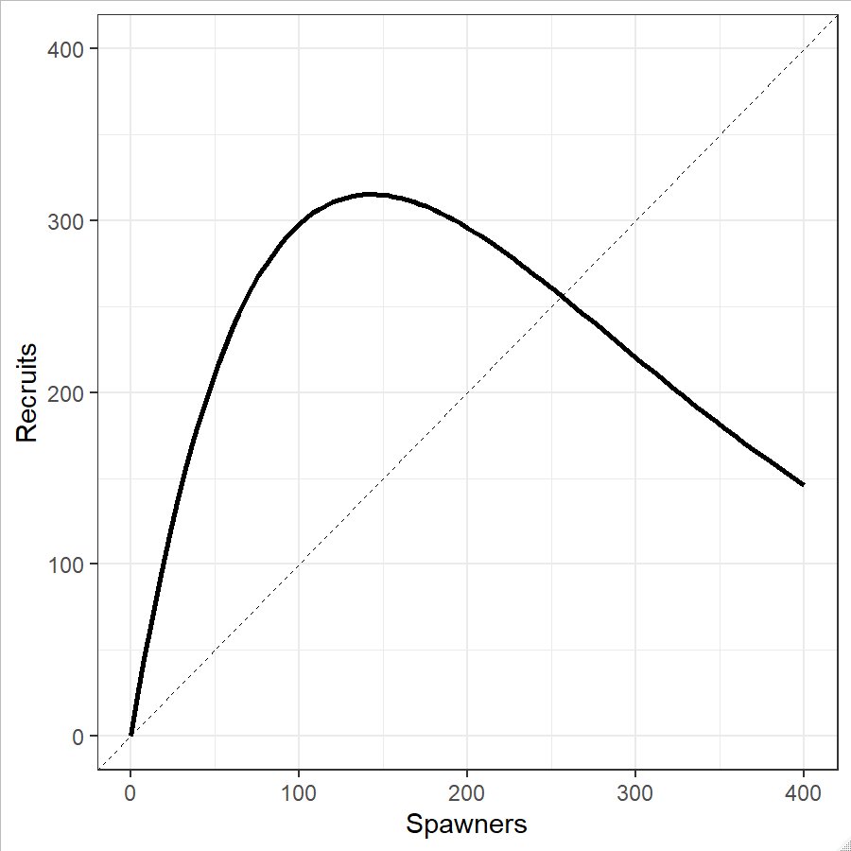
Time-varying Reference Points
Fecundity | 4000 eggs/spawner
Ova-smolt survival | 0.015 smolt/egg
Smolt-adult survival | 0.1 recruits/smolt
alpha | 6 recruits/spawner
Notes:
So we have been talking about time-varying productivity and shown some examples including time-varying productivity in SR models using covariates.
Let’s walk through a toy example to emphasize something about management reference points.
Imagine a stock with this SR relationship (Ricker; alpha=6, beta=0.007) and recall the table from earlier in the lecture about the life history components wrapped up in alpha.
Also recall that the freshwater life history stages are usually considered density dependent while the saltwater component of life history is usually considered density independent.
The DD numbers depend on S (expressed here as eggs), but the DI number (marine survival) does not.

Slide 37
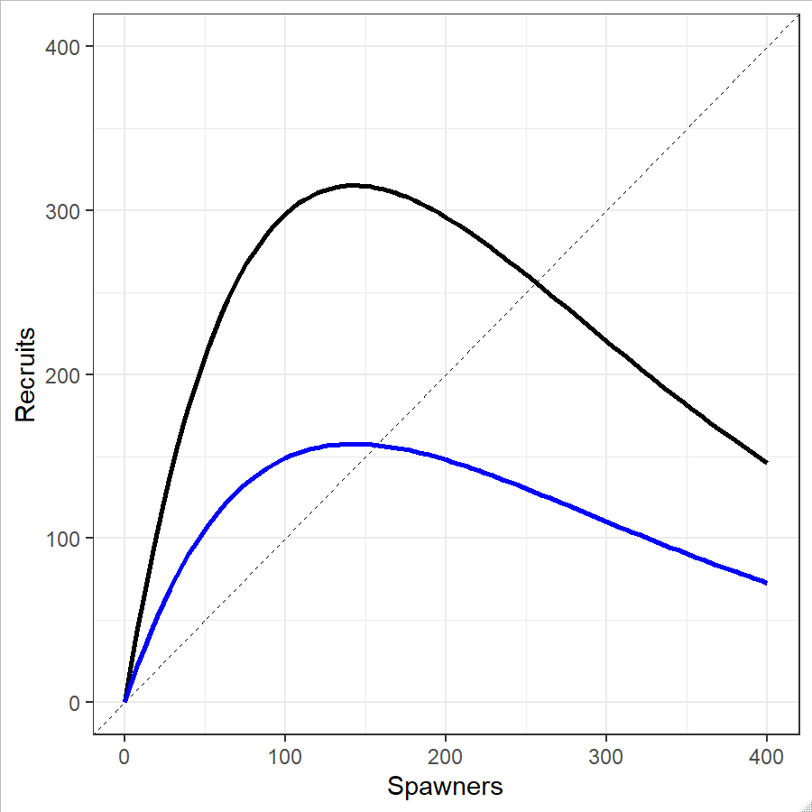

Time Varying Reference Points (2)
$R=αSe^{−βS}$
Fecundity | 4000 eggs/spawner
Ova-smolt survival | 0.015 smolt/egg
Smolt-adult survival | 0.1 recruits/smolt
alpha | 6 recruits/spawner
Fecundity | 4000 eggs/spawner
Ova-smolt survival | 0.015 smolt/egg
Smolt-adult survival | 0.05 recruits/smolt
alpha | 3 recruits/spawner
Notes:
Now imagine that the ocean environment changes and the marine survival for this stock declines by 50%.
Because marine survival is density-independent, alpha also decreases by 50%, as does recruitment for all escapement (all points on the Ricker curve drop halfway towards the X axis).
You can see that in the Ricker equation and in the graphic showing the new SR relationship in blue.

Slide 38
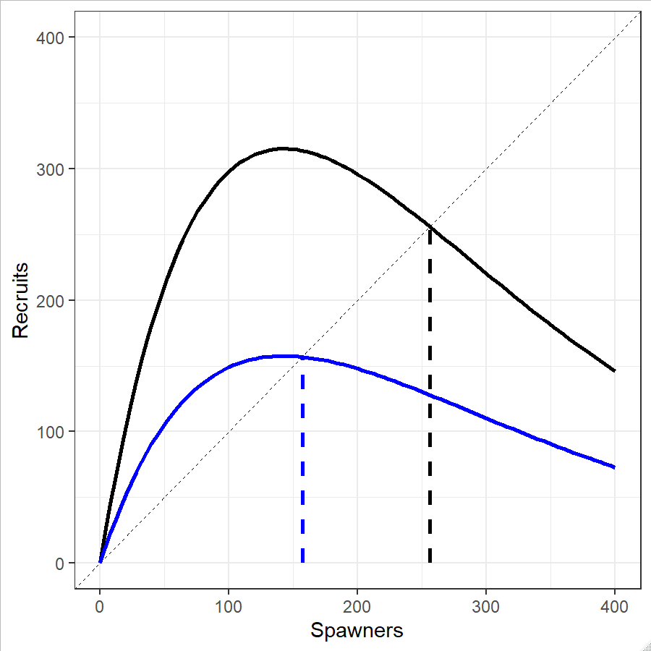

Time-varying S_{EQ}
$$S_{EQ}=\frac{{\ln{α}}^{′}}{β}$$
Fecundity | 4000 eggs/spawner
Ova-smolt survival | 0.015 smolt/egg
Smolt-adult survival | 0.1 recruits/smolt
alpha | 6 recruits/spawner
Fecundity | 4000 eggs/spawner
Ova-smolt survival | 0.015 smolt/egg
Smolt-adult survival | 0.05 recruits/smolt
alpha | 3 recruits/spawner
Notes:
Now look at Seq.
Seq dropped from 256 down to 157 through the effect of lag alpha.
You can see this in the equation for the reference point and in the graphic.

Slide 39
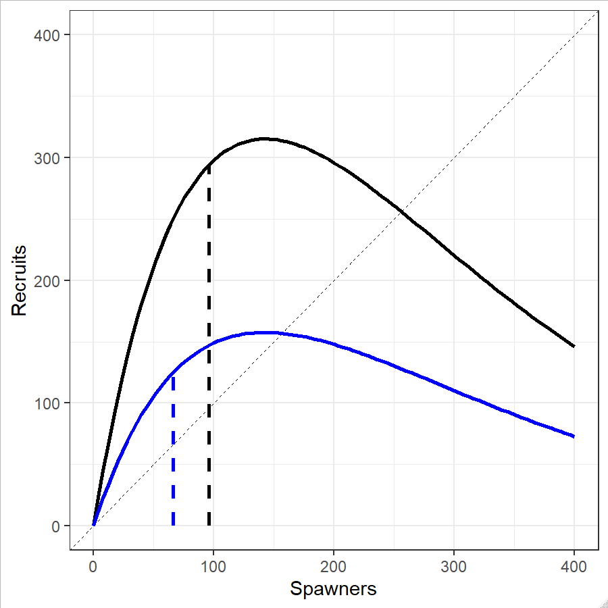

Time-varying S_{MSY}
$$S_{MSY}≅S_{EQ}(0.5−0.07{\ln{α}}^{′})$$
Fecundity | 4000 eggs/spawner
Ova-smolt survival | 0.015 smolt/egg
Smolt-adult survival | 0.1 recruits/smolt
alpha | 6 recruits/spawner
Fecundity | 4000 eggs/spawner
Ova-smolt survival | 0.015 smolt/egg
Smolt-adult survival | 0.05 recruits/smolt
alpha | 3 recruits/spawner
Notes:
Finally, Smsy also changes.
Seq dropped through the effect of lag alpha.
You can see this in the equation for the reference point and in the graphic.
It’s interesting to think about these changes because plausible changes in marine survival have large ramifications on the SR dynamics and the resulting management advice.
The implication is that escapements which maximize yield are also time varying.
Reminder, we like to think about this, but it’s not obviously actionable. We usually model average productivity across years.
What about Fecundity? If fecundity varies you would expect associated changes in density dependence.
This means changes in size/age at maturity will not carry through to alpha and recruitment as directly, i.e. they will be mediated by changes in ova-smolt survival in the opposite direction.

Slide 40
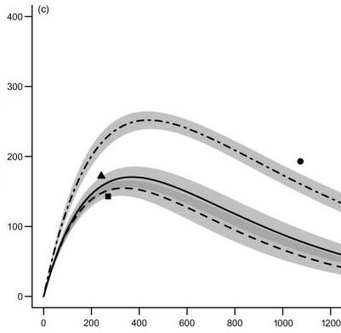
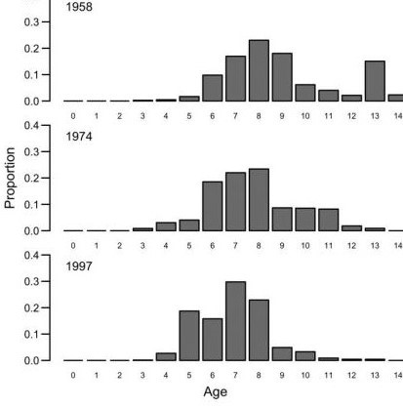
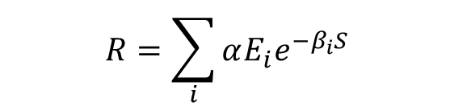
Process Error: Egg quantity/quality
Fecundity and Maternal age
$$R=\sum_{i}{αE_{i}e^{−β_{i}S}}$$
Sheldon A. et al. 2012. Maternal age, fecundity, egg quality, and
recruitment: linking stock structure to recruitment
using an age-structured Ricker model. CJFAS. 69:1631-1641
Notes:
Hip Pocket Slide
This SR relationship is from Icelandic Cod.
The authors know that fecundity varies with maternal age (i indicates an age class) and also that older females produce higher quality eggs.
They tested a variety of modified Ricker curves to account for these factors.
Their final model includes fecundity (E_i) directly as a measure of productivity. Recall that fecundity is usually tied up in alpha.
These authors argue there is no reason to use the same measure of abundance for density independent and density dependent covariates.
The final model also includes a different beta parameter for each age class.
The results are shown in the graphic. On the right-hand side we see 1958 was a brood year with a large spawning abundance of older females.
On the left-hand side we see the resulting SR-relationship (spawners in 1000s tons vrs. recruits millions).
The 1958 SR relationship is the dot-dash line.
I’m not sure how applicable this is to spawning salmon abut it’s interesting to think about how these terms interact.

Slide 41

SR Data
S-R analysis requires a lot of data
A lengthy time series of escapements
Age data
Harvest data
Notes:
We are going to shift gears slightly and wrap up with a few notes about SR data.
The first point is that recruitment is reconstructed from spawning abundance.
This table shows spawners and recruits for a population that matures over 3-5 years without harvest (far left and far right).
To get the pair we observe a spawning event (green) and wait.
Wait 3 years for the age-3 recruits (light green), 4 years for the age-4 recruits (medium green), and 5 years for the age-5 recruits (dark green).
Sometimes we have trouble reconstruction recruitment, it’s pretty data intensive.
The lag between a spawning event and observing the subsequent return truncates your time series.
In this example 1 year of missing age data effects 3 years of recruitment.
Missing or incomplete harvest data underestimates recruitment.
The following sections deals with all sorts of methods available to us when we have incomplete information.
Another point is that our estimates of spawning escapement and recruitment are based on the same observations.

Slide 42
Measurement Error
Typical measurement errors for salmon stock assessment
Assessment | CV
Sonar | >5%
Weir | >5%
Tower | >5%
Mark-Recapture | >10%
Foot Survey | >20%
Aerial Survey | >25%
Notes:
Errors in estimating escapement are called measurement errors.
Some methods (weirs) might be close to error free.
Other methods (aerial surveys) may include substantial error (not to mention bias).
If we are building a brood table, the errors in measuring escapement propagate through to recruitment.

Slide 43

Measurement Error and Estimation
Measurement errors are a nuisance that affect parameter estimation.
Notes:
The slide shows deterministic series of draws from the Ricker curve (black), and the same series with 2 levels of observation error applied [red, CV(S) of 0.1 and 0.3].
Errors propagate horizontally and vertically.
The lines show the parameter estimates were affected by observation error.
At this point we just need to understand that concept, measurement error will be discussed in greater detail later in the course.

Slide 44


Harvest Rates and Estimation
By controlling harvest rate we control the range of escapements observed… and affect parameter estimation.
Notes:
We saw earlier that applying harvest can change equilibrium abundance in the SR relationship.
If we generate data under two ranges of harvest rates we see that parameter estimation is affected by harvest policy.
Recall that alpha is the slope of the SR curve at the origin and beta is the reciprocal the Smax.
Under lower to moderate harvest rates (left side) we have some information about both parameters (alpha and beta).
Thinking about our management reference points we are in a decent position for estimating Smsy (uses both alpha and beta).
Under a moderate to high harvest rate (right side) we have a lot of data informing alpha but not much informing beta.
With respect to Smsy the variability in beta could be problematic.
This concept will come up repeatedly in the following sections and you will see it in the lab.

