Slide 1
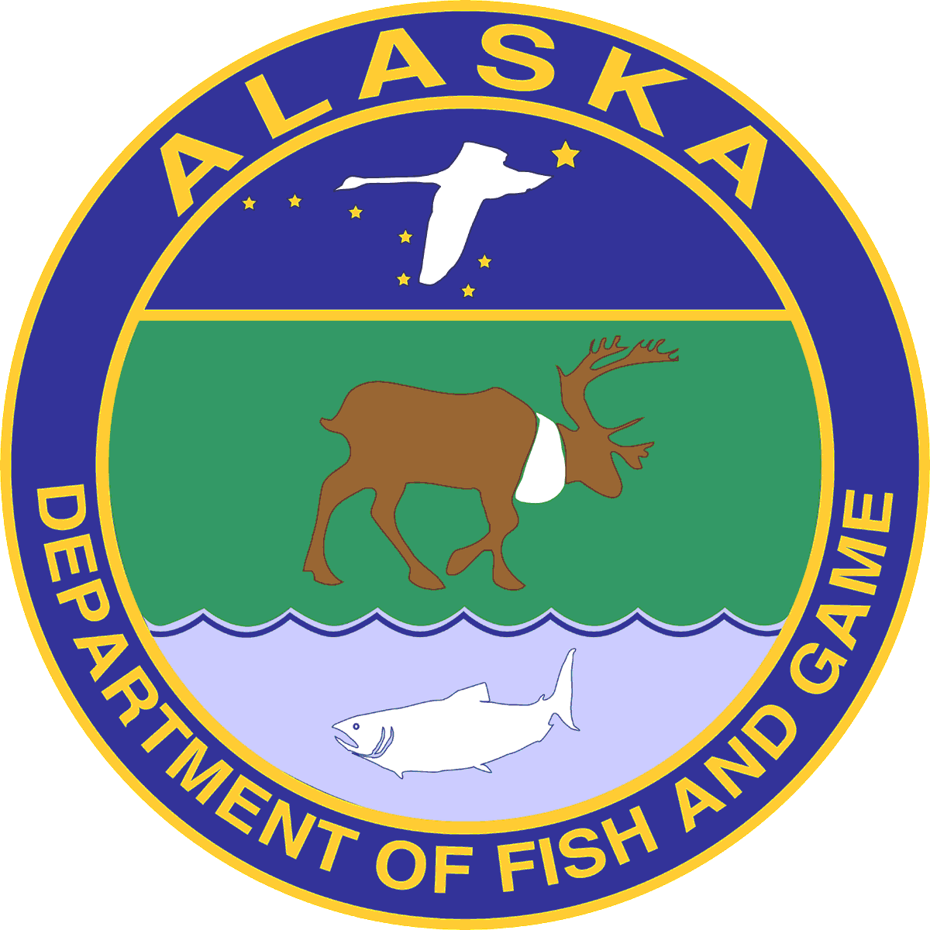
Mechanics
of Escapement Goal Analysis in Alaska
Lecture Slides for a Short Course to Staff of the Alaska Department of Fish and Game
Juneau, Alaska
12-14 November 2019
Matt B. Tyers
Adam M. Reimer
Andrew R. Munro
Alaska Department of Fish and Game
Originally offered by D.R. Bernard, S.J. Fleischman and R.A. Clark.

Slide 2
Mechanics
of Escapement Goal Analysis in
Alaska
Course Description:
Covers the basics of stock-recruit theory, the different types of escapement goals and how to select one, and stock-recruit analysis.
Course Goals:
If involved in stock-recruit analysis-> Try and understand all of it.
If peripheral involvement in stock-recruit analysis-> Understand general concepts. Try not to get bogged down by the math!
Course Timeline:
Day 1: Introduction / Stock Recruit Theory / Types and Selection of Goals
Day 2: Stock Recruit Analysis / Lab / Introduction to Case Studies
Day 3: Case Studies / Loose ends / Class Survey & Evaluation
Notes:
Other Details:
Please keep a list of slides you find difficult/unclear’ we’ll ask for them at the end
Cell phones off please
Ask Questions!

Slide 3
Mechanics
of Escapement Goal Analysis in Alaska
Introduction
Stock-Recruit Theory
Picking a Type of Goal and Method of Analysis
Stock-Recruit Analysis
Notes:
Here is a list of the sections in the handbooks…

Slide 4
Mechanics
of Escapement Goal Analysis in Alaska
Introduction:
definition of an escapement goal analysis
constitutional, statutory, and regulatory justifications for EGA
Escapement Goal Policy
types of escapement goals
stocks of concern in relation to escapement goal management
Introduction
4
Notes:
These are the topics that we will cover in this first lecture of the workshop…

Slide 5
Escapement Goal Analysis for a salmon stock:
The scientific determination of levels of spawning abundance that when used successfully as targets for managing fisheries will meet constitutional, statutory, and regulatory obligations.
Notes:
The definition of an escapement goal analysis for a salmon stock is…

Slide 6
Providing for Sustained Yield
Constitution:
Article VIII, Sec(4). Fish, forests, wildlife, grasslands, and all other replenishable resources belonging to the State shall be utilized, developed, and maintained on the sustained yield principle, subject to preferences among beneficial uses.
Statute:
AS 16.05.020(2). The commissioner (of the Department of Fish and Game) shall manage, protect, maintain, improve and extend the fish, game and aquatic plant resources of the state in the interest of the economy and general well-being of the state.
Notes:
The cornerstone of escapement goals in Alaska is found in the Constitution and State Statute.
Article 8, section 4 of the Alaska Constitution provides that replenishable resources of the State will be managed, developed and maintained on the sustained yield principle, subject to some preferences.
By Statute, the ADF&G Commissioner manages, protects, maintains, improves and extends resources in the interest of the economy and general well-being of the state.

Slide 7
Providing for Sustained Yield
Policies and Regulations:
Policy for the management of mixed stock salmon fisheries, 5 AAC 39.220
Policy for the management of sustainable salmon fisheries, 5 AAC 39.222
Policy for statewide salmon escapement goals,
5 AAC 39.223
Management plans for salmon fisheries
Notes:
Several policies underpin the escapement goal process, including:
the policy for management of mixed stock salmon fisheries, the policy for the management of sustainable salmon fisheries, and the policy for statewide salmon escapement goals.
Each provides general and specific direction to the escapement goal process.
Specific management plans ultimately guide application of fishery management strategies.

Slide 8
History of the Escapement Goal in Alaska
1880s: Commercial fishing of salmon begins under federal management
fish traps common
management is to catch earlier half of run (White Act, 1924)
1945: Industry funds W.F. Thompson (UW) to find out how to restore ‘depleted’ runs of sockeye salmon to Bristol Bay and elsewhere
escapement goals
systematically schedule fishing through the season
1959: Alaska statehood
fish traps outlawed
escapement goal management (EGM) adopted
1992: EGM explicitly adopted as written policy
2000: EGM codified into regulation as 5 AAC 39.222 and 5AAC 39.223
Woodby et al. 2005. ADF&G Spec. Publ. 05-09.
Krasnowski. 1998. Alaska’s salmon fisheries:
management and conservation. ADF&G.
Clark et al. 2006. AFRB 12(1):1-146.
Introduction - Justification
8
Notes:
8
Commercial fishing of salmon began in the 1880s and was managed by the federal government. Fish traps, which are extremely effective at catching returning salmon, were common and the fisheries were managed to harvest the earlier half of the run per the White act of 1924.
The early 1900s through the 1930s marked a period of industrial growth and prosperity as salmon prices increased and the industry lobbied hard in Washington D.C. to assure all new proposed regulations were abandoned or liberalized.
By the 1940s, sockeye salmon runs in Bristol Bay and elsewhere were depleted, so industry funded W.F. Thompson from UW to determine how to restore Alaska’s salmon stocks. His recommendations were to develop escapement goals and to spread the fishing effort throughout the season.
In 1959, Alaska gained statehood, which in part was to gain control over its fisheries, and immediately outlawed fish traps and adopted escapement goal-based management, as conceived by Thompson.
Then in 1992, first written escapement goal policy was adopted. And in 2000, escapement goal management was codified into regulation as the Sustainable Salmon Fisheries and Escapement Goal policies mentioned earlier.
If you would like to learn more about the history of salmon fisheries management and escapement goals in Alaska, I would encourage you to read the references listed on this slide.

Slide 9
Escapement Goal Policy (5 AAC 39.223)
(b) Department responsibilities:
(1) Document salmon escapement goals
(2-5) Establish BEG’s, SEG’s and SET’s for salmon stocks or population aggregates
(6) Review goals on the Board of Fisheries cycle
(7) Prepare scientific analyses for goals
(8) Notify public when goals are established or modified
(9) Report allocative impacts of goals to the Board of Fisheries
Notes:
The escapement goal policy speaks very specifically to roles and responsibilities of the department and the board in formulating escapement goals.
Paragraph (b) defines the role of ADF&G in nine sub-sections. The policy assigns ADF&G to document escapement goals, establish specific goals for stocks or population aggregates, review those goals on the BOF meeting schedule, prepare defensible, scientific analyses, notify the public when changes are made, and report allocative impacts of goals to this body.
Subsection seven is the promise of an escapement goal analysis by the department.

Slide 10
Biological Escapement Goal (BEG):
(means) the escapement that provides the greatest potential for maximum sustained yield (MSY);
BEG will be the primary management objective for the escapement unless an OEG or inriver goal has been adopted;
BEG will be developed from the best available biological information and
(BEG) should be scientifically defensible on the basis of (that) information;
BEG will be determined by the department and
(BEG) will be expressed as a range based on factors such as salmon stock productivity and data uncertainty; (and)
the department will seek to maintain evenly distributed salmon escapements within (this range);
Notes:
The SSFP also contains some key definitions. The Biological Escapement Goal is….
escapement with greatest potential for maximum sustained yield (MSY)
determined by the department
based on best available biological information
scientifically defensible
always a range
department will maintain evenly distributed escapements within the bounds

Slide 11
Sustainable Escapement Goal (SEG)
(means) … a level of escapement, indicated by an index or an escapement estimate, that is known to provide for sustained yield over a 5 to 10 year period used in situations where a BEG cannot be estimated or managed for;
the SEG is the primary management objective for the escapement, unless an optimal escapement or in-river run goal has been adopted by the board;
the SEG will be developed from the best available biological information;
(the SEG) … should be scientifically defensible … ;
the SEG will be determined by the department;
(the SEG) will be stated as a range "(SEG Range)" or a lower bound "(Lower Bound SEG)" that takes into account data uncertainty; and
the department will seek to maintain escapements within the bounds of the SEG Range or above the level of a Lower Bound SEG.
Notes:
In cases where a BEG cannot be estimated, a Sustainable Escapement Goal can be developed.
In addition the SEG is…
determined by the department
escapement known to provide for sustained yields over a five to ten-year period
based on best available biological information
scientifically defensible
can be a range or a lower bound
department will maintain escapements within the bounds of a range or above a lower bound
The vast majority of goals in Alaska are SEGs.

Slide 12
Sustained Escapement Threshold (SET):
(means) a threshold level of escapement, below which the ability of the salmon stock to sustain itself is jeopardized;
in practice, SET can be estimated based on lower ranges of historical escapement levels, for which the salmon stock has consistently demonstrated the ability to sustain itself;
…
the SET is established by the department in consultation with the board, as needed, for salmon stocks of management or conservation concern;
Notes:
Another term you hear about, or see reference to, is the Sustained Escapement Threshold or SET.
The SET does not represent any kind of escapement goal, because below that threshold, sustainability is jeopardized.
The SET is…
lower than the lower bound of BEG or SEG
can be based on lower levels of escapement that consistently sustain themselves
It is established by the department in consultation with the Board of Fisheries as need for stocks of management or conservation concern.

Slide 13
Stocks of Concern:
"yield concern" means a concern arising from a chronic inability (4-5 years), despite the use of specific management measures, to maintain expected yields, or harvestable surpluses, above a stock's escapement needs; 5 AAC 39.222(f)(42)
"management concern" means a concern arising from a chronic inability … to maintain escapements for a salmon stock within the bounds of the SEG, BEG, OEG, or other specified management objectives for the fishery; 5 AAC 39.222(f)(21)
"conservation concern" means concern arising from a chronic inability … to maintain escapements for a stock above a sustained escapement threshold (SET); 5 AAC 39.222(f)(6)
Notes:
Under the SSFP policy several concerns are defined.
A yield concern is least severe. A yield concern designates a salmon stock that fails to maintain expected yields, despite specific management measures.
The Management Concern is the next most severe. A management concern designates a salmon stock that, despite use of specific management measures, chronically fails to meet escapement goals.
The conservation Concern is the most severe, where there is a chronic failure to keep escapements above a theoretical, unsustainable level.

