Slide 1

a glance at reinforcement learning
Adam Green adgefficiency.com
adam.green@adgefficiency.com

Slide 2
Today
one
nomenclature & definitions
background & terminology
two
introduction to reinforcement learning
Markov Decision Processes
three
value functions
Policy approximation using dynamic programming, Monte Carlo & temporal difference methods
Q-Learning – 2013 Atair
four
policy gradients

Slide 3
one
nomenclature & definitions
background & terminology

Slide 4
Where to start
Sutton & Barto – Reinforcement learning: An Introduction
The bible of reinforcement learning
RL Course by David Silver
10 lecture series by lead DeepMind programmer
Both of these are in the course repo https://github.com/ADGEfficiency/DSR_RL

Slide 5
Nomenclature
s = state
s’ = next state
a = action
r_{t} = reward
G_{t} = discounted return after t
γ = discount factor
Experience = (s, a, r s’)
π(s) = policy
π* = optimal policy
V_{π}(s) = value function
Q_{π}(s, a) = action-value function
θ = function parameters
E(x) = expectation of x

Slide 6
Definitions
Expectation = mean (weighted average of all possible values)
Conditionals = probability of one thing given another
P(s’|s,a) = probability of next state, given state & action
R(s, a, s’) = reward received after being in state s, taking action a, ending up in next state s’
π(a|s) = action a chosen by policy π in state s

Slide 7
Variance & bias in supervised learning
Model generalization error = bias + variance + noise
Variance
error from sensitivity to noise in data set
model sees patterns that aren’t there -> overfitting
Bias
error from assumptions in the learning algorithm
model can miss relevant patterns -> underfitting

Slide 8
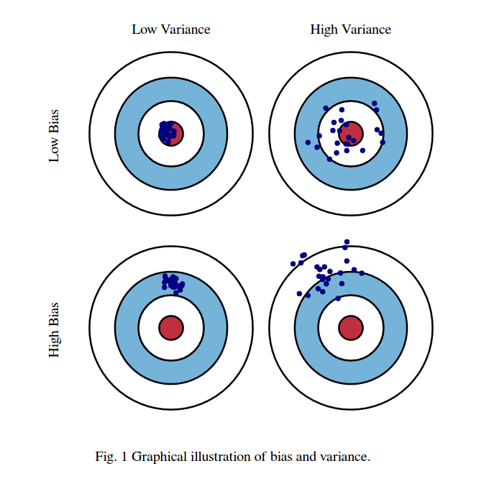
Variance & bias in reinforcement learning
Variance
how consistent is my model / sampling
can often be dealt with by sampling more (problem if sampling is expensive!)
Bias
how close to the truth is my model
approximations or bootstrapping tend to
introduce bias

Slide 9
Bootstrapping
In reinforcement learning bootstrapping refers to using a function recursively – using it to improve or approximate itself
The Bellman Equation is approximated using a recursive definition (more on this later)
V(s) = r + γ Q(s’)
Q(s,a) = r + γ Q(s’,a)
We can can use bootsrapping to improve our approximation of value functions (more on this later)

Slide 10
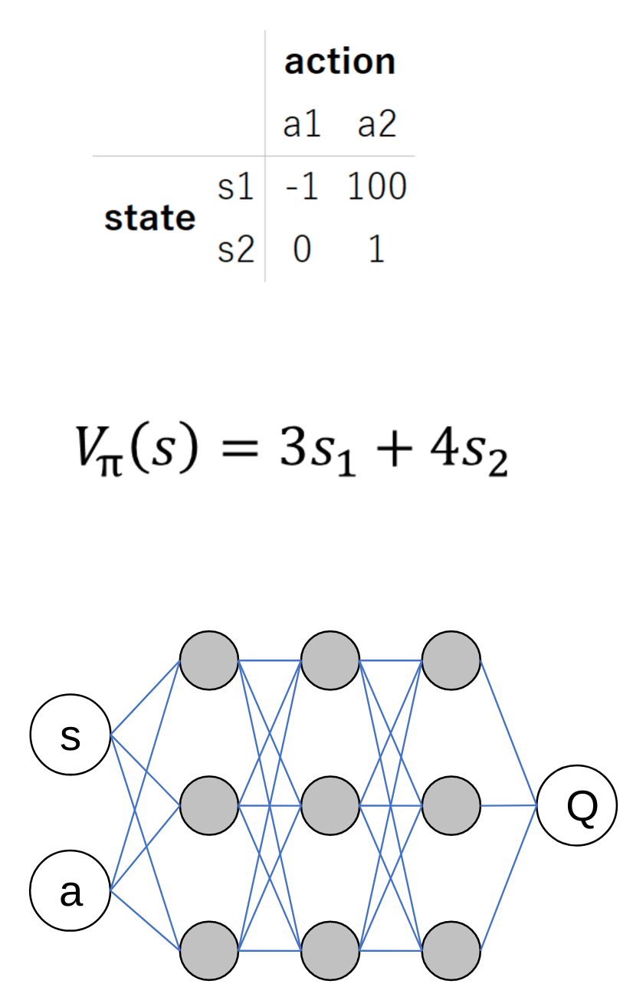
Function approximation
Lookup table
curse of dimensionality
Linear function
less parameters
generalize across states
Non-linear function
model complex dynamics
convolution for vision
recurrent for memory

Slide 11
iid
Independent and identically distributed
In statistical learning one always assumes the training set is independently drawn from a fixed distribution
May not be realistic in practice!

Slide 12
two
introduction to reinforcement learning

Slide 13
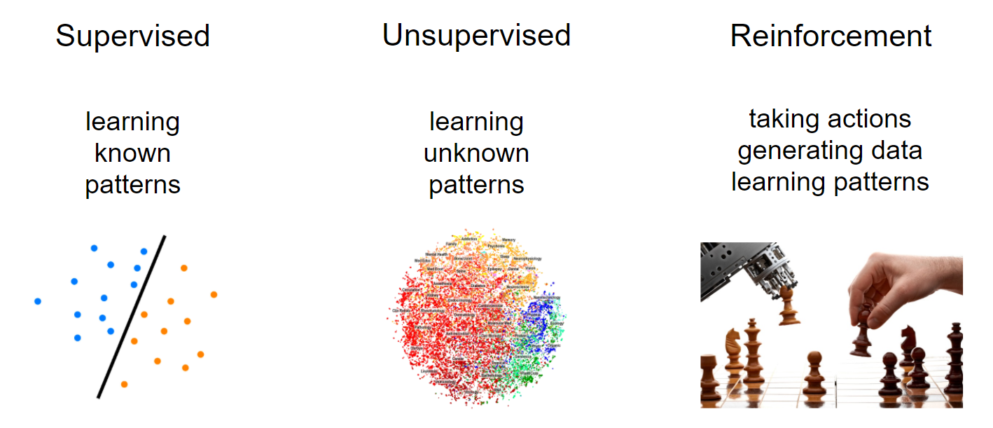
Machine learning

Slide 14
Reinforcement learning
Value functions
Parameterize a value function
V_{π}(s, θ)
Q_{π}(s, a, θ)
Policy gradients
Parameterize a policy
π(s, θ)
Actor-Critic
Parameterize both a value function & policy

Slide 15
Applications
Robotics
Self driving cars
Smart contracts on blockchains
Recommender systems
Neural network design
Manufacturing
Energy

Slide 16
Reinforcement learning is not
RL is NOT an alternative method to use instead of a random forest, neural network etc
“I’ll try to solve this problem using a convolutional nn or RL” this is nonsensical
Neural networks are a tool that reinforcement learners can use

Slide 17
Deep reinforcement learning
Deep learning = using neural networks (NN) with multiple layers
Deep reinforcement learning = using multiple layer NN to approximate/parameterize policies or value functions
We can use feedforward, convolutional or recurrent NN to do the approximation/parametrization

Slide 18
Reinforcement learning is learning through action

Slide 19
learns to maximise return
AGENT
state,
reward
action
ENVIRONMENT
responds to action

Slide 20
Data in reinforcement learning
Data is generated by the learner
supervised learning = only as good as the dataset
reinforcement learning = can generate more data through high quality policies
Data has the form
(state, action, reward, next state)
It’s not clear what we should do with this dataset!

Slide 21
Central challenges
1 – Exploration vs exploitation
2 – Data
3 – Credit assignment
4 – Sample efficiency

Slide 22
Exploration vs exploitation
Do I go to the restaurant in Berlin I think is best – or do I try something new?
Exploration = finding information
Exploitation = using information
How stationary are the environment state transition and reward functions? How stochastic is my policy?

Slide 23
Exploration vs exploitation
Design of reward signal vs exploration required
Algorithm does care about the time step
too small = rewards are delayed (credit assignment harder)
exploration becomes more like a random walk

Slide 24
Data – correlated samples
All the samples collected on a given episode are correlated (along the state trajectory)
This breaks the iid assumption of independent sampling
Receiving a certain sample of experience occurs only because we sampled another, correlated experience

Slide 25
Data – non-stationary distribution
Learning changes the data we see
Exploration changes the data we see
Environment can be non stationary
All of these break the identically distributed assumption of iid
Reinforcement learning is always breaking supervised learning assumptions about data quality

Slide 26
Credit assignment
How do we know which actions gave us reward
Reward signal can often be
delayed – benefit of action only seen later
sparse – experience may have a reward of 0
Sometimes we can design a more dense reward signal for a given problem

Slide 27
Sample efficiency

Slide 28
Markov Decision Processes

Slide 29
Markov Decision Processes
Mathematical framework for the reinforcement learning problem
A lot of theory (which we won’t cover today) proves that certain algorithms will converge to unbiased or optimal values in MDPs

Slide 30
Markov property
Can make prediction/decisions using only the current state
any additional information about the history of the process will not improve our prediction or decision
Present state is totally independent of the past
Future is conditional only on the present

Slide 31
State vs observation
It’s not required that all reinforcement learning problems are true MDPs – it’s more of an ideal or a useful model for non MDPs
Often we are limited to partially observed MDPs
the agent can only see some of the state variables
Lose convergence guarantees but still might be able to train a good agent

Slide 32
Formal definition of an MDP
Set of states S
Set of actions A
State transition function P(s|s’, a)
Reward function R(s, a, s’)
Initial state distribution P(s₀)
Discount factor γ
Horizion H

Slide 33
Discrete vs continuous spaces
This can be a key consideration – some algorithms can only work with discrete spaces
Q-Learning requires a discrete action space to argmax across
Always possible to discretize a continuous action space
curse of dimensionality
may lose information about the structure of the action space

Slide 34
Informal definition of an MDP
Two objects
agent + environment
Three signals
state, action, reward
agent
state,
reward
action
environment

Slide 35
Environment
Real or virtual
Discrete or continuous
action space
state space
Episodic vs. non-episodic
agent
state,
reward
state,
reward
action
environment

Slide 36

Discrete vs continuous action spaces
This can be a key factor in what kind of agent we can use!
Discrete action space
Continuous action space
Car accelerator from 0-100
We could discretize this as
[0, 1, 2, 3 … 99, 100]

Slide 37
State
Flexible concept
n-d array per time step
Information for agent to
learn from
choose next action
Fully observed vs hidden
agent
state,
reward
action
environment

Slide 38
Reward
Flexible concept
Scalar per time step
delayed
sparse
agent
state,
reward
action
environment

Slide 39
Agent
Learner & decision maker
maximize cumulative reward
Agent always has a policy (even if it’s a bad one!)
Can also choose to learn value functions or environment models
agent
state,
reward
action
environment

Slide 40
Policy - π
Rules to select actions
Always follow a policy
act randomly
always pick specific action
optimal (π*)
Deterministic or stochastic policies
agent
state,
reward
action
environment

Slide 41
Policy - π
On vs off policy learning
ability to learn from the experience of other policies
Policy can be
parameterized directly
generated from a value function
agent
state,
reward
action
environment

Slide 42
Environment model
Predicts environment response to actions
predicts s’, r from s, a
not predicting G (return)!
Sample vs. distributional model
Model has to be learnt
Model free RL is currently more powerful than model based
agent
state,
reward
action
environment

Slide 43
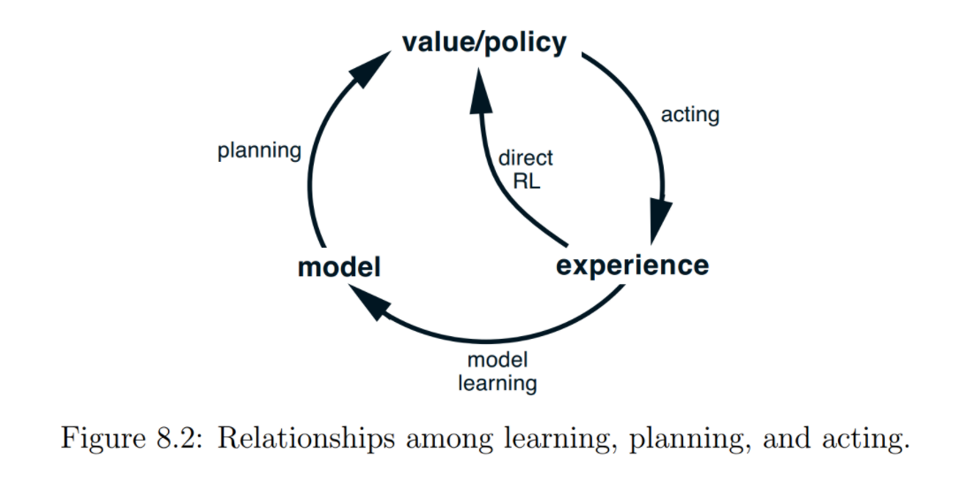
Sutton & Barto

Slide 44
learns to maximise return
AGENT
policy π(s)
value function(s) V_{π}(s), Q_{π}(s, a)
environment model
state s,
reward r
action a
ENVIRONMENT
state transition P(s’|s,a)
reward transition R(s, a, s’)
responds to action

Slide 45
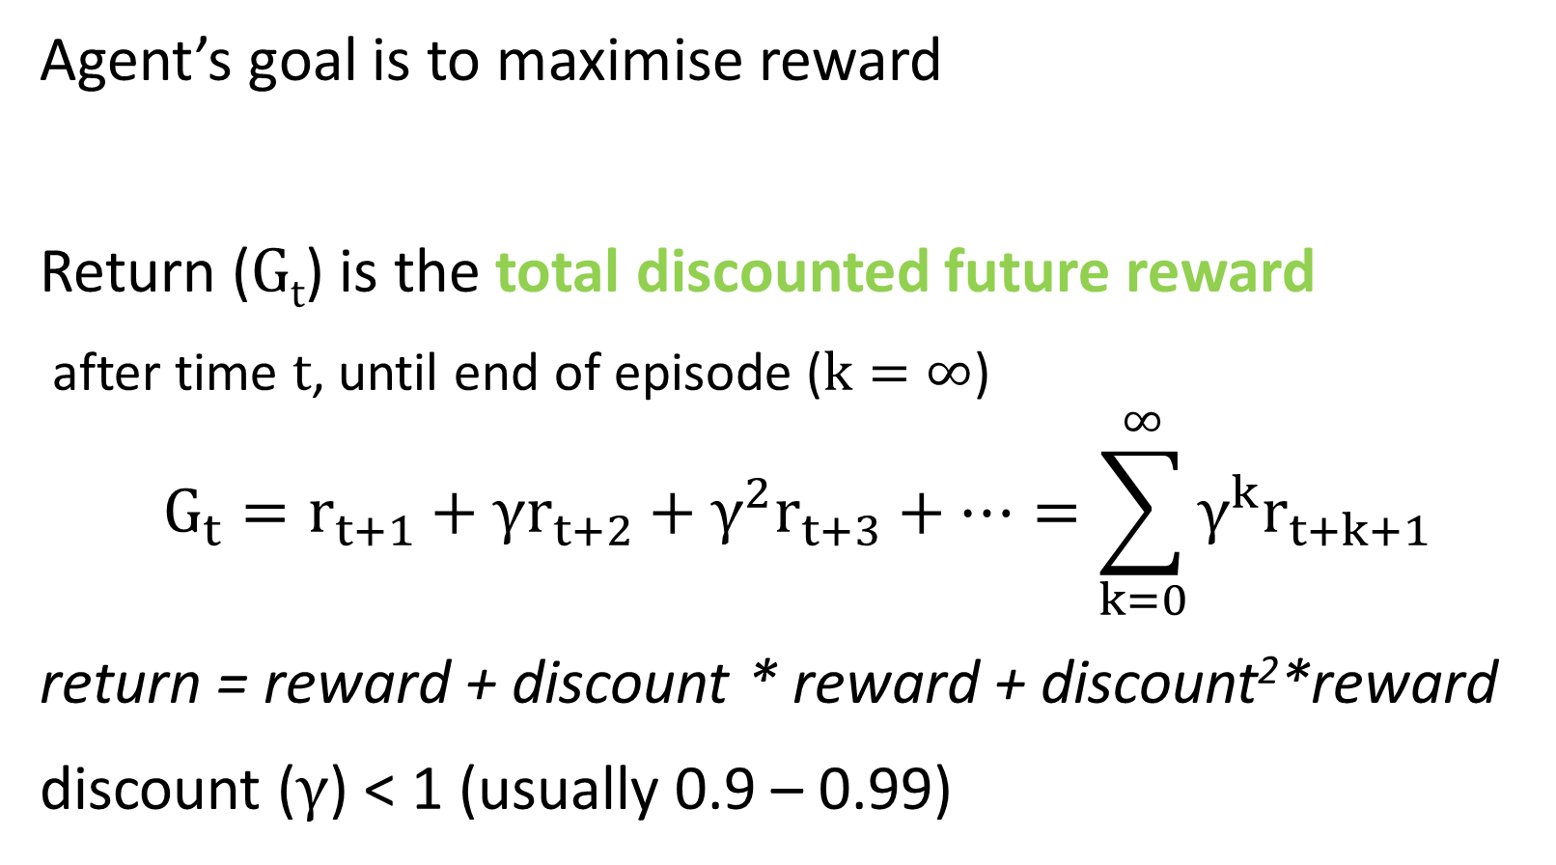
Return
Agent’s goal is to maximise reward
Return (G_{t}) is the total discounted future reward
after time t, until end of episode ($k=∞$)
$$G_{t}=r_{t+1}+γr_{t+2}+γ^{2}r_{t+3}+…=\sum_{k=0}^{∞}{γ^{k}r_{t+k+1}}$$
return = reward + discount * reward + discount²*reward
discount ($γ$) < 1 (usually 0.9 – 0.99)

Slide 46
Why are we discounting?

Slide 47
Discounting
Future is uncertain – stochastic environment
Matches human thinking – hyperbolic discounting
Finance – time value of money
Makes return a geometric series (for discount <1)
an infinite series with a finite sum

Slide 48
break

Slide 49
recap
Credit assignment
Exploration vs exploitation
Two objects – three signals
Agent & environment. State, reward & action
Policy = rules to select actions
Environment model = predicts next state & reward
Return = future discounted reward

Slide 50
A new level of intelligence
Artificial Intelligence and the Future | Demis Hassabis (2016)
https://www.youtube.com/watch?v=i3lEG6aRGm8&#t=27m12s
Demis Hassabis is Founder & CEO of DeepMind
Talking about the brilliance of AlphaGo in it’s 2015 series

Slide 51
three - value function methods
introduction to value functions & Bellman equation

Slide 52
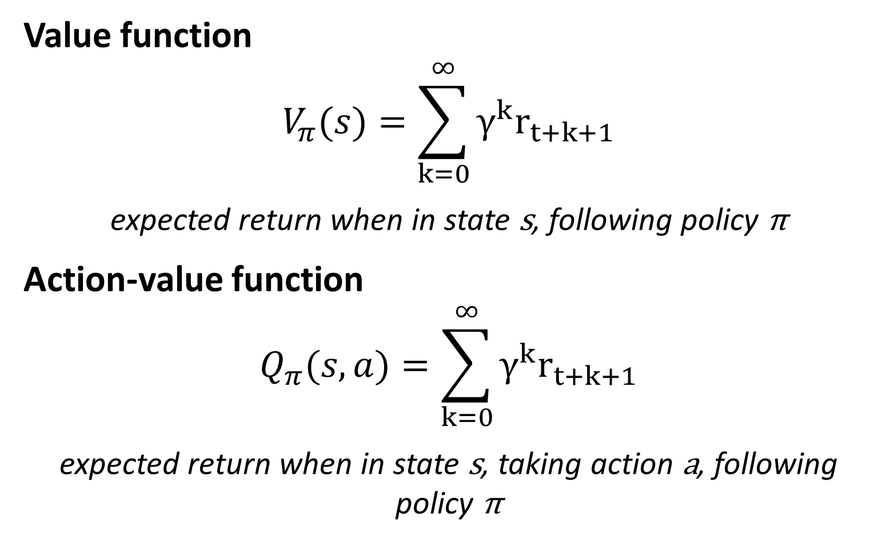
Value functions
Value function
$$V_{π}(s)=\sum_{k=0}^{∞}{γ^{k}r_{t+k+1}}$$
expected return when in state s, following policy π
Action-value function
$$Q_{π}(s,a)=\sum_{k=0}^{∞}{γ^{k}r_{t+k+1}}$$
expected return when in state s, taking action a, following policy π

Slide 53
Value functions
The value function is a prediction of the future
It’s a predication of return – which is what our agent wants to maximize
But we don’t know this function – the agent must learn it
Once we learn it – how will it help us to act?

Slide 54
Value functions
We can generate the optimal policy π* from the optimal value function Q*(s,a) (after we have learnt it)
Select an action by argmax[Q*(s,a)] for all possible actions
Select action with largest Q*
s
a₁
a₂
a₃
Q*(s,a)
3
4
5

Slide 55
Value function approximation
Lookup table
curse of dimensionality
Linear function
less parameters
generalize across states
Non-linear function
model complex dynamics
convolution for vision
recurrent for memory

Slide 56
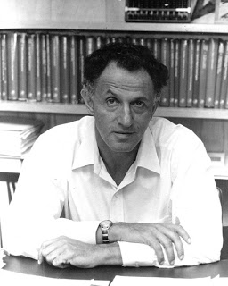
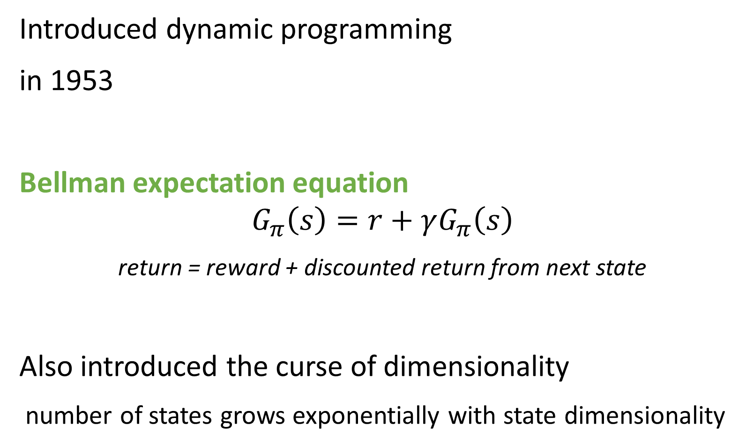
Richard Bellman
Introduced dynamic programming
in 1953
Bellman expectation equation
$$G_{π}\left(s\right)=r+γG_{π}\left(s\right)$$
return = reward + discounted return from next state
Also introduced the curse of dimensionality
number of states grows exponentially with state dimensionality

Slide 57
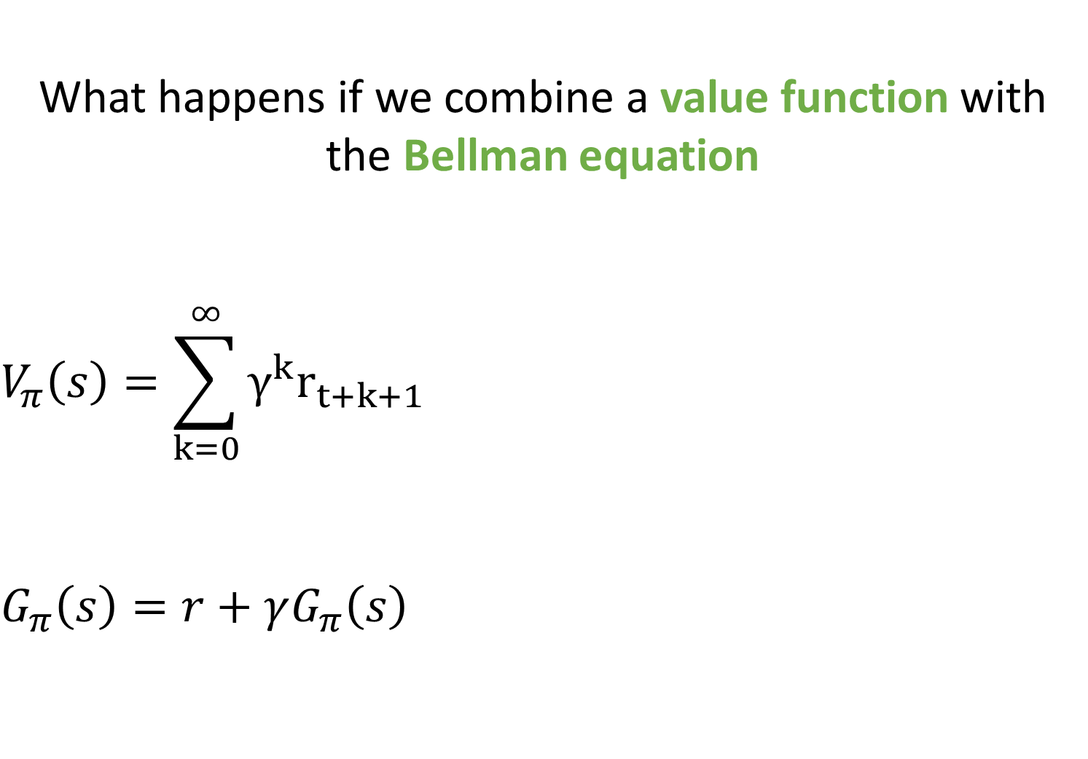
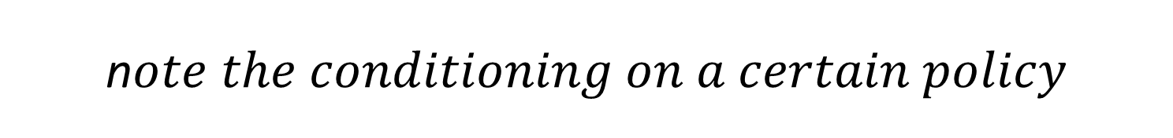
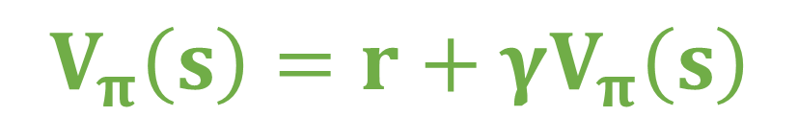
What happens if we combine a value function with the Bellman equation $$V_{π}\left(s\right)=\sum_{k=0}^{∞}{γ^{k}r_{t+k+1}}$$ $$G_{π}\left(s\right)=r+γG_{π}\left(s\right)$$ $$G_{π}\left(s\right)=r+γG_{π}\left(s\right)$$
$$V_{π}\left(s\right)=r+γV_{π}\left(s\right)$$
n$ote the conditioning on a certain policy$

Slide 58
Recursive relationship between states V(s) value of being in state = r reward we get after leaving state + γV(s’) discounted value of next state
s
state
r
s’
next state

Slide 59
Why is the Bellman equation important?

Slide 60
Bellman equation
Create a bootstrapped target to improve value function approximations
the target is used by supervised learners
We can improve our approximation by
loss = min(approximation – function output)
loss = min(r + Q(s’,a) – Q(s,a))

Slide 61
Bellman equation
Value function approximation is therefore crucial for policy improvement
Policy approximation vs policy improvement
Prediction vs control
Two problems
1 – improving our approximation of the value function
2 – improving our policy

Slide 62
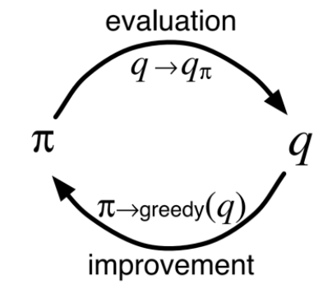
Approximation & improvement
We will look at three different methods for approximation
dynamic programming
Monte Carlo
temporal difference
One method for policy improvement
essentially just favour the best action (usually with an argmax)
Sutton & Barto

Slide 63
Approximation & improvement
This constant process of approximation & improvement is known as general policy iteration
Allows us to handle the non-stationary nature of reinforcement learning
non-stationary environment
learning process is non-stationary

Slide 64
three – value function methods
introduction to value functions & Bellman equation
value function approximation
dynamic programming

Slide 65
Dynamic programming
Imagine we had access to a perfect environment model
know state transition probabilities P(s|s’, a)
know the reward function R(s, a, s’)
How would you use this perfect environment model for value function approximation?
answer = use the Bellman equation

Slide 66
Dynamic programming backup
s1
Random policy
Discount = γ = 0.9
r = 1
p = 50%
r = 2
p = 50%
s2
s3
r = 5
p = 100%
s4
The state transition probabilities p depend both on the environment & policy

Slide 67
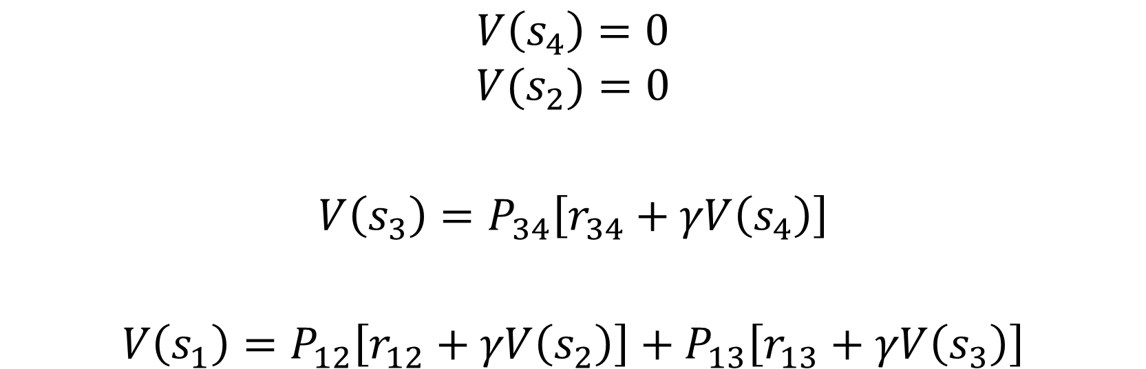
Dynamic programming backup
We can now perform iterative backups of the value of each state backwards in time
note – rewards for all terminal states are zero
$$V\left(s_{4}\right)=0$$
$$V(s_{2})=0$$
$$V\left(s_{3}\right)=P_{34}\left[r_{34}+γV\left(s_{4}\right)\right]$$
$$V\left(s_{1}\right)=P_{12}\left[r_{12}+γV\left(s_{2}\right)\right]+P_{13}\left[r_{13}+γV\left(s_{3}\right)\right]$$

Slide 68
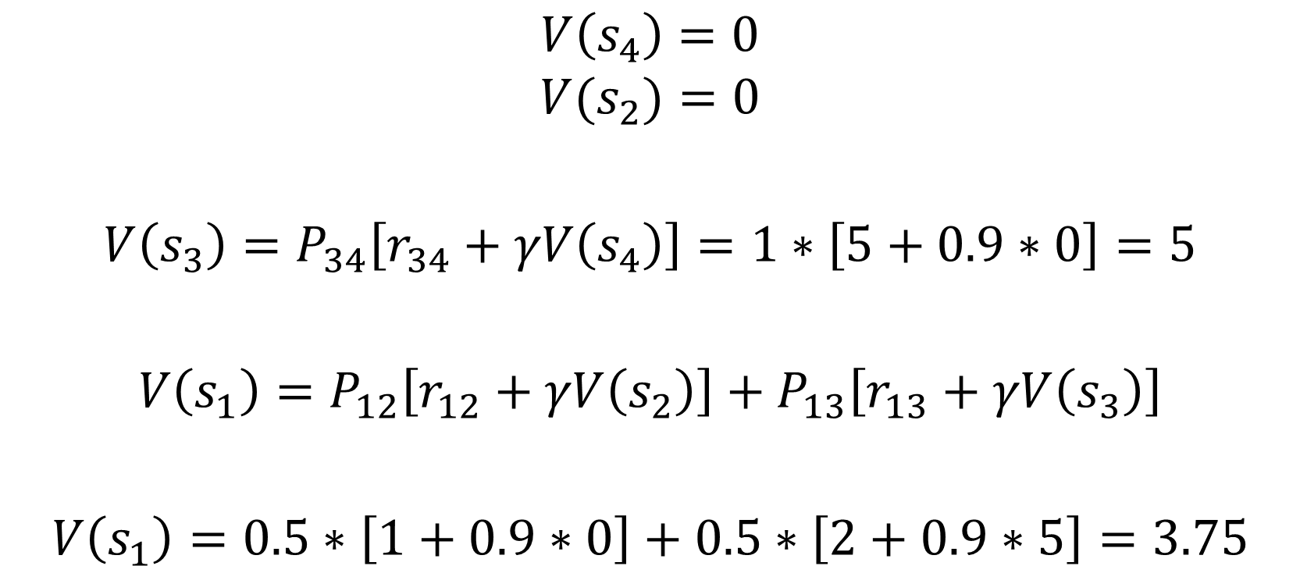
Dynamic programming backup
$$V\left(s_{4}\right)=0$$
$$V(s_{2})=0$$
$$V\left(s_{3}\right)=P_{34}\left[r_{34}+γV\left(s_{4}\right)\right]=1∗\left[5+0.9∗0\right]=5$$
$$V\left(s_{1}\right)=P_{12}\left[r_{12}+γV\left(s_{2}\right)\right]+P_{13}\left[r_{13}+γV\left(s_{3}\right)\right]$$
$$V\left(s_{1}\right)=0.5∗\left[1+0.9∗0\right]+0.5∗\left[2+0.9∗5\right]=3.75$$

Slide 69
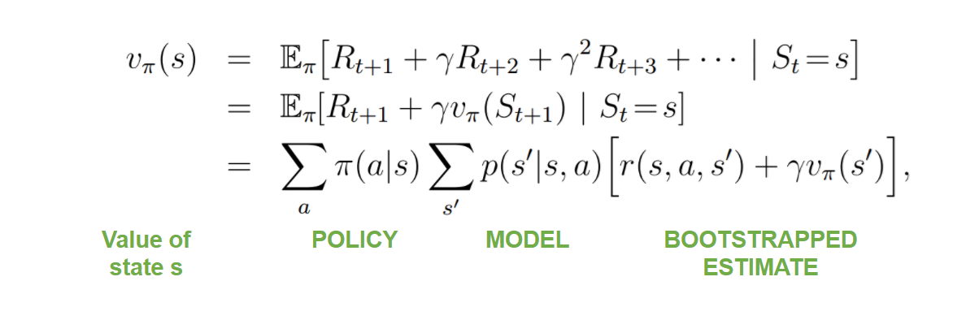
Dynamic programming
Sutton & Barto
Value function estimate V(s) depends on
our policy (what action we pick in state s)
the environment dynamics (state & reward transitions)
our estimate of V(s’) (bootstrapping)

Slide 70
Dynamic programming
Sutton & Barto
V(s) depends on on the value of all possible s’
Even when P(s|s’, a)=0
This makes dynamic programming computationally expensive

Slide 71
Dynamic programming
Requires a perfect environment model
we don’t learn from experience at all!
Bootstrapped
value function improves itself
Reliable convergence for finite, fully observed MDPs
Computationally expensive

Slide 72
three – value function methods
introduction to value functions & Bellman equation
value function approximation
dynamic programming
Monte Carlo

Slide 73
Monte Carlo
No model – learn from actual experience
experience = sequences of (s, a, r, s’)
No bootstrapping
V(s) = average of true discounted returns experienced
Episodic only
because we need to know the true discounted return
no within episode learning

Slide 74
Monte Carlo
Estimate value of state by averaging returns observed after visit to that state
estimate by sampling observed returns
As more episodes run, estimate should converge to the expected value
expected return of state s following policy π)
Low bias & high variance – why?

Slide 75
Monte Carlo
High variance
we need to sample enough episodes for our averages to converge
can be a lot for stochastic & path dependent environments
Low bias
we are using actual experience
no chance for our bootstrapped function to mislead us

Slide 76
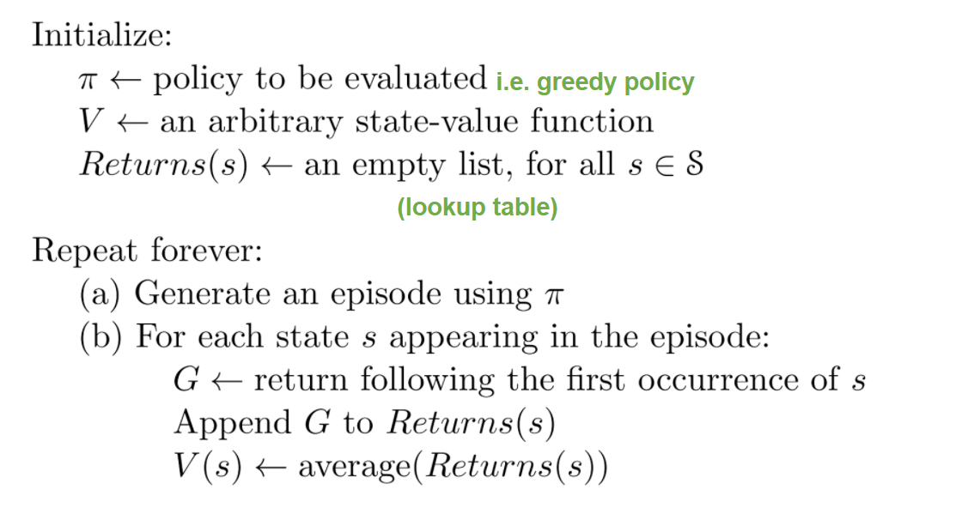
Monte Carlo
David Silver

Slide 77

Interesting things about Monte Carlo
Computational expense of estimating the value of state s is independent of the number of states
this is because we use experienced state transitions
s1
$$G\left(s_{4}\right)=0$$
$$G\left(s_{3}\right)=5+0.9∗0$$
$$G\left(s_{1}\right)=2+0.9∗5$$
r = 2
s2
s3
s4
r = 5

Slide 78
Monte Carlo
Learn from actual experience – no environment model
No bootstrapping – use true discounted returns
Episodic problems only – no learning online
High variance, low bias

Slide 79
three – value function methods
introduction to value functions & Bellman equation
value function approximation
dynamic programming
Monte Carlo
temporal difference

Slide 80
Temporal difference
Learn from actual experience – no environment model
Bootstrap – learn online
Episodic & non-episodic problems
Usually converges faster than Monte Carlo

Slide 81
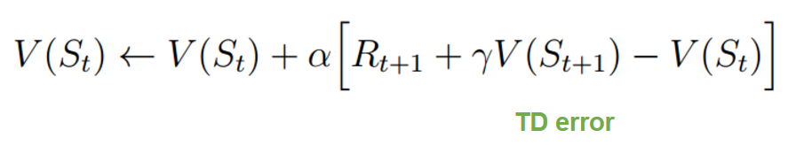
Temporal difference
Temporal difference methods use two methods of estimation / sampling
1 – bootstrap the approx. of V(s) using V(s’)
2 – sample from experienced trajectories
TD(0)

Slide 82
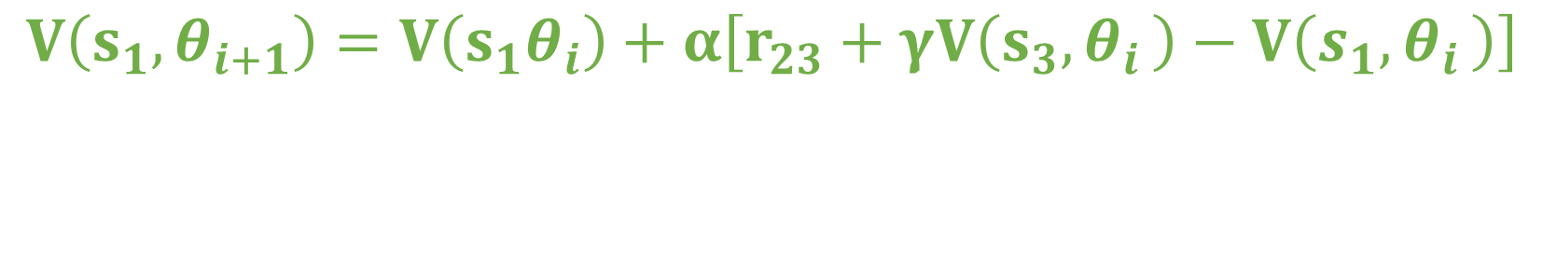
Temporal difference backup
s1
r = 2
s2
s3
s4
r = 5
$$V\left(s_{1},θ_{i+1}\right)=V\left(s_{1}θ_{i}\right)+α\left[r_{23}+γV\left(s_{3}{,θ}_{i}\right)−V\left(s_{1}{,θ}_{i}\right)\right]$$
Using the actual experienced trajectory
Bootstrapping

Slide 83
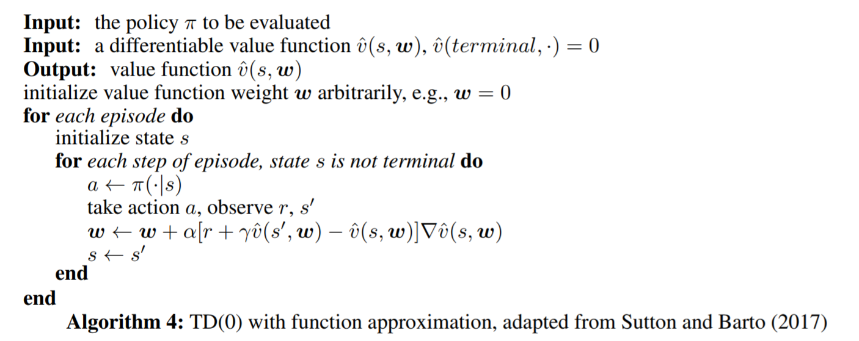
TD(0) algorithm
Ref = Li (2017)

Slide 84
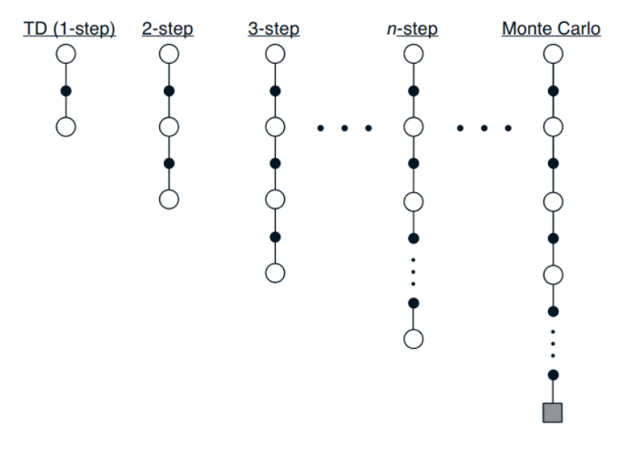
Linking together
Temporal difference & Monte Carlo are two extremes of the same scale
Further reading
TD(λ)
Eligibility traces
High bias
High variance
Sutton & Barto

Slide 85
break

Slide 86
recap – value function approximation
Dynamic programming
uses environment model, bootstraps
Monte Carlo
model free, samples actual returns, episodic only
Temporal difference
model free, bootstraps, samples actual experience

Slide 87
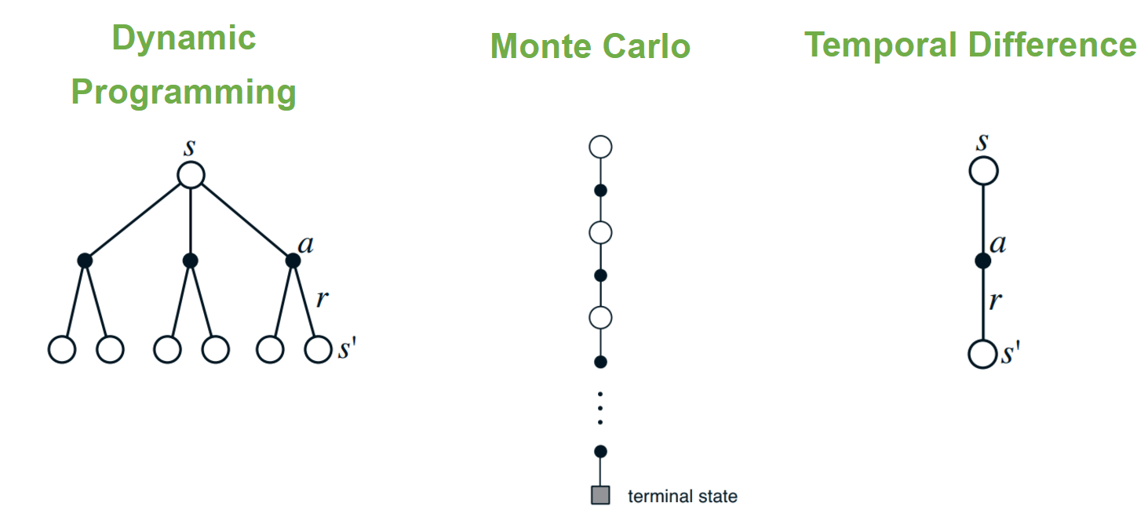
recap
Sutton & Barto

Slide 88
three – value functions
introduction to value functions & Bellman equation
value function approximation
dynamic programming
Monte Carlo
temporal difference
policy improvement & control
Q-Learning

Slide 89
Q-Learning
Popular modern method for reinforcement learning
DeepMind Atari work based around Q-Learning
DeepMind innovations that got Q-Learning to work with neural network function approximators (we will cover later)
experience replay
target networks
both improve learning stability

Slide 90
Deadly triad
Off policy learning – to free behaviour policy from target policy
Function approximation – scalability & generalization
Bootstrapping – computational & data efficiency
All combine to produce instability & divergence
Take fromLi 2017

Slide 91
Deadly triad
Unclear which is the root cause for instability
Dynamic programming will diverge with function approximation
Prediction can diverge (so it’s not exploration or control)
It’s not non-linear functions (since linear function can be unstable)

Slide 92
Q-Learning
Can be hard to get working
but if it works, works really well
Discrete action spaces only
because we take the argmax across all possible actions
Deterministic policies only
we always pick the best action

Slide 93
V(s) vs Q(s, a)
Both model future expected discounted return
Which is more useful?
V(s) tells us how good a state is
Doesn’t tell us how to get there!
Q(s, a) tells us how good an action is

Slide 94
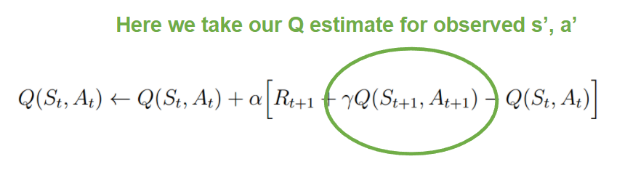
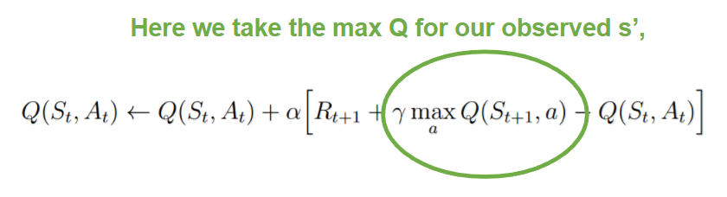
SARSA & Q-Learning
Both are temporal difference methods
SARSA
on-policy
observed state transition & action (take by policy)
Q-Learning
off policy
observed state transition + max across all possible actions

Slide 95
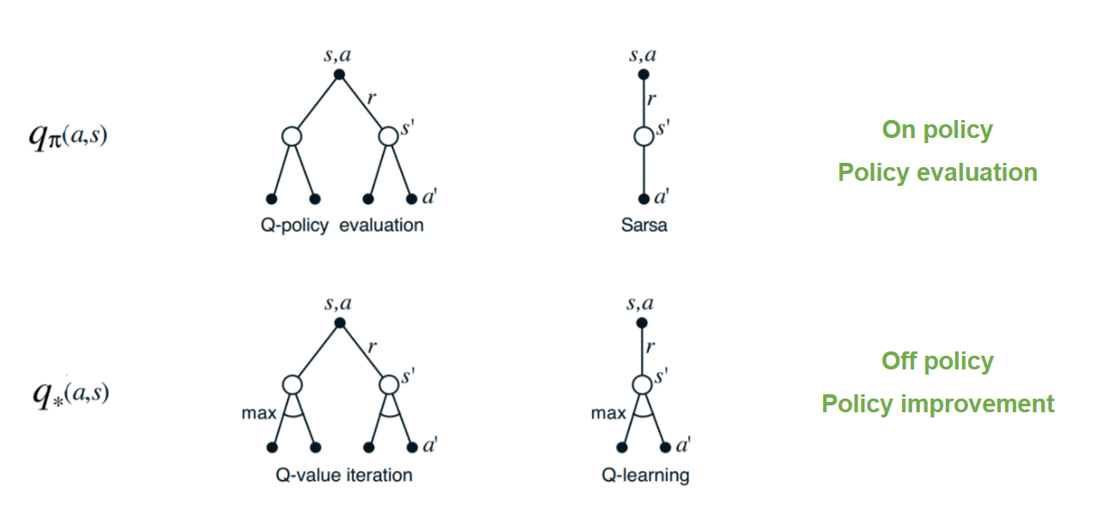
SARSA & Q-Learning

Slide 96
Maximization bias
The use of the max allows Q-Learning to learn off-policy
i.e. to learn the optimal policy while following a sub-optimal policy
But the maximum is
aggressive – this can be a problem when we are sharing weights between actions (ie parameterizing)
positively biased

Slide 97
Maximization bias
Imagine
state where Q(s,a) = 0 (for all possible a)
our estimates are distributed above & below 0
Maximum(true value) = 0
Maximum(estimated values) > 0

Slide 98
Maximization bias
Imagine
state where Q(s,a) = 0 (for all possible a)
our estimates are distributed above & below 0
Maximum(true value) = 0
Maximum(estimated values) > 0

Slide 99
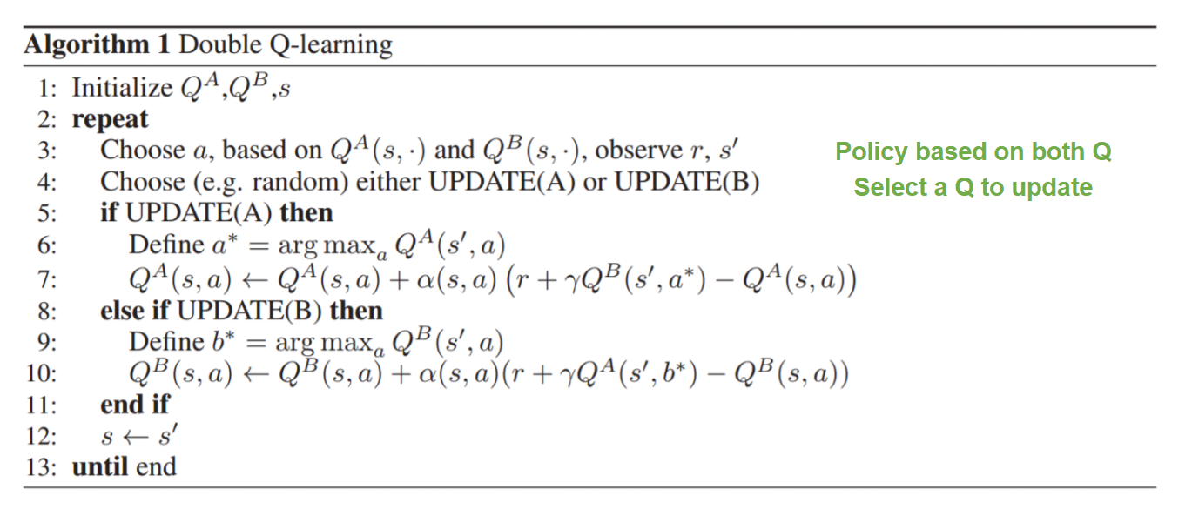
Double Q-Learning
Maintain two parameterized Q functions (A & B)
avg(A, B) to select actions
improve A by bootstrapping off B (or vice versa)

