Slide 1

a glance at reinforcement learning
Adam Green adgefficiency.com
adam.green@adgefficiency.com

Slide 2
Today
one
nomenclature & definitions
background & terminology
two
introduction to reinforcement learning
Markov Decision Processes
three
value functions
Policy approximation using dynamic programming, Monte Carlo & temporal difference methods
Q-Learning – 2013 Atair
four
policy gradients

Slide 3
one
nomenclature & definitions
background & terminology

Slide 4
Where to start
Sutton & Barto – Reinforcement learning: An Introduction
The bible of reinforcement learning
RL Course by David Silver
10 lecture series by lead DeepMind programmer
Both of these are in the course repo https://github.com/ADGEfficiency/DSR_RL

Slide 5
Nomenclature
s = state
s’ = next state
a = action
r_{t} = reward
G_{t} = discounted return after t
γ = discount factor
π(s) = policy
π* = optimal policy
V_{π}(s) = value function
Q_{π}(s, a) = action-value function
θ = function parameters
E(x) = expectation of x

Slide 6
Definitions
Expectation = mean (weighted average of all possible values)
Conditionals = probability of one thing given another
P(s’|s,a) = probability of next state, given state & action
R(s, a, s’) = reward received after being in state s, taking action a, ending up in next state s’
π(a|s) = action a chosen by policy π in state s

Slide 7
Variance & bias in supervised learning
Model generalization error = bias + variance + noise
Variance
error from sensitivity to noise in data set
model sees patterns that aren’t there -> overfitting
Bias
error from assumptions in the learning algorithm
model can miss relevant patterns -> underfitting

Slide 8
Variance & bias in reinforcement learning
Variance
how consistent is my model / sampling
can often be dealt with by sampling more (problem if sampling is expensive!)
Bias
how close to the truth is my model
introducing approximations or bootstrapping tends to introduce bias

Slide 9
Bootstrapping
In reinforcement learning bootstrapping refers to using a function recursively – using it to improve or approximate itself
The Bellman Equation is approximated using a recursive definition (more on this later)
V(s) = r + γ Q(s’)
Q(s,a) = r + γ Q(s’,a)
We can can use bootsrapping to improve our approximation of value functions (more on this later)

Slide 10
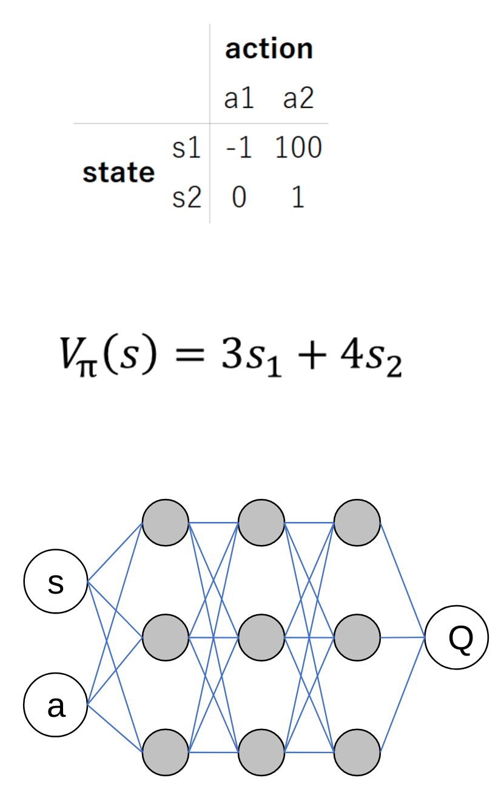
Function approximation
Lookup table
curse of dimensionality
Linear function
less parameters
generalize across states
Non-linear function
Model complex dynamics
Convolution for vision

Slide 11
iid
Independent and identically distributed
In statistical learning one always assumes the training set is independently drawn from a fixed distribution
May not be realistic in practice!

Slide 12
two
introduction to reinforcement learning

Slide 13
Machine learning
Three categories

Slide 14
Reinforcement learning
Value functions
Parameterize a value function
V_{π}(s, θ)
Q_{π}(s, a, θ)
Policy gradients
Parameterize a policy
π(s, θ)
Actor-Critic
Parameterize both a value function & policy

Slide 15
Applications
Robotics
Self driving cars
Smart contracts on blockchains
Reccomender systems
Neural network design
Manufacturing
Energy

Slide 16
Reinforcment learning is not
RL is NOT an alternative method to use instead of a random forest, neural network etc
“I’ll try to solve this problem using a convolutional nn or RL” this is nonsensical
Neural networks are a tool that reinforcement learners use to improve value functions or policies (using supervised techniques)

Slide 17
Reinforcement learning is learning through action

Slide 18
learns to maximise return
AGENT
state,
reward
action
ENVIRONMENT
responds to action

Slide 19
learns to maximise return
AGENT
policy π(s)
value function(s) V_{π}(s), Q_{π}(s, a)
environment model
state s,
reward r
action a
ENVIRONMENT
state transition P(s’|s,a)
reward transition R(s, a, s’)
responds to action

Slide 20
Data in reinforcement learning
Data is generated by the learner
supervised learning = only as good as the dataset
reinforcement learning = can generate more data through high quality policies
Data has the form
(state, action, reward, next state)
It’s not clear what we should do with this dataset!

Slide 21
Central challenges
1 – Exploration vs exploitation
2 – Data
3 – Credit assignment
4 – Sample efficiency

Slide 22
Exploration vs exploitation
Do I go to the resturant in Berlin I think is best – or do I try something new?
Exploration = finding information
Exploitation = using information
How stationary are the environment state transition and reward functions? How stochastic is my policy?

Slide 23
Data – correlated samples
All the samples collected on a given episode are correlated (along the state trajectory)
This breaks the iid assumption of independent sampling
Receiving a certain sample of experience occurs only because we sampled another, correlated experience

Slide 24
Data – non-stationary distribution
Learning changes the data we see
Exploration changes the data we see
Environment can be non stationary
All of these break the identically distributed assumption of iid
Reinforcement learning is always breaking supervised learning assumptions about data quality

Slide 25
Credit assignment
How do we know which actions gave us reward
Reward signal can often be
delayed – benefit of action only seen later
sparse – experience may have a reward of 0
Sometimes we can design a more dense reward signal for a given problem

Slide 26
Sample efficiency

Slide 27
Markov Decision Processes

Slide 28
Markov Decision Processes
Mathematical framework for the reinforcement learning problem
A lot of theory (which we won’t cover today) proves that certain algorithms will converge to unbiased or optimal values in MDPs

Slide 29
Markov property
Can make prediction/decisions using only the current state
any additional information about the history of the process will not improve our prediction or decision
Present state is totally independent of the past
Future is conditional only on the present

Slide 30
State vs observation
It’s not required that all reinforcement learning problems are true MDPs – it’s more of an ideal or a useful model for non MDPs
Often we are limited to partially observed MDPs
the agent can only see some of the state variables
Lose convergence guarantees but still might be able to train a good agent

Slide 31
Formal definition of an MDP
Set of states S
Set of actions A
State transition function P(s|s’, a)
Reward function R(s, a, s’)
Initial state distribution P(s₀)
Discount factor γ
Horizion H

Slide 32
Discrete vs continuous spaces
This can be a key consideration – some algorithms can only work with discrete spaces
Q-Learning requires a discrete action space to argmax across
Always possible to discretize a continuous action space
curse of dimensionality
may lose information about the structure of the action space

Slide 33
Informal definition of an MDP
Two objects
agent + environment
Three signals
state, action, reward
agent
state,
reward
action
environment

Slide 34
Environment
Real or virtual
Discrete or continuous
action space
state space
Episodic vs. non-episodic
agent
state,
reward
state,
reward
action
environment

Slide 35
State
Flexible concept
n-d array per time step
Information for agent to
a) learn from
b) choose next action
Fully observed vs hidden
agent
state,
reward
action
environment

Slide 36
Reward
Flexible concept
Scalar per time step
Delayed
Sparse
agent
state,
reward
action
environment

Slide 37
Reward
Flexible concept
Scalar per time step
delayed
sparse
agent
state,
reward
action
environment

Slide 38
Agent
Learner & decision maker
maximize cumulative reward
Agent always has a policy
Can also choose to learn value functions or environment models
agent
state,
reward
action
environment

Slide 39
Policy - π
Rules to select actions
Always follow a policy
act randomly
always pick specific action
optimal (π*)
Deterministic or stochastic policies
agent
state,
reward
action
environment

Slide 40
Policy - π
On vs off policy learning
can I learn from the experience of others
Policy can be
parameterized directly
generated from a value function
agent
state,
reward
action
environment

