Slide 1
Glance at reinforcement learning

Slide 2
Today
One background & terminology
      Nomenclature & definitions
Two introduction to reinforcement learning
      Markov Decision Processes
Three value functions
      Approximation using dynamic programming, Monte Carlo & temporal difference methods
      Q-Learning
      2013 Atair
Four policy gradients

Slide 3
One
Background & terminology

Slide 4
Where to start
1 - Sutton & Barto – Reinforcement learning: An Introduction
  The bible of reinforcement learning
2 – RL Course by David Silver
  10 lecture series by lead DeepMind programmer
Both of these are in the course repo https://github.com/ADGEfficiency/DSR_RL

Slide 5
Nomenclature
s = state
s’ = next state
a = action
r_{t} = reward
G_{t} = discounted return after t
γ = discount factor
π(s) = policy
π* = optimal policy
V_{π}(s) = value function
Q_{π}(s, a) = action-value function
θ = function parameters
E(x) = expectation of x

Slide 6
Definitions
Expectation = mean (weighted average of all possible values)
Conditionals = probability of one thing given another
  P(s’|s,a) = probability of next state, given state & action
  R(s, a, s’) = reward received after being in state s, taking action a, ending up in next state s’
  π(a|s) = action a chosen by policy π in state s

Slide 7
Variance & bias in supervised learning
Generalization error = bias + variance + noise
Variance
error from sensitivity to noise in data set
model sees patterns that aren’t there -> overfitting
Bias
error from assumptions in the learning algorithm
model can miss relevant patterns -> underfitting

Slide 8
Variance & bias in reinforcement learning
Variance
how consistent is my model / sampling
can often be dealt with by sampling more (problem if sampling is expensive!)
Bias
how close to the truth is my model
introducing approximations tends to introduce bias

Slide 9
Bootstrapping
In reinforcement learning bootstrapping refers to using a function recursively
The Bellman equation is approximated using a recursive defintion (more on this later)
V(s) = r + γ Q(s’)
Q(s,a) = r + γ Q(s’,a)
We often use bootstrapping to improve our approximation of functions

Slide 10
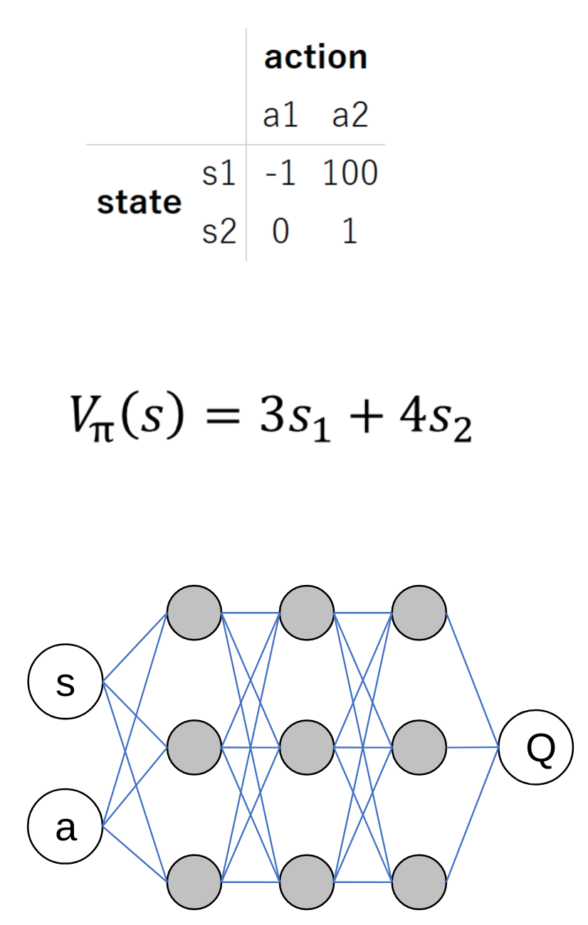
Function approximation
Lookup table
curse of dimensionality
Linear function
less parameters
generalize across states
Non-linear function
Model complex dynamics
Convolution for vision

Slide 11
iid
Independent and identically distributed
In statistical learning one always assumes the training set is independently drawn from a fixed distribution
May not be realistic in practice!

Slide 12
Two
Introduction to reinforcement learning

Slide 13
Machine learning
Three categories

Slide 14
Reinforcement learning
Value functions
Parameterize a value function
V_{π}(s, θ)
Q_{π}(s, a, θ)
Policy gradients
Parameterize a policy
π(s, θ)
Actor-Critic
Parameterize both a value function & policy

Slide 15
Applications
Robotics
Self driving cars
Smart contracts on blockchains
Reccomender systems
Neural network design

Slide 16
Reinforcment learning is not
RL is NOT an alternative method to use instead of a random forest, neural network etc
“I’ll try to solve this problem using a convolutional nn or RL” nonsensical
Neural networks are a tool that both supervised and reinforcement learners use

Slide 17
Reinforcment learning is learning through action

Slide 18
learns to maximise return
AGENT
state,
reward
action
ENVIRONMENT
responds to action

Slide 19
learns to maximise return
AGENT
policy π(s)
value function(s) V_{π}(s), Q_{π}(s, a)
environment model
state s,
reward r
action a
ENVIRONMENT
  state transition P(s’|s,a)
  reward transition R(s, a, s’)
responds to action

Slide 20
Data in reinforcement learning
Data is generated by the learner
  supervised learning = only as good as the dataset
  reinforcement learning = can generate more data through high quality policies
Data has the form
  (state, action, reward, next state)
It’s not clear what we should do with this dataset!

Slide 21
Central challenges
1 – Exploration vs exploitation
2 – Data
3 – Credit assignment
4 – Sample efficiency

Slide 22
Exploration vs exploitation
Do I go to the resturant in Berlin I think is best – or do I try something new?
Exploration = finding information
Exploitation = using infomation
How stationary are the environment state transition and reward functions?

Slide 23
Data – correlated samples
All the samples collected on a given episode are correalated
This breaks the iid assumption of independent samples
Recieving a certain sample of experience occurs only because we sampled another, correalted experience

Slide 24
Data – non-stationary distribution
Learning changes the data we see
Exploration changes the data we see
Break the identically distributed assumption of iid

Slide 25
Credit assignment
How do we know which actions gave us reward
Reward signal can often be
  delayed – benefit of action only seen later
  sparse – many samples have a reward signal of 0

Slide 26
Markov Decision Processes

Slide 27
Markov Decision Processes
Mathematical framework for the reinforcement learning problem
A lot of theory (which we won’t cover today) proves that certain algorithms will converge to unbiased or optimal values in MDPs

Slide 28
Markov property
Can make predictions using only the current state
  any additional information about the history of the process will not improve our prediction
Present state is totally independent of the past
Future is conditional only on the present

Slide 29
State vs observation
It’s not required that all reinforcement learning problems are true MDPs
Often we are limited to partially observed MDPs
  the agent can only see some of the state variables
Lose convergence gurantees but still might be able to train a good agent

Slide 30
Formal definition of an MDP
Set of states S
Set of actions A
State transition function P(s’|s,a)
Reward function R(s, a, s’)
Initial state distribution P(s₀)
Discount factor γ
Horizion H

Slide 31
Discrete vs continuous spaces
This can be a key consideration – some algorithms can only work with discrete spaces
  Q-Learning requires a discrete action space
Always possible to discretize a continuous space
  curse of dimensionality
  may lose information about the space structure

Slide 32
Informal definition of an MDP
Two objects
agent + environment
Three signals
state, action, reward
agent
state,
reward
action
environment

Slide 33
Environment
Real or virtual
Discrete or continuous
  action space
  state space
Episodic vs. non-episodic
agent
state,
reward
state,
reward
action
environment

Slide 34
State
Flexible concept
n-d array per time step
Infomation for agent to
  a) learn from
  b) choose next action
Fully observed vs hidden
agent
state,
reward
action
environment

Slide 35
Reward
Flexible concept
Scalar per time step
Can be often be
  delayed
  sparse
agent
state,
reward
action
environment

Slide 36
Reward
Flexible concept
Scalar per time step
Can be often be
  delayed
  sparse
agent
state,
reward
action
environment

Slide 37
Agent
Learner
Decision maker
Goal to maximize cumulative reward
Agent always has a policy
Can also choose to learn value functions or environment models
agent
state,
reward
action
environment

Slide 38
Policy - π
Rules to select actions
  def policy(state):
  return action
Always follow a policy
  act randomly
  always pick specific action
  maximize future discounted reward
Determinstic or stochastic policies
agent
state,
reward
action
environment

Slide 39
Policy - π
On vs off policy learning
Policy can be
  parameterized directly
  generated from a value function
agent
state,
reward
action
environment

