Slide 1
IncubateIND Hackathon
TEAM WHITE HAT SENIORS
Team Members:
Ritik Agarwal
Shray Sanan
Shreyansh Chaurasia
Kuwar Sahil Ali Khan

Slide 2
CONTENTS
01
02
03
04
05
Problem Statement
Proposed Solution
Technologies Used
Functionality
Future Scope
Out of the three Problems of which we chose one problem statements. ie. Education, as our problem Statement
We interpreted the lack of motivaion among students and thus proposed a solution
The Languages We Are
HTML, Bootstrap, and Javscript
Baisc Functionality Regarding Music Player, Login System, Blogs, etc
Considered Ahead...

Slide 3
01
Problem Statement
Out of the three Problems of which we chose one problem statements.
ie. Education ,as our problem Statement

Slide 4
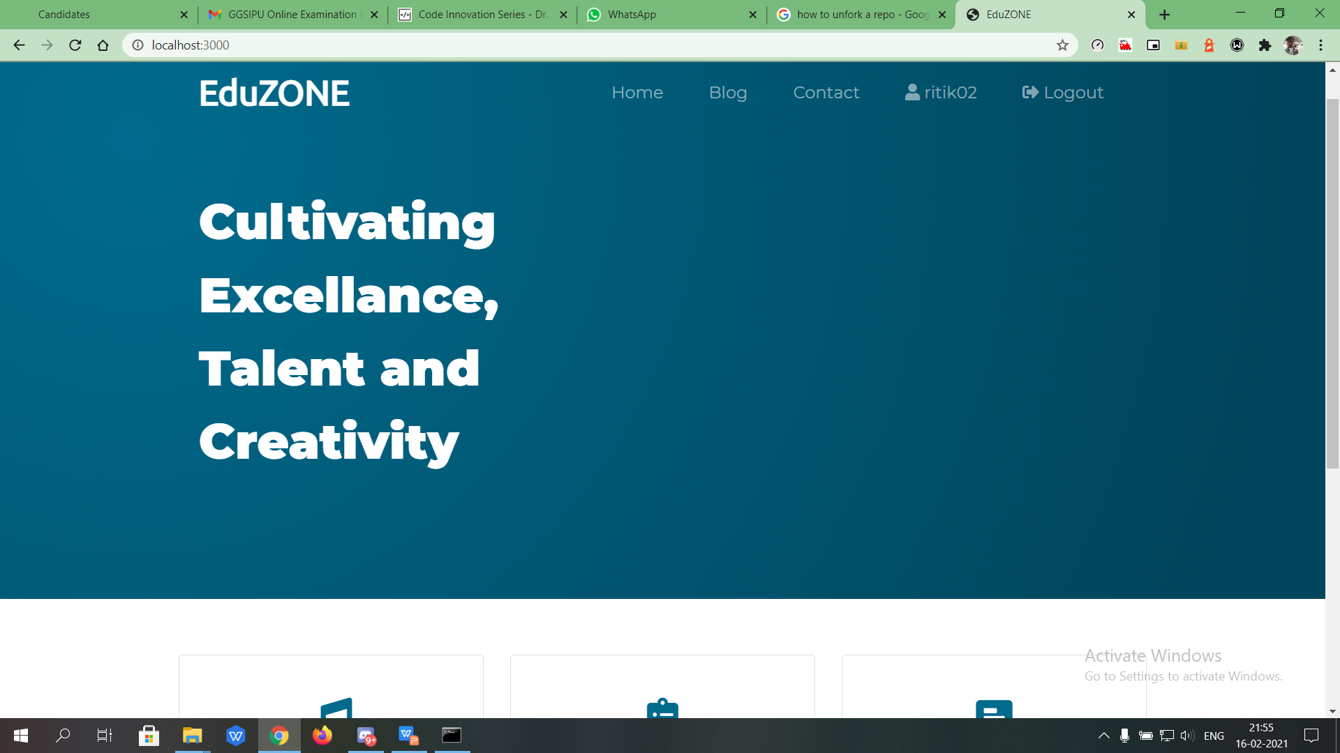
Create solutions to deal with these challenges faced by the users:
1. Transforming learning into Amazing e-learning Experiences.
2. Lack Of Learner Motivation And Engagement.
3. Staying Up-To-Date With Modern Tech.
4. Designing e-learning Courses For Different Generations.
5. Measurable learning outcomes.
6. Adaptive learner models to accommodate different learner needs.

Slide 5
02
Proposed Solution
We interpreted the lack of motivaion among students and thus proposed a solution

Slide 6
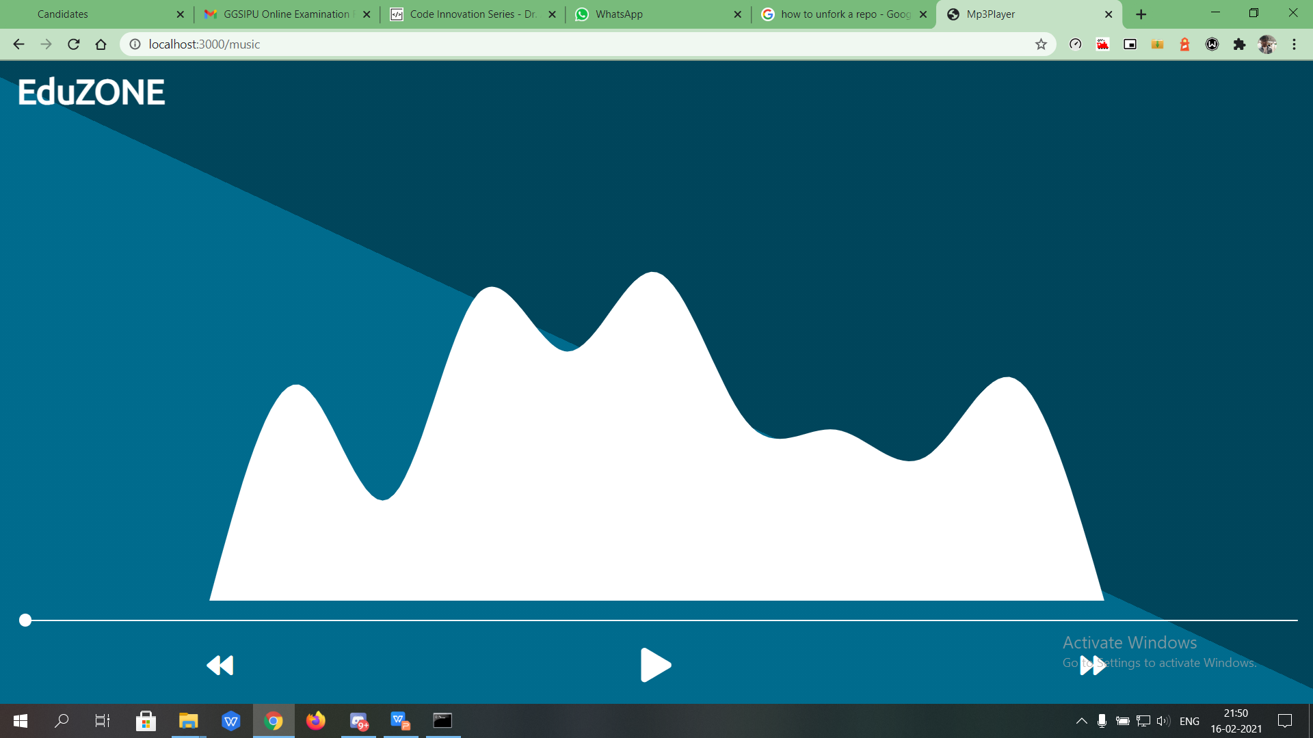
Music Player
Click here to add the text, the text is the extraction of your thought, please try to explain the point of view as succinctly as possible.

Slide 7
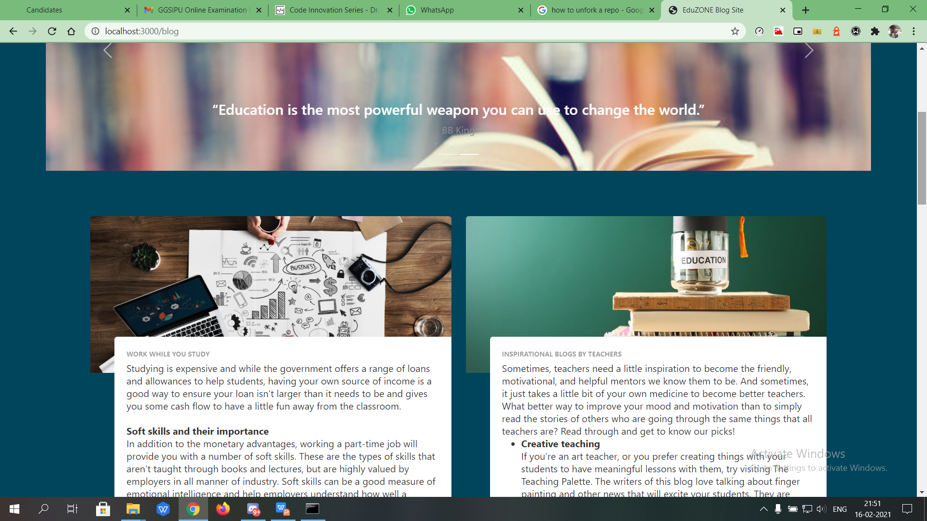
Motivational Blogs
Click here to add the text, the text is the extraction of your thought, please try to explain the point of view as succinctly as possible.

Slide 8
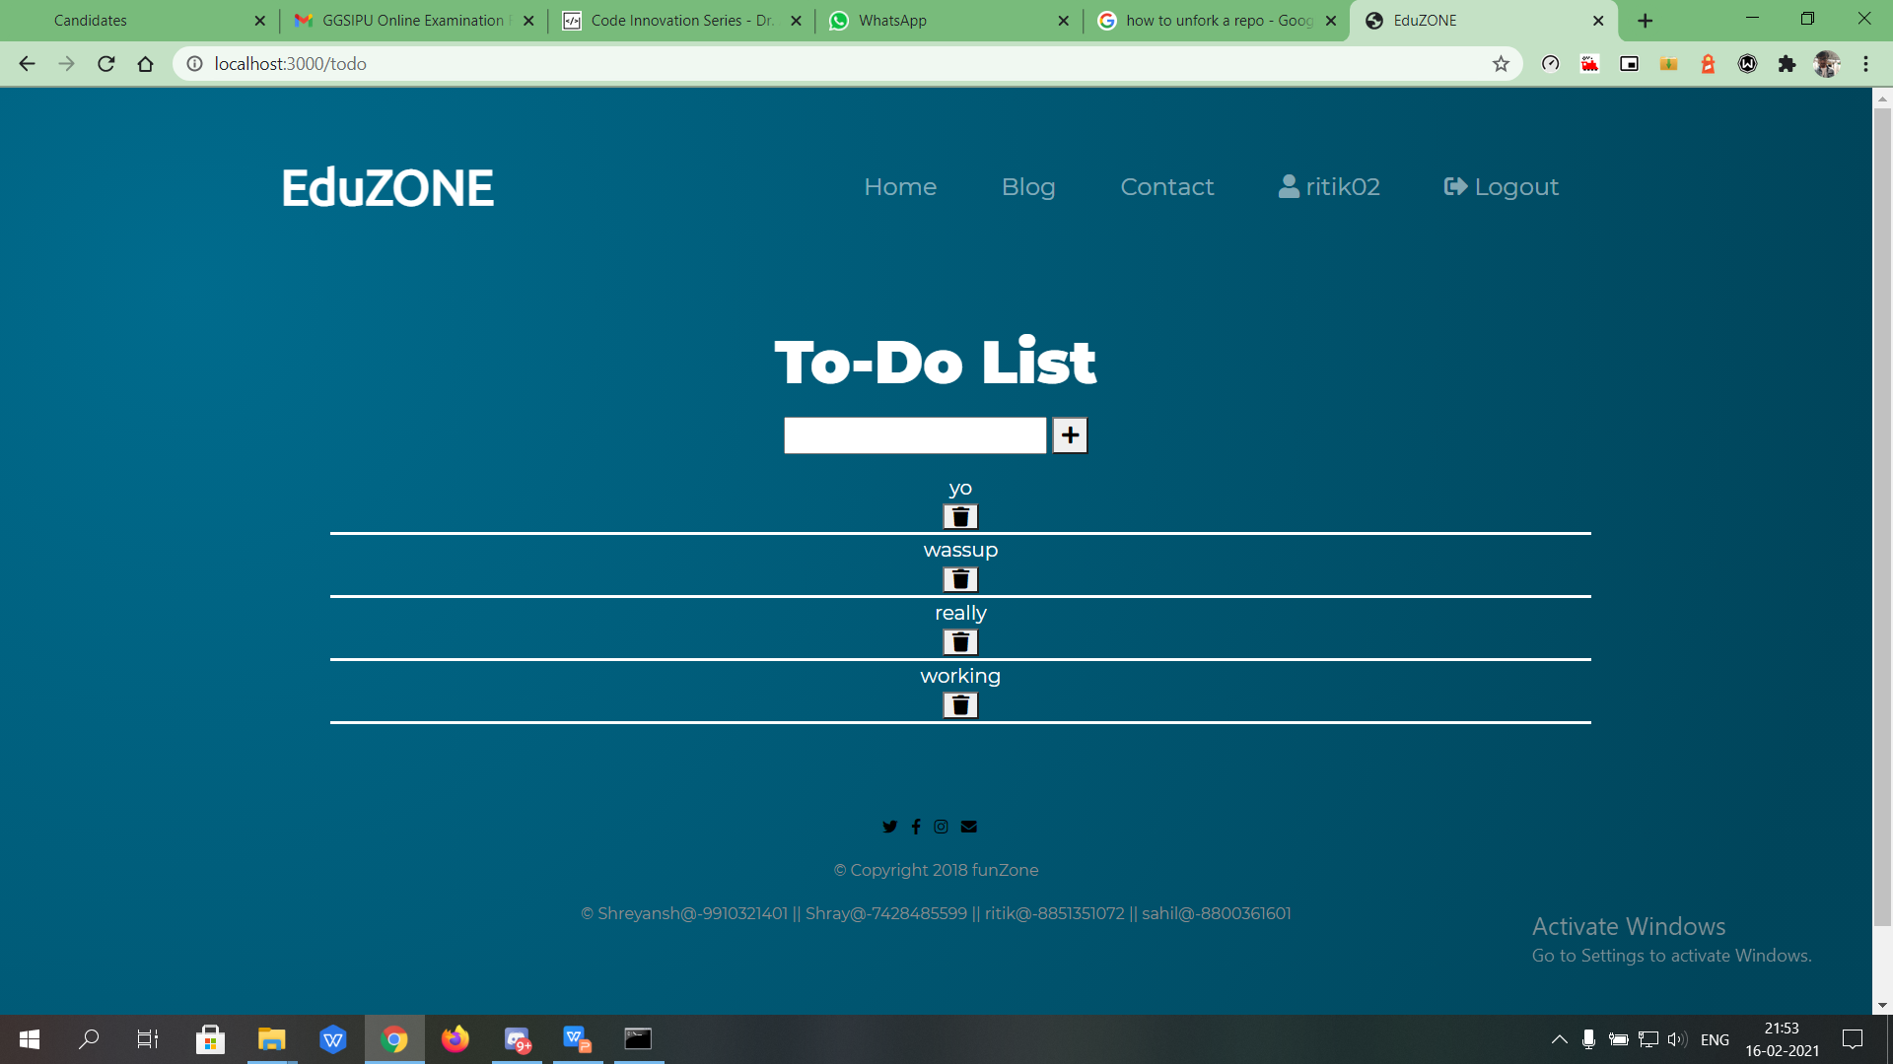
To-Do Lists
Click here to add the text, the text is the extraction of your thought, please try to explain the point of view as succinctly as possible.

Slide 9
03
Technologies Used
The Languages We Are
HTML, Bootstrap, and Javscript

Slide 10
Technogies Used
Bootstrap
HTML and CSS
Bootstrap
HTML and CSS
Node.js
Node.js
We used HTML as base for our app/document designed to be displayed on Web bowser along with custom CSS styling to make it look apealing.
Boostrap is a CSS, Js Framework which comes with numerous libraries and functionality which makes it possible to make a productive webapp with lesser CSS, Js elements
Node. js is primarily used for non-blocking, event driven servers, due to its single threaded nature. It's used for traditional web sites and back-end API services.
Express.js
MongoDB
Howler.js
Express. js is a free and open-source web application framework for Node. js. It is used for designing and building web applications quickly and easily.
MongoDB is a source-available cross-platform document-oriented database program. Classified as a NoSQL database program, MongoDB uses JSON-like documents with optional schemas.
Howler.js offers a consistent API for using audio with JavaScript, with control over common audio patterns including play, pause, seek to rate, fade and loop. Audio files are automatically cached where possible to improve playback performance.

Slide 11
04
Functionality
Basic Functionality Regarding Music Player, Login System, Blogs, etc

Slide 12
Functionality
LOGIN
BLOGS
TO DO LIST
MUSIC PLAYER
1
2
3
4
EduZONE is a fully functioning website that helps students to allow them to focus on their studies by providing them a fun environment with a music player for those who love to work while listening to music, a Todo for a regular check on their time table, a Blogs which motivates them to move forward. They can give their feedback and share their ideas about how we can help them. all they have to do is just login in.

Slide 13
05
Future Scope
Considered Ahead...

Slide 14
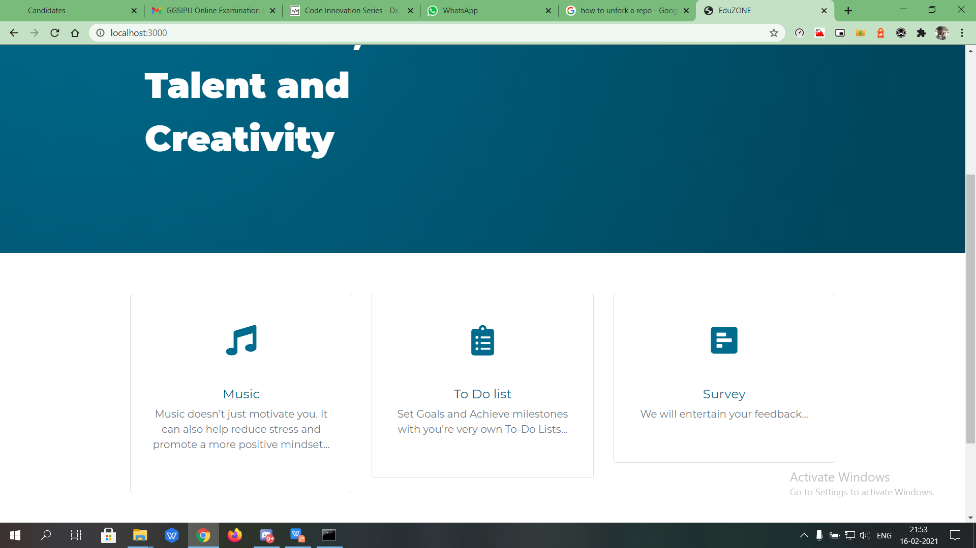
FUTURE PLANS
Planning of adding a few mini-games which can be used by students to get back on track when they just getting bored.
Planning to improve music player by providing students an option to add their pre-created music playlist thus they can enjoy songs which they prefer.
Planning to provide More blogs and few youtube channel links which can help them to understand topics clearly.

Slide 15
BUSI
NESS
TEMP
LATE
Gradient
THANKS
TEMPLATE
Gradient
BUSI
NESS
TEMP
LATE

