Slide 1
AnyERP
-A ERP solution which can provide both online and online support with the help of web and mobile app

Slide 2
Problems with Tradition ERP software
Inadequate flexibility
Resistance to change
Maintenance costs
Data Quality Issues
No web or mobile support

Slide 3
What is AnyERP
enterprise resource planning software that manages and integrates a company's financials, supply chain, operations, reporting, manufacturing, and human resource activities.

Slide 4
Features of AnyERP
Provide both Web and mobile support
Includes regular updates
Support online and offline with sync feature
Access from anywhere around the world

Slide 5


Not Just A Software -a complete full fledged system
Web and Mobile App
Desktop Application

Slide 6
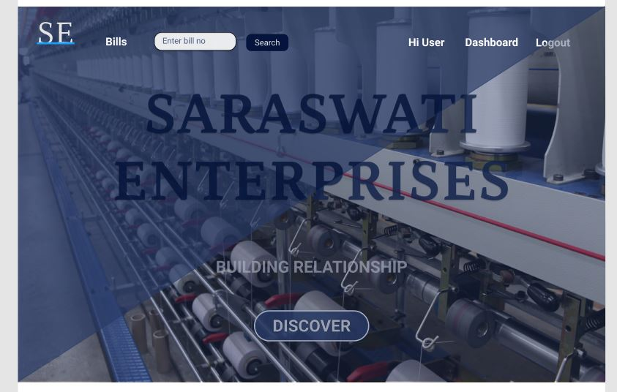
Enterprise Homepage

Slide 7
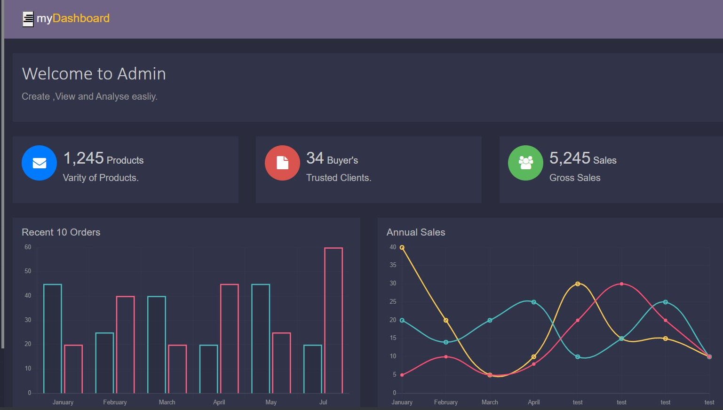
Admin DashBoard

Slide 8
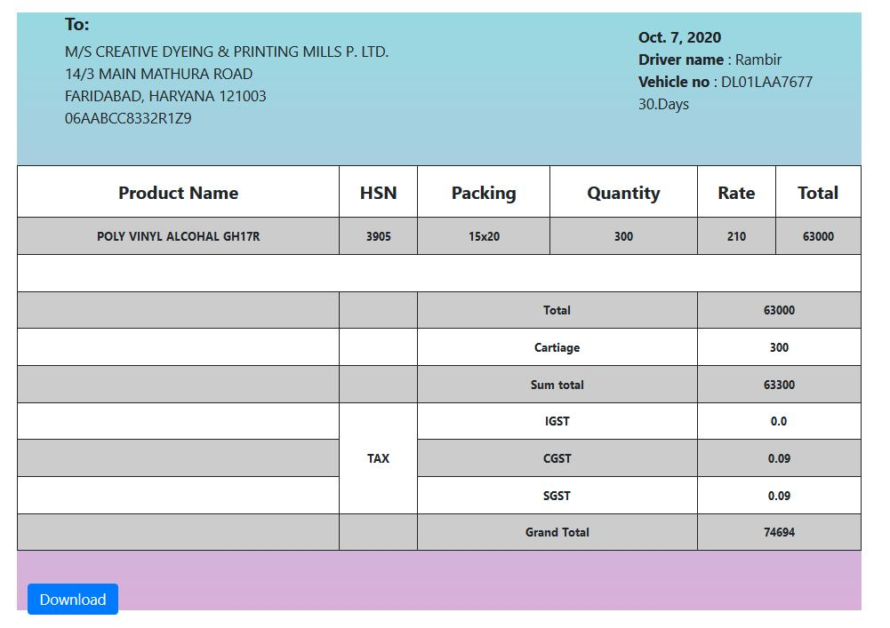
Invoice Preview

Slide 9
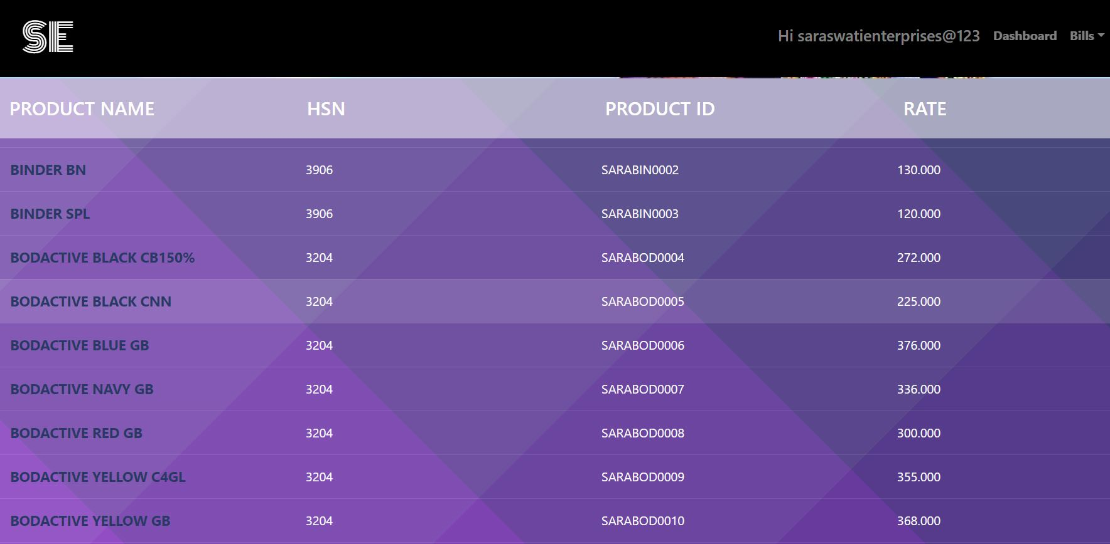
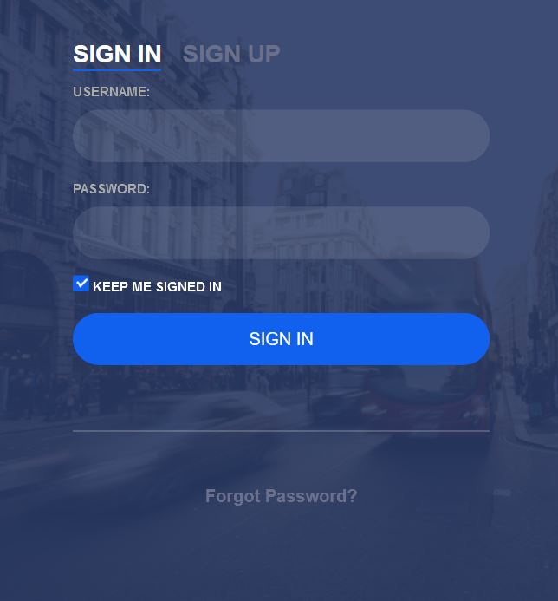

What’s more? A lot more…..!!
Product Stock
Login Form
Contact Form

Slide 10
Thank You from BinaryBeast

