Slide 1
DisasterSense
A Comparative Study of CNN, Patch-Based CNN and Vision Transformer
for Disaster Image Classification and Automated Alert Generation
300
3
30
98.33%
Disaster images
Models compared
Max epochs
Best accuracy (ViT)
GitHub Project Link: DisasterSense Project
Submitted to: Sir Tariq Mahmood
Team Leader: Muhammad Taha Masaud (F2023376266)
Team Members: Meerub Sohail (F2023376374) · Adhab Ahmad (F2023376027)
Machine Learning Theory — Section A1

Slide 2
Agenda
1
Introduction & Problem
6
Training Setup & Curves
2
Research Challenges & Contributions
7
Results & Model Comparison
3
Dataset & Preprocessing
8
Confusion Matrices & Per-Class Metrics
4
Three Model Architectures
9
Testing on Sample Images
5
How the System Works
10
Conclusion, Limitations & Future Work
DisasterSense — ML Theory Project
2

Slide 3
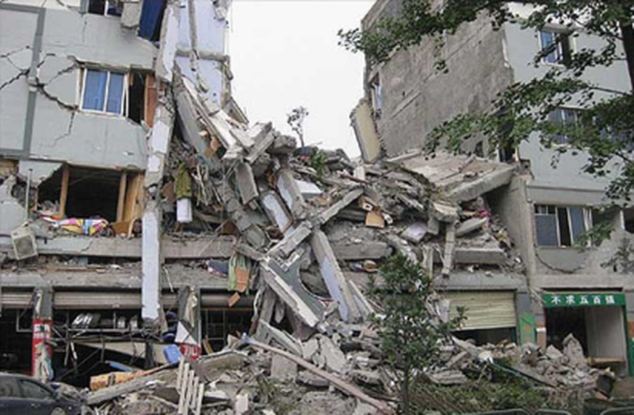
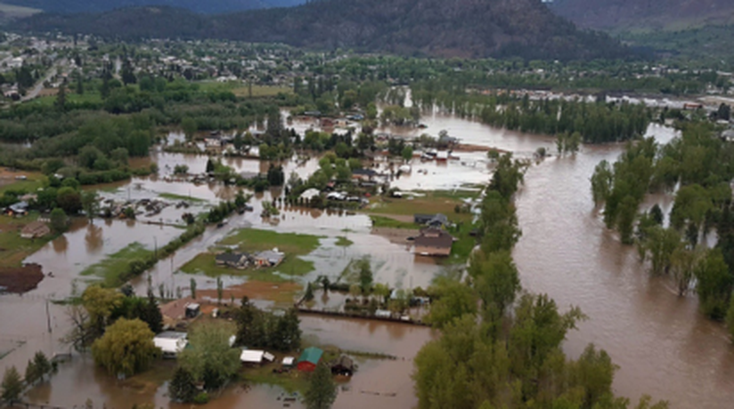
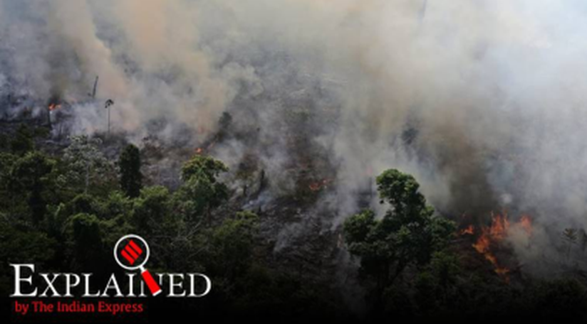
Introduction: Why DisasterSense?
Time-critical response: rescue teams must know quickly what kind of disaster an image shows to send the right help.
Manual review is slow: checking drone, satellite and social-media images by hand is slow and error-prone during emergencies.
Our solution: deep learning models that classify images into Earthquakes, Floods or Wildfires and generate an automatic alert.
Research question: Vision Transformers use patches and self-attention — which of these two ingredients actually improves accuracy?
Earthquake
Flood
Wildfire
DisasterSense — ML Theory Project
3

Slide 4
Research Challenges & Our Contributions
Challenges
Contributions
Visual ambiguity: rubble, mud, water and smoke look similar across disaster types.
Small dataset: only 300 images — deep networks overfit easily.
Weak first attempt: a simple CNN/ResNet trained from scratch (no transfer learning) gave results that were too weak.
Hidden cause: a plain CNN-vs-ViT test cannot show whether patches or attention make the difference.
3-way controlled study: added a middle model — CNN with patches but no attention.
Fair protocol: same data split, optimizer, learning rate, loss, batch size and early stopping for all models.
Clear finding: patches alone −3.33 points; attention on patches +8.33 points.
Alert module: rule-based severity alerts (CRITICAL / HIGH / MODERATE / VERIFY).
DisasterSense — ML Theory Project
4

Slide 5
Dataset & Preprocessing
Kaggle Disaster Dataset (2024–2026) — perfectly balanced, stratified 80/20 split
300
240
60
Preprocessing pipeline
Total images
Training (80%)
Test (20%)
1
Resize
every image → 224 × 224 pixels
2
Augment (train only)
rotation ±15°, horizontal flip, 10% shift, colour jitter
3
To tensor
pixel values scaled to [0, 1]
4
Normalize
mean 0.5, std 0.5 → range [−1, 1]
DisasterSense — ML Theory Project
5

Slide 6
Three Model Architectures
Each step changes only ONE ingredient
Model 1
Model 2
Model 3
CNN (No Patches)
CNN (With Patches)
Vision Transformer
ResNet50, ImageNet pre-trained
Sees the whole 224×224 image
Convolution + global pooling
New 3-class output layer
Same pre-trained ResNet50
Image split into 4×4 = 16 patches (56×56)
Patch features simply averaged
NO attention — patches never interact
google/vit-base-patch16-224
14×14 = 196 patches (16×16)
12 layers × 12 attention heads
Every patch attends to every other patch
23.5M params
23.5M params
85.8M params
Baseline
+ Patches
+ Attention
DisasterSense — ML Theory Project
6

Slide 7
How the System Works
From an input image to an automatic disaster alert
1
Image Input
2
Preprocessing
3
Feature Extraction
4
Softmax Classification
5
Alert Generation
6
Output & Comparison
Rule-based alert: confidence → severity
Confidence | Severity | Recommended action
> 95% | CRITICAL | Immediate response prioritisation
85% – 95% | HIGH | Dispatch teams; confirm with field reports
75% – 85% | MODERATE | Verify before dispatching teams
≤ 75% | VERIFY | Manual review strongly recommended
Example alert
[CRITICAL] EARTHQUAKES DETECTED – Confidence: 100.0%
Deterministic and template-based, so every alert is predictable and auditable.
DisasterSense — ML Theory Project
7

Slide 8
Training Setup
One shared training function — identical conditions for all three models
Hyperparameter | Value
Optimizer | Adam
Learning rate | 1e-4
Loss function | Cross-Entropy Loss
Batch size | 16
Maximum epochs | 30
Early stopping | Patience = 3 (test accuracy)
Split / seed | 240 / 60 images, seed 42
Hardware | Google Colab, PyTorch
Epochs trained before early stopping
6
5
4
CNN
CNN + Patches
ViT
Why transfer learning?
Our first model — a simple CNN/ResNet trained from scratch without pre-trained weights — gave results that were too weak on only 240 training images. Using ImageNet pre-trained weights fixed this, and the ViT converged fastest (4 epochs).
DisasterSense — ML Theory Project
8

Slide 9
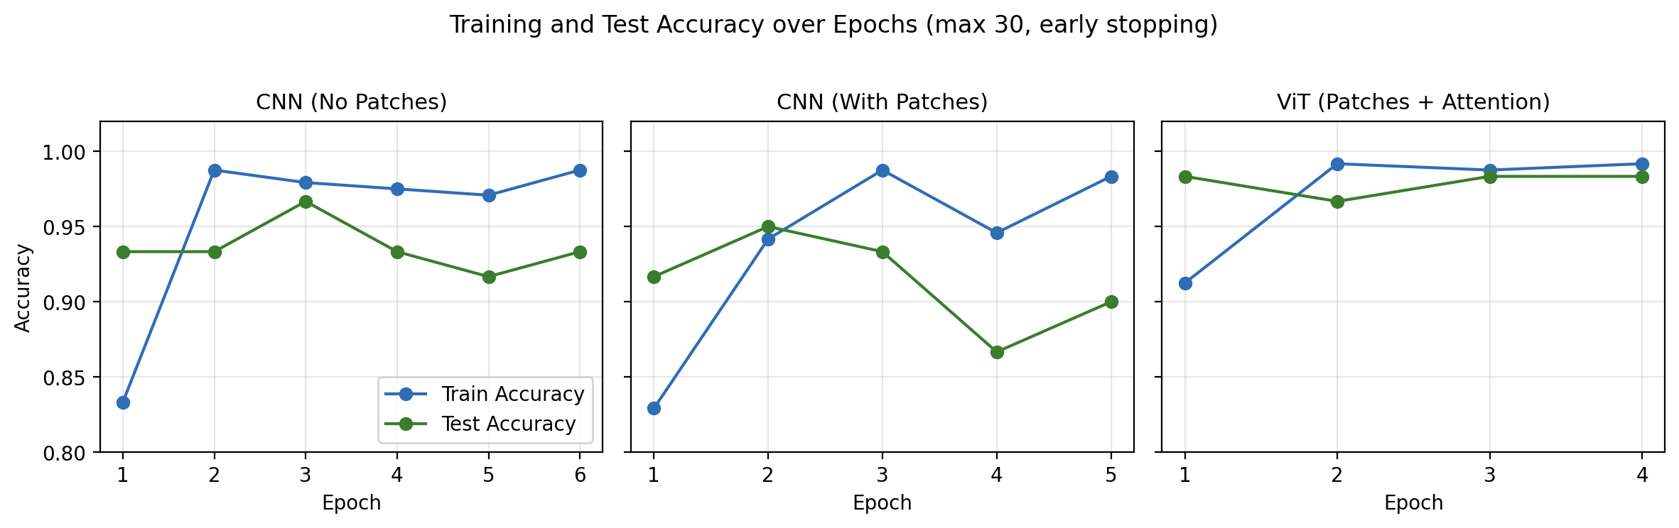
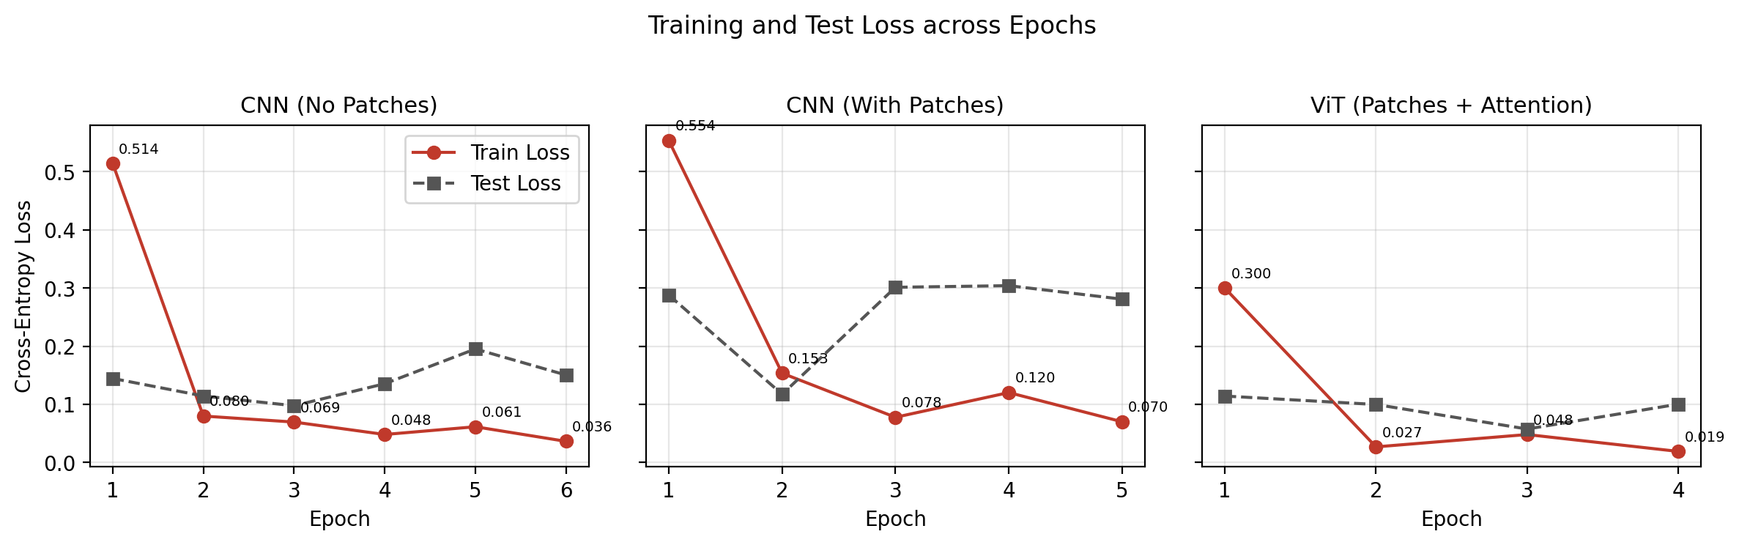
Training Curves
Train vs. test accuracy and loss for each epoch
DisasterSense — ML Theory Project
9

Slide 10
Results: Model Comparison
Performance on the 60-image test set
93.33%
CNN (No Patches)
4 errors / 60
90.00%
CNN (With Patches)
6 errors / 60
98.33%
Vision Transformer
1 error / 60 ★ BEST
DisasterSense — ML Theory Project
10

Slide 11
What Makes the Vision Transformer Best?
Measuring each ingredient separately
Patches alone hurt (−3.33)
A small 56×56 patch only shows a piece of the scene; averaging loses where each piece came from.
Attention fixes it (+8.33)
Self-attention lets every patch use information from all other patches — local clues become a global picture.
Best overall (+5.00 vs CNN)
ViT: highest accuracy, precision, recall and F1, only 1 error, fastest convergence, most stable test loss.
DisasterSense — ML Theory Project
11

Slide 12
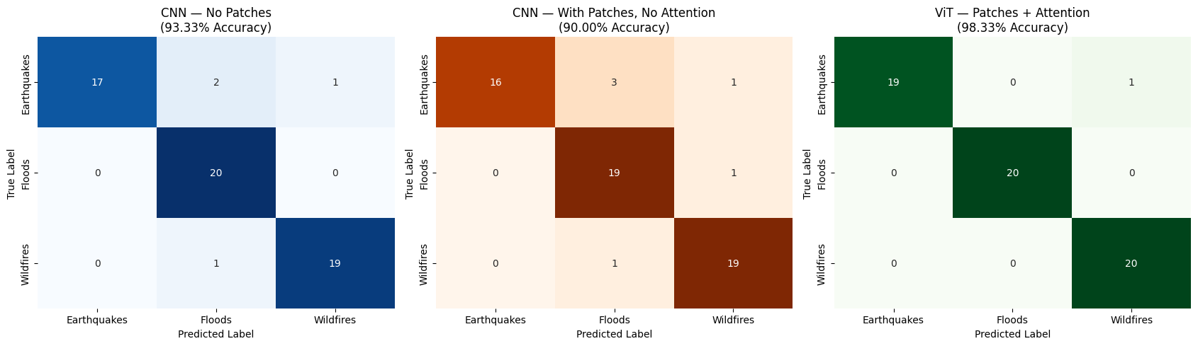
Confusion Matrices
Where each model makes its mistakes (rows = true class, columns = predicted)
CNN: 4 errors
CNN + Patches: 6 errors
ViT: 1 error
3 earthquakes misclassified (2 → Floods, 1 → Wildfires); 1 wildfire → Floods.
4 earthquakes wrong (3 → Floods); 1 flood → Wildfires; 1 wildfire → Floods.
All floods and wildfires correct; only 1 earthquake predicted as Wildfires.
DisasterSense — ML Theory Project
12

Slide 13
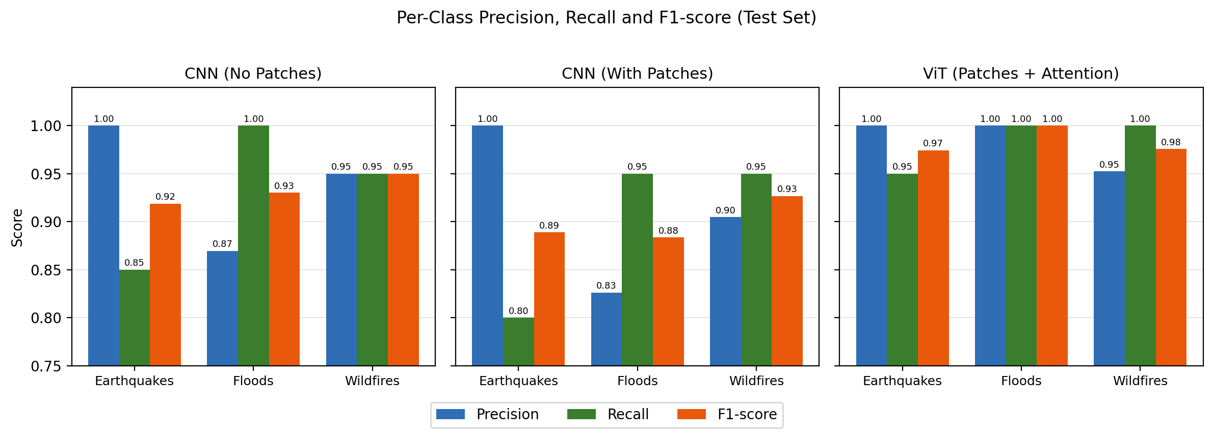
Per-Class Precision, Recall & F1-score
Vision Transformer (best model)
Class | Prec. | Recall | F1
Earthquakes | 1.00 | 0.95 | 0.97
Floods | 1.00 | 1.00 | 1.00
Wildfires | 0.95 | 1.00 | 0.98
Weighted avg | 0.98 | 0.98 | 0.98
Every ViT per-class score is 0.95 or higher — no class collapses in favour of another.
Earthquakes is the hardest class: CNN recall 0.85 and CNN+Patches recall 0.80 — both CNNs over-predict Floods for earthquake images (rubble, mud and water look alike).
DisasterSense — ML Theory Project
13

Slide 14
Testing on Sample Images
After training, we gave the same new image to all three models. Here are their answers.
Earthquake test
Flood test
Wildfire test
14

Slide 15
Test Sample: Earthquake Image
Test image: earthquakes/502.jpg · True class: Earthquakes
Model | Answer | Confidence | Generated alert | Result
CNN (No Patches) | Earthquakes | 100.00% | [CRITICAL] EARTHQUAKES DETECTED | ✔
CNN (With Patches) | Earthquakes | 99.61% | [CRITICAL] EARTHQUAKES DETECTED | ✔
ViT (Patches + Attention) | Earthquakes | 99.97% | [CRITICAL] EARTHQUAKES DETECTED | ✔
TRUE CLASS: EARTHQUAKES
All 3 models answered correctly ✔
DisasterSense — ML Theory Project
15

Slide 16
Test Sample: Flood Image
Test image: floods/501.jpg · True class: Floods
Model | Answer | Confidence | Generated alert | Result
CNN (No Patches) | Floods | 99.93% | [CRITICAL] FLOODS DETECTED | ✔
CNN (With Patches) | Floods | 100.00% | [CRITICAL] FLOODS DETECTED | ✔
ViT (Patches + Attention) | Floods | 99.84% | [CRITICAL] FLOODS DETECTED | ✔
TRUE CLASS: FLOODS
All 3 models answered correctly ✔
DisasterSense — ML Theory Project
16

Slide 17
Test Sample: Wildfire Image
Test image: wildfires/509.jpg · True class: Wildfires
Model | Answer | Confidence | Generated alert | Result
CNN (No Patches) | Wildfires | 100.00% | [CRITICAL] WILDFIRES DETECTED | ✔
CNN (With Patches) | Wildfires | 100.00% | [CRITICAL] WILDFIRES DETECTED | ✔
ViT (Patches + Attention) | Wildfires | 99.97% | [CRITICAL] WILDFIRES DETECTED | ✔
TRUE CLASS: WILDFIRES
All 3 models answered correctly ✔
DisasterSense — ML Theory Project
17

Slide 18
Testing Summary: Answers of All Models
Test image (true class) | CNN (No Patches) | CNN (With Patches) | ViT (Patches + Attention)
Earthquake — earthquakes/502.jpg | Earthquakes · 100.00% ✔ | Earthquakes · 99.61% ✔ | Earthquakes · 99.97% ✔
Flood — floods/501.jpg | Floods · 99.93% ✔ | Floods · 100.00% ✔ | Floods · 99.84% ✔
Wildfire — wildfires/509.jpg | Wildfires · 100.00% ✔ | Wildfires · 100.00% ✔ | Wildfires · 99.97% ✔
Alert generated | CRITICAL (all 3 images) | CRITICAL (all 3 images) | CRITICAL (all 3 images)
9 / 9
> 99.6%
1 vs 4 vs 6
correct answers on the sample images
confidence for every correct answer
errors on the full 60-image test set (ViT vs CNN vs CNN+Patches)
DisasterSense — ML Theory Project
18

Slide 19
Conclusion
WINNER
Controlled comparison: three models trained under identical conditions on 300 images (max 30 epochs).
Patches alone are not enough: CNN with patches dropped to 90.00% (−3.33 points).
Attention is the key ingredient: self-attention over patches raised accuracy to 98.33% (+8.33 points).
Transfer learning matters: the first from-scratch CNN was too weak; pre-trained weights fixed this.
Practical output: every prediction becomes a clear severity alert for emergency responders.
Vision Transformer
98.33%
test accuracy
F1 0.9833 · Precision 0.9841 · 1 error / 60 · 4 epochs
DisasterSense — ML Theory Project
19

Slide 20
Limitations & Future Work
Limitations
Future Work
Small dataset: 300 images, only 60 for testing (1 error = 1.67 points).
Early stopping used test accuracy — no separate validation split.
Only 3 single-label classes; real disasters can overlap.
ViT is 3.6× larger than the CNNs (85.8M vs 23.5M parameters).
Alert text is rule-based and fixed.
Larger dataset with more disaster types (hurricanes, tsunamis, landslides).
Validation split and k-fold cross-validation.
Attention-map visualisation to explain ViT decisions.
Multi-label classification for compound disasters.
Deploy as a web app (Streamlit / Gradio) and optimise for edge devices.
DisasterSense — ML Theory Project
20

Slide 21
Thank You
Any Questions?
GitHub Project Link: github.com/your-username/DisasterSense
Muhammad Taha Masaud · Meerub Sohail · Adhab Ahmad
Submitted to Sir Tariq Mahmood — Machine Learning Theory, Section A1

