Slide 1
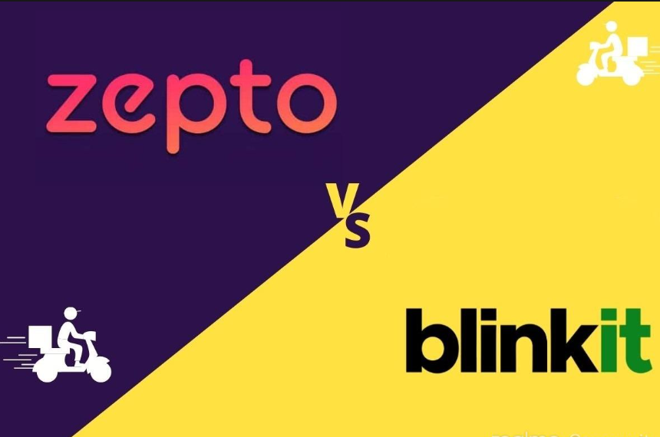
SQL Project: Zepto vs Blinkit Analysis
Adhish Saxena | Data Analyst Aspirant

Slide 2

Project Overview
- Compare Zepto & Blinkit using SQL
- Tables: Customers, Products, Orders
- Tools: Excel, MySQL,Power BI
- Analysis through SQL Views & Queries And power BI

Slide 3
Key Insights Covered
- Top 5 customers by spend
- Brand-wise & Age-wise revenue
- Top selling categories
- Yearly, monthly, and weekend revenue trends
- Repeat customer behavior

Slide 4
Sample SQL View
CREATE VIEW top_customers_by_spend AS
SELECT customer_name, SUM(total_bill) AS spend
FROM customers JOIN orders USING(customer_id)
GROUP BY customer_name
ORDER BY spend DESC LIMIT 5;

Slide 5
Business Recommendations
- Focus on 18–30 age group (high spenders)
- Promote underperforming categories
- Target top cities with marketing
- Analyze repeat customer trends

Slide 6
Technologies Used
- MySQL: Data querying and view creation
- Excel: Data cleaning and validation
- PowerPoint: Project insights presentation
-Power BI : For Visualization

