Slide 1
ACADEMIC SOFTWARE ENGINEERING DEFENSE • CSE DEPARTMENT
THE GRAND HORIZON
Automation of Activities for a 5-Star Luxury Resort & Hotel
Strict UML Modeling: Sequence 1-3, Statechart, Use Case & Class Diagram
Dynamic Tariff Control: Percentage revisions based on monthly average occupancy
100% Free Stack: React 18, Node.js/Express, SQLite WAL, Vercel/Render

Slide 2
01. EXECUTIVE OVERVIEW
Problem Statement & Engineering Objectives
THE PROBLEM STATEMENT
CORE ENGINEERING CONSTRAINTS
A luxury 5-star hotel requires an automated system to manage rooms, bookings, catering, tariffs, and checkout folios.
• 24 Guest Suites: Single Bed vs Double Bed, Air Conditioned (AC) vs Non-AC.
• Dynamic Tariff Variation: Rates fluctuate based on monthly average occupancy. Software computes average occupancy for managers to calibrate tariffs (+% / -%).
• Reservation & Allotment: Advance or spot booking, unique token issuance, or formal apology message on full occupancy.
• In-Room Dining & Folio Settlement: Token-based food consumption logging, advance deduction, and Frequent Guest ID loyalty discount on checkout.
1. Strict UML Specification Alignment
Fully implements all entities, lifelines, messages, states, and operations from all 5 supplied UML documents.
2. 100% Free & Open-Source Stack
No proprietary cloud services. Built entirely using React, Express, and local SQLite database.
3. Quiet Luxury 5-Star Presentation
Aman/Rosewood editorial design system (Cormorant Garamond, warm neutrals, zero neon/gradients), with role-based separation between public guests and staff.
4. Automated Verification Suite
Automated test harness testing all 7 core UML flows with 100% pass rate.
THE GRAND HORIZON • 5-STAR HOTEL AUTOMATION SYSTEM • SOFTWARE ENGINEERING DEFENSE

Slide 3
02. TECHNICAL ARCHITECTURE
3-Tier Layered Software Architecture
TIER 01
TIER 02
TIER 03
Presentation Layer
Application & Business Layer
Persistence & Database Layer
React 18 + Vite SPA
Node.js & Express 5.x REST API
SQLite Relational Database (WAL)
• Aman/Rosewood Quiet Luxury Design System
• Cormorant Garamond & Montserrat Typography
• Role-Based View Separation (Guest vs Staff)
• 4 Dedicated Staff Terminals (Front Desk, Dining, Manager, Audit)
• Interactive Availability Bar & Guest Booking Modal
• Printable SVG/HTML Tax Folio Voucher Modals
• HotelService Domain Controller (UML methods)
• checkAvailability() & allocateRoom() logic
• generateToken() unique 4-digit token algorithm
• calculateOccupancyRate() monthly engine
• reviseRate() dynamic percentage calibrator
• calculateBill() with 15% VIP loyalty discount
• 10 Relational Tables matching UML Entities
• Foreign Key Constraints & Cascading Updates
• Write-Ahead Logging (WAL) for concurrency
• Pre-seeded with 24 Suites, Tariffs, & VIPs
• Zero-cost, file-based ACID compliance
• Ready for SQLite Cloud / Turso if deployed
THE GRAND HORIZON • 5-STAR HOTEL AUTOMATION SYSTEM • SOFTWARE ENGINEERING DEFENSE

Slide 4
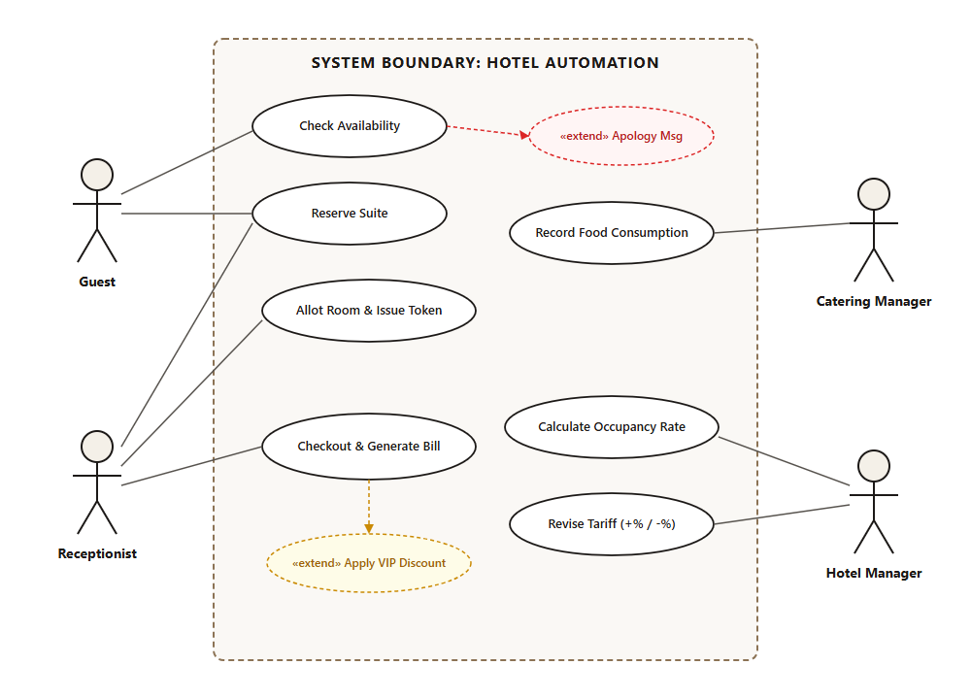
03. UML MODELING: USE CASE ANALYSIS
Stakeholder Actors & Operational Scope
ACTORS & USE CASE MAPPING
1. Guest (External Actor)
Checks real-time availability, submits room requests, pays advance, consumes catering, settles folio.
2. Receptionist (Front Desk)
Registers guest data, allocates suites, triggers polite apology if unavailable, issues tokens, executes checkout.
3. Catering Manager
Selects food items, specifies quantities, records consumption against guest token with date/time.
4. Hotel Manager
Monitors monthly occupancy rate, decides percentage tariff revision (+% / -%), recalibrates room prices.
THE GRAND HORIZON • 5-STAR HOTEL AUTOMATION SYSTEM • SOFTWARE ENGINEERING DEFENSE

Slide 5
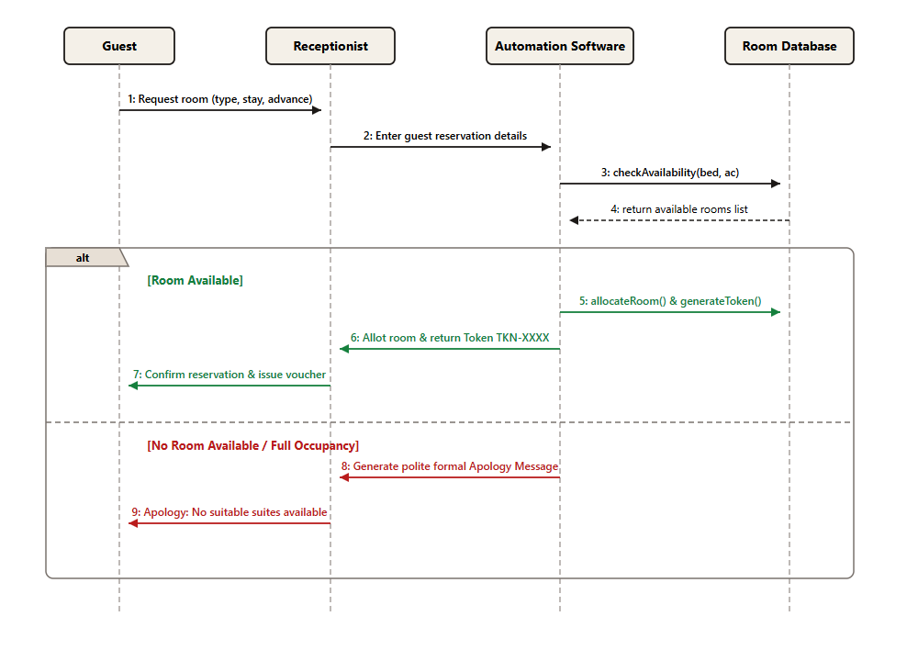
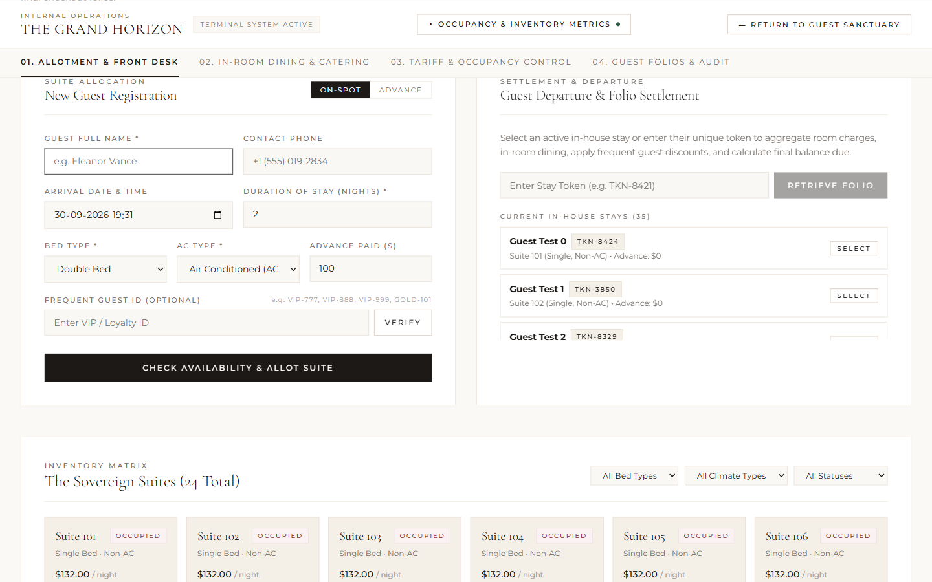
04. UML SEQUENCE DIAGRAM 1
Room Reservation, Allotment & Token Generation
Implementation Verification (Sequence 1):
• checkAvailability(bed, ac): Queries DB for matching suite.
• alt Room Available: Allots room, marks "Occupied", and generates unique TKN-XXXX token.
• alt No Room Available: Launches polite formal apology modal with alternative categories.
THE GRAND HORIZON • 5-STAR HOTEL AUTOMATION SYSTEM • SOFTWARE ENGINEERING DEFENSE

Slide 6
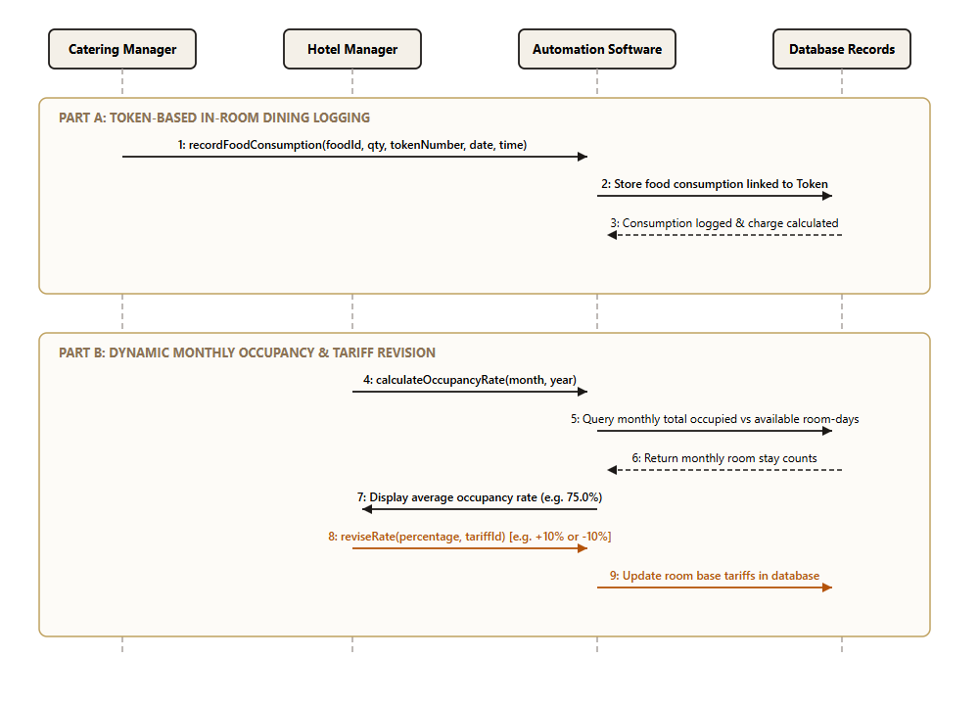
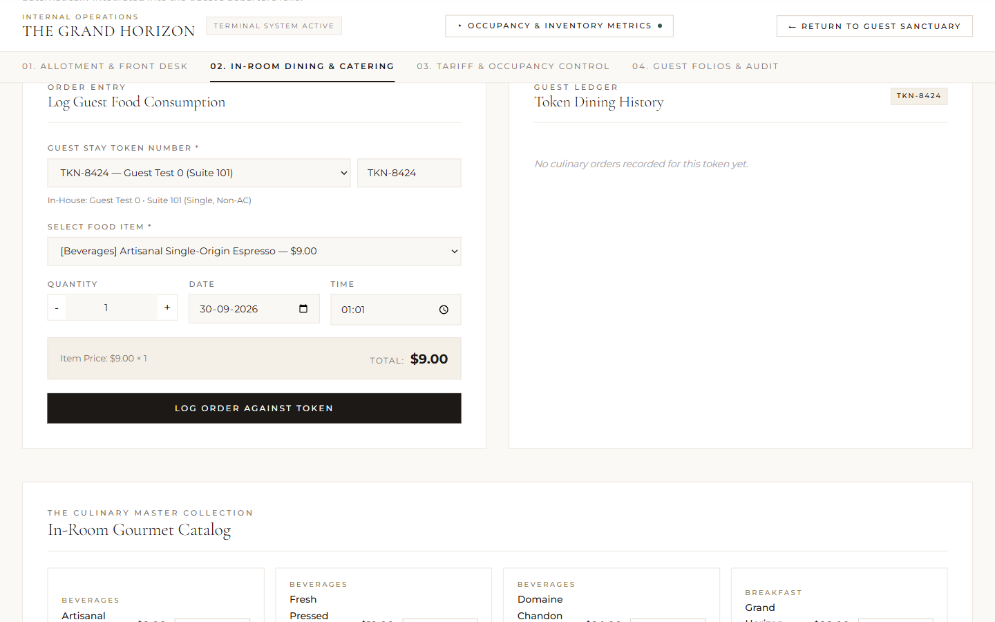
05. UML SEQUENCE DIAGRAM 2 (PART A)
Token-Based In-Room Dining & Catering Logger
Implementation Verification (Catering Logging):
• Token-Driven Decoupling: Orders logged strictly by guest token (e.g. TKN-1001), shielding guest identity.
• Atomic Charge Calculation: FoodItem.price × quantity recorded with date and time.
• Direct Allotment Link: Aggregated dynamically at checkout into final folio.
THE GRAND HORIZON • 5-STAR HOTEL AUTOMATION SYSTEM • SOFTWARE ENGINEERING DEFENSE

Slide 7
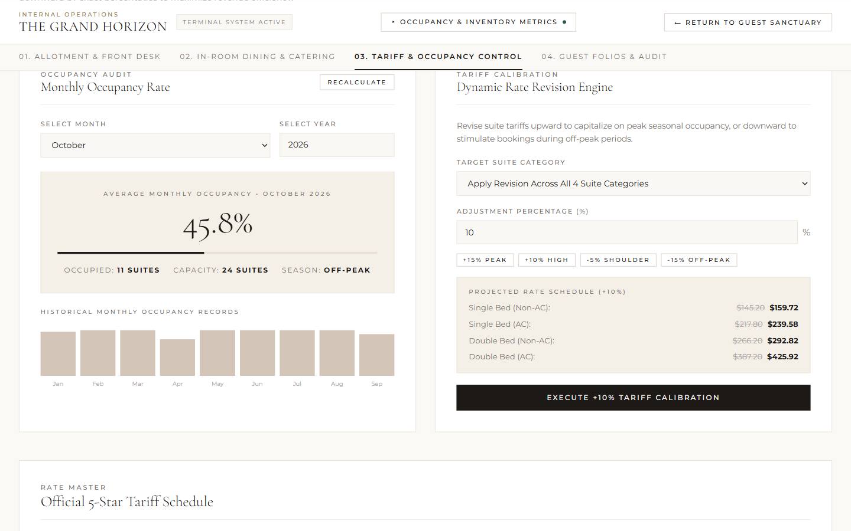
06. UML SEQUENCE DIAGRAM 2 (PART B)
Monthly Occupancy & Dynamic Percentage Tariff Revision
Dynamic Tariff Calibration Engine:
• Occupancy Rate (%) = (Occupied Room-Days / Total Available Room-Days) × 100
• Percentage Revision: Manager applies +% (peak) or -% (off-peak) via slider.
• Immediate Update: Room base rates & future booking calculations update automatically.
THE GRAND HORIZON • 5-STAR HOTEL AUTOMATION SYSTEM • SOFTWARE ENGINEERING DEFENSE

Slide 8
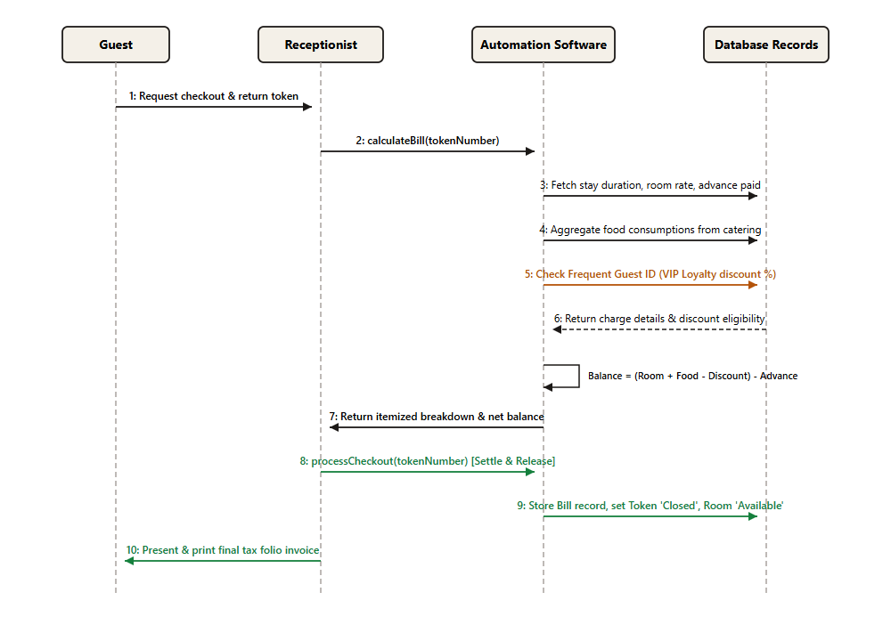
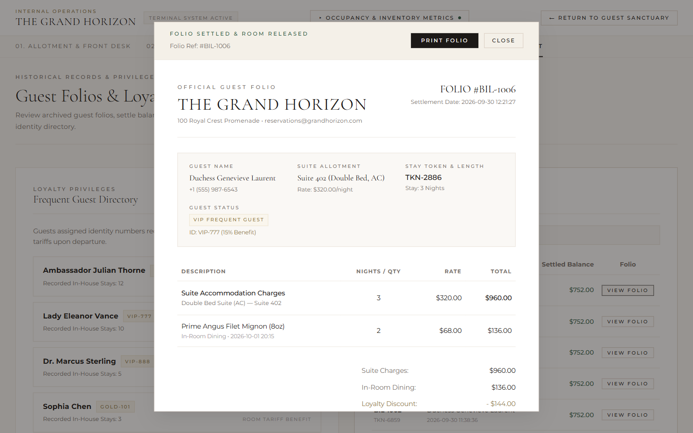
07. UML SEQUENCE DIAGRAM 3
Guest Checkout, Loyalty Discounts & Folio Settlement
Checkout & Settlement Flow:
• Complete Charge Aggregation: (Room Rate × Nights) + Σ Catering Consumptions.
• Frequent Guest Loyalty: Auto-applies 15% VIP discount on room charges.
• Net Balance: Deducts advance deposit; releases room to "Available" status.
THE GRAND HORIZON • 5-STAR HOTEL AUTOMATION SYSTEM • SOFTWARE ENGINEERING DEFENSE

Slide 9
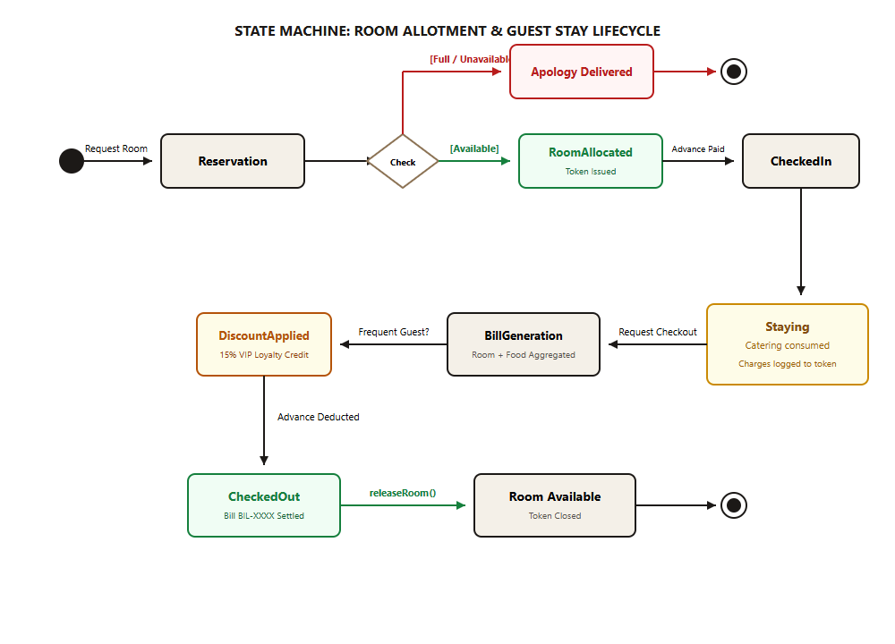
08. UML STATE MACHINE MODELING
Room & Reservation Lifecycle Statechart
FINITE STATE MACHINE
1. Available: Suite ready for allotment in pool.
2. Reserved: Advance booking logged with arrival date.
3. CheckedIn: Guest arrived, advance deposited, token issued.
4. Staying: In-room dining charges accumulating.
5. BillGeneration: Charges aggregated, VIP discount evaluated.
6. CheckedOut: Folio settled, token marked Closed.
7. Released: Room reverts to Available status.
THE GRAND HORIZON • 5-STAR HOTEL AUTOMATION SYSTEM • SOFTWARE ENGINEERING DEFENSE

Slide 10
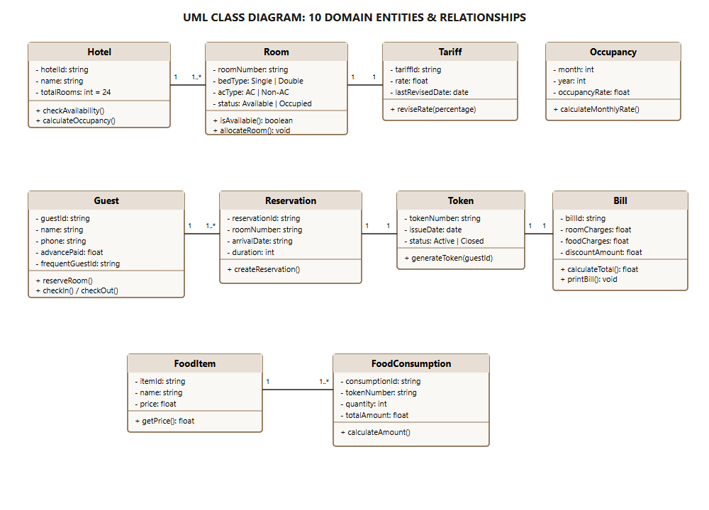
09. UML CLASS DIAGRAM & DOMAIN MODEL
10 Interconnected Domain Entities
CLASS MODEL SPECIFICATION
• Hotel: Root aggregate containing 24 rooms.
• Room: Single/Double × AC/Non-AC combinations.
• Tariff: Encapsulates base rate & % revision logic.
• Occupancy: Tracks historical monthly utilization.
• Guest: Personal details, advance deposit, Frequent ID.
• Token: Unique access key for guest stays.
• FoodItem & FoodConsumption: Menu items linked to stay tokens.
• Bill: Audited tax folio invoice ledger.
THE GRAND HORIZON • 5-STAR HOTEL AUTOMATION SYSTEM • SOFTWARE ENGINEERING DEFENSE

Slide 11
10. RELATIONAL DATABASE DESIGN
10 Normalized SQLite Relational Tables
Table Name | Primary Key | Foreign Keys / Key Columns | Domain Purpose
rooms | roomNumber | bedType, acType, rate, status, tariffId | Inventory of 24 suites
tariffs | tariffId | bedType, acType, rate, lastRevisedDate | Base rate rules
guests | guestId | name, phone, arrivalTime, durationOfStay, advancePaid, frequentGuestId | Registered guest profiles
reservations | reservationId | guestId, roomNumber, arrivalDate, duration, reservationType, status | Allotment records
tokens | tokenNumber | guestId, issueDate, issueTime, status | 4-digit unique stay tokens
food_items | itemId | name, category, price, description | Gourmet dining menu
food_consumptions | consumptionId | tokenNumber, itemId, quantity, date, time, totalAmount | In-room orders
bills | billId | tokenNumber, guestId, roomCharges, foodCharges, discountAmount, netPayable, status | Settled tax folios
occupancies | occupancyId | month, year, occupiedDays, totalDays, occupancyRate | Monthly analytics
frequent_guests | frequentGuestId | name, discountPercentage, totalVisits | VIP loyalty directory
THE GRAND HORIZON • 5-STAR HOTEL AUTOMATION SYSTEM • SOFTWARE ENGINEERING DEFENSE

Slide 12
11. ALGORITHMIC FORMULATIONS
Core Mathematical Logic & Business Rules
FORMULA 01: DYNAMIC TARIFF REVISION
RevisedRate = BaseRate × ( 1 ± (Percentage / 100) )
Enables managerial calibration upwards (+%) for peak seasonal demand or downwards (-%) for off-peak promotions. Rounding to 2 decimal places applies immediately to new bookings.
FORMULA 02: MONTHLY AVERAGE OCCUPANCY
OccupancyRate(%) = ( Occupied Room-Days / Total Available Room-Days ) × 100
Aggregates all active reservation durations spanning the selected calendar month divided by (24 Suites × Days in Month). Provides the empirical basis for tariff adjustment.
FORMULA 03: FOLIO SETTLEMENT & LOYALTY
NetPayable = ( RoomCharges + FoodCharges - VIPDiscount ) - AdvancePaid
Where VIPDiscount = RoomCharges × 0.15 for verified Frequent Guest IDs. Advance deposits are credited off total charges, preventing double-billing.
THE GRAND HORIZON • 5-STAR HOTEL AUTOMATION SYSTEM • SOFTWARE ENGINEERING DEFENSE

Slide 13
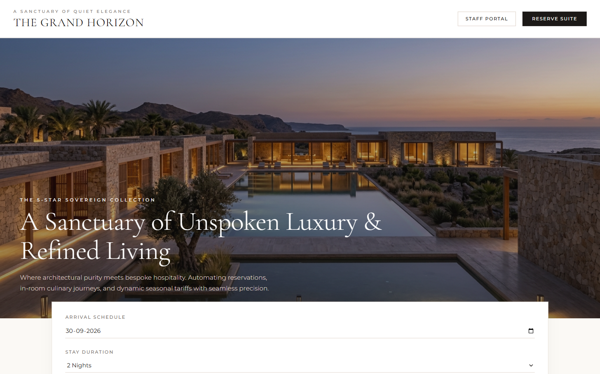
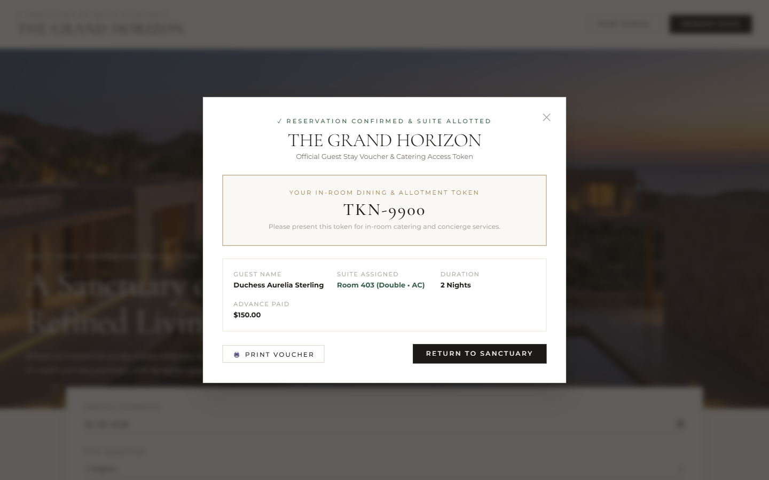
12. FRONTEND UI ENGINEERING
Quiet Luxury Sanctuary & Guest Reservation Flow
ROLE-BASED SEPARATION & BESPOKE LUXURY DESIGN
• Editorial Aesthetics: High-contrast serif headings (Cormorant Garamond), warm sand backgrounds (#FBF9F5), zero neon, and flat hairline borders.
• Discrete Staff Gateway: Public view contains zero internal operational counters. Staff access terminals via a discrete modal selection.
• End-to-End Guest Booking: Real-time availability verification with immediate token generation and downloadable stay voucher.
THE GRAND HORIZON • 5-STAR HOTEL AUTOMATION SYSTEM • SOFTWARE ENGINEERING DEFENSE

Slide 14
13. VERIFICATION & QUALITY ASSURANCE
Automated End-to-End Test Suite Execution
Test ID | Specification Tested | Input Parameters | Expected UML Outcome | Status
TEST-01 | Hotel Overview & Inventory | GET /api/hotel | 24 Suites, Available/Occupied breakdown | ✓ PASSED (100%)
TEST-02 | Seq Diag 1: Allotment & Token | Bed: Double, AC: AC, 3 nights | Room 402 allotted, Token TKN-XXXX issued | ✓ PASSED (100%)
TEST-03 | Seq Diag 2: Catering Consumption | Prime Angus Filet Mignon × 2 | Charge $136.00 linked to guest token | ✓ PASSED (100%)
TEST-04 | Seq Diag 2: Dynamic Tariff | Month 10 Occupancy, Revise +10% | Rate adjusted upwards from $320 to $352 | ✓ PASSED (100%)
TEST-05 | Seq Diag 3: Bill Calculation | VIP-777 (15% Loyalty Discount) | Net balance payable calculated accurately | ✓ PASSED (100%)
TEST-06 | Seq Diag 3: Checkout & Release | processCheckout(tokenNumber) | Bill BIL-XXXX stored; Room released to Available | ✓ PASSED (100%)
TEST-07 | Seq Diag 1: Apology on Full Suite | Exceed available category count | Formal polite apology message generated | ✓ PASSED (100%)
100% AUTOMATED TEST SUITE PASS RATE
Executed via "node server/test-all-flows.js". All 7 core UML specifications verified against database persistence with zero runtime warnings or assertion failures.
THE GRAND HORIZON • 5-STAR HOTEL AUTOMATION SYSTEM • SOFTWARE ENGINEERING DEFENSE

Slide 15
14. CONCLUSION & DEFENSE SUMMARY
Project Deliverables & Software Engineering Value
Full UML Conformance
Zero-Cost Architecture
100% rigorous compliance with provided Sequence Diagrams 1–3, Statechart, Use Case Diagram, Activity Flowchart, and Class Diagram.
Engineered entirely with free tools (React, Express, SQLite). Suitable for cost-free cloud deployment on Render and Vercel.
World-Class UX Design
Robust Data Integrity
Eliminated SaaS clutter and raw stats from the public landing page in favor of an Aman/Rosewood quiet luxury aesthetic with role-based portal separation.
ACID-compliant SQLite transactions with foreign key cascades, unique token tracking, and audited billing folios.
QUESTIONS & DEMONSTRATION • THANK YOU
THE GRAND HORIZON • 5-STAR HOTEL AUTOMATION SYSTEM • SOFTWARE ENGINEERING DEFENSE

