Slide 1
PICBOOK
An imitation of social media platform

Slide 2
ABSTRACT
The networking website is an online community designed to make the social life of students more active and stimulating.
The social network can help you maintain existing relationships with people and share pictures and messages, and establish new ones by reaching out to people you've never met before.
This website also provides the features of blogging all at one place.
The main idea behind blogging is to share your thoughts with all your friends which can be read by all the users using the website.
This blog can be handled by the user as he wants for example adding videos and photos also.
This website enhances Advertisements of products.
People using this website can buy and sell products from this website. The main purpose behind this advertisement function is to help people to buy products which are trusted in their circle

Slide 3
SCOPE OF THE PROJECT
Functional Requirements
Non-functional Requirements
Description Of The Modules Of The Project

Slide 4
SCOPE OF THE PROJECT
This is the age of contacts for interaction between people to people through social platforms in the web. The tremendous popularity of using the social media networking could never have been realized before. In fact, social media have become an important tool of marketing in true sense of customer orientation. The scope of social networking is widening, and today it offers a strong support to the companies in providing the much desired touch of concern. Future of social media networking brings exciting promises as expected from the experience of limited users from a few companies in the top bracket.The bright future prospect of social networking is also proven with the fact that the technology is integrated in the mobile phones as well.

Slide 5
1. FUNCTIONAL REQUIREMENTS
Must have a valid user id and password to login.
New users can create accounts through the signup page.
A user is not allowed to have 2 accounts.
A user is able to edit his account details and can post photos alongside with captions.
A user can find friends and send them requests and if the request is accepted they will be able to see what their friends have posted.
A user can also make a private post if the user wishes no one to be able to see it.

Slide 6
2. NON-FUNCTIONAL REQUIREMENTS
SCALIBILITY
SPEED
DATA SECURITY

Slide 7
NON-FUNCTIONAL REQUIREMENTS CONTD..
ENCRYPTION
DATA INTEGRITY
AUTHENTICATION

Slide 8
DESCRIPTION OF MODULES
Index.php: This module starts the session. If the correct user ID and password are entered then the user is redirected to home.php. For new users it provides an option for creating a new account and when the account is created successfully, it redirects the user to home.php.
Home.php: After successfully logging in, the first page that appears is the home page containing a navigation bar on top which consists of a search palette, friends, profile, friend requests and logout. Home page also shows the posts the user and the active friends have posted.
Friend.php: It shows the list of friends and by clicking on a tab the user is redirected to the profile the user clicked on
Profile.php: It shows the user profile and lets the user edit it.
Request.php: It shows friend requests received and lets the user accept or ignore it and redirects to the request page.
Search.php: It provides the user with options on how to search for someone and be able to send them a request. It provides 4 ways email, name, hometown and post as a search option. It makes use of SQL to search through different databases and returns the favourable choices.

Slide 9
DESCRIPTION OF MODULES CONTD..
Logout.php: It ends the session and redirects to login page
Navbar.php: It is used to include a navigation bar in the website
Post_picture.php: It provides the account with a default display picture based on gender
Post.php: It enables the user to make a post, the post is then saved in a table using sql and can or cannot be viewed by the user’s friends depending on whether the user chooses it to be public or not.
includes/profile.php: It inputs the user data into tables using php and SQL
Userquery.php: If the search is invalid then it notifies the search.php of the inexistence of the keywords entered by the user.
Functions.php: It connects the webpage to the database
Upload.php: It checks whether the posted file is supported or not.

Slide 10
TOOLS AND TECHNOLOGIES

Slide 11
TOOLS AND TECHNOLOGIES
This project is developed using web programming and it’s components like HTML, CSS, JAVASCRIPT, SQL and PHP. The project is developed to overcome the barrier between the modern form of communication.
Tools required to developed the application:
HTML: It defines the content of the application.
CSS: It specifies the layout of the application. The styling of the application like you see in the Login and Register page is done using CSS.
JavaScript: It is used to program the behavior of the application. This is used for authentication purposes in the application.
PHP: It is a server-side language. Connect the webpages to the database.

Slide 12
TOOLS AND TECHNOLOGIES CONTD..
SQL: Used to create database and store data received from clients in form tables
XAMPP: Provides a platform to use php and MySQL.
Web Browser: A web browser (commonly referred to as browser) is a software application for retrieving, presenting and traversing information resources on the World Wide Web.
Pc/System: All operations are performed on this device.It falls under the category of hardware requirements required for carrying out the project.

Slide 13
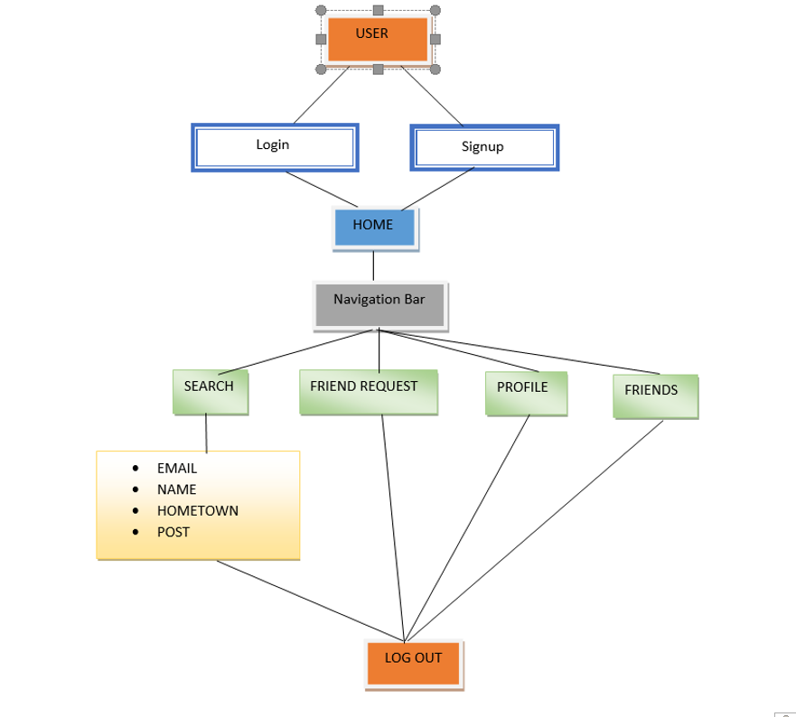
DESIGN OF PROJECT

Slide 14
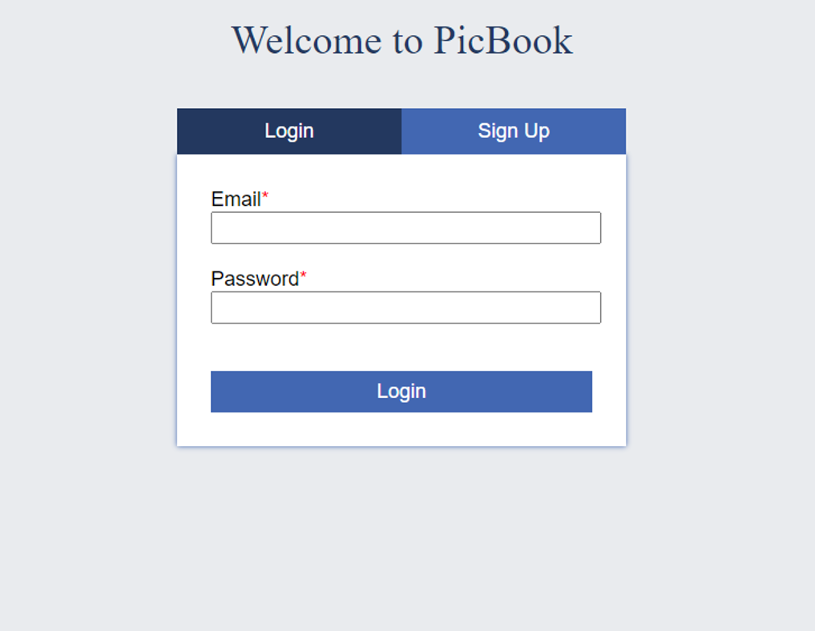
SCREENSHOT AND EXPLANATION
This is the first page the user sees when they open the website through this page they can log in.

Slide 15
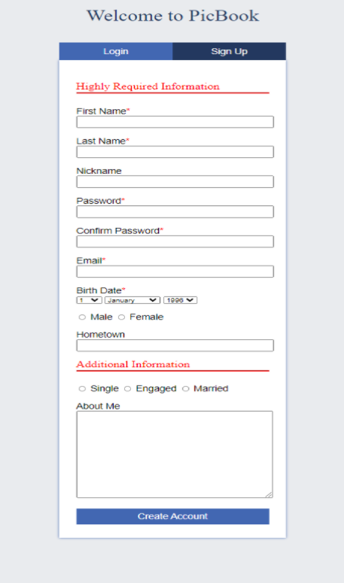
SCREENSHOT AND EXPLANATION
New user has to sign in and fill up the registration form, entering their details and if everything meets the required criteria the account is successfully created and the user will be redirected to homepage

Slide 16
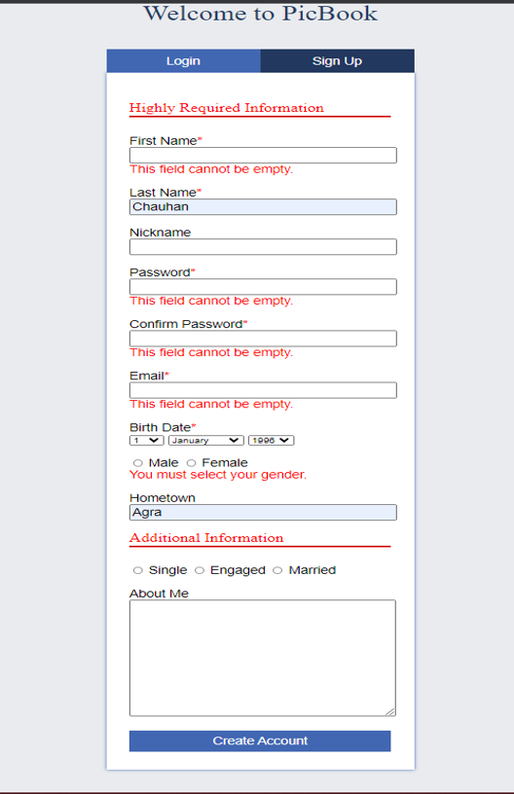
SCREENSHOT AND EXPLANATION
Mandatory fields are marked with an asterisk(*) and not filling any will show a message as shown above.

Slide 17
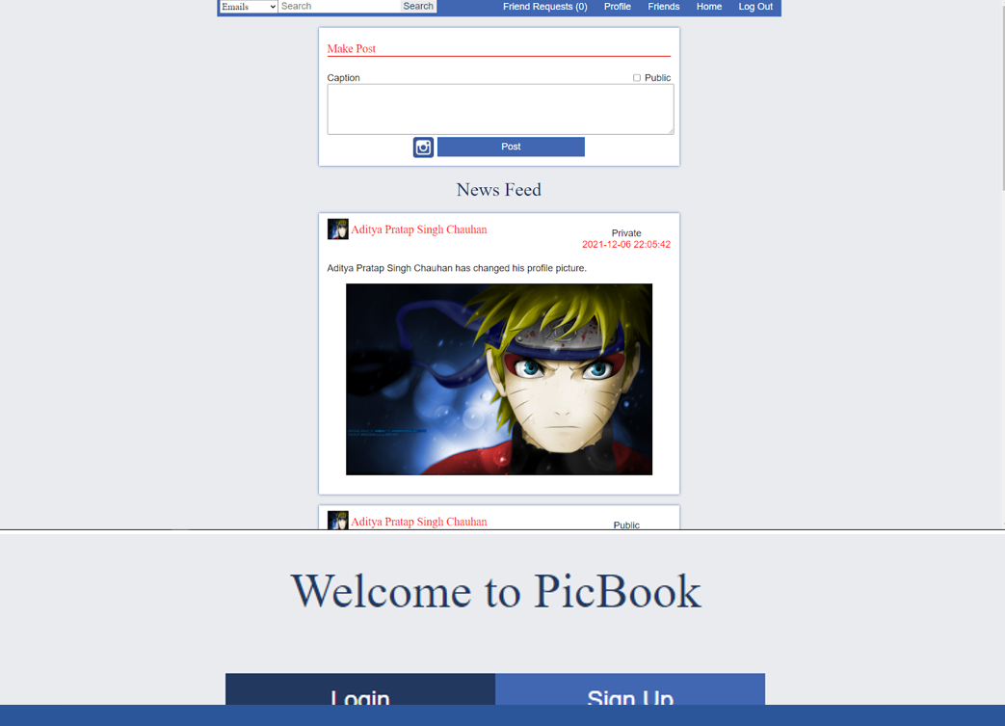
SCREENSHOT AND EXPLANATION
This is the home page where all the user’s and their friends’ posts are shown in chronological order from to latest to oldest

Slide 18
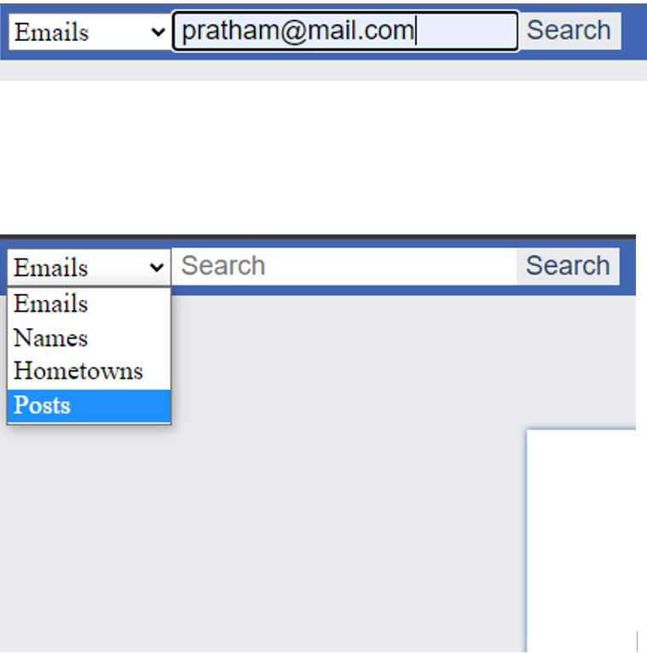
SCREENSHOT AND EXPLANATION
This is the search bar through which a user may search for friends it has different filter options as shown below.

Slide 19
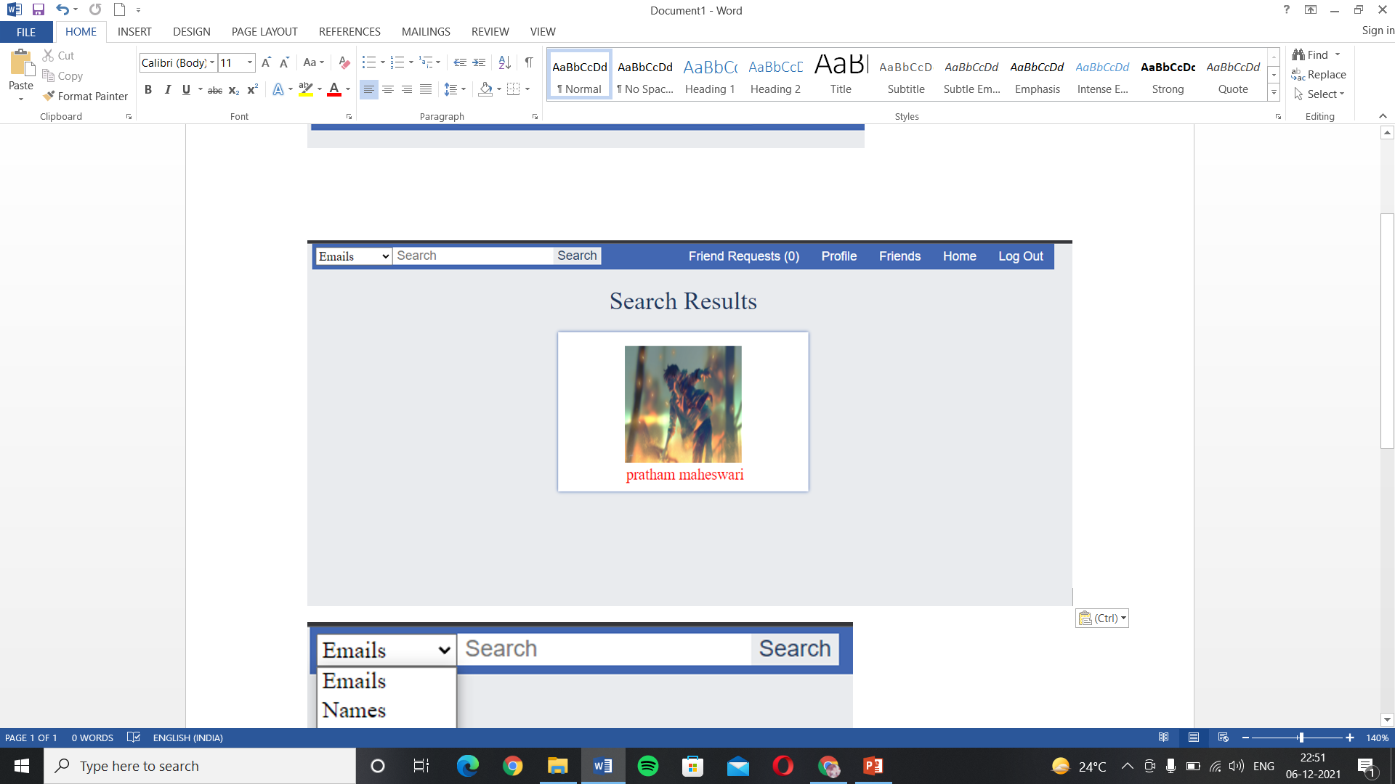
SCREENSHOT AND EXPLANATION
After searching for the above mail id the results will be shown as above.

Slide 20
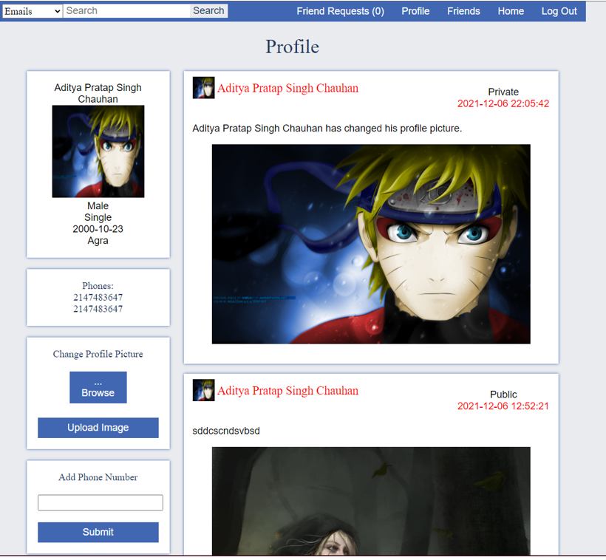
SCREENSHOT AND EXPLANATION
This is the profile page of the user which shows all their posts and their details and also enables them to change their profile picture.

Slide 21
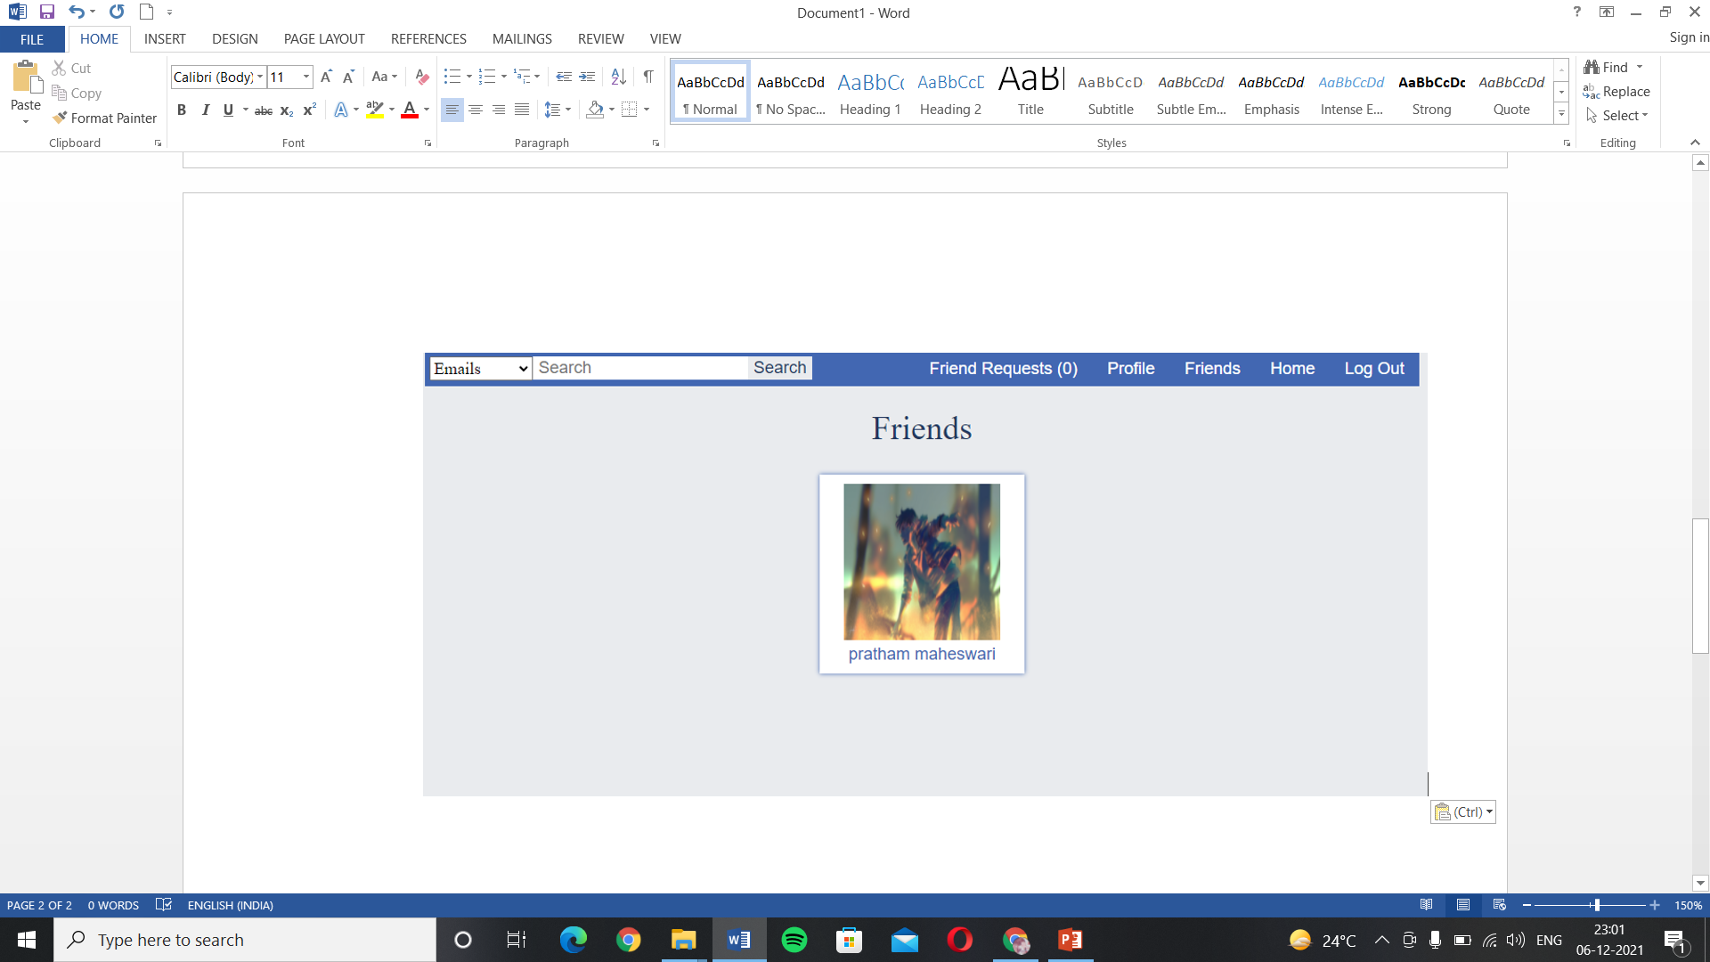
SCREENSHOT AND EXPLANATION
If the user wishes to see their friend list they can do so by clicking on the friends option in the navigation bar and they will be redirected to the page containing a list of their friends as shown above.

Slide 22
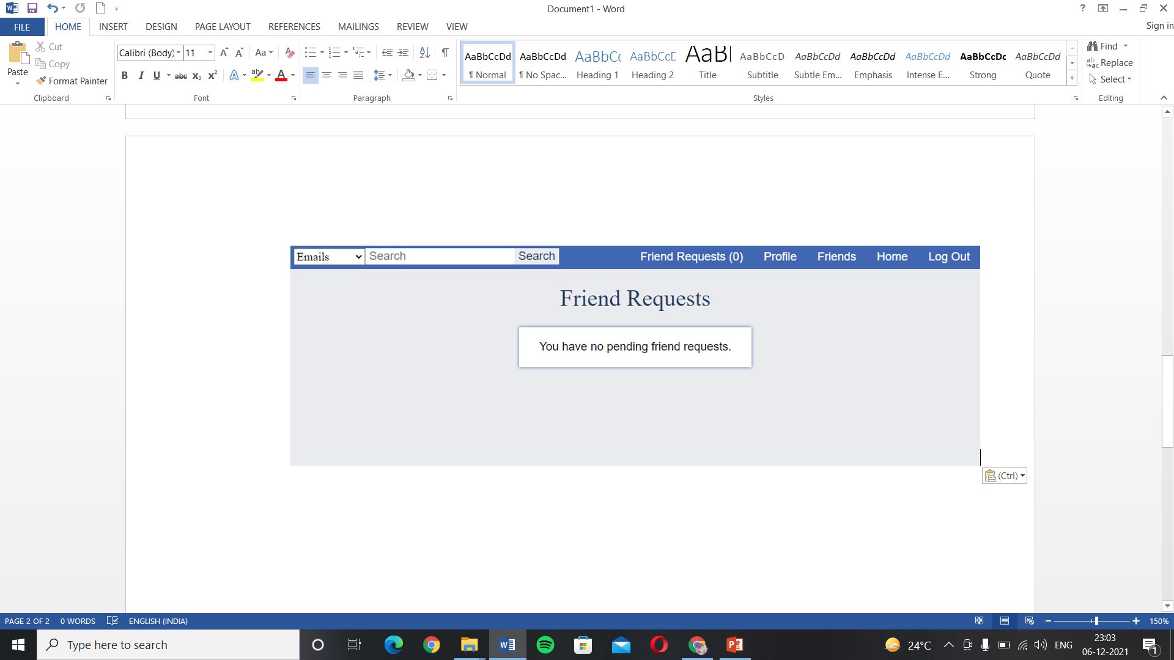
SCREENSHOT AND EXPLANATION
The above page shows the friend requests received by the user from this they can react to those requests.

Slide 23
REFERENCES
https://www.w3schools.com/
https://www.tutorialspoint.com/index.htm
The Complete Reference Javascript Third edition book by Thomas A. Powell and Fritz Schneider
https://www.geeksforgeeks.org/
https://www.php.net/docs.php
https://www.javatpoint.com/
Tom Butler & Kevin Yank,”PHP and MySQL Novice to Ninja”, Sixth Edition, Site Point.
Lynn Beighley & Michael Morrison, “Head First PHP and MySQL”, First Edition, O’Reilly.

