Slide 1



chapter 7
design rules

Slide 2
design rules
Designing for maximum usability
– the goal of interaction design
Principles of usability
  general understanding
Standards and guidelines
  direction for design
Design patterns
  capture and reuse design knowledge

Slide 3
dimensions of design rules
We can classify these rules along two dimensions, based on:
- the rule’s authority
- rule’s generality
Authority means an indication of whether or not the rule must be followed in design or whether it is only suggested.
generality mean whether the rule can be applied to many design situations or whether it is focused on a more limited application situation.

Slide 4
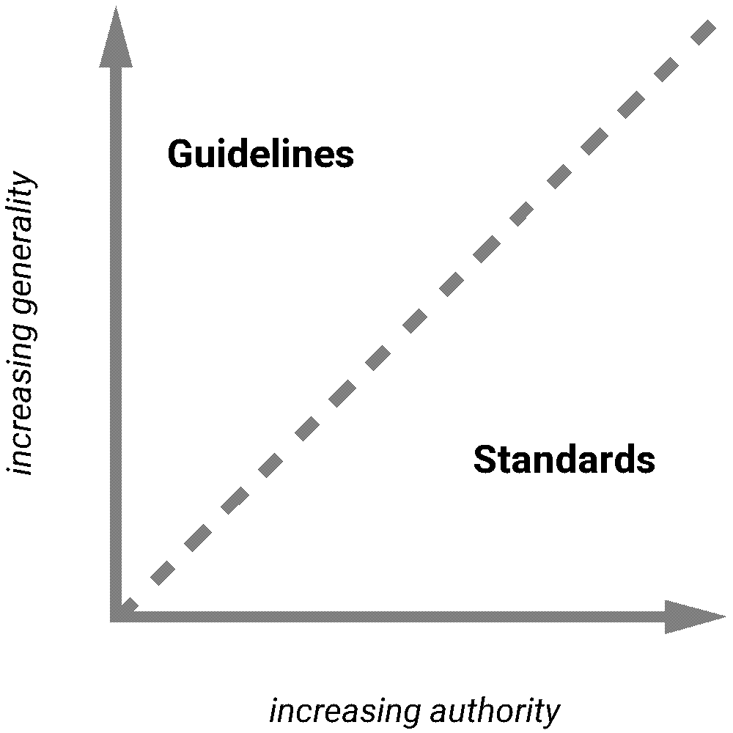
types of design rules
principles
  abstract design rules
  low authority
  high generality
standards
  specific design rules
  high authority
  limited application
guidelines
  lower authority
  more general application
increasing generality
increasing authority

Slide 5
Principles to support usability
Learnability
  the ease with which new users can begin effective interaction and achieve maximal performance
Flexibility
  the multiplicity of ways the user and system exchange information
Robustness
  the level of support provided the user in determining successful achievement and assessment of goal-directed behaviour

Slide 6
Principles of learnability
Predictability
  determining effect of future actions based on past interaction history
  operation visibility
Synthesizability
  assessing the effect of past actions
  immediate vs. eventual honesty

Slide 7
Principles of learnability (ctd)
Familiarity
  how prior knowledge applies to new system
  guessability; affordance
Generalizability
  extending specific interaction knowledge to new situations
Consistency
  likeness in input/output behaviour arising from similar situations or task objectives

Slide 8
Principles of flexibility
Dialogue initiative
  freedom from system imposed constraints on input dialogue
  system vs. user pre-emptiveness
Multithreading
  ability of system to support user interaction for more than one task at a time
  concurrent vs. interleaving; multimodality
Task migratability
  passing responsibility for task execution between user and system

Slide 9
Principles of flexibility (ctd)
Substitutivity
  allowing equivalent values of input and output to be substituted for each other
  representation multiplicity; equal opportunity
Customizability
  modifiability of the user interface by user (adaptability) or system (adaptivity)

Slide 10
Principles of robustness
Observability
  ability of user to evaluate the internal state of the system from its perceivable representation
  browsability; defaults; reachability; persistence; operation visibility
Recoverability
  ability of user to take corrective action once an error has been recognized
  reachability; forward/backward recovery; commensurate effort

Slide 11
Principles of robustness (ctd)
Responsiveness
  how the user perceives the rate of communication with the system
  Stability
Task conformance
  degree to which system services support all of the user's tasks
  task completeness; task adequacy

Slide 12
Using design rules
Design rules
suggest how to increase usability
differ in generality and authority
increasing generality
increasing authority

Slide 13
Standards
set by national or international bodies to ensure compliance by a large community of designers standards require sound underlying theory and slowly changing technology
hardware standards more common than software high authority and low level of detail
ISO 9241 defines usability as effectiveness, efficiency and satisfaction with which users accomplish tasks

Slide 14
Guidelines
more suggestive and general
many textbooks and reports full of guidelines
abstract guidelines (principles) applicable during early life cycle activities
detailed guidelines (style guides) applicable during later life cycle activities
understanding justification for guidelines aids in resolving conflicts

Slide 15
Golden rules and heuristics
“Broad brush” design rules
Useful check list for good design
Better design using these than using nothing!
Different collections e.g.
  Nielsen’s 10 Heuristics (see Chapter 9)
  Shneiderman’s 8 Golden Rules
  Norman’s 7 Principles

Slide 16
Shneiderman’s 8 Golden Rules
1. Strive for consistency
2. Enable frequent users to use shortcuts
3. Offer informative feedback
4. Design dialogs to yield closure
5. Offer error prevention and simple error handling
6. Permit easy reversal of actions
7. Support internal locus of control
8. Reduce short-term memory load

Slide 17
Norman’s 7 Principles
1. Use both knowledge in the world and knowledge in the head.
2. Simplify the structure of tasks.
3. Make things visible: bridge the gulfs of Execution and Evaluation.
4. Get the mappings right.
5. Exploit the power of constraints, both natural and artificial.
6. Design for error.
7. When all else fails, standardize.

Slide 18
HCI design patterns
An approach to reusing knowledge about successful design solutions
Originated in architecture: Alexander
A pattern is an invariant solution to a recurrent problem within a specific context.
Examples
  Light on Two Sides of Every Room (architecture)
  Go back to a safe place (HCI)
Patterns do not exist in isolation but are linked to other patterns in languages which enable complete designs to be generated

Slide 19
HCI design patterns (cont.)
Characteristics of patterns
  capture design practice not theory
  capture the essential common properties of good examples of design
  represent design knowledge at varying levels: social, organisational, conceptual, detailed
  embody values and can express what is humane in interface design
  are intuitive and readable and can therefore be used for communication between all stakeholders
  a pattern language should be generative and assist in the development of complete designs.

Slide 20
Summary
Principles for usability
  repeatable design for usability relies on maximizing benefit of one good design by abstracting out the general properties which can direct purposeful design
  The success of designing for usability requires both creative insight (new paradigms) and purposeful principled practice
Using design rules
  standards and guidelines to direct design activity

