Slide 1
Sentence Subject Complement
Minimum requirement to make a sentence
Subject + Verb.
I write.
We write.
You write.
They write.
He/She writes
Kevin writes.
It writes.
The writer writes.
The boy plays.
The boys play
Peter, Kevin, He, She, It are Third person singular number.
I write a book.
I = I is Subject which is personal pronoun.
write a book = Predicate.

Slide 2
The mouse eats cheese.
My sister likes to listen music.
The family is going to Sydney tomorrow. (British)
The family are going to Sydney tomorrow. (American)
A box of chocolates is on the table.
A box of chocolates are on the table.
My partner and I are very interested in renting your garage.
My partner and I am very interested in renting your garage.
If Noun suggest only one idea
Bread and butter is his only food.
Time and tide waits for none.
A lot of people speak English.
A lot of people speaks English.
People, Police are plural.
The police want to talk to anybody who saw the accident.
The team wants to arrange a meeting.

Slide 3
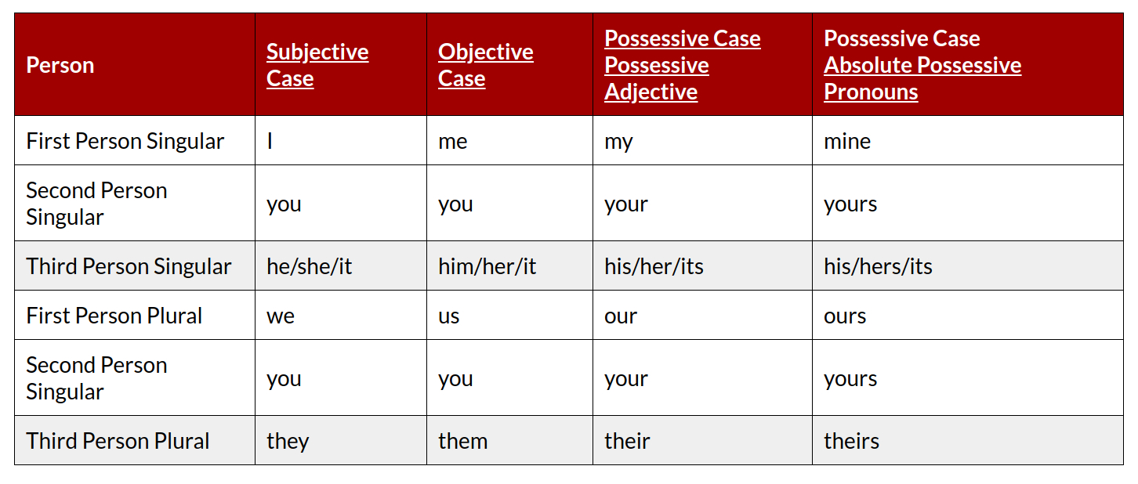
He is taller than me.
He is taller than I am.

Slide 4
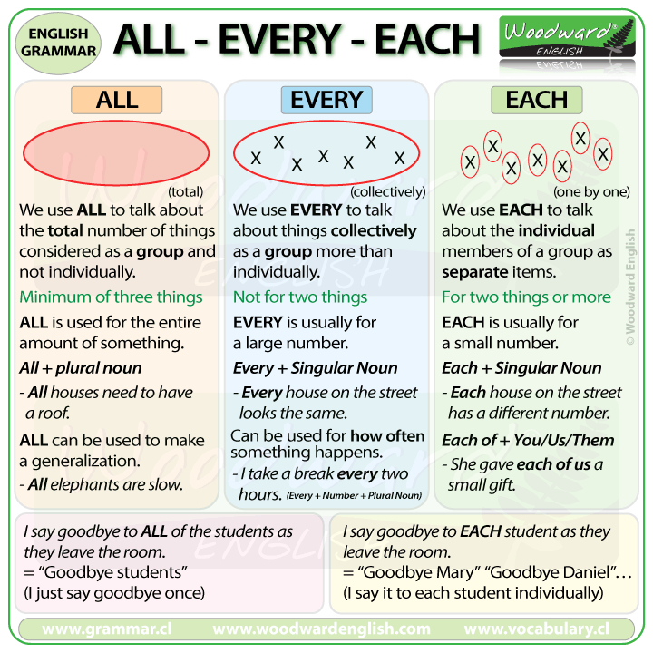

Slide 5
Nobody lives there.
Nobody live there.
Every country has a national flag.
All countries have a national flag.
Everybody needs to live in a society
Every soldier and every sailor has a rifle.
Each child has received a present.
Every person needs to work to lead a life

Slide 6
He is taller than me.
He is taller than I am.
Complement
He is a student.
Honey tastes sweets.
He is handsome.
He is poor.
No object here, they are called complement as it describes subject.

Slide 7
Article
Articles are words that define a noun as specific or unspecific.
Rule #1
we use a before words which begin with consonants (b,c,d,f…)
a doctor
a big car
a girl
When u makes the same sound as `you`
a uniform
a university
a used plate
'one' begin with consonants 'W'
a one-eyed monster
a one-rupee note
Rule #2
We use an before words which begin with vowels (a,e,i,o,u)
an hour (`auer`)
an MA (em-a)

Slide 8
Rule #3
Use a or an only with countable nouns with singular form
Please give me a water.
Please give me some water.
Please give me a bottle of water.
Please give a advice.
Please give some advice.
A love. (Uncountable)
A happiness. (Uncountable)
A doctors. (Plural)
Rule #4
1.Use a or an to talk about a person or thing unknown to your listener
2. Use the talk about a person or thing known to your listener
My uncle has an antique car and a motorcycle. Even today, The car is very comfortable to drive and the bike seems almost intact.
Peter has a son. The boy wants to be an astronaut.
First introduce a noun with your listener then use the before a noun.

Slide 9
Rule #3
No article before a proper noun.
Chine, Dhaka, Zurich
However, there are some exceptions. A very few names of countries, which include words like republic and kingdom
1. the Ukraine
2. the Irish Republic
3. the Netherlands
4. the United States
5. the United Kingdom
6. the Middle East
7. the Arab world
8. the Bakans
9. the Baltics
10. the Philippines
Before names of things unique of their kinds
1. The sun,
2. The sky,
3. The sea,
4. The earth

Slide 10
Rule #4
Use a or an only with countable nouns with singular form
Please give me a water.
Please give me some water.
Please give me a bottle of water.
Please give a advice.
Please give some advice.
A love. (Uncountable)
A happiness. (Uncountable)
A doctors. (Plural)
Rule #5
1.Use a or an to talk about a person or thing unknown to your listener
2. Use the talk about a person or thing known to your listener
My uncle has an antique car and a motorcycle. Even today, The car is very comfortable to drive and the bike seems almost intact.
First introduce a noun with your listener then use the before a noun.

Slide 11
Tense
Present Simple or Indefinite
Hobby/
Routine/
Remain/Seems/
Like/Love/
Always/never/often/Usually/Every day
We use present simple for things that are true in general.
He goes to park on Sunday.
He likes tea.
I like coffee.
I love to play football
Peter lives in Dublin.
He works in a station.
He never goes to Cape Town.

Slide 12
He goes to school.
He goes to school regularly.
Peter swims with his friends.
Peter often swims with his friends.
Tom has a shower every morning.
The train arrives at 8:00 AM.
The train is arriving at 8.00 AM.
My friends is living in Havana.
My friends lives in Havana.
I am working as a teacher.
I work as a teacher.
Peter plays football regularly.
I sometimes go to office on foot.
It costs a lot of money to build a house.
Peter and Kevin are good friends.

Slide 13
Some verbs do not describe actions. These verbs are called
non-action or state verbs
I am wanting ice-cream.
I am liking tea.
I am drinking tea every morning.
I drink tea every morning.
I am listening to a bird singing.
I am hearing a bird singing.
He goes to school.
He goes to school regularly.
Peter swims with his friends.
Peter often swims with his friends.
Tom has a shower every morning

Slide 14
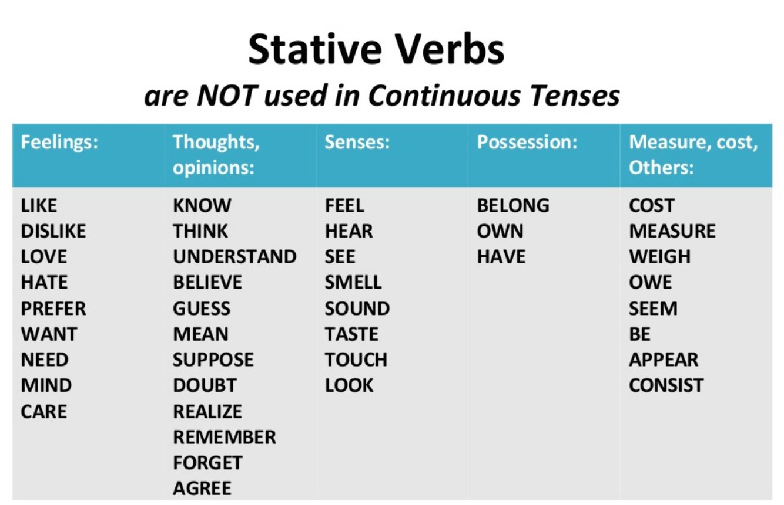

Slide 15
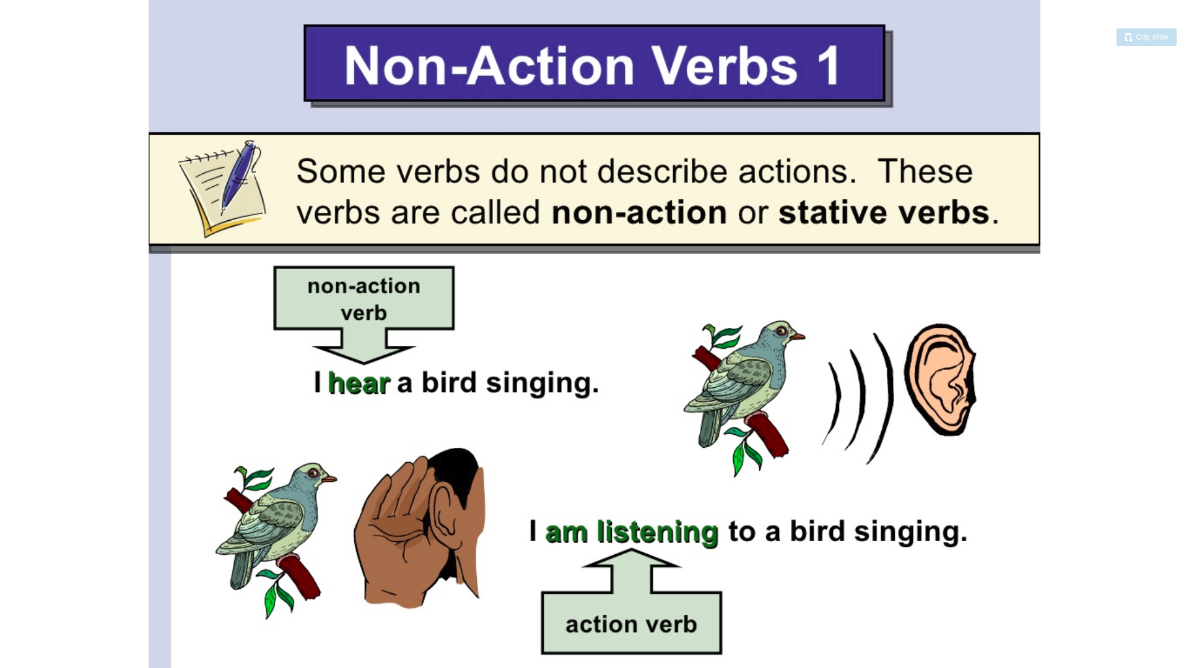

Slide 16
Present Continuous
Now, At the moment time of speaking or doing
Structure = Subject + am/is/are/was/were + Verb-ing
The phone is ringing.
He is listening to me..
It is raining.
The baby is crying.
Tom is working today.
Rabia is going to phone later (Plan: Future Simple).
We are going to get married this year (Plan: Future Simple)
We are getting married on 20th March. (Fixed Arrangement) Present Continuous

Slide 17
Do not use these verbs in present continuous
Like
Love
Want
Know
Understand
Remember
Depend
Prefer
Need
Mean
Forget
Believe
Mean

Slide 18
Present Perfect
Action is important than the time.
Something happened in past but we don’t know when it happened
I have a bought a house.
When did you it?
I bought it last week.
I have bought a house few weeks ago.
I have bought a house yesterday.
I have bought a house in February.
I have bought a house in 2010.
He has gone to Stockholm yesterday.
I have been to Australia. {Held past but Time does not specific}
I have bought a watch recently. {Held past but Time does not specific}

Slide 19
If the past time is important then use past simple.
If the time is not important then use present perfect.
Just
Recently.
Time does not mention exactly, on that case use present perfect.
Talking about unfinished state.
Rule #1
To express past actions whose time is not given and not define;
He has just gone out.
Rule #2
To describe past events when we think more of their effect in the present than of the action.
I have finished my work.

Slide 20
Present Perfect Continuous
Action that started in the past and are still continuing.
Form: Subject + have/has + been + verb (-ing)
I have been doing this job for last 2 years.
I have been living in here since 2000.
I am living in here since 2000.
He has been playing tennis since his childhood.
I have been waiting for doctor for 2 hours.
I am waiting for doctors for 2 hours.

Slide 21
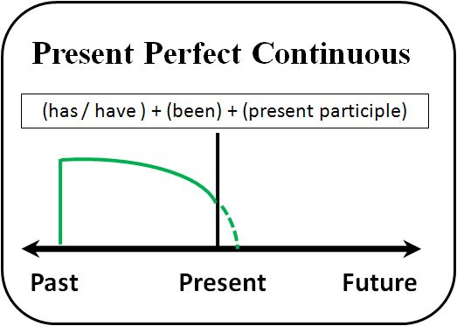

Slide 22
Past Simple
An action which happened in past and finished.
I was a student.
I bought a car.
I bought a car in 2014.
I have bought a car yesterday.
I have bought a car a few seconds ago.
I bought a car few seconds ago.
I played football with my friends last Sunday.
Peter lived in Canada for 5 years.

Slide 23
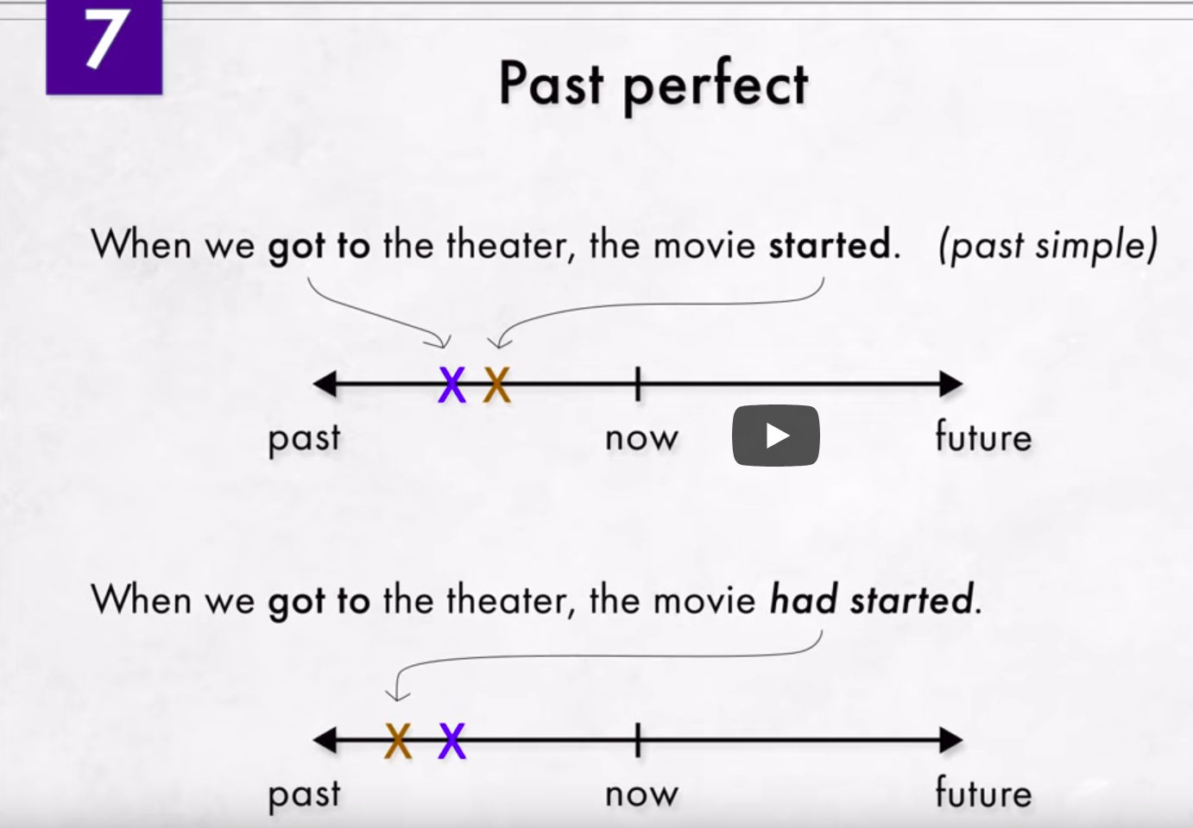
When we got to the theater, the movie had started.

Slide 24
Past Continuous
Unfinished, Ongoing action in the past also mention a finished action in the past.
I was having dinner with my family when door bell rang.
It was raining when Julia left for work.
The power went out when children were studying.
While we were waiting at the bus stop, we saw a car accident.

Slide 25
Past Perfect
Unfinished, Ongoing action in the past also mention a finished action in the past.
I was sick because I had eaten too much the previous night.
The man looked very familiar. I had seen him somewhere before.
The doctor arrived, after the patient had died.
Past perfect and past simple together use in a past story.

Slide 26
Past Perfect Continuous
Form: Subject + had been + verb (-ing)
The first ( continuous ) past action
1. I felt really tired because I had been driving all day.
2. She had been waiting for two hours when doctor finally arrived.
3. When the phone rang, I had been washing the dishes for half an hour.

Slide 27
Past Perfect Continuous
Form: Subject + had been + verb (-ing)
The first ( continuous ) past action
1. I felt really tired because I had been driving all day.
2. She had been waiting for two hours when doctor finally arrived.
3. When the phone rang, I had been washing the dishes for half an hour.

Slide 28
Future Simple
Simple future has two different forms in English: "will" and "be going to." they often express two very different meanings.
Structure
1. Subject + am/is/are + verb (base)
2. Subject + to be going to + verb (base)
Going to — plans and Intentions
1. We are going to buy a new car. (plan)
2. Hasan is going to take a vacation from work. (plan)
3. You are going to meet Jane tonight.
Going to vs Present continuous
We are going to get married this year. (Plan: Future Simple)
We are getting married on 20th April. (Fixed arrangement : present continuous)

Slide 29
Shall/Will --------------- Offer, Promise, Instant decisions, Make predictions
I think Spain will win the 2022 World Cup.
It will rain tomorrow.
I'll pay for the tickets by credit card.
You will do exactly as I say.

Slide 30
Future Continuous
Structure
1. Subject + shall-will + be + verb (-ing)
Ongoing actions in the future
1. At 11:00 a.m tomorrow, I shall be driving to Portland.
2. I will be staying at the hotel in Portland.

Slide 31
Future Perfect Continuous
Structure
1. Subject + will have + be + verb (past participle / V3)
By December, Peter will have saved $1200.

Slide 32
Sentence
Sentence are 3 kinds in terms of structure
1. Simple Sentence
2. Compound Sentence
3. Complex Sentence
Simple Sentence:
One subject and one finite verb.
I am a doctor.
Peter is reading a book.
It’s another name is independent clause.

Slide 33
Compound Sentence:
It has two or more independent clause.
Kevin is a doctor. His wife is a teacher.
Kevin is a doctor, and his wife is a teacher.
He did no have enough cash, so he paid by credit card.
You should study properly, or you will fail.
Two sentence connected with coordinating conjunction like
F = for
A = and
N = nor
B = but
O = or
Y = yet
S = so

Slide 34
Complex Sentence:
A complex sentence has one independent clause and a dependent clause
When I get home from work, = Dependent clause
I usually watch TV = Independent clause.
When I get home from work, I usually watch TV.
Let me know if you need any help.

