Slide 1
Linking words
However
We use ‘however’ and ‘nevertheless’ to express a contrast.
Usually, the first half of a sentence contrasts (opposes) the second half.
However is closer to ‘but’ and Nevertheless is closer to ‘in spite of’
Nevertheless emphasizes a stronger contrast than however.
Example
I already knew a lot about the subject; however, his presentation was still interesting.
I have already told on this topic. However, I am going to recapitulate once again what I told.
This is one solution to the problem. However, there are a number of others.
I'm a vegetarian. However, sometimes I eat fish.
I'm a vegetarian. Sometimes, however, I eat fish.

Slide 2
Nevertheless (তবুও)
Many know that too much sugar is bad for health. Nevertheless, many continue to eat a lot of it every day.
There are several serious problems with the car. Nevertheless, we will have to use it to drive to work this week.
Unless ( Condition or শর্ত )
The guard will not allow you to enter the theatre unless you show the ticket.
I will not go unless Peter gives my phone.

Slide 3
In addition
Players in Ac Milan are all good footballers. In addition, many of them have years of experience playing together.
He is kind, helpful and generous person. In addition, he is a sportsmen.
He is an popular actor. In addition, he often conducts program act as an anchor.

Slide 4
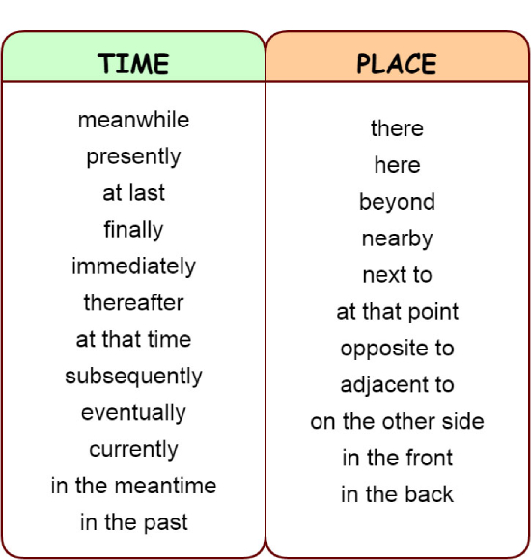

Slide 5
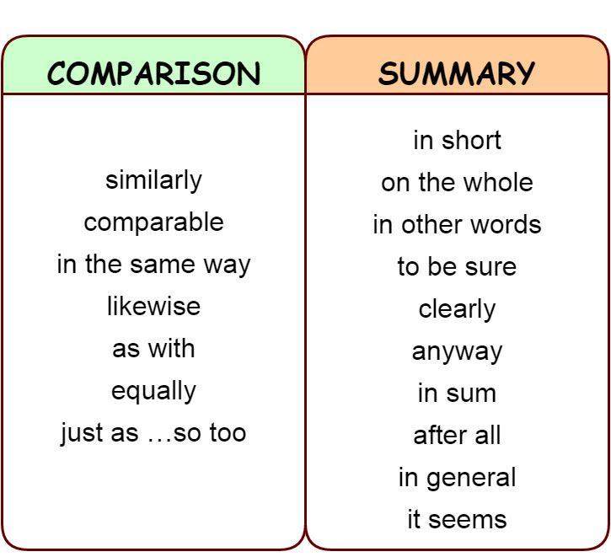

Slide 6
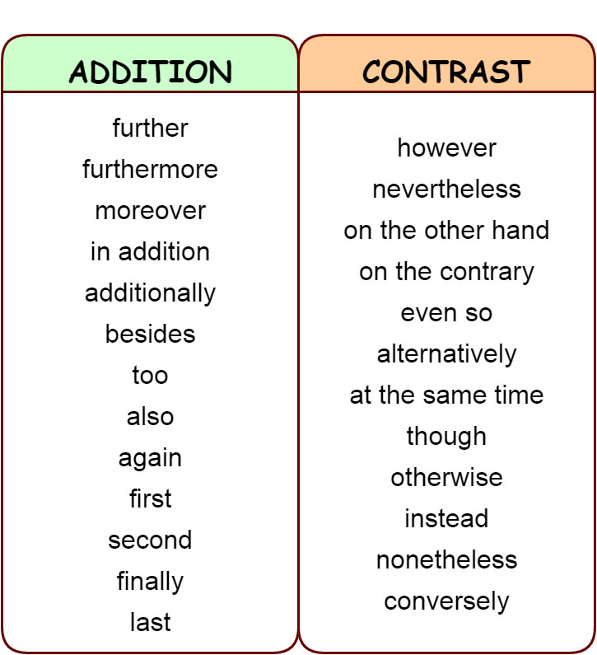

Slide 7
Phrasal Verb
1. Look after – Watch or protect; to keep safe
He look after his parents meticulously.
2. Look into – Investigate, explore, or consider
The college principal promised to look into the matter.
They set up a working party to look into the issue.
3. Look for = to search / to try to find
Peter is looking for a new job.
The detective is looking for clues to solve the case.

