Slide 1
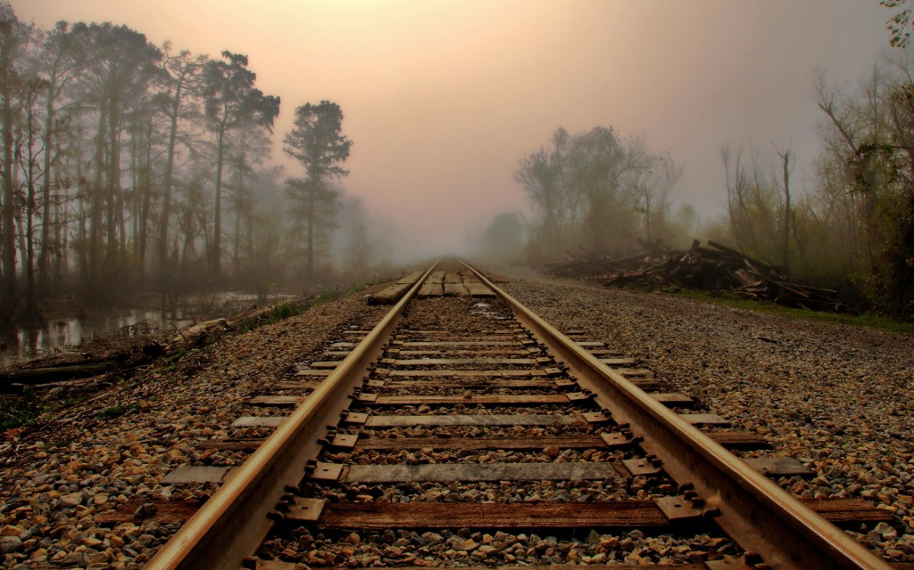
Clause

Slide 2
Clause
A clause is a structure that has a subject and a verb. There are two kinds of clauses: independent and dependent.
An independent clause is a main clause and expresses a complete thought. It is a sentence.
A dependent clause is not a complete sentence. It must be part of an independent clause.

Slide 3
There are three types of sub-ordinate clause.
Noun clause
Adjective Clause
Adverb Clause
Noun clause comes after following subordinating clause
that
what
if
whether
how
whom
whose
who
whom
why
however
Whatever
whoever

Slide 4
Position of Noun
1. Subject
2. Object
3. After preposition
4. Complement
I expect that I shall get a prize
I know that she left for dance class in the morning.
I know what?

Slide 5
Hasan plays football.
Hasan is a student.
He lives in Dhaka.
He is going to market.
Here Hasan, football and student are noun.
Hasan is a subject
Football is a object
Student is complement.
Noun comes after preposition.
These are the place where a noun clause can be found. However, there are many exceptions.

Slide 6
I know where he lives.
I know that he will come.
This is what I want.
Where he said is not correct.
I shall go where he lives. This is adverb clause.
I know it.
I know it.
It is not correct.
I shall go it.
You know what? If you get answer then it is noun clause.

Slide 7
She does not know where he went.
Noun clause
Whatever you do, do it well.
What route we take is our choice.
As subject of a verb.
Jim wants to know where his friends are.
As object of an infinitive.
My belief is that we will win.
Complement of a verb
Sometimes people wish that they could go back in time.
object of a verb

Slide 8
Types of Noun Clauses
1. That clauses.
It begins with (that).
Example: She thought that the exam was cancelled.
2. Subjunctive clauses.
It begins with (that). However, the verb of the noun clause is in the subjunctive mode.
Example: It is urgent that Ali submit the report today.

Slide 9
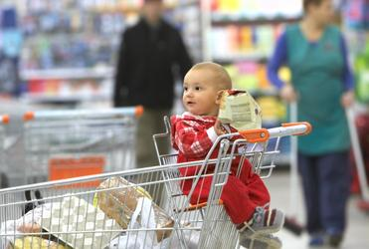
14-1 NOUN CLAUSES: INTRODUCTION
I wonder where my mother is.
Notes:
<number>

Slide 10
14-1 NOUN CLAUSES: INTRODUCTION
s v o
(a) We know her parents.
(noun phrase)
group of related words
phrase
no subject & verb
s v o
(b) We know where her parents live.
(noun clause)
group of related words
clause
has a subject & verb
Notes:
<number>

Slide 11
14-1 NOUN CLAUSES: INTRODUCTION
o
s v
s v
(c) We know where her parents live.
(noun clause)
has
noun clause subject + verb
Notes:
<number>

Slide 12
14-1 NOUN CLAUSES: INTRODUCTION
(d) We know where her parents live.
(noun clause)
(e) I wonder if they will visit us.
(noun clause)
(f) I think that they will try to come soon.
(noun clause)
question word
noun clauses
can begin with
if or whether
that
Notes:
<number>

Slide 13

14-1 LET’S PRACTICE
Hi. Nice to see
you again. I
remember
your name.
phrase
clause
phrase
noun _______
Notes:
<number>

Slide 14
14-1 LET’S PRACTICE
Hi. I remember
when we met.
phrase
clause
noun _______
clause
Notes:
<number>

Slide 15

14-2 NOUN CLAUSES THAT BEGIN WITH A QUESTION WORD
I wonder what he is thinking about.
Notes:
<number>

Slide 16
14-2 NOUN CLAUSES THAT BEGIN WITH A QUESTION WORD
INFORMATION QUESTION
NOUN CLAUSE
Where does she work ?
(b) I wonder where she works.
(c) When did he call?
(d) Do you know when he called?
(e) What did they do?
(f) Please tell me what they did.
(g) Why is she sad?
(h) I don’t know why she is sad.
INCORRECT: I don’t know why is she sad.
usual word order noun clause
Notes:
<number>

Slide 17
14-2 NOUN CLAUSES THAT BEGIN WITH A QUESTION WORD
INFORMATION
QUESTION
NOUN CLAUSE
S
(i) Who wants to go?
(j) I wonder who wants to go.
S
(k) What’s going on?
(l) Tell me what’s going on.
when a question
word is the subject
no change in
word order
Notes:
<number>

Slide 18
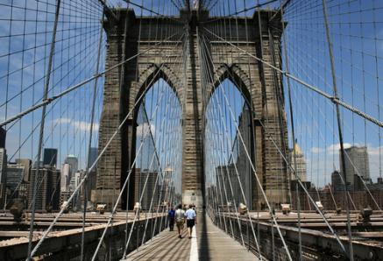
14-2 LET’S PRACTICE
?
noun clause
OR
question
where the bridge was built
Notes:
<number>

Slide 19
14-2 LET’S PRACTICE
?
noun clause
OR
question
where the bridge was built
Notes:
<number>

Slide 20
14-2 LET’S PRACTICE
?
noun clause
OR
question
who built the bridge
noun clause:
I know who built the bridge.
Who built the bridge?
question:
Notes:
<number>

Slide 21
14-2 LET’S PRACTICE
?
noun clause
OR
question
who built the bridge
noun clause:
I know who built the bridge.
Who built the bridge?
question:
Notes:
<number>

Slide 22
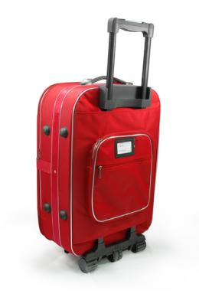
14-3 NOUN CLAUSES WITH WHO, WHAT, WHOSE + BE
Whose suitcase is this?
Notes:
<number>

Slide 23
14-3 NOUN CLAUSES WITH WHO, WHAT, WHOSE + BE
QUESTION NOUN CLAUSE
v
s
s
v
(a) Who is that actor ? (b) Tell me who that actor is.
v
s
s
v
(c) Whose dog is this ? (d) Tell me whose dog this is.
main verb
be
noun or
pronoun
noun or
pronoun
main verb
be
+
+
Notes:
<number>

Slide 24
14-3 NOUN CLAUSES WITH WHO, WHAT, WHOSE + BE
QUESTION NOUN CLAUSE
s
v
s
v
(e) Who is out there ? (f) Tell me who is out there.
s
v
s
v
(g) Whose dog is in here? (h) Tell me whose dog is
in here.
prepositional
phrase
main verb
be
+
Notes:
<number>
Same bracket issue as last slide

Slide 25

14-3 LET’S PRACTICE
Who’s calling?
who’s calling
Please tell me ____________.
Notes:
<number>

Slide 26
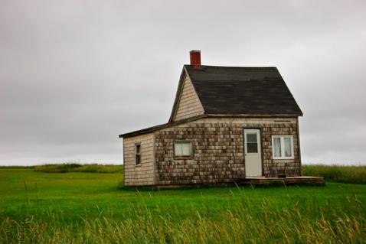
14-3 LET’S PRACTICE
Whose house is that?
whose house that is
I wonder _________________.
Notes:
<number>

Slide 27

14-3 LET’S PRACTICE
Who will join us for a picnic?
who will join us for a picnic
I don’t know _______________________.
Notes:
<number>

Slide 28
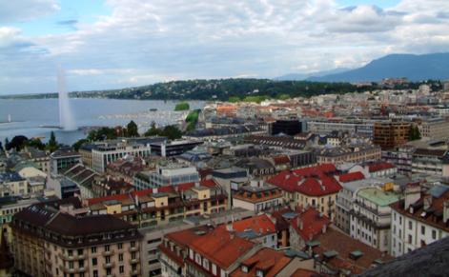
14-4 NOUN CLAUSES THAT BEGIN WITH IF OR WHETHER
I don’t know if Geneva is the capital of Switzerland or not.
Notes:
<number>

Slide 29
14-4 NOUN CLAUSES THAT BEGIN WITH IF OR WHETHER
YES/NO QUESTION NOUN CLAUSE
(a) Is Alice friendly? (b) I wonder if Alice is friendly.
(c) Does Al dance? (d) Do you know if Al dances?
(e) Did class end early? (f) I wonder if class ended early.
yes/no questions noun clause
if introduces the clause
Notes:
<number>

Slide 30
14-4 NOUN CLAUSES THAT BEGIN WITH IF OR WHETHER
(g) I don’t know if class ended early or not.
if + clause + or not
Notes:
<number>

Slide 31
14-4 NOUN CLAUSES THAT BEGIN WITH IF OR WHETHER
(g) I don’t know if class ended early or not.
(h) I don’t know whether class ended early or not.
if = whether
Notes:
<number>

Slide 32
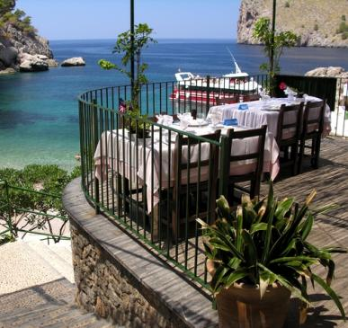
14-4 LET’S PRACTICE
Is that a good restaurant?
NOUN CLAUSE:
Do you know _______________________
if that is a good restaurant?
Notes:
<number>

Slide 33
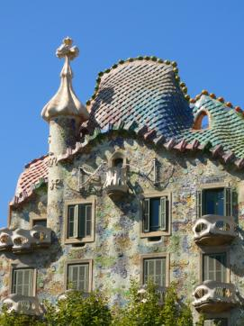
14-4 LET’S PRACTICE
Will we go to the Gaudi Museum again?
Do you know _______________________
if we will go to the Gaudi
______________
Museum again?
Notes:
<number>

Slide 34

14-4 LET’S PRACTICE
Will your friend pass his exam?
I wonder __________________
if your friend will pass
his exam.
___________
Notes:
<number>

Slide 35
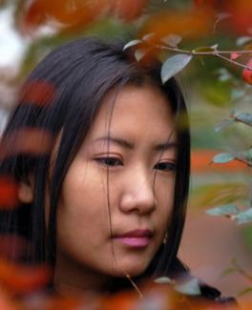
14-5 NOUN CLAUSES THAT BEGIN WITH THAT
I was sad when I found
out that my friend was ill.
Notes:
<number>

Slide 36
14-5 NOUN CLAUSES THAT BEGIN WITH THAT
s
v
o
(a) I know that you are a good friend.
(b) She hopes that she can go to college.
(c) Jane heard that the exam is difficult.
(d) We discovered that our house was robbed.
that-clause object of verb
mental activity
Notes:
<number>

Slide 37
14-5 NOUN CLAUSES THAT BEGIN WITH THAT
(e) I know that you are a good friend.
(f) I know Ø you are a good friend.
same
meaning
that
often omitted
especially in speaking
Notes:
<number>

Slide 38

14-5 LET’S PRACTICE
?
CORRECT
OR
INCORRECT
I hope that you can come to dinner tomorrow.
Notes:
<number>

Slide 39
14-5 LET’S PRACTICE
?
CORRECT
OR
INCORRECT
I hope that you can come to dinner tomorrow.
Notes:
<number>

Slide 40
14-5 LET’S PRACTICE
?
CORRECT
OR
INCORRECT
I hope you can come to dinner tomorrow.
Notes:
<number>

Slide 41

14-6 OTHER USES OF THAT- CLAUSES
She was disappointed that she failed the test.
Notes:
<number>

Slide 42
14-6 OTHER USES OF THAT- CLAUSES
(a) I’m certain that you will like this class.
(b) I’m happy that you joined us.
(c) You are fortunate that the weather was good.
(d) She was surprised that he proposed.
certain expressions:
be + adjective OR
be + past participle
+
that-clause
Notes:
<number>

Slide 43
14-6 OTHER USES OF THAT- CLAUSES
(e) It is true that cancer is a serious disease.
(f) It is a fact that cancer is a serious disease.
It is true…
It is a fact…
+
two common
expressions
that-clause
=
Notes:
<number>

