Slide 1
Pronoun
A clause is a structure that has a subject and a verb. There are two kinds of clauses: independent and dependent.
An independent clause is a main clause and expresses a complete thought. It is a sentence.
A dependent clause is not a complete sentence. It must be part of an independent clause.

Slide 2
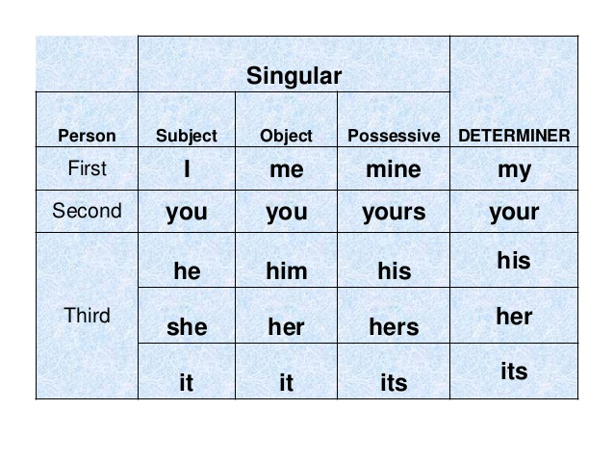

Slide 3
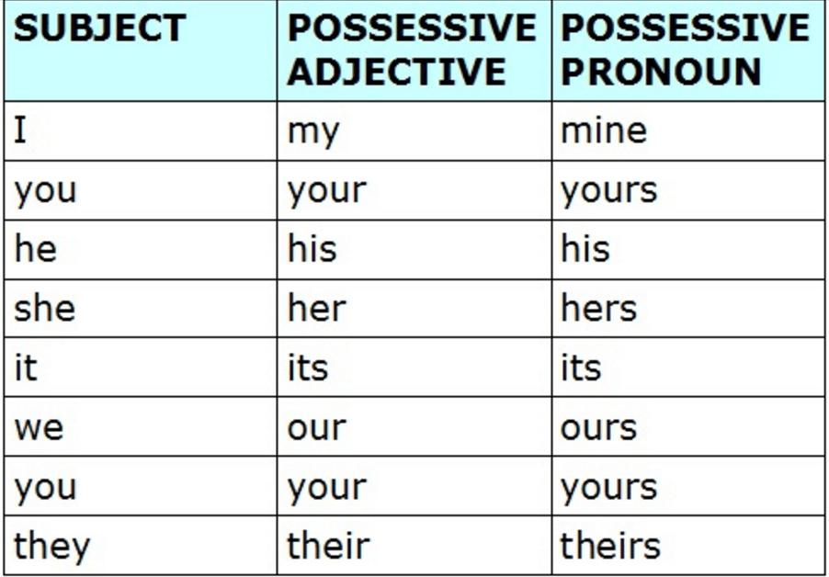

Slide 4
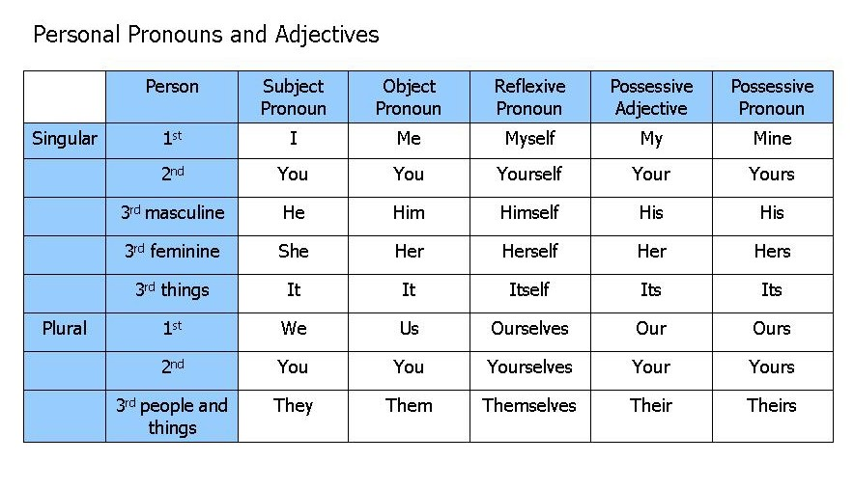

Slide 5
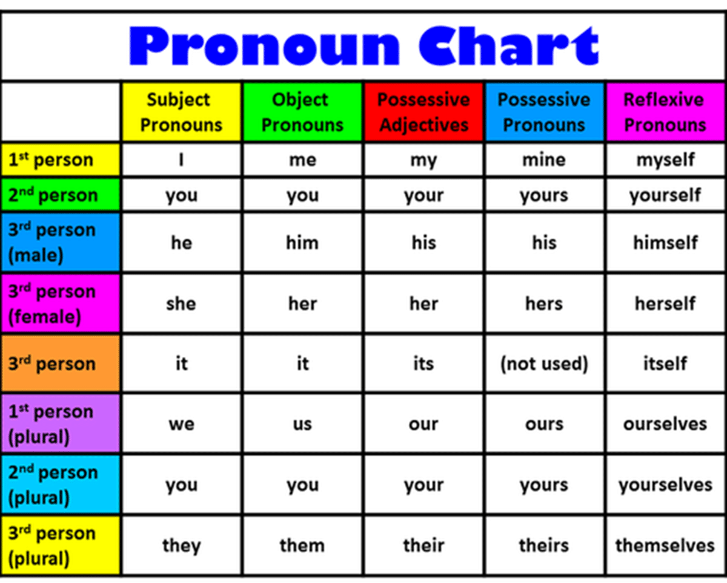

Slide 6
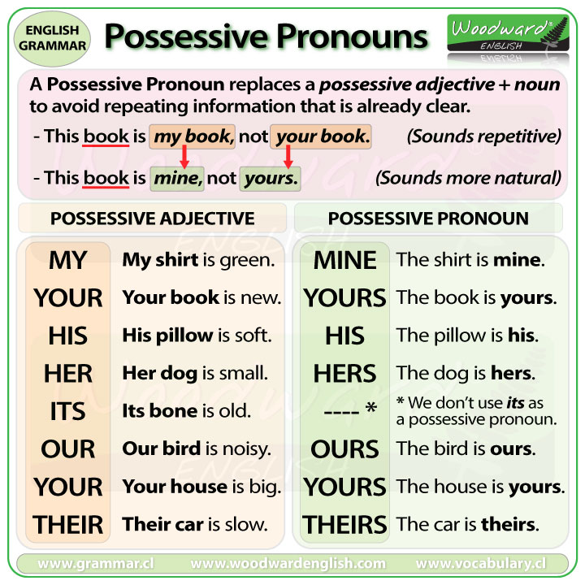

Slide 7
Pronoun
A word that is used instead of noun is called
Pronoun.
Kinds of Pronoun
1. Personal pronoun: I, you, we, me
We are playing football.
Possessive Pronouns
Possessive Pronouns
2. Reflexive pronoun: myself, yourself
He hurt herself.
3. Relative pronoun:
The man who drive the car is my uncle.

Slide 8
4. Demonstrative Pronouns
This is Tanzina.
5. Interrogative Pronouns
What is your name?
6. Indefinite pronoun:
Anybody can do it if they try.

Slide 9
7. Distributive Pronouns
Each boy was given a prize.
8. Reciprocal Pronouns
They hate each other.
Peter and Harry help one another.

Slide 10
Quiz
He is taller than me
John and myself went there.
I and Mark are friends.
I and he are brothers.
White and me work together.
The teacher assigned a home work to I and Hasan.

Slide 11
Quiz
He is taller than I am.
John and I went there.
Mark and I are friends.
He and I are brothers.
White and I work together.
The teacher assigned a home work to me and Hasan.

Slide 12
Possessive
My is put before a noun to indicate your possession
(or other kinds of relationships with the noun).
For example,
Possessive pronouns are used in English to avoid repeating information that is already clear. In general
it makes the sentence less confusing because the same information is not being repeated.
This book is my book, not your book. (Sounds repetitive)
This book is mine, not yours.
(Mine and yours are possessive pronouns)
This is my pen.
This pen is mine.
This is his pen.
This pen is his.

Slide 13
Possessive
My is put before a noun to indicate your possession
(or other kinds of relationships with the noun).
For example,
Possessive pronouns are used in English to avoid repeating information
that is already clear. In general it makes the sentence less confusing
because the same information is not being repeated.
This book is my book, not your book. (Sounds repetitive)
This book is mine, not yours.
(Mine and yours are possessive pronouns)
This is my pen.
This pen is mine.
This is his pen.
This pen is his.
Her car is faster than mine.
Her car is faster than my car.

Slide 14
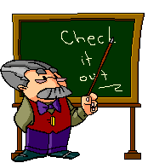
Pronouns
There’s more than one way to say anything!

Slide 15
Why on earth do we need pronouns?
When Susie arrived at the party, Susie knew Susie had made a mistake. Susie saw that Susie did not fit in with Susie’s new friends. Susie wondered if Susie should leave, or if Susie should just act like it was normal for Susie to be involved in such activities. Drinking and smoking were not things in which Susie normally participated. Susie decided Susie was not going to allow Susie to behave in such a ridiculous manner.

Slide 16
Why on earth do we need pronouns?
Think about the paragraph on the previous slide. Then answer the question above on your worksheet.

Slide 17
Pronouns
Pronouns make our speech and writing less boring.
We do not have to continually repeat our subject.
We can identify our subject in a variety of ways, other than by “name”.

Slide 18
Pronouns
Pronouns can substitute for
(or take the place of) nouns.
Pronouns can
appear
anywhere in
a sentence.

Slide 19
Antecedents
Antecedent: The noun that is being replaced by a pronoun.
Abigail lost her notebook at school.
her = pronoun
Abigail = antecedent

Slide 20
Pronouns
There are seven major types of pronouns:
  Personal
  Demonstrative
  Reflexive
  Intensive
  Indefinite
  Relative
  Interrogative

Slide 21
Personal Pronouns

Slide 22
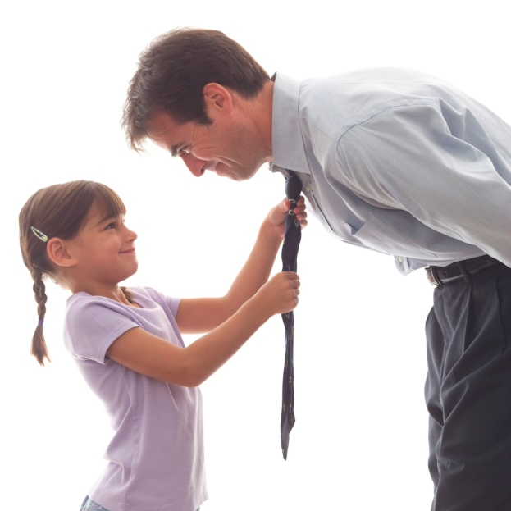
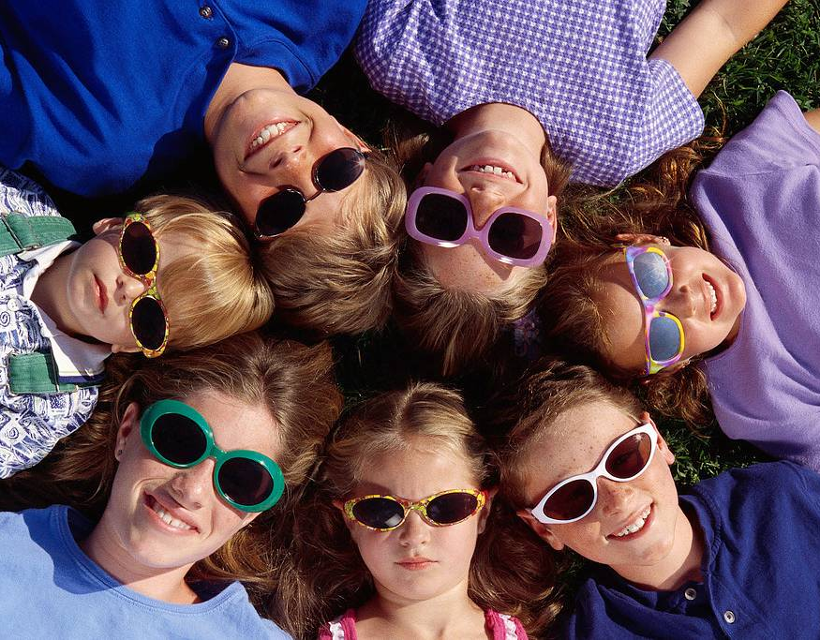
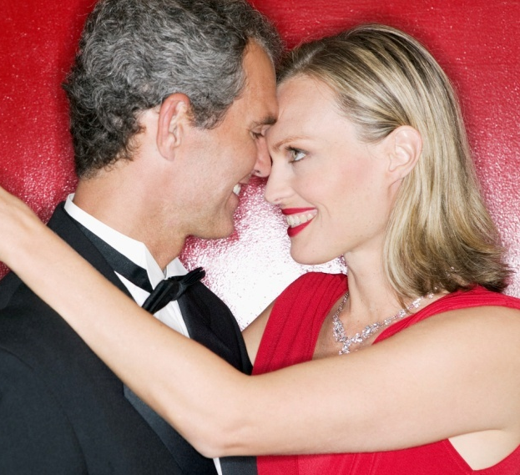
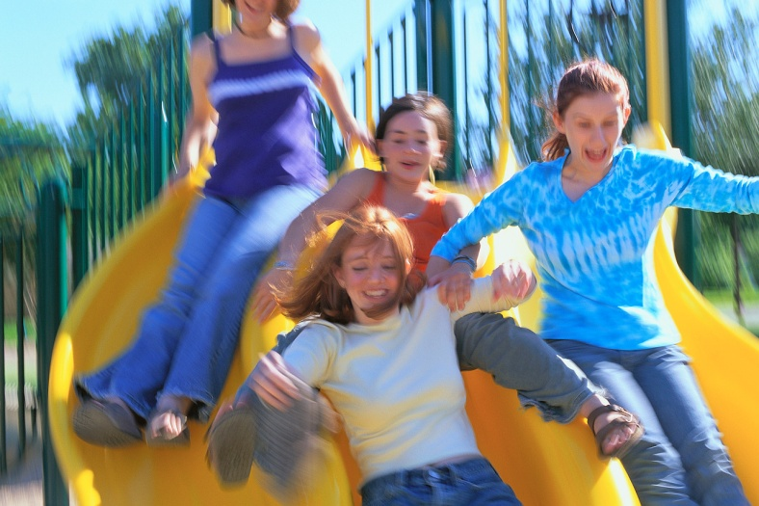
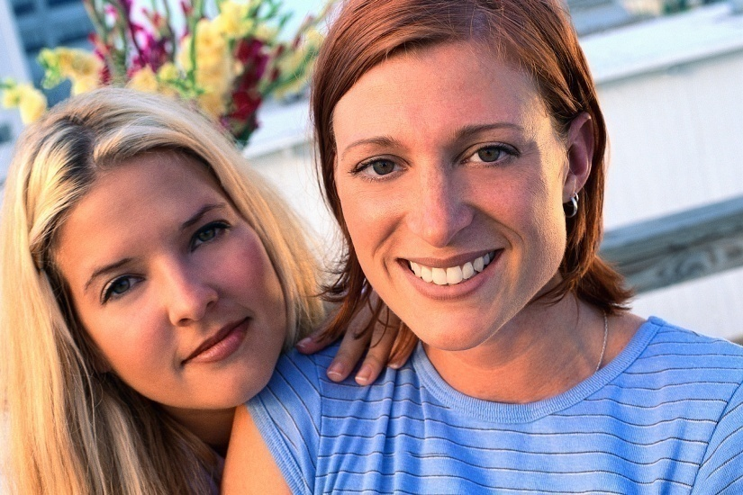
Personal Pronouns
Personal pronouns always refer to people.

Slide 23
PERSONAL PRONOUNS
SINGULAR
Nominative | Objective | Possessive
I, you he, she, it | me, you him, her it | my, mine, your, yours, his, her, hers, its
PLURAL
Nominative | Objective | Possessive
we you they | us you them | Our, ours your, yours their, theirs

Slide 24
Demonstrative Pronouns

Slide 25



Demonstrative Pronouns
Demonstrative pronouns demonstrate or point out things like people, places, objects, or ideas.

Slide 26
Demonstrative Pronouns
this
that
these
those

Slide 27
Demonstrative Pronouns
This is easy.
That was difficult.
These are hilarious.
Those will not last.
Do not put a noun after the demonstrative pronoun it will then become an adjective.

Slide 28
Demonstrative Pronouns
To remember “demonstrative”, think of a monster pointing at you!
With my giant demonstrative” teeth, I’m going to
eat this, then that,
then these and those!!

Slide 29
Intensive and Reflexive Pronouns

Slide 30
Reflexive and Intensive Pronouns
myself
herself
himself
itself
yourself yourselves
ourselves
themselves

Slide 31
Reflexive and Intensive Pronouns
Reflexive and Intensive pronouns always end in “self” or “selves”

Slide 32
Reflexive and Intensive Pronouns
Reflexive pronouns REFLECT
Intensive pronouns INTENSIFY

Slide 33
Intensive pronouns emphasize (or intensify) another noun or pronoun.
Amanda made the cake herself.
I myself sold fifty tickets.

Slide 34
Intensive Pronouns
To remember intensive pronouns, think of a very “intense” “elf” or “elves” working frantically to get
toys ready for the holidays…

Slide 35
Reflexive Pronouns
Reflexive pronouns refer to the subject and reflect the action of the verb back to the subject.
John wrote himself a note.
Sue gave herself a haircut.

Slide 36
Reflexive Pronouns
To remember reflexive pronouns:
They REFLECT
the action of the
verb.

Slide 37
Indefinite Pronouns

Slide 38

Indefinite
Pronouns
“Indefinite” means not definite or not clear—cloudy.
Indefinite pronouns refer to a person, a place, or a thing that is not specifically named.

Slide 39

Indefinite Pronouns
To remember indefinite pronouns, think of a cloudy day, when things
are not as clear.

Slide 40
Indefinite
Pronouns
all | each | more | one
another | either | most | other
any | everybody | neither | several
anybody | everyone | nobody | some
anyone | everything | none | somebody
anything | few | no one | someone
both | many | nothing | something

Slide 41
Relative and Interrogative Pronouns

Slide 42

Relative Pronouns
Relative pronouns introduce subordinate clauses.

Slide 43

Interrogative pronouns introduce a question (?).
The word “interrogative”
means “to ask”

Slide 44
Relative | that which who whom whose
Interrogative | what which who whom whose

Slide 45
Relative and Interrogative Pronouns
The list of relative and interrogative pronouns is the SAME except for what and that.

Slide 46
Relative Pronouns
The ball (that was lost) was found.
The girl (which lives down the street) was absent today.
The teacher (who my brother had last year) is now retired.
The family (whose dog ran away) has bought another one.
The student (whom you might know) was selected for the team.

Slide 47
Hi! I’m Relative
Guy.
We’re
TWINS!
And I’m Interrogative Guy.
Relative
that
which
who
whose
whom
what
which
who
whose
whom

