Slide 1
Noun
Noun: Name, Place, Things

Slide 2
Kinds of Noun
1) Proper noun
A particular person, place, or thing, e.g. Steven, Africa, London, Monday. In written English, proper nouns begin with capital letters.
2) Common noun
That refers to people or things in general, e.g. boy, country, bridge, city,

Slide 3
3) Collective nouns Collective nouns refer to groups of people or things, e.g. audience, family, government, team, jury.
4) Abstract noun
which refers to ideas, qualities, and conditions - things that cannot be seen or touched e.g. truth, danger, happiness, time, friendship.

Slide 4
5) Material noun
It is the name of material from which different things can be made e.g. milk, gold, wood
6) Countable noun
Those that can be countable: Pen, Paper, Table,
7) Uncountable noun
Those that can’t be countable: Water, Sugar, Hair

Slide 5
Pronoun
A word that is used instead of noun is called Pronoun.
Kinds of Pronoun
1. Personal pronoun: I, you, we, me
We are playing football.
Possessive Pronouns
Possessive Pronouns
2. Reflexive pronoun: myself, yourself
He hurt herself.
3. Relative pronoun:
The man who drive the car is my uncle.

Slide 6
4. Demonstrative Pronouns
This is Tanzina.
5. Interrogative Pronouns
What is your name?
6. Indefinite pronoun:
Anybody can do it if they try.

Slide 7
7. Distributive Pronouns
Each boy was given a prize.
8. Reciprocal Pronouns
They hate each other.
Peter and Harry help one another.

Slide 8
Verb
Verbs are the action words in a sentence that describe what the subject is doing.
Verbs are state or action.
State Verbs or Non-action Verbs:
I have a car.
I have two brothers and one sister.
Hasan is a boy.
He is from France.
The book is on the table.
Hasan likes to play football.
State verbs can not be used in -ing(Continuous) forms

Slide 9
Action Verbs:
The boys are playing in the field.
He is playing football.
Julia is eating noodles.
I am having a large family.
He is liking to play football.
No continuous form for state verbs.

Slide 10
Auxilary Verbs or Helping Verbs:
Am, is, are, was, were, have, had, shall, will
Modal Verbs:
Can, must, may, might, should,
Transitive Verbs:
Which required an object
Like, want, eat. write
I want a pen.
He writes a book.
Hansa kicked a ball.

Slide 11
Intransitive Verbs:
It does not take an object.
Cry, smile, live, die, sleep, sit,
The baby is crying.
The kids smiled.
The man laughed loudly.
He is sleeping.
The thief climbed and then escaped.
The thief climbed over the wall and then escaped.
Intransitive verbs which can not be changed into passive voice.

Slide 12
Finite and non-finite verbs
When a verb has a subject and a tense, it can be referred to as a finite verb.
Simply, if we can trace the tense from verb it is called Finite Verbs, otherwise non-finite verbs.
He gives me to eat.
He gave me to eat.
He will give me to eat.
He wanted to find a solution.

Slide 13
Regular verbs and
Regular verbs form their past and past participle forms by adding –ed.
Walk – walked – walked
Dance – danced – danced
Paint – painted – painted
Work – worked – worked
Irregular verbs
put – put – put
Go – went – gone

Slide 14
Infinitive | Present | Past | Past Participle | Verb ing
To go | go | Went | gone | going
become

Slide 15
Adverb
Provide information about verbs, adjectives, even whole sentence.
Answer following question
Where
When
How
How much
How often … etc
He ate the sandwich quickly.(How)
He went to school yesterday.(When)
You can park here.(Where)
I sometimes drink coffee in the morning (How often)

Slide 16
Types of Adverbs
1. Adverbs of Degree or Manner
Really, Very, Extremely, Absolutely, Loudly, quietly
2. Adverbs of Place
Here, There, Somewhere, nearby, upstairs
3. Adverbs of Frequency
I meet him daily.
She is calling me again and again.
4. Adverbs of Time
I will go to school tomorrow.
I am still waiting for my friend.

Slide 17
Opinion: Fortunately, Personally, Sadly
Generally added by ‘ly’.
Friendly, Lovely are adjectives not adverb.
Position: Beginning, Middle, and end
Fortunately, I have a car.
I often go to park.
He laughs loudly.

Slide 18
Adjective
An Adjective modifies or describes noun or pronoun.
Types of Adjectives
1. Determiners: My, Our, Her, a/an, the
2. Descriptive Adjective
Beautiful, cold, tall, short, red, blue
That’s my car.
I have a car.
The window is broken.

Slide 19
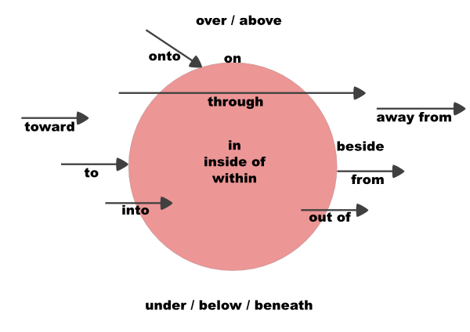
Preposition

Slide 20
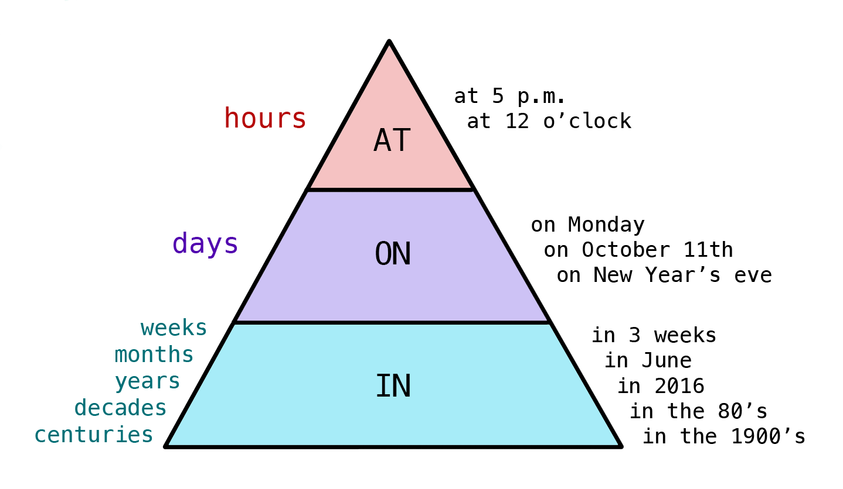
Day —————— on
Time —————— at
Year/month —————— in

Slide 21
'at' for Specific time
I start work at 8 o'clock.
I feel good in the morning
I feel bad in the evening.
I feel good at night.
He started his job on January 12, 2018.
He started his job in January 2018.
He started his job on the 1st of January 2000.
Jane is waiting for you at the bus stop.
The shop is at the end of the street.
When will you arrive at the office?
Do you work in an office?

Slide 22
I am in a taxi.
I am in the car.
I am on the train.
I am on the plain.
I am on the bus.
I ride on a motorcycle.
I ride on a horse.
I ride on an elephant.
at, in or in
at for a POINT
in for an ENCLOSED SPACE
on for a SURFACE

Slide 23
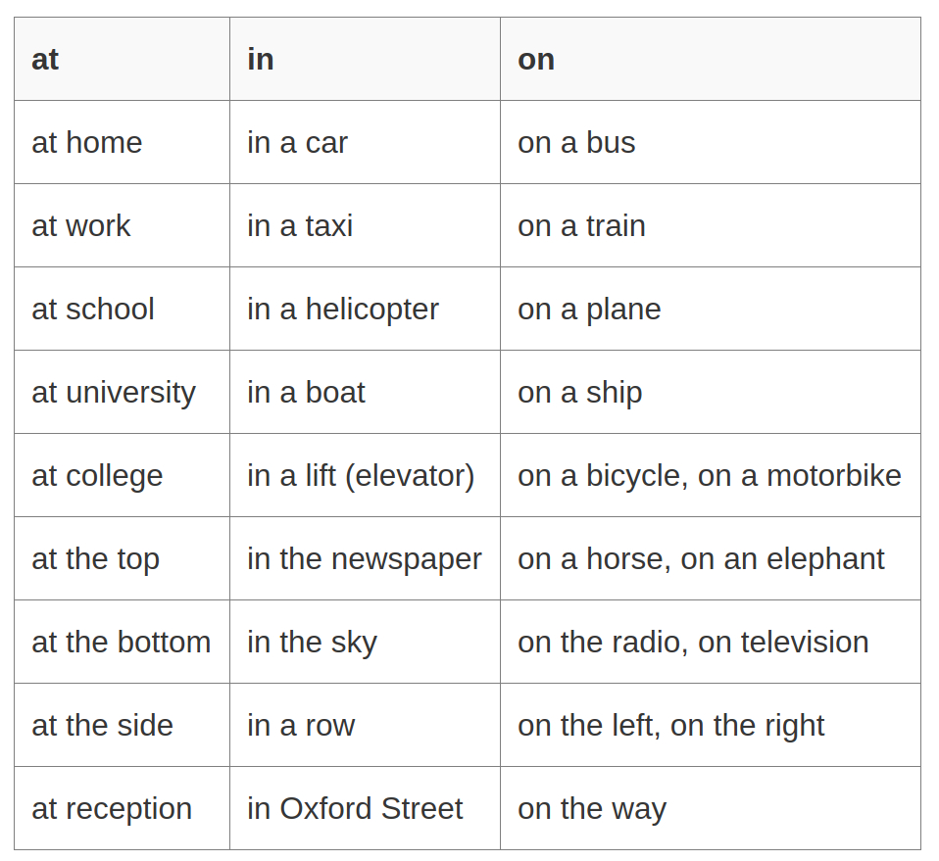

Slide 24
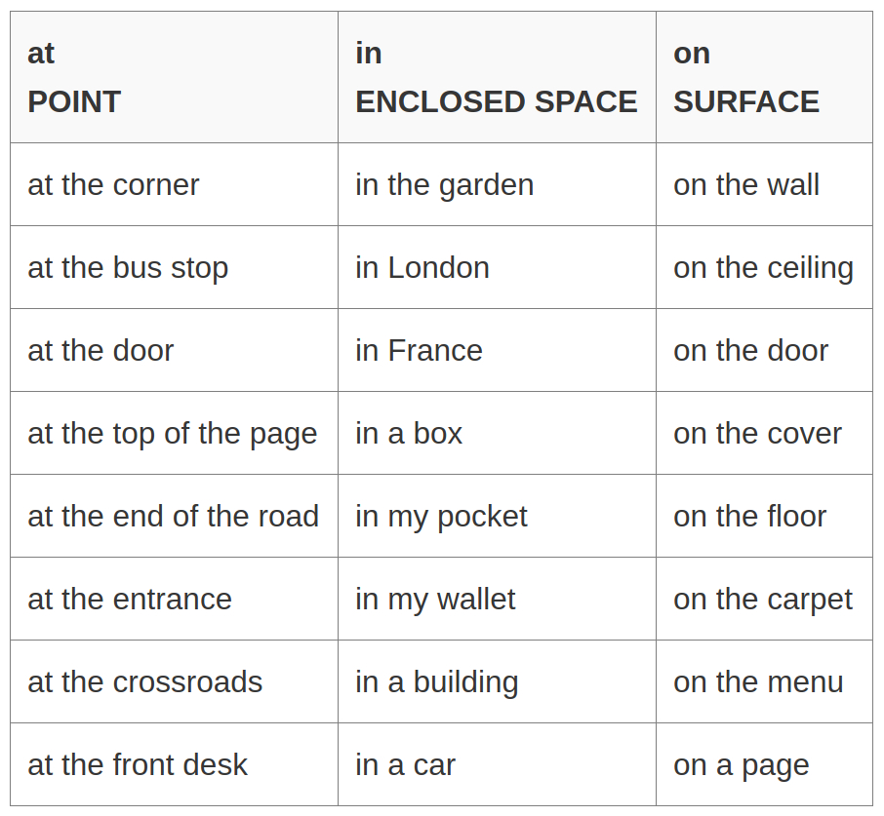

Slide 25
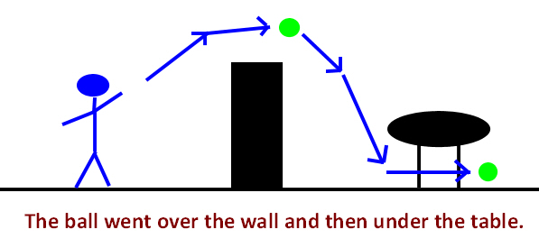
The ball went over the wall and then under the table.

Slide 26
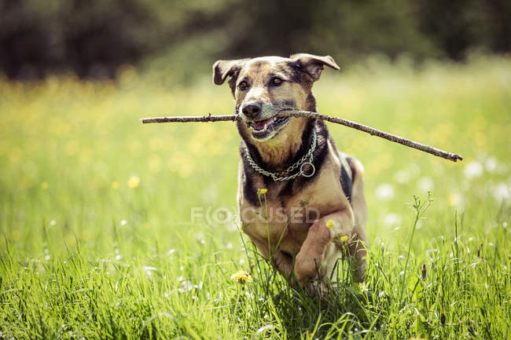
Towards is used to describe direction.
The dog is running towards me.
He kicked the ball towards the goal.
Peter was carrying a suitcase and walking towards his friends.

Slide 27

The cup is on the table

Slide 28
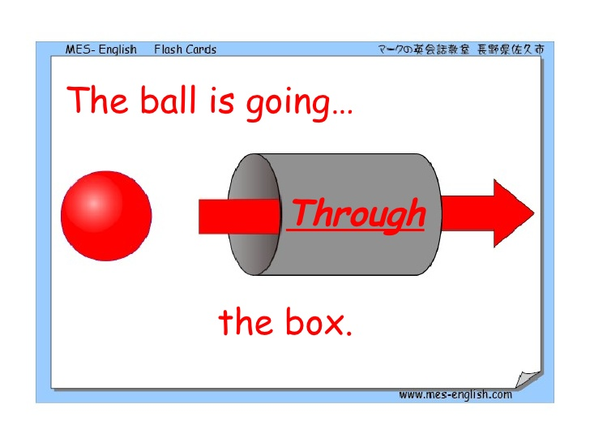
The ball is going through the box.

Slide 29
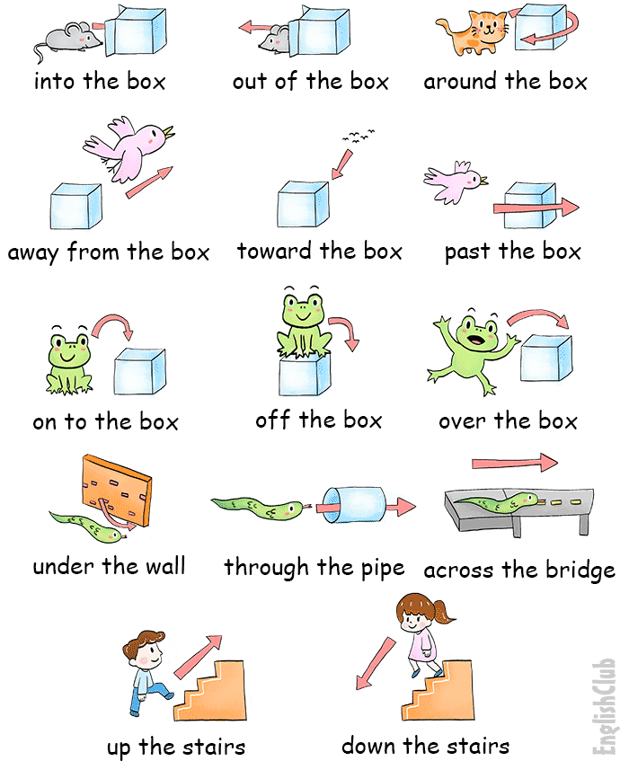

Slide 30
The rat got into the box.
The bird ran away from the cat and escaped.
The cat is moving around the box.
The frog jumped over the box
The snake goes through a tunnel.

Slide 31
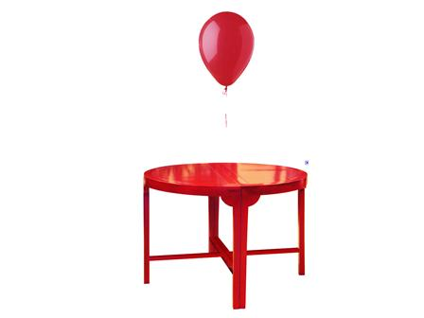
The balloon is above the table.(No movement, fixed)

Slide 32
Phrase Prepositions
Groups of words used with the force of a single preposition
according to
along with
away from
in course of
in front of
in order to
in place of
in case of

Slide 33
Example:
In order to avoid litigation, he accepted the offer.
There is a big tree in front of his house.

Slide 34
Why Parts of speech important
You can’t explain unless you master on
Parts of speech.
My have a pen
I have a pen.

Slide 35
To vs For
To is used when it is related to Transfer or Movement.
For is used to explain a motive/ reason.
I went to London to learn English
I went to market to buy apples.
I went to market for apples.
I made a cake for Hasan.
I gave the cake to Hasan.

