Slide 1
Noun
Noun: Name, Place, Things

Slide 2
Kinds of Noun
1) Proper noun
A particular person, place, or thing, e.g. Steven, Africa, London, Monday. In written English, proper nouns begin with capital letters.
2) Common noun
That refers to people or things in general, e.g. boy, country, bridge, city,

Slide 3
3) Collective nounsCollective nouns refer to groups of people or things, e.g. audience, family, government, team, jury.
4) Abstract noun
which refers to ideas, qualities, and conditions - things that cannot be seen or touched e.g. truth, danger, happiness, time, friendship.

Slide 4
5) Material noun
It is the name of material from which different things can be made e.g. milk, gold, wood
6) Countable noun
Those that can be countable: Pen, Paper, Table,
7) Uncountable noun
Those that can’t be countable: Water, Sugar, Hair

Slide 5
Pronoun
A word that is used instead of noun is called Pronoun.
Kinds of Pronoun
1. Personal pronoun: I, you, we, me
We are playing football.
Possessive Pronouns
Possessive Pronouns
2. Reflexive pronoun: myself, yourself
He hurt herself.
3. Relative pronoun:
The man who drive the car is my uncle.

Slide 6
4. Demonstrative Pronouns
This is Tanzina.
5. Interrogative Pronouns
What is your name?
6. Indefinite pronoun:
Anybody can do it if they try.

Slide 7
7. Distributive Pronouns
Each boy was given a prize.
8. Reciprocal Pronouns
They hate each other.
Peter and Harry help one another.

Slide 8
Verb
Verbs are the action words in a sentence that describe what the subject is doing.
Verbs are state or action.
State Verbs or Non-action Verbs:
I have a car.
I have two brothers and one sister.
Hasan is a boy.
He is from France.
The book is on the table.
Hasan likes to play football.
State verbs can not be used in -ing(Continuous) forms

Slide 9
Action Verbs:
The boys are playing in the field.
He is playing football.
Julia is eating noodles.
I am having a large family.
He is liking to play football.
No continuous form for state verbs.

Slide 10
Auxilary Verbs or Helping Verbs:
Am, is, are, was, were, have, had, shall, will
Modal Verbs:
Can, must, may, might, should,
Transitive Verbs:
Which required an object
Like, want, eat. write
I want a pen.
He writes a book.
Hansa kicked a ball.

Slide 11
Intransitive Verbs:
It does not take an object.
Cry, smile, live, die, sleep, sit,
The baby is crying.
The kids smiled.
The man laughed loudly.
He is sleeping.
The thief climbed and then escaped.
The thief climbed over the wall and then escaped.
Intransitive verbs which can not be changed into passive voice.

Slide 12
Adverb
Provide information about verbs, adjectives, even whole sentence.
Answer following question
Where
When
How
How much
How often … etc
He ate the sandwich quickly.(How)
He went to school yesterday.(When)
You can park here.(Where)
I sometimes drink coffee in the morning (How often)

Slide 13
Types of Adverbs
1. Adverbs of Degree or Manner
Really, Very, Extremely, Absolutely, Loudly, quietly
2. Adverbs of Place
Here, There, Somewhere, nearby, upstairs
3. Adverbs of Frequency
I meet him daily.
She is calling me again and again.
4. Adverbs of Time
I will go to school tomorrow.
I am still waiting for my friend.

Slide 14
Opinion: Fortunately, Personally, Sadly
Generally added by ‘ly’.
Friendly, Lovely are adjectives not adverb.
Position: Beginning, Middle, and end
Fortunately, I have a car.
I often go to park.
He laughs loudly.

Slide 15
Adjective
An Adjective modifies or describes noun or pronoun.
Types of Adjectives
1. Determiners: My, Our, Her, a/an, the
2. Descriptive Adjective
Beautiful, cold, tall, short, red, blue
That’s my car.
I have a car.
The window is broken.

Slide 16
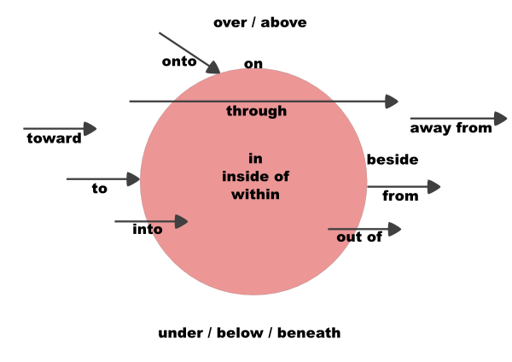
Preposition

Slide 17
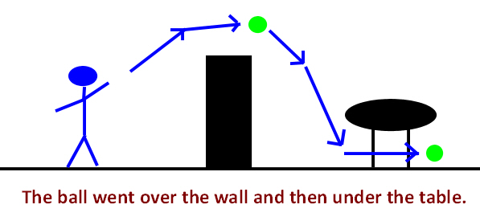
The ball went over the wall and then under the table.

Slide 18

The dog is running towards me.

Slide 19

The cup is on the table

Slide 20
The dog is running towards me.

Slide 21
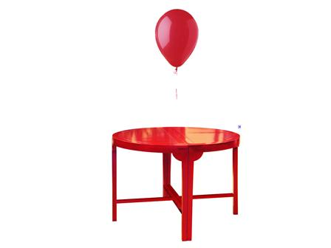
The balloon is above the table.(No movement, fixed)

Slide 22
Phrase Prepositions
Groups of words used with the force of a single preposition
according to
along with
away from
in course of
in front of
in order to
in place of
in case of

Slide 23
Example:
In order to avoid litigation, he accepted the offer.
There is a big tree in front of his house.

Slide 24
To vs For
To is used when it is related to Transfer or Movement.
For is used to explain a motive/ reason.
I went to London to learn English
I went to market to buy apples.
I went to market for apples.
I made a cake for Hasan.
I gave the cake to Hasan.

