Slide 1
How to Form a Question
Hasan plays football every noon at our local field.
Does Hasan play football ? // Yes-No
What do you play ? // Answer might be a noun
Who play football? // Answer must be subject
Where does Hasan play?
When does Hasan play?
What time does Hasan play?
How does Hasan play?
How often does Hasan play?
Structure to form a question
Question word or Question phrase
Auxiliary verb
Subject
Main verb (Finite verb)
Question word/phrase + Auxiliary verb + Subject + Finite verb
What have you written? // A letter // I have written a letter
Have you written a letter? // yes/no

Slide 2
How to Form a Question
Yes/No or Confirmation
I have a pen?
Have I a pen?
You write a letter regularly?
Do you write a letter?
My name is Hasan?
What is your name?
Is your name Hasan?

Slide 3
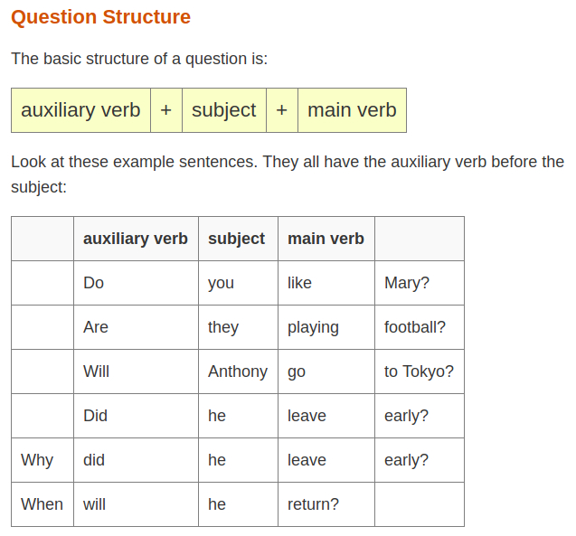

Slide 4
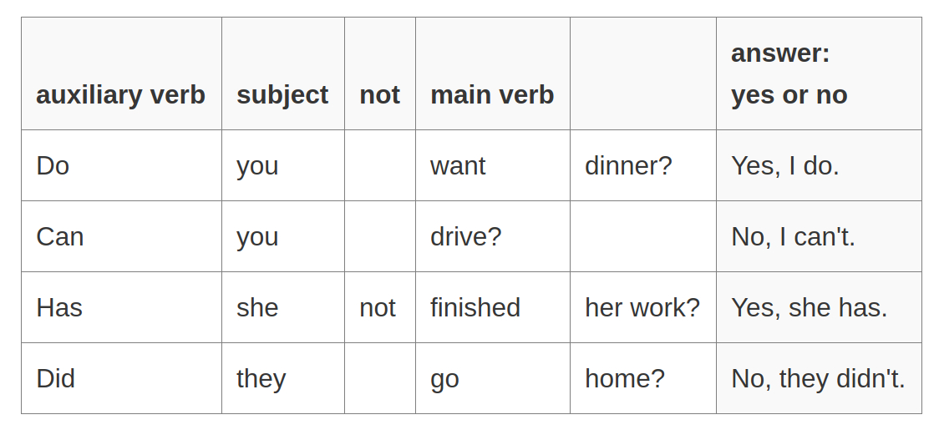

Slide 5
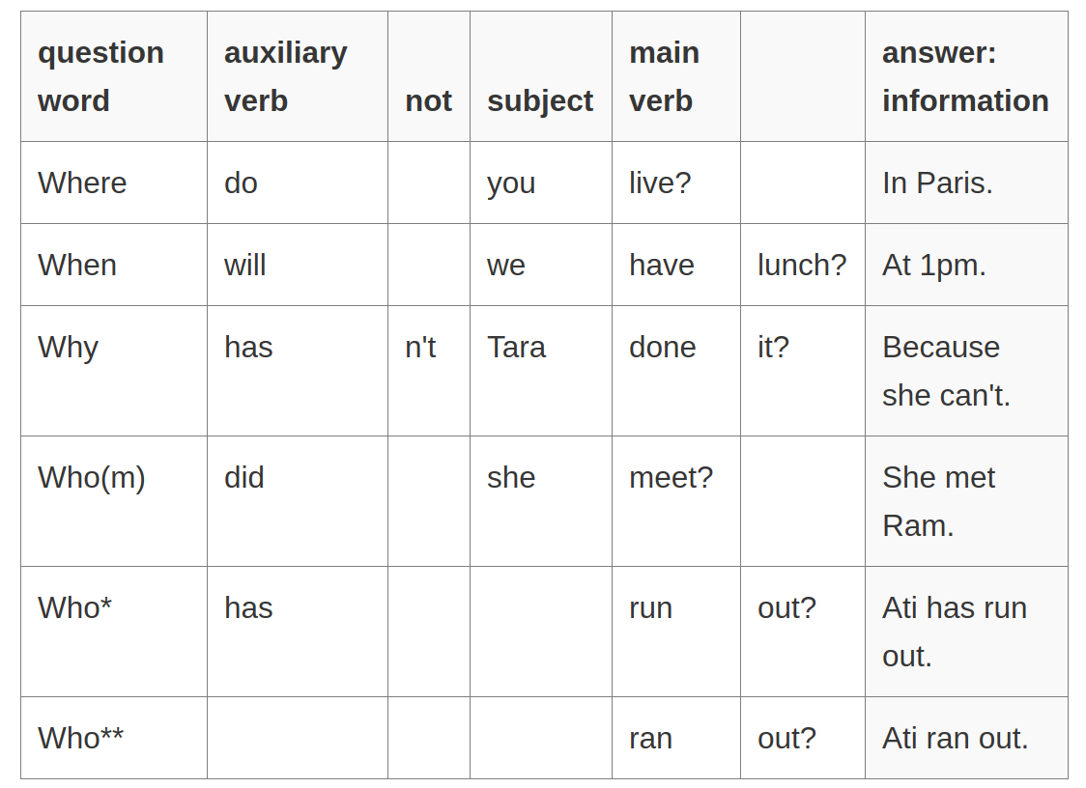

Slide 6
What? Which? (to ask about things)
Where? (to ask about locations)
Who? (to ask about people)
When? (to ask about time)
Why? (to ask for the reason)
How? (to ask about the way things happen or are done)
How many? How much? How often? (to ask about the number or amount)

Slide 7
I could have reserved a seat
Could I have reserved a seat?
They arrived at six o’clock.
Did they arrived at six?
When did they arrive?
What time did they arrive?
Who paid? = Who did pay money?
Following are look like a question but there role is different
Suggestion: Shall we take the early train?
Asking permission: Can I help you?

Slide 8
When Question words (Wh) are subject
Wh + Finite Verb
Wh + Auxiliary Verb + Subject + Finite Verb
Who write a letter?
What happens next?
How many people know the secret?
How
How can express means or manner
How do you open the door?
How wide is the river?
How soon can you let me know?
How is that?
How much money do you need?
How often do you play?
t

Slide 9
Question or Question Phrase
How often = Frequent
How much = Amount or Quantity
How long = Time
How many = Quantity
How could = Solution
Who what and which
Who refers to people.
Which refers to people or non-human
We use what, when there is an indefinite — number of possible answers
We use which when is a definite possible answer.
What newspaper do you read?
Which newspapers do you read?
t

Slide 10
Who what and which
What = Many possible answers. You can choose anything
Which = There are options. We have to choose.
What do you want to eat for lunch? // you can choose anything
Which do you want to eat? // Sandwich or Cake
Are you coming back today or tomorrow? Tomorrow or Today
Why pay more = Why should I pay more?
Why the panic? What is the reason for panic?
Who knows “who knows” as a phrase or an expression, not a question”
How come you're a reporter? // How it is possible that you can be a reporter.

Slide 11
Question: How warm is the water?
Exclamation: How warm the water is!
How lucky you are!
How lucky are you?
How we laughed!
How quickly the time passed!
What a journey we had!

Slide 12
Sentence Kinds
There are four kinds of sentence according to their meaning.
Sentences are divided into four types according to their meaning.
1. Declarative or Assertive sentence
The sentence which is used to convey a fact, information or describe something is called Declarative Sentence.
2. Imperative Sentence: The sentence which it used to convey a command, a request or a forbiddance is called an imperative sentence.
3. Interrogative Sentence: The sentence which asks a question is an interrogative sentence.
Do you want to go there?
Did you see her?

Slide 13
4.Optative Sentence & Exclamatory Sentence:
The sentence which expresses a prayer, keen wish, curse etc. is called an optative sentence. This kind of sentence generally starts with ‘may’ and ‘wish’. Sometimes, ‘may’ remains hidden.
May the king of Westeros live long!
Long live the king of Westeros.
How blessed I am to see such a sight!

Slide 14
Punctuation
Punctuation is used to create sense, clarity, and stress in sentence. We use punctuation marks to make well-structure and organize our writing.
Full Stop or Period(American)
Comma
Colon
Em-Dash
Semi-colon
Hyphen
Question mark
Exclamation
https://www.thepunctuationguide.com

Slide 15
Full stop: Full stop between two separate sentences.
Declarative sentences
I write a letter daily.
It is raining.
Shakespeare wrote plays. He also acted on the stage.
Imperative sentences
Close the door.
Don’t do this.

Slide 16
Comma:
When a sentence start with a Subordinating conjunction like: if, where, when then a comma is inserted after the dependent clause.
It is noted that if a sentence starts with a subordinating conjunction: it is call dependent clause.
Dependent clause = If you study more
Independent clause = I was so happy
If you study more, your grades might improve.
Your grades might improve if you study more.
I was so happy when I heard the news.
Rue:
Used in salutation
Dear Sir,
Dear Professor,

Slide 17
Rule: Separate items in a list
We need to buy milk, eggs, flour and sugar for the cake.
Rule: Separate words that are not part of the sentence.
After the Sentence adverbs: Unfortunately, Frankly, Sadly, however
Unfortunately, I missed the train.
Frankly, I don't care whether he agrees with my decision or not.
We know he was guilty; there was no evidence, however.
We know he was guilty; however, there was no evidence.
His parents wanted him to be a doctor. However, he had other plans.
His parents wanted him to be a doctor. He, however, had other plans.
Rue:
Used in salutation
Dear Sir,
Dear Professor,

Slide 18
When two independent clauses connect with coordinating conjunction, a comma is put in-front of coordinating conjunction.
She wanted to study, but she was so tired.
Rule
Wanda is a kind, beautiful woman.
Please pass that book, Sam.
Peter did not study. Therefore, he did not pass the exam.
The woman who is wearing red dress is my teacher.
The woman is my teacher.
Lucy, who is a tall woman, climbed the tree.
Lucy climbed the tree.
Peter did not study. Therefore, he did not pass the exam.
We washed the dog, and then we cleaned up the mess that he made.
We washed the dog and then cleaned up his mess.

Slide 19
The boys sang, and the girls danced.
The boys sang and the girls danced.
The comma is not exactly necessary in the example given above because the clauses are short. However, it is possible.
Exception:
He climbed up the building and he jumped. // Comma missing due to small independent clause.
She must weep, or she will die
The men went up to the 86th floor and he jumped.

Slide 20
Rule
Adjective clause
Maria, who studies hard, will pass the exam.
All the student who study hard will pass the exam.
Mr. White, my uncle, is nice person.
The woman who is wearing red dress is my teacher.
The woman is my teacher.
Chicago, which is located on Lake Michigan, is the third largest city in the US.
Chicago, which is located on Lake Michigan, is the third largest city in the US.
Chicago is the third largest city in the US.
I live in Chicago, which is located on Lake Michigan.
Non-essential
This man is my uncle.
This tall man is my uncle.
This man, who is tall, is my uncle.

Slide 21
Semi-colon
The semi-colon is used to combine closely related sentences.
Used to replace a conjunction or full stop to connect two related ides.
Semicolons can be used in English to join phrases and sentences that are thematically linked without having to use a conjunction.
Example
The population of Shanghai is around 24 million; Beijing has around 22 million people.
The population of Shanghai is around 24 million, while Beijing has around 22 million people.
The population of Shanghai is around 24 million, and Beijing has around 22 million people.
This is s great book. In fact, it is one of the best I have ever read.
This is s great book; in fact, it is one of the best I have ever read.
I enjoy visiting New York. I love living in London.
I enjoy visiting New York; I love living in London.
While, and are connecting word.
Shakespeare wrote plays; he also acted on the stage.

Slide 22
We have a problem. He is not doing enough to help me.
// He is not the factor of this problem.
We have a problem; he is not doing enough to help me with this problem. // He is the factor of this problem.
We know he was guilty; there was no evidence, however.
I thought it was amazing, but she thought it was terrible.
I thought it was amazing; she thought it was terrible.
His parents wanted her to be a doctor. However, she had other plans.
His parents wanted her to be a doctor; however, she had other plans.

Slide 23
Colon
The colon is used to introduce a list of items.
The colon introduces information after an independent clauses. It is used as substitute of such as, thus, as following
Between independent clauses when the second explains or illustrates the first
Colons are used before explanations.
Example
We should work hard to play well: put your best effort.
We have invited a small number of people: Bill, Peter, Kevin
We have a problem: he is not doing enough to help me.
Whenever you drive, you must do the following: wear your seat belt, obey traffic laws, and keep your eyes on the road.
We decided to cancel the match: it was raining.

Slide 24
Capitals
In British English, it is unusual for a capital letter to follow a colon. In American English, colons are more often followed by capital letters.
Letters
Americans usually put a colon after the opening salutation in a business letter.
Dear Mr James:

Slide 25
Em Dash
Depending on the context, the em dash can take the place of commas, parentheses, or colons—in each case to slightly different effect.
The em dash can be used in place of a colon when you want to emphasize the conclusion of your sentence. The dash is less formal than the colon.
After months of deliberation, the jurors reached a unanimous verdict—guilty.
The white sand, the warm water, the sparkling sun—this is what brought them to Hawaii.

Slide 26
Em-Dash —:
Upon discovering the errors (all 124 of them), the publisher immediately recalled the books.
Upon discovering the errors—all 124 of them—the publisher immediately recalled the books.
After three weeks on set, the cast was fed up with his direction (or, rather, lack of direction).
After three weeks on set, the cast was fed up with his direction—or, rather, lack of direction.

Slide 27
Exclamation: The Exclamation mark is used to convey strong emotion.
I am really excited to visit a new country. // No emotion
I am really excited to visit a new country! // Excitement

